Slide 1

Names, Binding, Scope
Her name was McGill and she called herself Lil
But everyone knew her as Nancy. -- Lennon & McCartney
  Names
    abstraction
    variables
    aliasing
  Binding
    binding time
    static vs. dynamic binding
    variable bindings
  Scope
    blocks, visibility
    static vs. dynamic scoping
4.2, 4.3
4.4
4.8-4.10

Slide 2

What’s in a Name?
  A name is a handle associated with some entity. When we want to use the entity (create it, change it, destroy it, etc.), we only need to refer to its name.
  An entity’s name is an abstraction:
    it allows us to use the entity without regard for its internal complexities
What internal complexities are hidden by names in programs?

Slide 3
What Needs a Name?
  contants, variables, objects, atoms
  operators
  labels
  types, classes
  procedures, functions, predicates, rules
  modules, libraries, programs, packages
  files, disks, peripherals
  commands, menu items, macros
  computers, networks, hosts, domains
  users, user groups

Slide 4
Identifiers
A name is denoted by a sequence of characters, called an identifier.
  not all sequences of characters are legal identifiers in a given language; they obey naming rules
  Hmmm... sequences, rules, language... Grammar!
<identifier> ::= <letter> { <idchar> }
<idchar> ::= <letter> | <digit> | _
<letter> ::= A | B | C | ... | a | b | ... | z
<digit> ::= 0 | 1 | 2 | 3 | 4 | 5 | 6 | 7 | 8 | 9

Slide 5

Keywords, Reserved Words
A keyword in a programming language is a name that is recognized as having a particular meaning in the language (for all programs written in that language).
A reserved word in a programming language is a keyword that may not be used by the programmer for naming other things.
  Example reserved words:
  if C then S1 else S2 end;
  Other possibilities:
  { C -> S1; S2 }
  kama C kwa hiyo S1 ingina S2 mwisho;
  если C тогда S1 еще S2 конец;
Note that keywords have a functional role, and an aesthetic one.

Slide 6
Variables
In the lower virtual machines (e.g., machine language) data is merely the value stored in a memory location (or group of locations).
  a variable is a higher level abstraction of a memory location (or group of locations).
  in the imperative paradigm, program variables are complex entities, consisting of six parts:
  <name, address, value, type, lifetime, scope>
  these six attributes are essential to the interpretation of a variable, but hidden behind the first attribute (the name)

Slide 7
The Variable Sextuplet...
  Name
    almost every variable has a name
    a variable name must be unique within its scope and lifetime
  Address
    the location of the variable in memory
    a variable’s address is sometimes called its l-value
    for composite variables determining the address can be complicated
  Value
    the contents of the memory location at the address of a variable
    the value may span more than one physical memory cell
    a variable’s value is sometimes called its r-value

Slide 8
More The Variable Sextuplet
  Type
    a restriction on the kinds of values a variable can store
    a variable’s type determines how much memory it requires
    the type also determines what operations can be done to a variable
  Lifetime
    a variable may only be accessible for a part of program execution
    variables can be created and destroyed at various times
  Scope
    a variable may be visible to some parts of a program and invisible to other parts
    some variables block the visibility of other variables

Slide 9
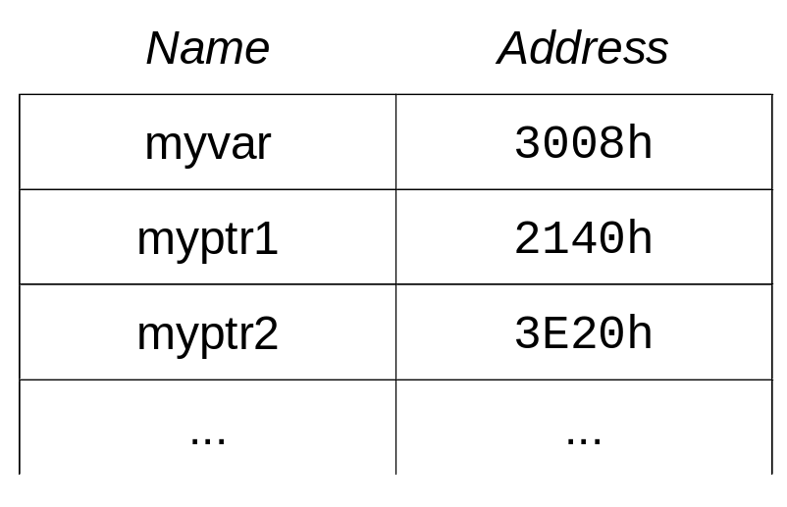
Aliasing...
It is possible for two names to refer to the same memory location. Such names are called aliases.
  pointers
    a pointer is a variable whose value is the address of another variable
    pointers with the same value are aliases for the memory location they point to
3008
42
2140
3008
3E20
3008

Slide 10
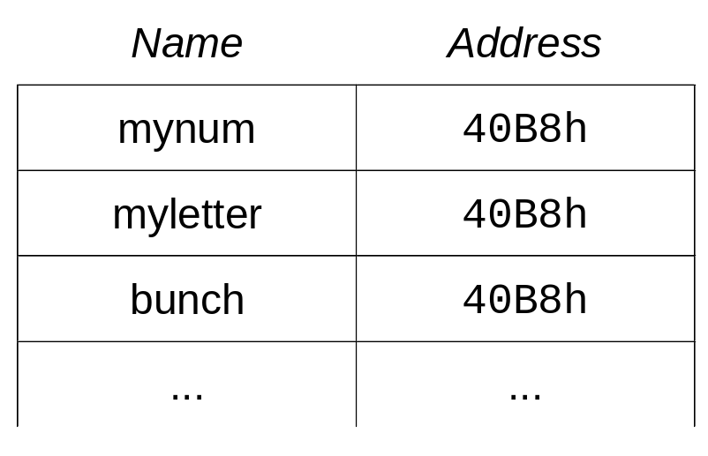
More Aliasing...
  unions, variant records
  union { type myunion = record
  int mynum; case fieldtype: (i,c,f) of
  char myletter; i : (mynum : integer);
  float bunch[10]; c : (myletter : char);
  }; f : (bunch : array[1..10] of real)
  enum fieldtype {i,c,f}; end;
40B8
00
00
00
00
00
00
00
00

Slide 11
More Aliasing
Aliasing also occurs:
  as a result of certain kinds of parameter passing
    more in section 8: Procedural Abstraction
  as a result of macro expansion
    more in section 8: Procedural Abstraction
  through explicit aliasing mechanisms in some languages
    Fortran
In general, aliasing is considered a “bad thing”!

Slide 12
Binding
Binding is the association of an attribute with an entity. When we associate an attribute to an entity, we are binding the attribute to the entity.
  when we associate a type with a variable, we are binding the type to the variable
  when we associate a particular memory location with a variable, we are binding the address to the variable
  etc.
In programming languages, we have many different things to bind and many different times when we can bind them.

Slide 13
Binding Time
Recall that a variable can be thought of as a sextuple (consisting of six attributes). Each of the six attributes is bound to the variable at some time or other.
  compile time
    binding occurs during translation
    applies to interpreters too! (interpretation time or translation time)
  load time
    binding occurs during the load/link phase
    when libraries and modules are linked in
    when external references are resolved
  run time
    binding occurs sometime between the start of execution of a program and its termination

Slide 14
Static Binding vs. Dynamic Binding
  static binding
    binding occurs before program execution and is permanent during execution (does not change while the program is running)
    compile time binding
    load time binding
  dynamic binding
    binding occurs during program execution
or
    binding expires during program execution
or
    binding changes during program execution

Slide 15
Variable Bindings...
  compile time
    bound by variable declarations
  variable → name
  load time
    normal variables
  load time
    normal variables
  run time
    stack variables
    dynamic memory allocation
    subprogram parameters
  variable → address
  compile time
    most imperative languages
  compile time
    most imperative languages
  run time
    weakly-typed languages
    implicitly-typed languages
  variable → type

Slide 16
More Variable Bindings
  run time
    assignment, etc.
  run time
    assignment, etc.
  load time
    initialization
  variable → value
  compile time
    lifetime is bound statically, even for implicit dynamic variables
  run time
    for some explicit dynamic variables
  compile time
    lifetime is bound statically, even for implicit dynamic variables
  variable → lifetime
  compile time
    expressed by location of declarations
  run time
    rare (for dynamic scoping only)
  compile time
    expressed by location of declarations
  variable → scope

Slide 17

Variable → Address
An address is bound to a variable when it is allocated memory.
  static variables
    memory is allocated once, before program execution (load time)
  dynamic variables
    memory is allocated after program execution begins (run time)
    explicit allocation/deallocation
      programmer is responsible for memory allocation
      new/release, malloc/free, etc.
    implicit allocation/deallocation
      stack variables (local to a block)
      some subprogram parameters
What’s the main difference
between Pascal and C here?
(size counts)
If a language has static variables only (like Fortran),
is recursion possible?

Slide 18
Scope
We already defined the scope of a name as the range of statements in a program to which the name is visible.
More rigorously:
  the scope of a name N denoting an entity E is the set of all statements in a program for which N refers uniquely to E
  the definition implies that there are places in a program where N does not refer uniquely to E
    there may be places where N refers to something other than E
    there may be places where N does not refer to anything

Slide 19
Blocks
Some imperative languages are called block-structured languages because programs are organized as nested blocks.
  A block is a delimited group of statements, possibly named.
    a group of statements is delimited if there are markers indicating the beginning and end of the group
    blocks can have their own local variable declarations; these variables can only be used within the block
    many block-structured languages allow the programmer to associate a name with the marker indicating the beginning of a block; examples of named blocks are procedures and functions
    a block without a name is called an anonymous block
Is Pascal a block-structured language?
Would you consider C a block structured language?

Slide 20
Anonymous Block Examples
Ada
cylDiam: REAL := 2.8;
cylDepth: REAL := 8.3;
cylVolume: REAL;
put("The volume is: ");
declare
pi: constant REAL := 3.142;
circArea, cylRadius: REAL;
begin
cylRadius := cylDiam/2;
circArea := pi*cylRadius**2;
cylVolume := circArea*cylDepth;
end;
put(cylVolume);
C
float cylDiam = 2.8;
float cylDepth = 8.3;
float cylVolume;
printf("The volume is: ");
{
const float pi = 3.142;
float circArea, cylRadius;
cylRadius = cylDiam/2;
circArea = pi*cylRadius*cylRadius;
cylVolume = circArea*cylDepth;
}
printf("%f”, cylVolume);

Slide 21
Named Blocks and Nesting
Most block-structured languages allow unlimited nesting of blocks.
Consider the Pascal example:
  unlimited nesting of procedures (named blocks) is allowed
  names are only visible inside the block where they’re defined (including inside subblocks)
Pascal
program P;
var X: integer
procedure A;
var Y: char;
procedure B;
var Z: Boolean
begin S_{B} end;
begin S_{A} end;
procedure C;
var Z: integer;
begin S_{C} end;
begin S_{P} end.
Where is Z visible?

Slide 22
Visibility
Consider a slightly more abstract view of our Pascal program (called a nesting diagram):
  There are eight names in our program (including P):
    P X A C Y B Z (in B) Z (in C)
  we can make the names unique by specifying their context
    P P.X P.A P.C P.A.Y P.A.B P.A.B.Z P.C.Z
P
X
A
C
A
C
Y
B
B
Z
Z
S_{B}
S_{A}
S_{C}
S_{P}

Slide 23
Potential Call Graphs
Here is another kind of diagram called a potential call graph. The graph shows which named blocks are visible to each other (and could potentially be called).
  recall that a name is visible to statements inside the block where the name is defined; e.g., names visible to S_{B}:
    P.A, P.B, P.C, P.X, P.A.Y, P.A.B, P.A.B.Z
P
A
C
B
Why is P not visible to the statements in B (S_{B})?

Slide 24
Referencing Environments
The referencing environment of a statement is the set of variables that are visible to the statement.
  referencing environment of S_{P}:
    P.X, P.Y, P.A, P.B
  referencing environment of S_{A}:
    P.A.X, P.A.Z, P.Y, P.A, P.B
  referencing environment of S_{B}:
    P.B.Y, P.B.Z, P.X, P.A, P.B
Note that P.X is visible to S_{P} and S_{B}, but not to S_{A}.
P.A.X hides P.X In S_{A}; A is a hole in the scope of P.X.
  in S_{A} the name X refers to P.A.X
  in S_{P} and S_{B} the name X refers to P.X
P
X
Y
A
B
A
B
X
Z
Y
Z
S_{A}
S_{B}
S_{P}

Slide 25
Dynamic Scoping
  The scoping discussed so far has been static scoping (a.k.a. lexical scoping). With static scoping, the scope of a name never changes and can be determined independently of program execution.
    a name is visible within the block where it is defined in the program (including within subblocks of that block)
  With dynamic scoping, the scope of a name depends on program execution, and may change depending on subprogram calls.
    a name that is visible within the currently executing block is visible within blocks called from within the currently executing block.

Slide 26
Static Scoping vs. Dynamic Scoping
This Pascal program shows the difference between static and dynamic scoping.
program P;
var X: integer
procedure A;
begin
X := X + 1;
print(X)
end;
procedure B;
var X: integer;
begin
X := 42;
A
end;
begin
X := 13;
B
end.
What does the name X refer to?
3
static
dynamic
1
P.X
P.X
2
P.B.X
P.B.X
3
P.X
P.B.X
2
What does the program output?
static
dynamic
1
14
43

