Slide 1
Computer System Overview
Chapter 1

Slide 2
Ch.1 : Computer System Overview
An Operating System makes the computing power available to users by controlling the hardware
Let us review the aspects of computer hardware which are important for the OS

Slide 3
Basic Components
Processor (CPU)
Main Memory (aka real memory, aka primary memory)
  holds data in code
I/O modules (I/O controllers, I/O channels, I/O processors...)
  hardware (with registers called I/O ports) that moves data between cpu and peripherals like:
    secondary memory devices (e.g.: hard disks)
    keyboard, display...
    communications equipment
System interconnection (i.e.: Buses)
  communication among processors, memory, and I/O modules

Slide 4
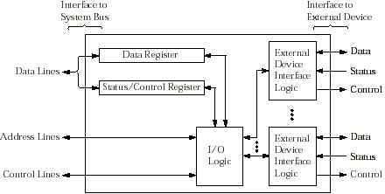
I/O Module Structure
Data to/from system bus are buffered in data register(s)
Status/Control register(s) holds
  current status information of the I/O operation
  current control information from CPU
I/O logic interact with CPU via control bus
Contains logic specific to the interface of each device

Slide 5
CPU Registers (fast memory on cpu)
Control & Status Registers
  Generally not available to user programs
  some used by CPU to control its operation
  some used by OS to control program execution
User-visible Registers
  available to system (OS) and user programs
  holds data, addresses, and some condition codes

Slide 6
Examples of Control & Status Registers
Program Counter (PC)
  Contains the address of the next instruction to be fetched
Instruction Register (IR)
  Contains the instruction most recently fetched
Program Status Word (PSW)
  A register or group of registers containing:
    condition codes and status info bits
    Interrupt enable/disable bit
    Supervisor(OS)/user mode bit

Slide 7
User-Visible Registers
Data Registers
  can be assigned by the user program to perform operations on data
Address Registers
  contain memory address of data and instructions
  may contain a portion of an address that is used to calculate the complete address

Slide 8
User-Visible Registers
Examples of Address Registers
  Index/Offset
    involves adding an index to a base value to get an address
  Segment pointer
    when memory is divided into segments, memory is referenced by a segment and an offset
  Stack pointer
    points to top of stack

Slide 9
User-Visible Registers
Condition Codes or Flags
  Bits set by the processor hardware as a result of operations
  Can be accessed by a program but not changed directly
  Examples
    sign flag
    zero flag
    overflow flag

Slide 10
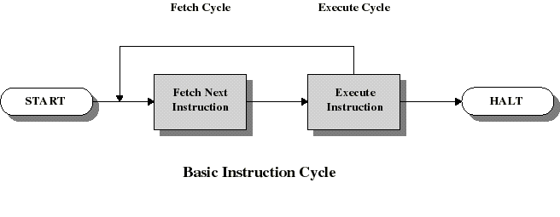
The Basic Instruction Cycle
The CPU fetches the next instruction (with operands) from memory.
Then the CPU executes the instruction
Program counter (PC) holds address of the instruction to be fetched next
Program counter is automatically incremented after each fetch

Slide 11
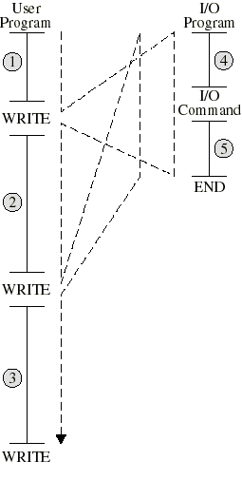
Then CPU must wait for I/O to complete!
WRITE transfer control to the printer driver (I/O pgm)
I/O pgm prepare I/O module for printing (4)
CPU has to WAIT for I/O command to complete
Long wait for a printer
I/O pgm finishes in (5) and report status of operation

Slide 12
Interrupts
Computers now permit I/O modules to INTERRUPT the CPU.
For this the I/O module just assert an interrupt request line on the control bus
Then CPU transfer control to an Interrupt Handler Routine (normally part of the OS)

Slide 13
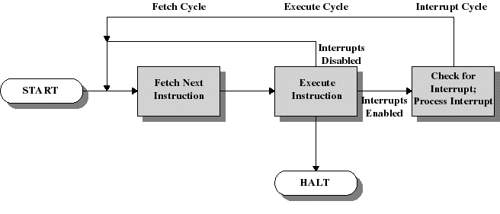
Instruction Cycle with Interrupts!
CPU checks for interrupts after each instruction
If no interrupts, then fetch the next instruction for the current program
If an interrupt is pending, then suspend execution of the current program, and execute the interrupt handler

Slide 14
Interrupt Handler
Is a program that determines nature of the interrupt and performs whatever actions are needed
Control is transferred to this program
Control must be transferred back to the interrupted program so that it can be resumed from the point of interruption
This point of interruption can occur anywhere in the program
Thus: must save the state of the program (content of PC + PSW + registers + ...)

Slide 15
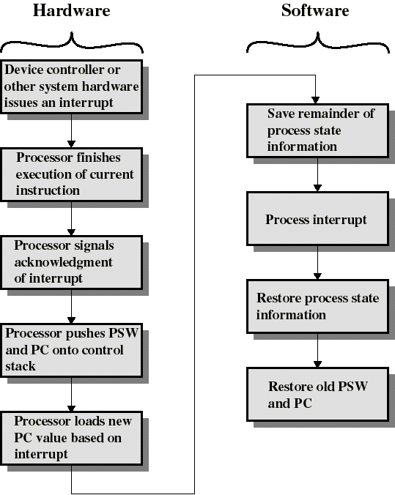
Simple Interrupt Processing

Slide 16
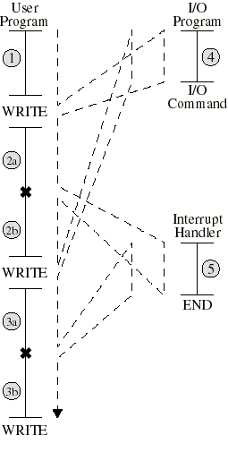
Interrupts improve CPU usage
I/O pgm prepares the I/O module and issues the I/O command (e.g.: to printer)
I/O pgm branches to user pgm
User code gets executed during I/O operation (e.g.: printing): no waiting
User pgm gets interrupted (x) when I/O operation is done and branches to interrupt handler to examine status of I/O module
Execution of user code resumes

Slide 17
Classes of Interrupts
I/O
  signals normal completion of operation or error
Program Exception
  overflows
  try to execute illegal instruction
  reference outside user’s memory space
Timer
  preempts a pgm to perform another task
Hardware failure (e.g.: memory parity error)

Slide 18
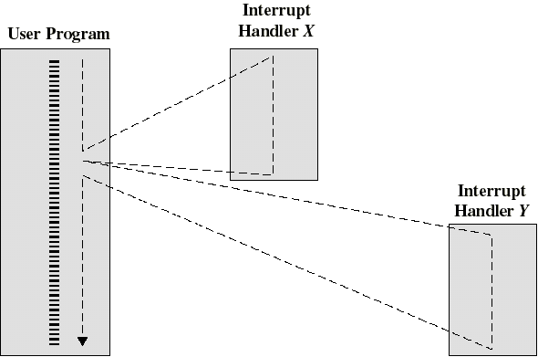
Multiple interrupts: sequential order
Disable interrupts during an interrupt
Interrupts remain pending until the processor enables interrupts
After interrupt handler routine completes, the processor checks for additional interrupts

Slide 19
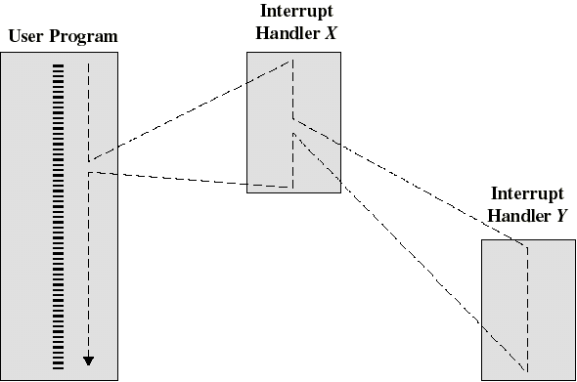
Multiple Interrupts: priorities
Higher priority interrupts cause lower-priority interrupts to wait
Causes a lower-priority interrupt handler to be interrupted
Example: when input arrives from communication line, it needs to be absorbed quickly to make room for more input

Slide 20
Multiprogramming
When a program reads a value on a I/O device it will need to wait for the I/O operation to complete
Interrupts are mostly effective when a single CPU is shared among several concurrently active processes.
The CPU can then switch to execute another program when a program waits for the result of the read operation. (more later)

Slide 21
I/O communication techniques
3 techniques are possible for I/O operation
  Programmed I/O
    Does not use interrupts: CPU has to wait for completion of each I/O operation
  Interrupt-driven I/O
    CPU can execute code during I/O operation: it gets interrupted when I/O operation is done.
  Direct Memory Access
    A block of data is transferred directly from/to memory without going through CPU

Slide 22
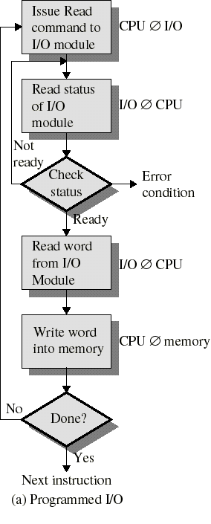
Programmed I/O
I/O module performs the action, on behalf of the processor
But the I/O module does not interrupt the CPU when I/O is done
Processor is kept busy checking status of I/O module

Slide 23
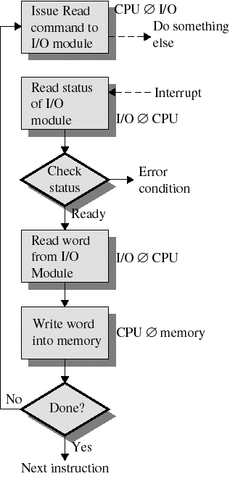
Interrupt-Driven I/O
Processor is interrupted when I/O module ready to exchange data
Processor is free to do other work
No needless waiting
Consumes a lot of processor time because every word read or written passes through the processor and requires an interrupt

Slide 24
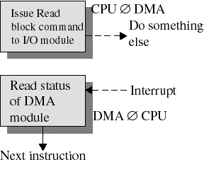
Direct Memory Access
CPU issues request to a DMA module (separate module or incorporated into I/O module)
DMA module transfers a block of data directly to or from memory (without going through CPU)
An interrupt is sent when the task is complete
The CPU is only involved at the beginning and end of the transfer
The CPU is free to perform other tasks during data transfer

Slide 25
Memory Hierarchy
Cheaper
Larger capacity
Slower
Registers
Cache
Main Memory
Magnetic Disc
Smaller frequency
of access
Removable Media

Slide 26
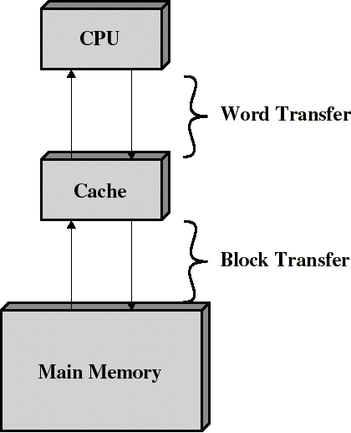
Cache Memory
Small cache of expensive but very fast memory interacting with slower but much larger memory
Invisible to OS and user programs but interact with other memory management hardware
Processor first checks if word referenced to is in cache
If not found in cache, a block of memory containing the word is moved to the cache

Slide 27
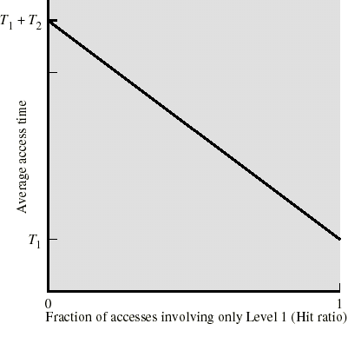
The Hit Ratio
Hit ratio = fraction of access where data is in cache
T1 = access time for fast memory
T2 = access time for slow memory
T2 >> T1
When hit ratio is close to 1 the average access time is close to T1

Slide 28
Locality of reference
Memory reference for both instruction and data tend to cluster over a long period of time.
Example: once a loop is entered, there is frequent access to a small set of instructions.
Hence: once a word gets referenced, it is likely that nearby words will get referenced often in the near future.
Thus, the hit ratio will be close to 1 even for a small cache.

Slide 29
Disk Cache (same principles)
A portion of main memory used as a buffer to temporarily to hold data for the disk
Locality of reference also applies here: once a record gets referenced, it is likely that nearby records will get referenced often in the near future.
If a record referenced is not in the disk cache, the sector containing the record is moved into the disk cache.

