Slide 1
Operating Systems Overview
Chapter 2

Slide 2
Operating System
Is a program that controls the execution of application programs
  OS must relinquish control to user programs and regain it safely and efficiently
  Tells the CPU when to execute other pgms
Is an interface between the user and hardware
Masks the details of the hardware to application programs
  Hence OS must deal with hardware details

Slide 3
Services Provided by the OS
Facilities for Program creation
  editors, compilers, linkers, and debuggers
Program execution
  loading in memory, I/O and file initialization
Access to I/O and files
  deals with the specifics of I/O and file formats
System access
  Protection in access to resources and data
  Resolves conflicts for resource contention

Slide 4
Services Provided by the OS
Error Detection
  internal and external hardware errors
    memory error
    device failure
  software errors
    arithmetic overflow
    access forbidden memory locations
  Inability of OS to grant request of application
Error Response
  simply report error to the application
  Retry the operation
  Abort the application

Slide 5
Services Provided by the OS
Accounting
  collect statistics on resource usage
  monitor performance (e.g.: response time)
  used for system parameter tuning to improve performance
  useful for anticipating future enhancements
  used for billing users (on multi-user systems)

Slide 6
Evolution of an Operating System
Must adapt to hardware upgrades and new types of hardware. Examples:
  Character vs graphic terminals
  Introduction of paging hardware
Must offer new services, e.g.: internet support
The need to change the OS on regular basis place requirements on it’s design
  modular construction with clean interfaces
  object oriented methodology

Slide 7
Simple Batch Systems
Are the first operating systems (mid-50s)
The user submit a job (written on card or tape) to a computer operator
The computer operator place a batch of several jobs on a input device
A special program, the monitor, manages the execution of each program in the batch
Resident monitor is in main memory and available for execution
Monitor utilities are loaded when needed

Slide 8
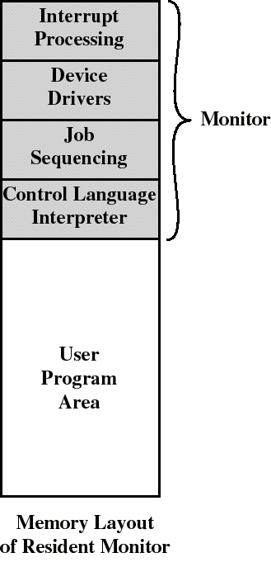
The Monitor
Monitor reads jobs one at a time from the input device
Monitor places a job in the user program area
A monitor instruction branches to the start of the user program
Execution of user pgm continues until:
  end-of-pgm occurs
  error occurs
Causes the CPU to fetch its next instruction from Monitor

Slide 9
Job Control Language (JCL)
Is the language to provide instructions to the monitor
  what compiler to use
  what data to use
Example of job format: ------->>
$FTN loads the compiler and transfers control to it
$LOAD loads the object code (in place of compiler)
$RUN transfers control to user program
$JOB
$FTN
...
FORTRAN
program
...
$LOAD
$RUN
...
Data
...
$END

Slide 10
Job Control Language (JCL)
Each read instruction (in user pgm) causes one line of input to be read
Causes (OS) input routine to be invoke
  checks for not reading a JCL line
  skip to the next JCL line at completion of user program

Slide 11
Batch OS
Alternates execution between user program and the monitor program
Relies on available hardware to effectively alternate execution from various parts of memory

Slide 12
Desirable Hardware Features
Memory protection
  do not allow the memory area containing the monitor to be altered by user programs
Timer
  prevents a job from monopolizing the system
  an interrupt occurs when time expires

Slide 13
Desirable Hardware Features
Privileged instructions
  can be executed only by the monitor
  an interrupt occurs if a program tries these instructions
Interrupts
  provides flexibility for relinquishing control to and regaining control from user programs

Slide 14
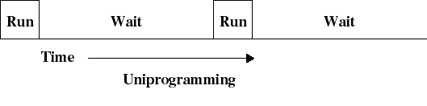
Multiprogrammed Batch Systems
I/O operations are exceedingly slow (compared to instruction execution)
A program containing even a very small number of I/O ops, will spend most of its time waiting for them
Hence: poor CPU usage when only one program is present in memory

Slide 15
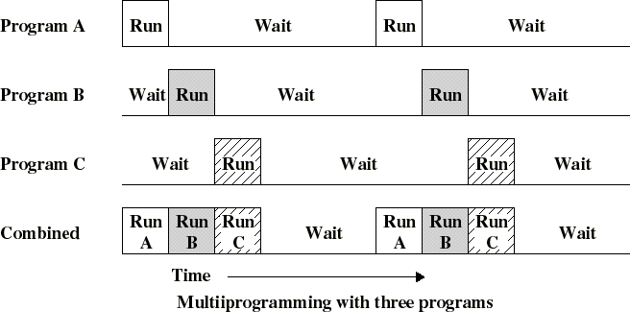
Multiprogrammed Batch Systems
If memory can hold several programs, then CPU can switch to another one whenever a program is awaiting for an I/O to complete
This is multitasking (multiprogramming)

Slide 16
Requirements for Multiprogramming
Hardware support:
  I/O interrupts and (possibly) DMA
    in order to execute instructions while I/O device is busy
  Memory management
    several ready-to-run jobs must be kept in memory
  Memory protection (data and programs)
Software support from the OS:
  Scheduling (which program is to be run next)
  To manage resource contention

Slide 17
Example: three jobs are submitted
JOB1 JOB2 JOB3
Type of job Heavy compute Heavy I/O Heavy I/O
Duration 5 min. 15 min. 10 min.
Memory req.. 50K 100 K 80 K
Need disk? No No Yes
Need terminal No Yes No
Need printer? No No Yes
Almost no contention for resources
All 3 can run in minimum time in a multitasking environment (assuming JOB2/3 have enough CPU time to keep their I/O operations active)

Slide 18
Advantages of Multiprogramming
Uniprogramming Multiprogramming
Processor use 17% 33%
Memory use 33% 67%
Disk use 33% 67%
Printer use 33% 67%
Elapsed time 30 min. 15 min.
Throughput rate 6 jobs/hr 12 jobs/hr
Mean response time 18 min. 10 min.

Slide 19
Time Sharing Systems (TSS)
Batch multiprogramming does not support interaction with users
TSS extends multiprogramming to handle multiple interactive jobs
Processor’s time is shared among multiple users
Multiple users simultaneously access the system through terminals

Slide 20
Time Sharing Systems (TSS)
Because of slow human reaction time, a typical user needs 2 sec of processing time per minute
Then (about) 30 users should be able to share the same system without noticeable delay in the computer reaction time
The file system must be protected (multiple users…)

Slide 21
Difficulties with OS Design
Improper synchronization
  ensure a program waiting for an I/O device receives the signal
Failed mutual exclusion
  must permit only one program at a time to perform a transaction on a portion of data
Deadlock
  It might happen that 2 or more pgms wait endlessly after each other to perform an operation.

Slide 22
An example of deadlock
Program A wants to copy from disk1 to disk2 and takes control of disk1
Program B wants to copy from disk2 to disk1 and takes control of disk2
Program A must wait that program B releases disk2 and program B must wait that program A releases disk1
Program A and B will wait forever

Slide 23
Major Achievements of OS
To meet the difficult requirements of multiprogramming and time sharing, there have been 5 major achievements by OS:
  Processes
  Memory management
  Information protection and security
  Scheduling and resource management
  System structure

Slide 24
Process
Introduced to obtain a systematic way of monitoring and controlling pgm execution
A process is an executable program with:
  associated data (variables, buffers…)
  execution context: i.e. all the information that
    the CPU needs to execute the process
      content of the processor registers
    the OS needs to manage the process:
      priority of the process
      the event (if any) after which the process is waiting
      other data (that we will introduce later)

Slide 25
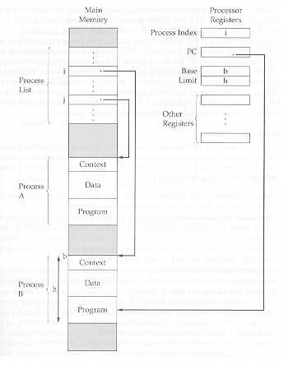
A simple implementation of processes
The process index register contains the index into the process list of the currently executing process (B)
A process switch from B to A consist of storing (in memory) B’s context and loading (in CPU registers) A’s context
A data structure that provides flexibility (to add new features)

Slide 26
Memory Management
The key contribution is virtual memory
It allows programs to address memory from a logical point of view without regard to the amount that is physically available
While a program is running only a portion of the program and data is kept in (real) memory
Other portions are kept in blocks on disk
  the user has access to a memory space that is larger than real memory

Slide 27
Virtual Memory
All memory references made by a program are to virtual memory which can be either
  a linear address space
  a collection of segments (variable-length blocks)
The hardware (mapper) must map virtual memory address to real memory address
If a reference is made to a virtual address not in memory, then
  (1) a portion of the content of real memory is swapped out to disk
  (2) the desired block of data is swapped in

Slide 28
File System
Implements long-term store (often on disk)
Information stored in named objects called files
  a convenient unit of access and protection for OS
Files (and portions) may be copied into virtual memory for manipulation by programs

Slide 29
Security and Protection
Access control to resources
  forbid intruders (unauthorized users) to enter the system
  forbid user processes to access resources which they are not authorized to

Slide 30
Scheduling and Resource Management
Differential responsiveness
  discriminate between different classes of jobs
Fairness
  give equal and fair access to all processes of the same class
Efficiency
  maximize throughput, minimize response time, and accommodate as many users as possible

Slide 31
Key Elements for Scheduling
OS maintains queues of processes waiting for some resource
  Short term queue of processes in memory ready to execute
    The dispatcher (short term scheduler) decides who goes next
  Long term queue of new jobs waiting to use the system
    OS must not admit too many processes
  A queue for each I/O device consisting of processes that want to use that I/O device

Slide 32
System Structure
Because of it’s enormous complexity, we view the OS system as a series of levels
Each level performs a related subset of functions
Each level relies on the next lower level to perform more primitive functions
Well defined interfaces: one level can be modified without affecting other levels
This decomposes a problem into a number of more manageable sub problems

Slide 33
Characteristics of Modern Operating Systems
New design elements were introduced recently
In response to new hardware development
  multiprocessor machines
  high-speed networks
  faster processors and larger memory
In response to new software needs
  multimedia applications
  Internet and Web access
  Client/Server applications

Slide 34
Microkernel architecture
Only a few essential functions in the kernel
  primitive memory management (address space)
  Interprocess communication (IPC)
  basic scheduling
Other OS services are provided by processes running in user mode (servers)
  device drivers, file system, virtual memory…
More flexibility, extensibility, portability…
A performance penalty by replacing service calls with message exchanges between process...

Slide 35
Multithreading
A process is a collection of one or more threads that can run simultaneously
Useful when the application consists of several tasks that do not need to be serialized
Gives the programmer a greater control over the timing of application-related events
All threads within the same process share the same data and resources and a part of the process’s execution context
It is easier to create or destroy a thread or switch among threads (of the same process) than to do these with processes

Slide 36
Symmetric Multiprocessing (SMP)
A computer with multiple processors
Each processor can perform the same functions and share same main memory and I/O facilities (symmetric)
The OS schedule processes/threads across all the processors (real parallelism)
Existence of multiple processors is transparent to the user.
Incremental growth: just add another CPU!
Robustness: a single CPU failure does not halt the system, only the performance is reduced.

Slide 37
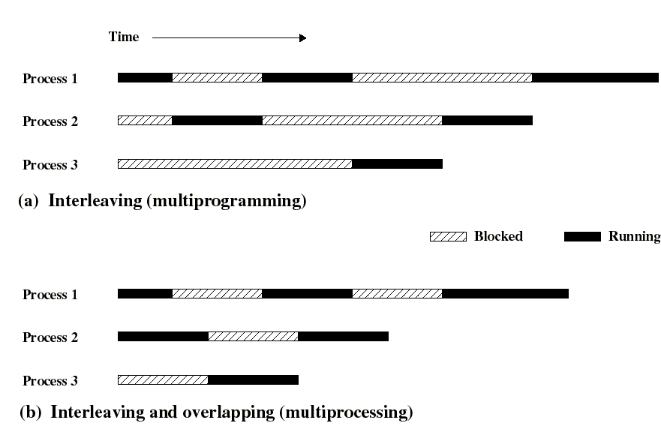
Example of parallel execution on SMP

