Slide 1
Process Description and Control
Chapter 3
All multiprogramming OS are build around the concept of processes
A process is sometimes called a task

Slide 2
OS Requirements for Processes
OS must interleave the execution of several processes to maximize CPU usage while providing reasonable response time
OS must allocate resources to processes while avoiding deadlock
OS must support inter-process communication and user creation of processes

Slide 3
Dispatcher (short-term scheduler)
Is an OS program that moves the processor from one process to another
It prevents a single process from monopolizing processor time
It decides who goes next according to a scheduling algorithm (chap 9)
The CPU will always execute instructions from the dispatcher while switching from process A to process B

Slide 4
When does a process gets created?
Submission of a batch job
User logs on
Created by OS to provide a service to a user (ex: printing a file)
Spawned by an existing process
  a user program can dictate the creation of a number of processes

Slide 5
When does a process get terminated?
Batch job issues Halt instruction
User logs off
Process executes a service request to terminate
Error and fault conditions

Slide 6
Reasons for Process Termination
Normal completion
Time limit exceeded
Memory unavailable
Memory bounds violation
Protection error
  example: write to read-only file
Arithmetic error
Time overrun
  process waited longer than a specified maximum for an event

Slide 7
Reasons for Process Termination
I/O failure
Invalid instruction
  happens when try to execute data
Privileged instruction
Operating system intervention
  such as when deadlock occurs
Parent request to terminate one offspring
Parent terminates so child processes terminate

Slide 8
Process States
Let us start with these states:
  The Running state
    The process that gets executed (single CPU)
  The Ready state
    any process that is ready to be executed
  The Blocked state
    when a process cannot execute until some event occurs (ex: the completion of an I/O)

Slide 9
Other Useful States
The New state
  OS has performed the necessary actions to create the process
    has created a process identifier
    has created tables needed to manage the process
  but has not yet committed to execute the process (not yet admitted)
    because resources are limited

Slide 10
Other Useful States
The Exit state
  Termination moves the process to this state
  It is no longer eligible for execution
  Tables and other info are temporarily preserved for auxiliary program
    Ex: accounting program that cumulates resource usage for billing the users
The process (and its tables) gets deleted when the data is no more needed

Slide 11
Process Transitions
Ready --> Running
  When it is time, the dispatcher selects a new process to run
Running --> Ready
  the running process has expired his time slot
  the running process gets interrupted because a higher priority process is in the ready state

Slide 12
Process Transitions
Running --> Blocked
  When a process requests something for which it must wait
    a service that the OS is not ready to perform
    an access to a resource not yet available
    initiates I/O and must wait for the result
    waiting for a process to provide input (IPC)
Blocked --> Ready
  When the event for which it was waiting occurs

Slide 13
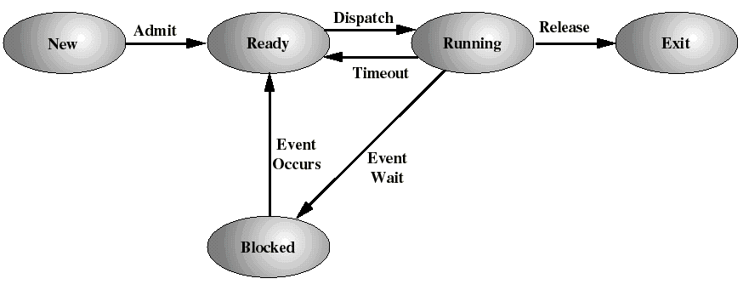
A Five-state Process Model
Ready to exit: A parent may terminate a child process

Slide 14
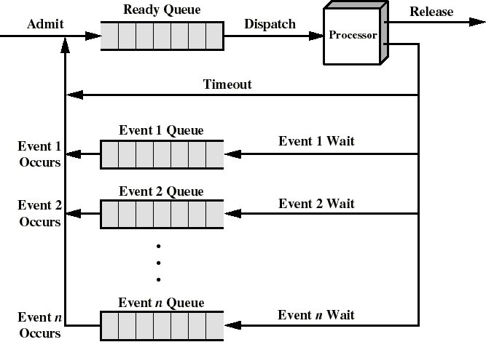
A Queuing Discipline
Ready queue without priorities (ex: FIFO)
When event n occurs, the corresponding queue is moved into the ready queue

Slide 15
The need for swapping
So far, all the processes had to be (at least partly) in main memory.
Even with virtual memory, keeping too many processes in main memory will deteriorate the system’s performance.
The OS may need to suspend some processes, i.e.: to swap them out to disk. We add 2 new states:
Blocked Suspend: blocked processes which have been swapped out to disk
Ready Suspend: ready processes which have been swapped out to disk

Slide 16
New state transitions (mid-term scheduling)
Blocked --> Blocked Suspend
  When all processes are blocked, the OS will make room to bring a ready process in memory
Blocked Suspend --> Ready Suspend
  When the event for which it as been waiting occurs (state info is available to OS)
Ready Suspend --> Ready
  when no more ready process in main memory
Ready--> Ready Suspend (unlikely)
  When there are no blocked processes and must free memory for adequate performance

Slide 17
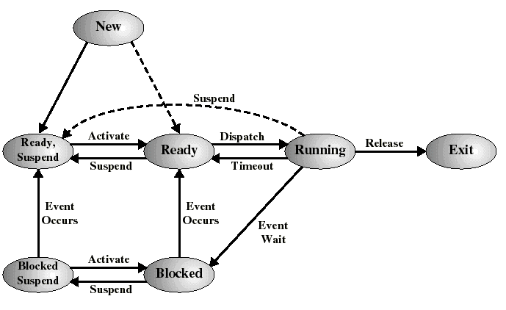
A Seven-state Process Model

Slide 18
Operating System Control Structures
An OS maintains the following tables for managing processes and resources:
  Memory tables (see later)
  I/O tables (see later)
  File tables (see later)
  Process tables (this chapter)

Slide 19
Process Image (process constituents)
User program
User data
Stack(s)
  for procedure calls and parameter passing
Process Control Block (execution context)
  Data needed (process attributes) by the OS to control the process. This includes:
    Process identification information
    Processor state information
    Process control information

Slide 20
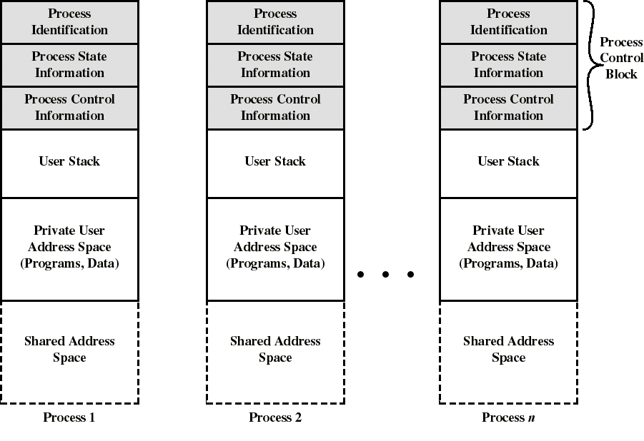
Process images in virtual memory

Slide 21
Location of the Process Image
Each process image is in virtual memory
  may not occupy a contiguous range of addresses (depends on the memory management scheme used)
  both a private and shared memory address space is used
The location if each process image is pointed to by an entry in the Primary Process Table
For the OS to manage the process, at least part of its image must be bring into main memory

Slide 22
Process Identification (in the PCB)
A few numeric identifiers may be used
  Unique process identifier (always)
    indexes (directly or indirectly) into the primary process table
  User identifier
    the user who is responsible for the job
  Identifier of the process that created this process

Slide 23
Processor State Information (in PCB)
Contents of processor registers
  User-visible registers
  Control and status registers
  Stack pointers
Program status word (PSW)
  contains status information
  Example: the EFLAGS register on Pentium machines

Slide 24
Process Control Information (in PCB)
scheduling and state information
  Process state (i.e.: running, ready, blocked...)
  Priority of the process
  Event for which the process is waiting (if blocked)
data structuring information
  may hold pointers to other PCBs for process queues, parent-child relationships and other structures

Slide 25
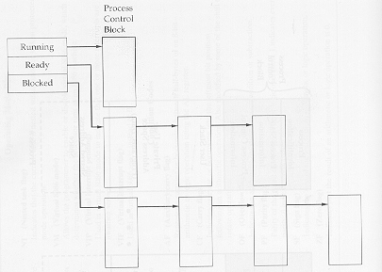
Queues as linked lists of PCBs

Slide 26
Process Control Information (in PCB)
Inter-process communication
  may hold flags and signals for IPC
process privileges
  Ex: access to certain memory locations...
memory management
  pointers to segment/page tables assigned to this process
resource ownership and utilization
  resource in use: open files, I/O devices...
  history of usage (of CPU time, I/O...)

Slide 27
Modes of Execution
To provide protection to PCBs (and other OS data) most processors support at least 2 execution modes:
  Privileged mode (a.k.a. system mode, kernel mode, supervisor mode, control mode )
    manipulating control registers, primitive I/O instructions, memory management...
  User mode
For this the CPU provides a (or a few) mode bit which may only be set by an interrupt or trap or OS call

Slide 28
Process Creation
Assign a unique process identifier
Allocate space for the process image
Initialize process control block
  many default values (ex: state is New, no I/O devices or files...)
Set up appropriate linkages
  Ex: add new process to linked list used for the scheduling queue

Slide 29
When to Switch a Process ?
A process switch may occur whenever the OS has gained control of CPU. i.e. when:
  Supervisor Call
    explicit request by the program (ex: file open). The process will probably be blocked
  Trap
    An error resulted from the last instruction. It may cause the process to be moved to the Exit state
  Interrupt
    the cause is external to the execution of the current instruction. Control is transferred to IH

Slide 30
Examples of interrupts
  Clock
    process has expired his time slice and is transferred to the ready state
  I/O
    first move the processes that were waiting for this event to the ready (or ready suspend) state
    then resume the running process or choose a process of higher priority
  Memory fault
    memory address is in virtual memory so it must bring corresponding block into main memory
    thus move this process to a blocked state (waiting for the I/O to complete)

Slide 31
Mode Switching
It may happen that an interrupt does not produce a process switch
The control can just return to the interrupted program
Then only the processor state information needs to be saved on stack (ref. Chap 1)
This is called mode switching (user to kernel mode when going into IH)
Less overhead: no need to update the PCB like for process switching

Slide 32
Steps in Process (Context) Switching
Save context of processor including program counter and other registers
Update the PCB of the running process with its new state and other associate info
Move PCB to appropriate queue - ready, blocked
Select another process for execution
Update PCB of the selected process
Restore CPU context from that of the selected process

Slide 33
Execution of the Operating System
Up to now, by process we were referring to “user process”
If the OS is just like any other collection of programs, is the OS a process?
If so, how it is controlled?
The answer depends on the OS design.

Slide 34
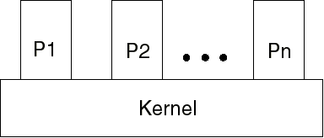
Non-process Kernel (old)
The concept of process applies only to user programs
OS code is executed as a separate entity in privilege mode
OS code never gets executed within a process

Slide 35
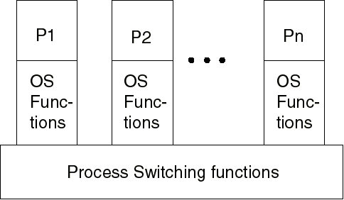
Execution within User Processes
Virtually all OS code gets executed within the context of a user process
On Interrupts, Traps, System calls: the CPU switch to kernel mode to execute OS routine within the context of user process (mode switch)
Control passes to process switching functions (outside processes) only when needed

Slide 36
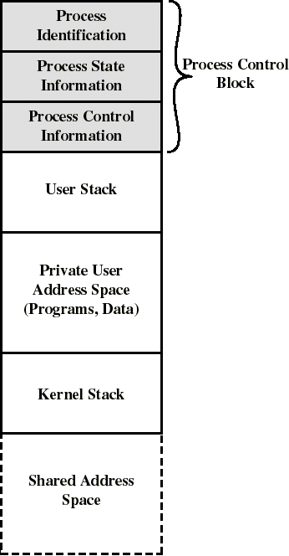
Execution within User Processes
OS code and data are in the shared address space and are shared by all user processes
Separate kernel stack for calls/returns when the process is in kernel mode
Within a user process, both user and OS programs may execute (more than 1)

Slide 37
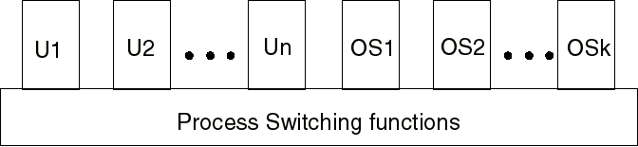
Process-based Operating System
The OS is a collection of system processes
major kernel functions are separate processes
small amount of process switching functions is executed outside of any process
Design that easily makes use of multiprocessors

Slide 38
UNIX SVR4 Process management
Most of OS executes within user processes
Uses two categories of processes:
  System processes
    run in kernel mode for housekeeping functions (memory allocation, process swapping...)
  User processes
    run in user mode for user programs
    run in kernel modes for system calls, traps, and interrupts

Slide 39
UNIX SVR4 Process States
Similar to our 7 state model
2 running states: User and Kernel
  transitions to other states (blocked, ready) must come from kernel running
Sleeping states (in memory, or swapped) correspond to our blocking states
A preempted state is distinguished from the ready state (but they form 1 queue)
Preemption can occur only when a process is about to move from kernel to user mode

Slide 40
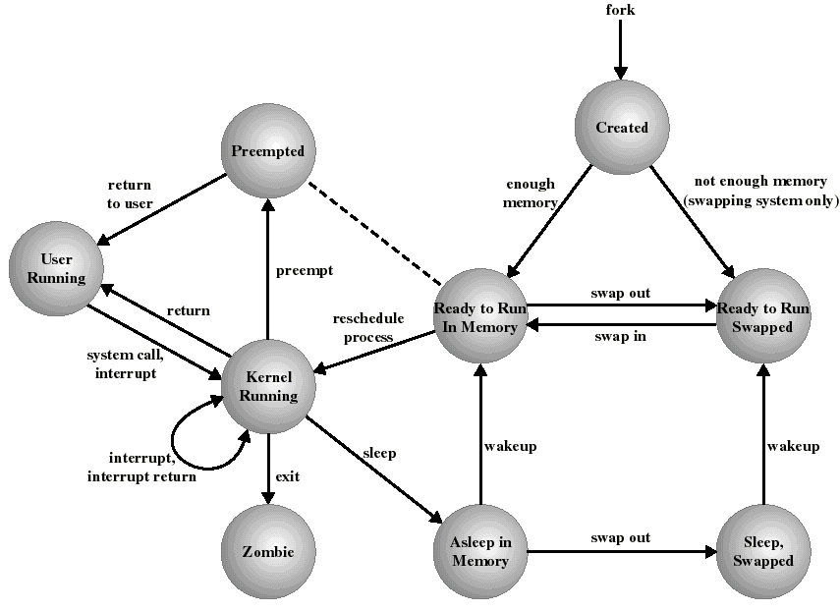
UNIX Process State Diagram

Slide 41
UNIX Process Creation
Every process, except process 0, is created by the fork() system call
  fork() allocates entry in process table and assigns a unique PID to the child process
  child gets a copy of process image of parent: both child and parent are executing the same code following fork()
  but fork() returns the PID of the child to the parent process and returns 0 to the child process

Slide 42
UNIX System Processes
Process 0 is created at boot time and becomes the “swapper” after forking process 1 (the INIT process)
When a user logs in: process 1 creates a process for that user

Slide 43
UNIX Process Image
User-level context
  Process Text (i.e. code: read-only)
  Process Data
  User Stack (calls/returns in user mode)
  Shared memory (for IPC)
    only one physical copy exists but, with virtual memory, it appears as it is in the process’s address space
Register context

Slide 44
UNIX Process Image
System-level context
  Process table entry
    the actual entry concerning this process in the Process Table maintained by OS
      Process state, UID, PID, priority, event awaiting, signals sent, pointers to memory holding text, data...
  U (user) area
    additional process info needed by the kernel when executing in the context of this process
      effective UID, timers, limit fields, files in use ...
  Kernel stack (calls/returns in kernel mode)
  Per Process Region Table (used by memory manager)

