Slide 1
Threads
Chapter 4

Slide 2
Process Characteristics
Unit of resource ownership - process is allocated:
  a virtual address space to hold the process image
  control of some resources (files, I/O devices...)
Unit of dispatching - process is an execution path through one or more programs
  execution may be interleaved with other process
  the process has an execution state and a dispatching priority

Slide 3
Process Characteristics
These two characteristics are treated independently by some recent OS
The unit of dispatching is usually referred to a thread or a lightweight process
The unit of resource ownership is usually referred to as a process or task

Slide 4
Multithreading vs. Single threading
Multithreading: when the OS supports multiple threads of execution within a single process
Single threading: when the OS does not recognize the concept of thread
MS-DOS support a single user process and a single thread
UNIX supports multiple user processes but only supports one thread per process
Solaris supports multiple threads

Slide 5
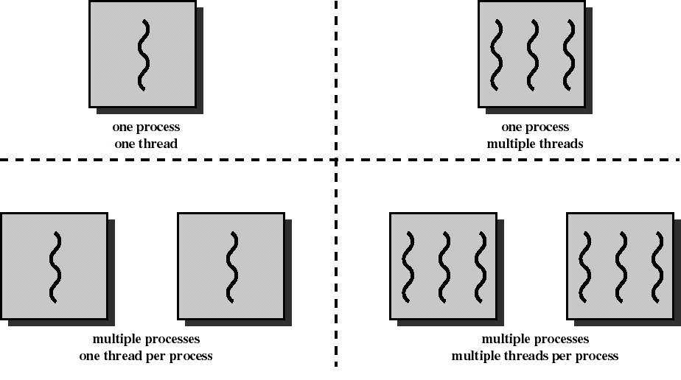
Threads and Processes

Slide 6
Processes
Have a virtual address space which holds the process image
Protected access to processors, other processes, files, and I/O resources

Slide 7
Threads
Has an execution state (running, ready, etc.)
Saves thread context when not running
Has an execution stack and some per-thread static storage for local variables
Has access to the memory address space and resources of its process
  all threads of a process share this
  when one thread alters a (non-private) memory item, all other threads (of the process) sees that
  a file open with one thread, is available to others

Slide 8
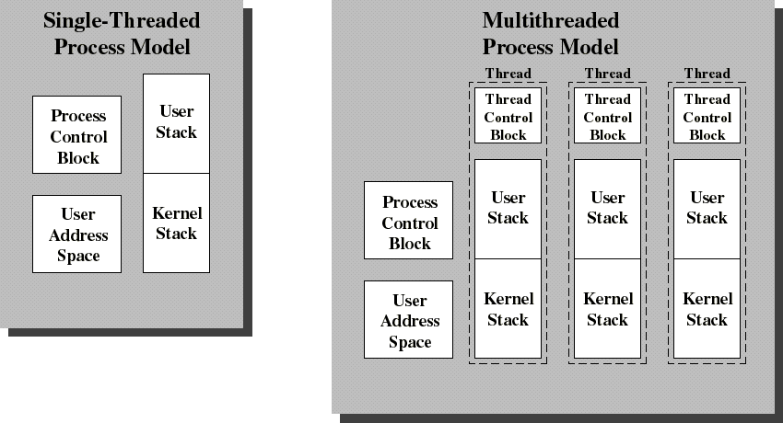
Single Threaded and Multithreaded Process Models
Thread Control Block contains a register image, thread priority and
thread state information

Slide 9
Benefits of Threads vs Processes
Takes less time to create a new thread than a process
Less time to terminate a thread than a process
Less time to switch between two threads within the same process

Slide 10
Benefits of Threads
Example: a file server on a LAN
It needs to handle several file requests over a short period
Hence more efficient to create (and destroy) a single thread for each request
On a SMP machine: multiple threads can possibly be executing simultaneously on different processors
Example2: one thread display menu and read user input while the other thread execute user commands

Slide 11
Application benefits of threads
Consider an application that consists of several independent parts that do not need to run in sequence
Each part can be implemented as a thread
Whenever one thread is blocked waiting for an I/O, execution could possibly switch to another thread of the same application (instead of switching to another process)

Slide 12
Benefits of Threads
Since threads within the same process share memory and files, they can communicate with each other without invoking the kernel
Therefore necessary to synchronize the activities of various threads so that they do not obtain inconsistent views of the data (chap 5)

Slide 13
Example of inconsistent view
3 variables: A, B, C which are shared by thread T1 and thread T2
T1 computes C = A+B
T2 transfers amount X from A to B
  T2 must do: A = A -X and B = B+X (so that A+B is unchanged)
But if T1 computes A+B after T2 has done A = A-X but before B = B+X
then T1 will not obtain the correct result for C = A + B

Slide 14
Threads States
Three key states: running, ready, blocked
They have no suspend state because all threads within the same process share the same address space
  Indeed: suspending (ie: swapping) a single thread involves suspending all threads of the same process
Termination of a process, terminates all threads within the process

Slide 15
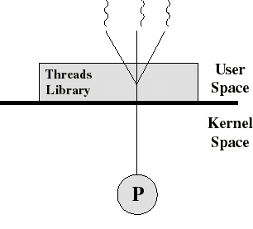
User-Level Threads (ULT)
The kernel is not aware of the existence of threads
All thread management is done by the application by using a thread library
Thread switching does not require kernel mode privileges (no mode switch)
Scheduling is application specific

Slide 16
Threads library
Contains code for:
  creating and destroying threads
  passing messages and data between threads
  scheduling thread execution
  saving and restoring thread contexts

Slide 17
Kernel activity for ULTs
The kernel is not aware of thread activity but it is still managing process activity
When a thread makes a system call, the whole process will be blocked
but for the thread library that thread is still in the running state
So thread states are independent of process states

Slide 18
Advantages and inconveniences of ULT
Advantages
  Thread switching does not involve the kernel: no mode switching
  Scheduling can be application specific: choose the best algorithm.
  ULTs can run on any OS. Only needs a thread library
Inconveniences
  Most system calls are blocking and the kernel blocks processes. So all threads within the process will be blocked
  The kernel can only assign processes to processors. Two threads within the same process cannot run simultaneously on two processors

Slide 19
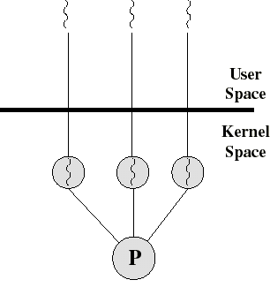
Kernel-Level Threads (KLT)
All thread management is done by kernel
No thread library but an API to the kernel thread facility
Kernel maintains context information for the process and the threads
Switching between threads requires the kernel
Scheduling on a thread basis
Ex: Windows NT and OS/2

Slide 20
Advantages and inconveniences of KLT
Advantages
  the kernel can simultaneously schedule many threads of the same process on many processors
  blocking is done on a thread level
  kernel routines can be multithreaded
Inconveniences
  thread switching within the same process involves the kernel. We have 2 mode switches per thread switch
  this results in a significant slow down

Slide 21
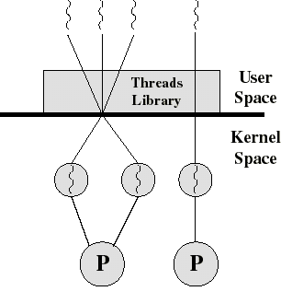
Combined ULT/KLT Approaches
Thread creation done in the user space
Bulk of scheduling and synchronization of threads done in the user space
The programmer may adjust the number of KLTs
May combine the best of both approaches
Example is Solaris

Slide 22
Solaris
Process includes the user’s address space, stack, and process control block
User-level threads (threads library)
  invisible to the OS
  are the interface for application parallelism
Kernel threads
  the unit that can be dispatched on a processor and it’s structures are maintain by the kernel
Lightweight processes (LWP)
  each LWP supports one or more ULTs and maps to exactly one KLT
  each LWP is visible to the application

Slide 23
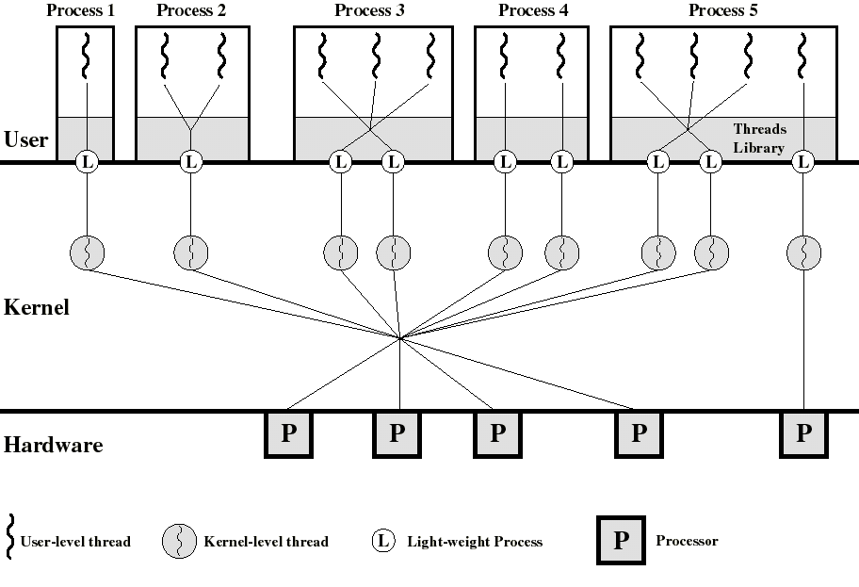
Process 2 is equivalent to a pure ULT approach
Process 4 is equivalent to a pure KLT approach
We can specify a different degree of parallelism (process 3 and 5)

Slide 24
Solaris: versatility
We can use ULTs when logical parallelism does not need to be supported by hardware parallelism (we save mode switching)
  Ex: Multiple windows but only one is active at any one time
If threads may block then we can specify two or more LWPs to avoid blocking the whole application

Slide 25
Solaris: user-level thread execution
Transitions among these states is under the exclusive control of the application
  a transition can occur only when a call is made to a function of the thread library
It’s only when a ULT is in the active state that it is attached to a LWP (so that it will run when the kernel level thread runs)
  a thread may transfer to the sleeping state by invoking a synchronization primitive (chap 5) and later transfer to the runnable state when the event waited for occurs
  A thread may force another thread to go to the stop state...

Slide 26
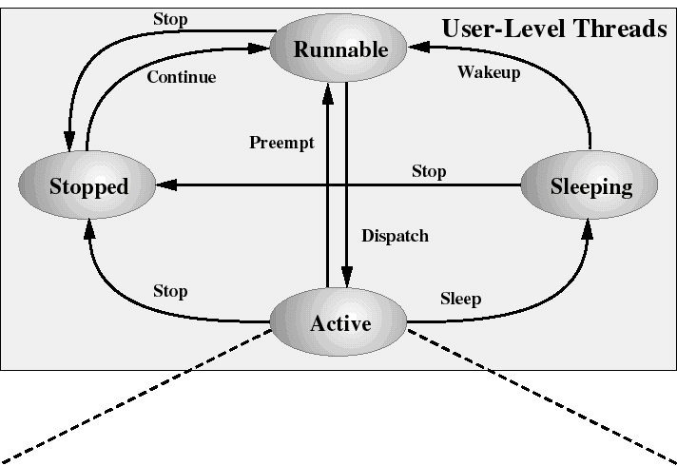
Solaris: user-level thread states
(attached to a LWP)

Slide 27
Decomposition of user-level Active state
When a ULT is Active, it is associated to a LWP and, thus, to a KLT
Transitions among the LWP states is under the exclusive control of the kernel
A LWP can be in the following states:
  running: when the KLT is executing
  blocked: because the KLT issued a blocking system call (but the ULT remains bound to that LWP and remains active)
  runnable: waiting to be dispatched to CPU

Slide 28
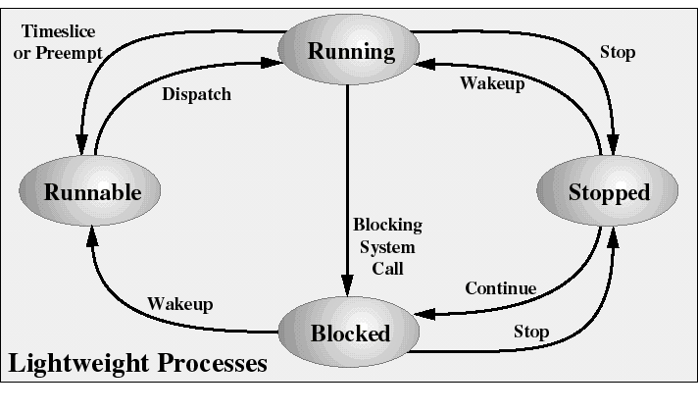
Solaris: Lightweight Process States
LWP states are independent of ULT states
(except for bound ULTs)

