Slide 1
Concurrency: Mutual Exclusion and Synchronization
Chapter 5

Slide 2
Problems with concurrent execution
Concurrent processes (or threads) often need to share data (maintained either in shared memory or files) and resources
If there is no controlled access to shared data, some processes will obtain an inconsistent view of this data
The action performed by concurrent processes will then depend on the order in which their execution is interleaved

Slide 3
An example
Process P1 and P2 are running this same procedure and have access to the same variable “a”
Processes can be interrupted anywhere
If P1 is first interrupted after user input and P2 executes entirely
Then the character echoed by P1 will be the one read by P2 !!
static char a;
void echo()
{
cin >> a;
cout << a;
}

Slide 4
Race Conditions
Situations like this where processes access the same data concurrently and the outcome of execution depends on the particular order in which the access takes place is called a race condition
How must the processes coordinate (or synchronise) in order to guard against race conditions?

Slide 5
The critical section problem
When a process executes code that manipulates shared data (or resource), we say that the process is in it’s critical section (CS) (for that shared data)
The execution of critical sections must be mutually exclusive: at any time, only one process is allowed to execute in its critical section (even with multiple CPUs)
Then each process must request the permission to enter it’s critical section (CS)

Slide 6
The critical section problem
The section of code implementing this request is called the entry section
The critical section (CS) might be followed by an exit section
The remaining code is the remainder section
The critical section problem is to design a protocol that the processes can use so that their action will not depend on the order in which their execution is interleaved (possibly on many processors)

Slide 7
Framework for analysis of solutions
Each process executes at nonzero speed but no assumption on the relative speed of n processes
General structure of a process:
many CPU may be present but memory hardware prevents simultaneous access to the same memory location
No assumption about order of interleaved execution
For solutions: we need to specify entry and exit sections
repeat
entry section
critical section
exit section
remainder section
forever

Slide 8
Requirements for a valid solution to the critical section problem
Mutual Exclusion
  At any time, at most one process can be in its critical section (CS)
Progress
  Only processes that are not executing in their RS can participate in the decision of who will enter next in the CS.
  This selection cannot be postponed indefinitely

Slide 9
Requirements for a valid solution to the critical section problem (cont.)
Bounded Waiting
  After a process has made a request to enter it’s CS, there is a bound on the number of times that the other processes are allowed to enter their CS
    otherwise the process will suffer from starvation
  Of course also no deadlock

Slide 10
Types of solutions
Software solutions
  algorithms who’s correctness does not rely on any other assumptions (see framework)
Hardware solutions
  rely on some special machine instructions
Operation System solutions
  provide some functions and data structures to the programmer

Slide 11
Software solutions
We consider first the case of 2 processes
  Algorithm 1 and 2 are incorrect
  Algorithm 3 is correct (Peterson’s algorithm)
Then we generalize to n processes
  the bakery algorithm
Notation
  We start with 2 processes: P0 and P1
  When presenting process Pi, Pj always denotes the other process (i != j)

Slide 12
Algorithm 1
The shared variable turn is initialized (to 0 or 1) before executing any Pi
Pi’s critical section is executed iff turn = i
Pi is busy waiting if Pj is in CS: mutual exclusion is satisfied
Progress requirement is not satisfied since it requires strict alternation of CSs
If a process requires its CS more often then the other, it cannot get it.
Process Pi:
repeat
while(turn!=i){};
CS
turn:=j;
RS
forever

Slide 13
Process P0:
repeat
while(turn!=0){};
CS
turn:=1;
RS
forever
Process P1:
repeat
while(turn!=1){};
CS
turn:=0;
RS
forever
Algorithm 1 global view
Ex: P0 has a large RS and P1 has a small RS. If turn=0, P0 enter its CS and then its long RS (turn=1). P1 enter its CS and then its RS (turn=0) and tries again to enter its CS: request refused! He has to wait that P0 leaves its RS.

Slide 14
Algorithm 2
Keep 1 Bool variable for each process: flag[0] and flag[1]
Pi signals that it is ready to enter it’s CS by: flag[i]:=true
Mutual Exclusion is satisfied but not the progress requirement
If we have the sequence:
  T0: flag[0]:=true
  T1: flag[1]:=true
Both process will wait forever to enter their CS: we have a deadlock
Process Pi:
repeat
flag[i]:=true;
while(flag[j]){};
CS
flag[i]:=false;
RS
forever

Slide 15
Algorithm 3 (Peterson’s algorithm)
Initialization: flag[0]:=flag[1]:=false turn:= 0 or 1
Willingness to enter CS specified by flag[i]:=true
If both processes attempt to enter their CS simultaneously, only one turn value will last
Exit section: specifies that Pi is unwilling to enter CS
Process Pi:
repeat
flag[i]:=true;
// I want in
turn:=j;
// but I let the other in
while
(flag[j]&turn=j){};
CS
flag[i]:=false;
// I no longer want in
RS
forever

Slide 16
Process P0:
repeat
flag[0]:=true;
// 0 wants in
turn:= 1;
// 0 gives a chance to 1
while
(flag[1]&turn=1){};
CS
flag[0]:=false;
// 0 no longer wants in
RS
forever
Process P1:
repeat
flag[1]:=true;
// 1 wants in
turn:=0;
// 1 gives a chance to 0
while
(flag[0]&turn=0){};
CS
flag[1]:=false;
// 1 no longer wants in
RS
forever
Peterson’s algorithm global view

Slide 17
Algorithm 3: proof of correctness
Mutual exclusion is preserved since:
  P0 and P1 are both in CS only if flag[0] = flag[1] = true and only if turn = i for each Pi (impossible)
We now prove that the progress and bounded waiting requirements are satisfied:
  Pi cannot enter CS only if stuck in while() with condition flag[ j] = true and turn = j.
  If Pj is not ready to enter CS then flag[ j] = false and Pi can then enter its CS

Slide 18
Algorithm 3: proof of correctness (cont.)
  If Pj has set flag[ j]=true and is in its while(), then either turn=i or turn=j
  If turn=i, then Pi enters CS. If turn=j then Pj enters CS but will then reset flag[ j]=false on exit: allowing Pi to enter CS
  but if Pj has time to reset flag[ j]=true, it must also set turn=i
  since Pi does not change value of turn while stuck in while(), Pi will enter CS after at most one CS entry by Pj (bounded waiting)

Slide 19
What about process failures?
If all 3 criteria (ME, progress, bounded waiting) are satisfied, then a valid solution will provide robustness against failure of a process in its remainder section (RS)
  since failure in RS is just like having an infinitely long RS
However, no valid solution can provide robustness against a process failing in its critical section (CS)
  A process Pi that fails in its CS does not signal that fact to other processes: for them Pi is still in its CS

Slide 20
n-process solution: bakery algorithm
Before entering their CS, each Pi receives a number. Holder of smallest number enter CS (like in bakeries, ice-cream stores...)
When Pi and Pj receives same number:
  if i<j then Pi is served first, else Pj is served first
Pi resets its number to 0 in the exit section
Notation:
  (a,b) < (c,d) if a < c or if a = c and b < d
  max(a0,...ak) is a number b such that
    b >= ai for i=0,..k

Slide 21
The bakery algorithm (cont.)
Shared data:
  choosing: array[0..n-1] of boolean;
    initialized to false
  number: array[0..n-1] of integer;
    initialized to 0
Correctness relies on the following fact:
  If Pi is in CS and Pk has already chosen its number[k]!= 0, then (number[i],i) < (number[k],k)
  but the proof is somewhat tricky...

Slide 22
The bakery algorithm (cont.)
Process Pi:
repeat
choosing[i]:=true;
number[i]:=max(number[0]..number[n-1])+1;
choosing[i]:=false;
for j:=0 to n-1 do {
while (choosing[j]) {};
while (number[j]!=0
and (number[j],j)<(number[i],i)){};
}
CS
number[i]:=0;
RS
forever

Slide 23
Drawbacks of software solutions
Processes that are requesting to enter in their critical section are busy waiting (consuming processor time needlessly)
If Critical Sections are long, it would be more efficient to block processes that are waiting...

Slide 24
Hardware solutions: interrupt disabling
On a uniprocessor: mutual exclusion is preserved but efficiency of execution is degraded: while in CS, we cannot interleave execution with other processes that are in RS
On a multiprocessor: mutual exclusion is not preserved
  CS is now atomic but not mutually exclusive
  Generally not an acceptable solution
Process Pi:
repeat
disable interrupts
critical section
enable interrupts
remainder section
forever

Slide 25
Hardware solutions: special machine instructions
Normally, access to a memory location excludes other access to that same location
Extension: designers have proposed machines instructions that perform 2 actions atomically (indivisible) on the same memory location (ex: reading and writing)
The execution of such an instruction is also mutually exclusive (even with multiple CPUs)
They can be used to provide mutual exclusion but need to be complemented by other mechanisms to satisfy the other 2 requirements of the CS problem (and avoid starvation and deadlock)

Slide 26
The test-and-set instruction
An algorithm that uses testset for Mutual Exclusion:
Shared variable b is initialized to 0
Only the first Pi who sets b enter CS
A C++ description of test-and-set:
bool testset(int& i)
{
if (i==0) {
i=1;
return true;
} else {
return false;
}
}
Process Pi:
repeat
repeat{}
until testset(b);
CS
b:=0;
RS
forever

Slide 27
The test-and-set instruction (cont.)
Mutual exclusion is preserved: if Pi enter CS, the other Pj are busy waiting
Problem: still using busy waiting
When Pi exit CS, the selection of the Pj who will enter CS is arbitrary: no bounded waiting. Hence starvation is possible
Processors (ex: Pentium) often provide an atomic xchg(a,b) instruction that swaps the content of a and b.
But xchg(a,b) suffers from the same drawbacks as test-and-set

Slide 28
Using xchg for mutual exclusion
Shared variable b is initialized to 0
Each Pi has a local variable k
The only Pi that can enter CS is the one who finds b=0
This Pi excludes all the other Pj by setting b to 1
Process Pi:
repeat
k:=1
repeat xchg(k,b)
until k=0;
CS
b:=0;
RS
forever

Slide 29
Semaphores
Synchronization tool (provided by the OS) that do not require busy waiting
A semaphore S is an integer variable that, apart from initialization, can only be accessed through 2 atomic and mutually exclusive operations:
  wait(S)
  signal(S)
To avoid busy waiting: when a process has to wait, it will be put in a blocked queue of processes waiting for the same event

Slide 30
Semaphores
Hence, in fact, a semaphore is a record (structure):
type semaphore = record
count: integer;
queue: list of process
end;
var S: semaphore;
When a process must wait for a semaphore S, it is blocked and put on the semaphore’s queue
The signal operation removes (acc. to a fair policy like FIFO) one process from the queue and puts it in the list of ready processes

Slide 31
Semaphore’s operations
wait(S):
S.count--;
if (S.count<0) {
block this process
place this process in S.queue
}
signal(S):
S.count++;
if (S.count<=0) {
remove a process P from S.queue
place this process P on ready list
}
S.count must be initialized to a nonnegative value (depending on application)

Slide 32
Semaphores: observations
When S.count >=0: the number of processes that can execute wait(S) without being blocked = S.count
When S.count<0: the number of processes waiting on S is = |S.count|
Atomicity and mutual exclusion: no 2 process can be in wait(S) and signal(S) (on the same S) at the same time (even with multiple CPUs)
Hence the blocks of code defining wait(S) and signal(S) are, in fact, critical sections

Slide 33
Semaphores: observations
The critical sections defined by wait(S) and signal(S) are very short: typically 10 instructions
Solutions:
  uniprocessor: disable interrupts during these operations (ie: for a very short period). This does not work on a multiprocessor machine.
  multiprocessor: use previous software or hardware schemes. The amount of busy waiting should be small.

Slide 34
Using semaphores for solving critical section problems
For n processes
Initialize S.count to 1
Then only 1 process is allowed into CS (mutual exclusion)
To allow k processes into CS, we initialize S.count to k
Process Pi:
repeat
wait(S);
CS
signal(S);
RS
forever

Slide 35
Using semaphores to synchronize processes
We have 2 processes: P1 and P2
Statement S1 in P1 needs to be performed before statement S2 in P2
Then define a semaphore “synch”
Initialize synch to 0
Proper synchronization is achieved by having in P1:
  S1;
  signal(synch);
And having in P2:
  wait(synch);
  S2;

Slide 36
The producer/consumer problem
A producer process produces information that is consumed by a consumer process
  Ex1: a print program produces characters that are consumed by a printer
  Ex2: an assembler produces object modules that are consumed by a loader
We need a buffer to hold items that are produced and eventually consumed
A common paradigm for cooperating processes

Slide 37
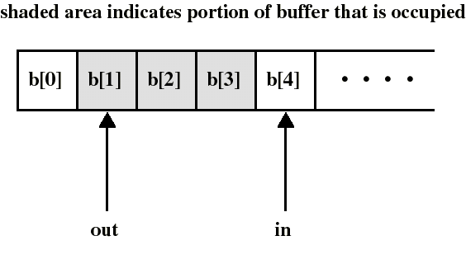
P/C: unbounded buffer
We assume first an unbounded buffer consisting of a linear array of elements
in points to the next item to be produced
out points to the next item to be consumed

Slide 38
P/C: unbounded buffer
We need a semaphore S to perform mutual exclusion on the buffer: only 1 process at a time can access the buffer
We need another semaphore N to synchronize producer and consumer on the number N (= in - out) of items in the buffer
  an item can be consumed only after it has been created

Slide 39
P/C: unbounded buffer
The producer is free to add an item into the buffer at any time: it performs wait(S) before appending and signal(S) afterwards to prevent customer access
It also performs signal(N) after each append to increment N
The consumer must first do wait(N) to see if there is an item to consume and use wait(S)/signal(S) to access the buffer

Slide 40
Solution of P/C: unbounded buffer
Initialization:
S.count:=1;
N.count:=0;
in:=out:=0;
append(v):
b[in]:=v;
in++;
Producer:
repeat
produce v;
wait(S);
append(v);
signal(S);
signal(N);
forever
Consumer:
repeat
wait(N);
wait(S);
w:=take();
signal(S);
consume(w);
forever
take():
w:=b[out];
out++;
return w;
critical sections

Slide 41
P/C: unbounded buffer
Remarks:
  Putting signal(N) inside the CS of the producer (instead of outside) has no effect since the consumer must always wait for both semaphores before proceeding
  The consumer must perform wait(N) before wait(S), otherwise deadlock occurs if consumer enter CS while the buffer is empty
Using semaphores is a difficult art...

Slide 42
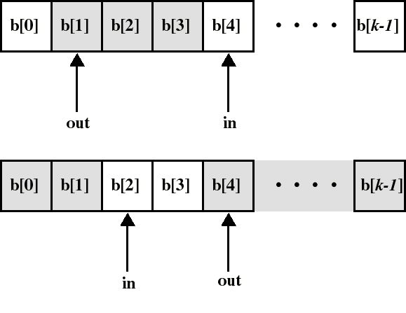
P/C: finite circular buffer of size k
can consume only when number N of (consumable) items is at least 1 (now: N!=in-out)
can produce only when number E of empty spaces is at least 1

Slide 43
P/C: finite circular buffer of size k
As before:
  we need a semaphore S to have mutual exclusion on buffer access
  we need a semaphore N to synchronize producer and consumer on the number of consumable items
In addition:
  we need a semaphore E to synchronize producer and consumer on the number of empty spaces

Slide 44
Solution of P/C: finite circular buffer of size k
Initialization: S.count:=1; in:=0;
N.count:=0; out:=0;
E.count:=k;
append(v):
b[in]:=v;
in:=(in+1)
mod k;
Producer:
repeat
produce v;
wait(E);
wait(S);
append(v);
signal(S);
signal(N);
forever
Consumer:
repeat
wait(N);
wait(S);
w:=take();
signal(S);
signal(E);
consume(w);
forever
take():
w:=b[out];
out:=(out+1)
mod k;
return w;
critical sections

Slide 45
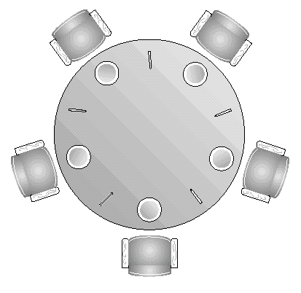
The Dining Philosophers Problem
5 philosophers who only eat and think
each need to use 2 forks for eating
we have only 5 forks
A classical synchron. problem
Illustrates the difficulty of allocating resources among process without deadlock and starvation

Slide 46
The Dining Philosophers Problem
Each philosopher is a process
One semaphore per fork:
  fork: array[0..4] of semaphores
  Initialization: fork[i].count:=1 for i:=0..4
A first attempt:
Deadlock if each philosopher start by picking his left fork!
Process Pi:
repeat
think;
wait(fork[i]);
wait(fork[i+1 mod 5]);
eat;
signal(fork[i+1 mod 5]);
signal(fork[i]);
forever

Slide 47
The Dining Philosophers Problem
A solution: admit only 4 philosophers at a time that tries to eat
Then 1 philosopher can always eat when the other 3 are holding 1 fork
Hence, we can use another semaphore T that would limit at 4 the numb. of philosophers “sitting at the table”
Initialize: T.count:=4
Process Pi:
repeat
think;
wait(T);
wait(fork[i]);
wait(fork[i+1 mod 5]);
eat;
signal(fork[i+1 mod 5]);
signal(fork[i]);
signal(T);
forever

Slide 48
Binary semaphores
The semaphores we have studied are called counting (or integer) semaphores
We have also binary semaphores
  similar to counting semaphores except that “count” is Boolean valued
  counting semaphores can be implemented by binary semaphores...
  generally more difficult to use than counting semaphores (eg: they cannot be initialized to an integer k > 1)

Slide 49
Binary semaphores
waitB(S):
if (S.value = 1) {
S.value := 0;
} else {
block this process
place this process in S.queue
}
signalB(S):
if (S.queue is empty) {
S.value := 1;
} else {
remove a process P from S.queue
place this process P on ready list
}

Slide 50
Problems with semaphores
semaphores provide a powerful tool for enforcing mutual exclusion and coordinate processes
But wait(S) and signal(S) are scattered among several processes. Hence, difficult to understand their effects
Usage must be correct in all the processes
One bad (or malicious) process can fail the entire collection of processes

Slide 51
Monitors
Are high-level language constructs that provide equivalent functionality to that of semaphores but are easier to control
Found in many concurrent programming languages
    Concurrent Pascal, Modula-3, uC++, Java...
Can be implemented by semaphores...

Slide 52
Monitor
Is a software module containing:
  one or more procedures
  an initialization sequence
  local data variables
Characteristics:
  local variables accessible only by monitor’s procedures
  a process enters the monitor by invoking one of it’s procedures
  only one process can be in the monitor at any one time

Slide 53
Monitor
The monitor ensures mutual exclusion: no need to program this constraint explicitly
Hence, shared data are protected by placing them in the monitor
  The monitor locks the shared data on process entry
Process synchronization is done by the programmer by using condition variables that represent conditions a process may need to wait for before executing in the monitor

Slide 54
Condition variables
are local to the monitor (accessible only within the monitor)
can be access and changed only by two functions:
  cwait(a): blocks execution of the calling process on condition (variable) a
    the process can resume execution only if another process executes csignal(a)
  csignal(a): resume execution of some process blocked on condition (variable) a.
    If several such process exists: choose any one
    If no such process exists: do nothing

Slide 55
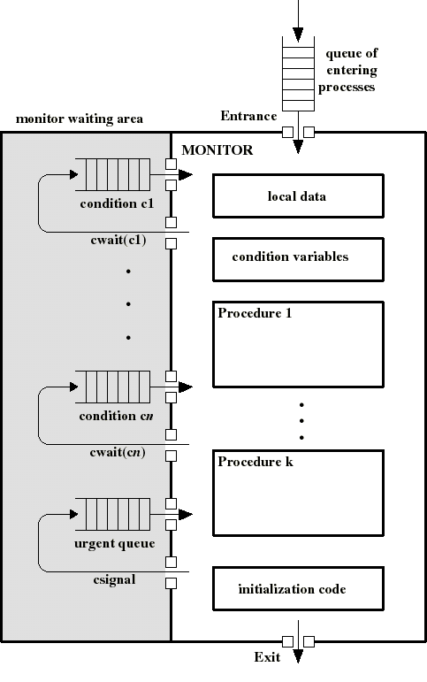
Monitor
Awaiting processes are either in the entrance queue or in a condition queue
A process puts itself into condition queue cn by issuing cwait(cn)
csignal(cn) brings into the monitor 1 process in condition cn queue
Hence csignal(cn) blocks the calling process and puts it in the urgent queue (unless csignal is the last operation of the monitor procedure)

Slide 56
Producer/Consumer problem
Two types of processes:
  producers
  consumers
Synchronization is now confined within the monitor
append(.) and take(.) are procedures within the monitor: are the only means by which P/C can access the buffer
If these procedures are correct, synchronization will be correct for all participating processes
ProducerI:
repeat
produce v;
Append(v);
forever
ConsumerI:
repeat
Take(v);
consume v;
forever

Slide 57
Monitor for the bounded P/C problem
Monitor needs to hold the buffer:
  buffer: array[0..k-1] of items;
needs two condition variables:
  notfull: csignal(notfull) indicates that the buffer is not full
  notemty: csignal(notempty) indicates that the buffer is not empty
needs buffer pointers and counts:
  nextin: points to next item to be appended
  nextout: points to next item to be taken
  count: holds the number of items in buffer

Slide 58
Monitor for the bounded P/C problem
Monitor boundedbuffer:
buffer: array[0..k-1] of items;
nextin:=0, nextout:=0, count:=0: integer;
notfull, notempty: condition;
Append(v):
if (count=k) cwait(notfull);
buffer[nextin]:= v;
nextin:= nextin+1 mod k;
count++;
csignal(notempty);
Take(v):
if (count=0) cwait(notempty);
v:= buffer[nextout];
nextout:= nextout+1 mod k;
count--;
csignal(notfull);

Slide 59
Message Passing
Is a general method used for interprocess communication (IPC)
  for processes inside the same computer
  for processes in a distributed system
Yet another mean to provide process synchronization and mutual exclusion
We have at least two primitives:
  send(destination, message)
  received(source, message)
In both cases, the process may or may not be blocked

Slide 60
Synchronization in message passing
For the sender: it is more natural not to be blocked after issuing send(.,.)
  can send several messages to multiple dest.
  but sender usually expect acknowledgment of message receipt (in case receiver fails)
For the receiver: it is more natural to be blocked after issuing receive(.,.)
  the receiver usually needs the info before proceeding
  but could be blocked indefinitely if sender process fails before send(.,.)

Slide 61
Synchronization in message passing
Hence other possibilities are sometimes offered
Ex: blocking send, blocking receive:
  both are blocked until the message is received
  occurs when the communication link is unbuffered (no message queue)
  provides tight synchronization (rendez-vous)

Slide 62
Addressing in message passing
direct addressing:
  when a specific process identifier is used for source/destination
  but it might be impossible to specify the source ahead of time (ex: a print server)
indirect addressing (more convenient):
  messages are sent to a shared mailbox which consists of a queue of messages
  senders place messages in the mailbox, receivers pick them up

Slide 63
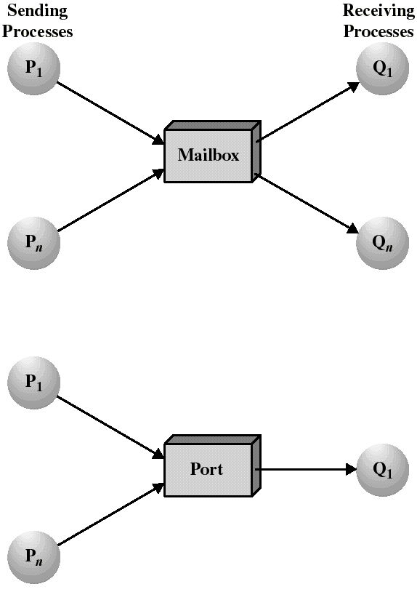
Mailboxes and Ports
A mailbox can be private to one sender/receiver pair
The same mailbox can be shared among several senders and receivers
  the OS may then allow the use of message types (for selection)
Port: is a mailbox associated with one receiver and multiple senders
  used for client/server applications: the receiver is the server

Slide 64
Ownership of ports and mailboxes
A port is usually own and created by the receiving process
The port is destroyed when the receiver terminates
The OS creates a mailbox on behalf of a process (which becomes the owner)
The mailbox is destroyed at the owner’s request or when the owner terminates

Slide 65
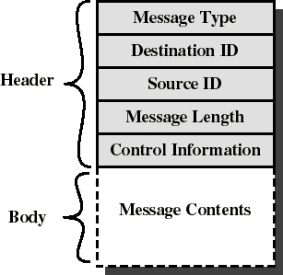
Message format
Consists of header and body of message
In Unix: no ID, only message type
control info:
  what to do if run out of buffer space
  sequence numbers
  priority...
Queuing discipline: usually FIFO but can also include priorities

Slide 66
Enforcing mutual exclusion with message passing
create a mailbox mutex shared by n processes
send() is non blocking
receive() blocks when mutex is empty
Initialization: send(mutex, “go”);
The first Pi who executes receive() will enter CS. Others will be blocked until Pi resends msg.
Process Pi:
var msg: message;
repeat
receive(mutex,msg);
CS
send(mutex,msg);
RS
forever

Slide 67
The bounded-buffer P/C problem with message passing
We will now make use of messages
The producer place items (inside messages) in the mailbox mayconsume
mayconsume acts as our buffer: consumer can consume item when at least one message is present
Mailbox mayproduce is filled initially with k null messages (k= buffer size)
The size of mayproduce shrinks with each production and grows with each consumption
can support multiple producers/consumers

Slide 68
The bounded-buffer P/C problem with message passing
Producer:
var pmsg: message;
repeat
receive(mayproduce, pmsg);
pmsg:= produce();
send(mayconsume, pmsg);
forever
Consumer:
var cmsg: message;
repeat
receive(mayconsume, cmsg);
consume(cmsg);
send(mayproduce, null);
forever

Slide 69
Unix SVR4 concurrency mechanisms
To communicate data across processes:
  Pipes
  Messages
  Shared memory
To trigger actions by other processes:
  Signals
  Semaphores

Slide 70
Unix Pipes
A shared bounded FIFO queue written by one process and read by another
  based on the producer/consumer model
  OS enforces Mutual Exclusion: only one process at a time can access the pipe
  if there is not enough room to write, the producer is blocked, else he writes
  consumer is blocked if attempting to read more bytes that are currently in the pipe
  accessed by a file descriptor, like an ordinary file
  processes sharing the pipe are unaware of each other’s existence

Slide 71
Unix Messages
A process can create or access a message queue (like a mailbox) with the msgget system call.
msgsnd and msgrcv system calls are used to send and receive messages to a queue
There is a “type” field in message headers
  FIFO access within each message type
  each type defines a communication channel
Process is blocked (put asleep) when:
  trying to receive from an empty queue
  trying to send to a full queue

Slide 72
Shared memory in Unix
A block of virtual memory shared by multiple processes
The shmget system call creates a new region of shared memory or return an existing one
A process attaches a shared memory region to its virtual address space with the shmat system call
Mutual exclusion must be provided by processes using the shared memory
Fastest form of IPC provided by Unix

Slide 73
Unix signals
Similar to hardware interrupts without priorities
Each signal is represented by a numeric value. Ex:
  02, SIGINT: to interrupt a process
  09, SIGKILL: to terminate a process
Each signal is maintained as a single bit in the process table entry of the receiving process: the bit is set when the corresponding signal arrives (no waiting queues)
A signal is processed as soon as the process runs in user mode
A default action (eg: termination) is performed unless a signal handler function is provided for that signal (by using the signal system call)

Slide 74
Unix Semaphores
Are a generalization of the counting semaphores (more operations are permitted).
A semaphore includes:
  the current value S of the semaphore
  number of processes waiting for S to increase
  number of processes waiting for S to be 0
We have queues of processes that are blocked on a semaphore
The system call semget creates an array of semaphores
The system call semop performs a list of operations: one on each semaphore (atomically)

Slide 75
Unix Semaphores
Each operation to be done is specified by a value sem_op.
Let S be the semaphore value
  if sem_op > 0:
    S is incremented and process awaiting for S to increase are awaken
  if sem_op = 0:
    If S=0: do nothing
    if S!=0, block the current process on the event that S=0

Slide 76
Unix Semaphores
  if sem_op < 0 and |sem_op| <= S:
    set S:= S + sem_op (ie: S decreases)
    then if S=0: awake processes waiting for S=0
  if sem_op < 0 and |sem_op| > S:
    current process is blocked on the event that S increases
Hence: flexibility in usage (many operations are permitted)

