Slide 1
Concurrency: Deadlock and Starvation
Chapter 6

Slide 2
Deadlock
Permanent blocking of a set of processes that either compete for system resources or communicate with each other
Involves conflicting needs for resources by two or more processes
There is no satisfactory solution in the general case
Some OS (ex: Unix SVR4) ignore the problem and pretend that deadlocks never occur...

Slide 3
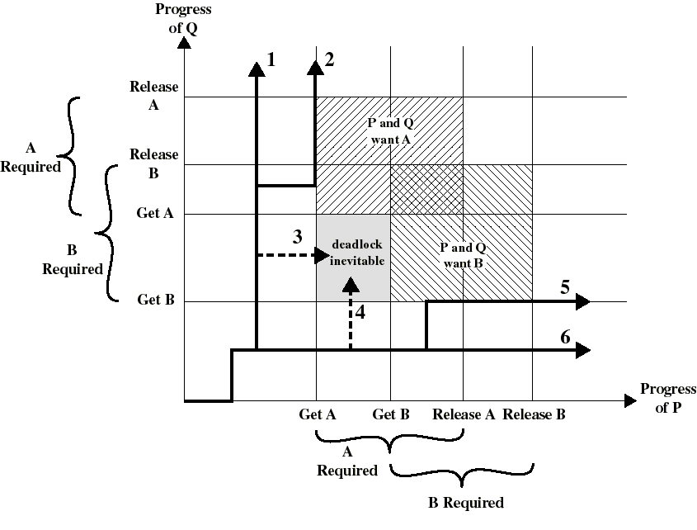
Example where deadlock can occur

Slide 4
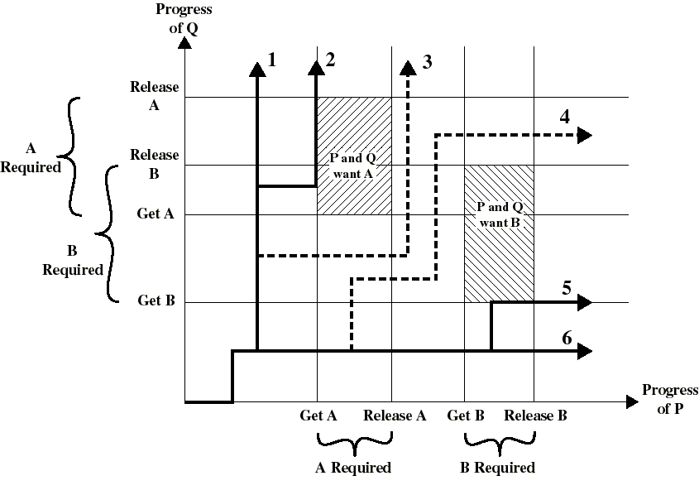
Example where deadlock cannot occur

Slide 5
The Conditions for Deadlock
These 3 conditions of policy must be present for a deadlock to be possible:
  1: Mutual exclusion
    only one process may use a resource at a time
  2: Hold-and-wait
    a process may hold allocated resources while awaiting assignment of others
  3: No preemption
    no resource can be forcibly removed from a process holding it

Slide 6
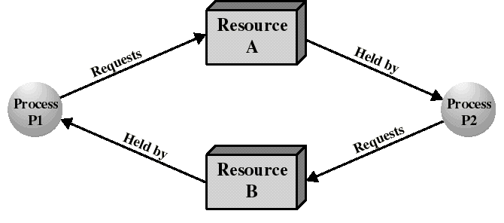
The Conditions for Deadlock
We also need the occurrence of a particular sequence of events that result in:
  4: Circular wait
    a closed chain of processes exists, such that each process holds at least one resource needed by the next process in the chain

Slide 7
The Conditions for Deadlock
Deadlock occurs if and only if the circular wait condition is unresolvable
The circular wait condition is unresolvable when the first 3 policy conditions hold
Thus the 4 conditions taken together constitute necessary and sufficient conditions for deadlock

Slide 8
Methods for handling deadlocks
Deadlock prevention
  disallow 1 of the 4 necessary conditions of deadlock occurrence
Deadlock avoidance
  do not grant a resource request if this allocation might lead to deadlock
Deadlock detection
  always grant resource request when possible. But periodically check for the presence of deadlock and then recover from it

Slide 9
Deadlock Prevention
The OS is design in such a way as to exclude a priori the possibility of deadlock
Indirect methods of deadlock prevention:
  to disallow one of the 3 policy conditions
Direct methods of deadlock prevention:
  to prevent the occurrence of circular wait

Slide 10
Indirect methods of deadlock prevention
Mutual Exclusion
  cannot be disallowed
  ex: only 1 process at a time can write to a file
Hold-and-Wait
  can be disallowed by requiring that a process request all its required resources at one time
  block the process until all requests can be granted simultaneously
  process may be held up for a long time waiting for all its requests
  resources allocated to a process may remain unused for a long time. These resources could be used by other processes
  an application would need to be aware of all the resources that will be needed

Slide 11
Indirect methods of deadlock prevention
No preemption
  Can be prevented in several ways. But whenever a process must release a resource who’s usage is in progress, the state of this resource must be saved for later resumption.
  Hence: practical only when the state of a resource can be easily saved and restored later, such as the processor.

Slide 12
Direct methods of deadlock prevention
A protocol to prevent circular wait:
  define a strictly increasing linear ordering O() for resource types. Ex:
    R1: tape drives: O(R1) = 2
    R2: disk drives: O(R2) = 4
    R3: printers: O(R3) = 7
  A process initially request a number of instances of a resource type, say Ri. A single request must be issued to obtain several instances.
  After that, the process can request instances for resource type Rj if and only if O(Rj) > O(Ri)

Slide 13
Prevention of circular wait
Circular wait cannot hold under this protocol. Proof:
  Processes {P0, P1..Pn} are involved in circular wait iff Pi is waiting for Ri which is held by Pi+1 and Pn is waiting for Rn held which is held by P0 (circular waiting)

Slide 14
Prevention of circular wait
  under this protocol, this means:
    O(R0) < O(R1) < .. < O(Rn) < O(R0) impossible!
This protocol prevents deadlock but will often deny resources unnecessarily (inefficient) because of the ordering imposed on the requests

Slide 15
Deadlock Prevention: Summary
We disallow one of the 3 policy conditions or use a protocol that prevents circular wait
This leads to inefficient use of resources and inefficient execution of processes

Slide 16
Deadlock Avoidance
We allow the 3 policy conditions but make judicious choices to assure that the deadlock point is never reached
Allows more concurrency than prevention
Two approaches:
  do not start a process if it’s demand might lead to deadlock
  do not grant an incremental resource request if this allocation might lead to deadlock
In both cases: maximum requirements of each resource must be stated in advance

Slide 17
Resource types
Resources in a system are partitioned in resources types
Each resource type in a system exists with a certain amount. Let R(i) be the total amount of resource type i present in the system. Ex:
  R(main memory) = 128 MB
  R(disk drives) = 8
  R(printers) = 5
The partition is system specific (ex: printers may be further partitioned...)

Slide 18
Process initiation denial
Let C(k,i) be the amount of resource type i claimed by process k.
To be admitted in the system, process k must show C(k,i) for all resource types i
C(k,i) is the maximum value of resource type i permitted for process k.
Let U(i) be the total amount of resource type i unclaimed in the system:
  U(i) = R(i) - Σ_k C(k,i)

Slide 19
Process initiation denial
A new process n is admitted in the system only if C(n,i) <= U(i) for all resource type i
This policy ensures that deadlock is always avoided since a process is admitted only if all its requests can always be satisfied (no matter what will be their order)
A sub optimal strategy since it assumes the worst: that all processes will make their maximum claims together at the same time

Slide 20
Resource allocation denial: the banker’s algorithm
Processes are like customers wanting to borrow money (resources) to a bank...
A banker should not allocate cash when it cannot satisfy the needs of all its customers
At any time the state of the system is defined by the values of R(i), C(j,i) for all resource type i and process j and the values of other vectors and matrices.

Slide 21
The banker’s algorithm
We also need the amount allocated A(j,i) of resource type i to process j for all (j,i)
The total amount available of resource i is given by: V(i) = R(i) - Σ_k A(k,i)
We also use the need N(j,i) of resource type i required by process j to complete its task: N(j,i) = C(j,i) - A(j,i)
To decide if a resource request made by a process should be granted, the banker’s algorithm test if granting the request will lead to a safe state:
  If the resulting state is safe then grant request
  Else do not grant the request

Slide 22
The banker’s algorithm
A state is safe iff there exist a sequence {P1..Pn} where each Pi is allocated all of its needed resources to be run to completion
  ie: we can always run all the processes to completion from a safe state
The safety algorithm is the part that determines if a state is safe
Initialization:
  all processes are said to be “unfinished”
  set the work vector to the amount resources available: W(i) = V(i) for all i;

Slide 23
The banker’s algorithm
REPEAT: Find a unfinished process j such that N(j,i) <= W(i) for all i.
  If no such j exists, goto EXIT
  Else: “finish” this process and recover its resources: W(i) = W(i) + A(j,i) for all i. Then goto REPEAT
EXIT: If all processes have “finished” then this state is safe. Else it is unsafe.

Slide 24
The banker’s algorithm
Let Q(j,i) be the amount of resource type i requested by process j.
To determine if this request should be granted we use the banker’s algorithm:
  If Q(j,i) <= N(j,i) for all i then continue. Else raise error condition (claim exceeded).
  If Q(j,i) <= V(i) for all i then continue. Else wait (resource not yet available)
  Pretend that the request is granted and determine the new resource-allocation state:

Slide 25
The banker’s algorithm
    V(i) = V(i) - Q(j,i) for all i
    A(j,i) = A(j,i) + Q(j,i) for all i
    N(j,i) = N(j,i) - Q(j,i) for all i
  If the resulting state is safe then allocate resource to process j. Else process j must wait for request Q(j,i) and restore old state.

Slide 26
Example of the banker’s algorithm
We have 3 resources types with amount:
  R(1) = 9, R(2) = 3, R(3) = 6
and have 4 processes with initial state:
Claimed Allocated Available
R1 R2 R3
R1 R2 R3
R1 R2 R3
P1
P2
P3
P4
3 2 2
6 1 3
3 1 4
4 2 2
1 0 0
5 1 1
2 1 1
0 0 2
1 1 2
Suppose that P2 is requesting Q = (1,0,1). Should this request be granted?

Slide 27
Example of the banker’s algorithm
The resulting state would be:
Claimed Allocated Available
R1 R2 R3
R1 R2 R3
R1 R2 R3
P1
P2
P3
P4
3 2 2
6 1 3
3 1 4
4 2 2
1 0 0
6 1 2
2 1 1
0 0 2
0 1 1
This state is safe with sequence {P2, P1, P3, P4}. After P2, we have W = (6,2,3) which enables the other processes to finish. Hence: request granted.

Slide 28
Example of the banker’s algorithm
However, if from the initial state, P1 request Q = (1,0,1). The resulting state would be:
Claimed Allocated Available
R1 R2 R3
R1 R2 R3
R1 R2 R3
P1
P2
P3
P4
3 2 2
6 1 3
3 1 4
4 2 2
2 0 1
5 1 1
2 1 1
0 0 2
0 1 1
Which is not a safe state since any process to finish would need an additional unit of R1. Request refused: P1 is blocked.

Slide 29
banker’s algorithm: comments
A safe state cannot be deadlocked. But an unsafe state is not necessarily deadlocked.
  Ex: P1 from the previous (unsafe) state could release temporarily a unit of R1 and R3 (returning to a safe state)
  some process may need to wait unnecessarily
  sub optimal use of resources
All deadlock avoidance algorithms assume that processes are independent: free from any synchronization constraint

Slide 30
Deadlock Detection
Resource access are granted to processes whenever possible. The OS needs:
  an algorithm to check if deadlock is present
  an algorithm to recover from deadlock
The deadlock check can be performed at every resource request
Such frequent checks consume CPU time

Slide 31
A deadlock detection algorithm
Makes use of previous resource-allocation matrices and vectors
Marks each process not deadlocked. Initially all processes are unmarked. Then perform:
  Mark each process j for which: A(j,i) = 0 for all resource type i. (since these are not deadlocked)
  Initialize work vector: W(i) = V(i) for all i
  REPEAT: Find a unmarked process j such that Q(j,i) <= W(i) for all i. Stop if such j does not exists.
  If such j exists: mark process j and set W(i) = W(i) + A(j,i) for all i. Goto REPEAT
  At the end: each unmarked process is deadlocked

Slide 32
Deadlock detection: comments
Process j is not deadlocked when Q(j,i) <= W(i) for all i.
Then we are optimistic and assume that process j will require no more resources to complete its task
It will thus soon return all of its allocated resources. Thus: W(i) = W(i) + A(j,i) for all i
If this assumption is incorrect, a deadlock may occur later
This deadlock will be detected the next time the deadlock detection algorithm is invoked

Slide 33
Deadlock detection: example
Request Allocated Available
R1 R2 R3 R4 R5
R1 R2 R3 R4 R5
R1 R2 R3 R4 R5
P1
P2
P3
P4
0 1 0 0 1
0 0 1 0 1
0 0 0 0 1
1 0 1 0 1
1 0 1 1 0
1 1 0 0 0
0 0 0 1 0
0 0 0 0 0
0 0 0 0 1
Mark P4 since it has no allocated resources
Set W = (0,0,0,0,1)
P3’s request <= W. So mark P3 and set W = W + (0,0,0,1,0) = (0,0,0,1,1)
Algorithm terminates. P1 and P2 are deadlocked

Slide 34
Deadlock Recovery
Needed when deadlock is detected. The following approaches are possible:
  Abort all deadlocked processes (one of the most common solution adopted in OS!!)
  Rollback each deadlocked process to some previously defined checkpoint and restart them (original deadlock may reoccur)
  Successively abort deadlock processes until deadlock no longer exists (each time we need to invoke the deadlock detection algorithm)

Slide 35
Deadlock Recovery (cont.)
  Successively preempt some resources from processes and give them to other processes until deadlock no longer exists
    a process that has a resource preempted must be rolled back prior to its acquisition
For the 2 last approaches: a victim process needs to be selected according to:
  least amount of CPU time consumed so far
  least total resources allocated so far
  least amount of “work” produced so far...

Slide 36
An integrated deadlock strategy
We can combine the previous approaches into the following way:
  Group resources into a number of different classes and order them. Ex:
    Swappable space (secondary memory)
    Process resources (I/O devices, files...)
    Main memory...
  Use prevention of circular wait to prevent deadlock between resource classes
  Use the most appropriate approach for each class for deadlocks within each class

