Slide 1
Memory Management
Chapter 7

Slide 2
Memory Management
Is the task carried out by the OS and hardware to accommodate multiple processes in main memory
If only a few processes can be kept in main memory, then much of the time all processes will be waiting for I/O and the CPU will be idle
Hence, memory needs to be allocated efficiently in order to pack as many processes into memory as possible

Slide 3
Memory Management
In most schemes, the kernel occupies some fixed portion of main memory and the rest is shared by multiple processes

Slide 4
Memory Management Requirements
Relocation
  programmer cannot know where the program will be placed in memory when it is executed
  a process may be (often) relocated in main memory due to swapping
  swapping enables the OS to have a larger pool of ready-to-execute processes
  memory references in code (for both instructions and data) must be translated to actual physical memory address

Slide 5
Memory Management Requirements
Protection
  processes should not be able to reference memory locations in another process without permission
  impossible to check addresses at compile time in programs since the program could be relocated
  address references must be checked at run time by hardware

Slide 6
Memory Management Requirements
Sharing
  must allow several processes to access a common portion of main memory without compromising protection
    cooperating processes may need to share access to the same data structure
    better to allow each process to access the same copy of the program rather than have their own separate copy

Slide 7
Memory Management Requirements
Logical Organization
  users write programs in modules with different characteristics
    instruction modules are execute-only
    data modules are either read-only or read/write
    some modules are private others are public
  To effectively deal with user programs, the OS and hardware should support a basic form of module to provide the required protection and sharing

Slide 8
Memory Management Requirements
Physical Organization
  secondary memory is the long term store for programs and data while main memory holds program and data currently in use
  moving information between these two levels of memory is a major concern of memory management (OS)
    it is highly inefficient to leave this responsibility to the application programmer

Slide 9
Simple Memory Management
In this chapter we study the simpler case where there is no virtual memory
An executing process must be loaded entirely in main memory (if overlays are not used)
Although the following simple memory management techniques are not used in modern OS, they lay the ground for a proper discussion of virtual memory (next chapter)
  fixed partitioning
  dynamic partitioning
  simple paging
  simple segmentation

Slide 10
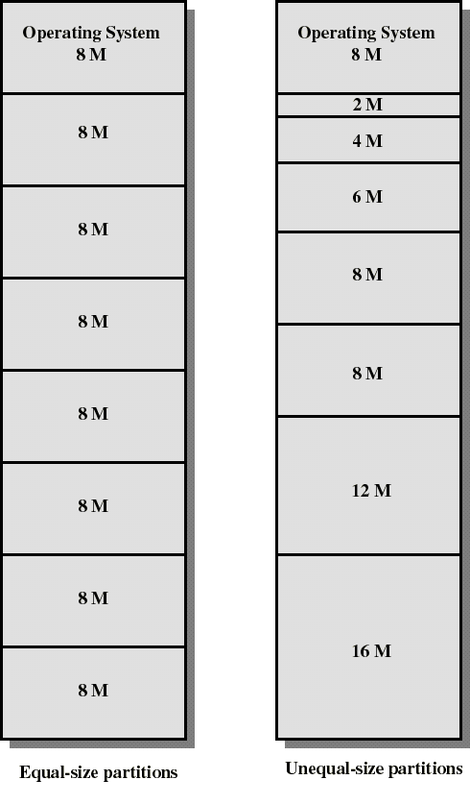
Fixed Partitioning
Partition main memory into a set of non overlapping regions called partitions
Partitions can be of equal or unequal sizes

Slide 11
Fixed Partitioning
any process whose size is less than or equal to a partition size can be loaded into the partition
if all partitions are occupied, the operating system can swap a process out of a partition
a program may be too large to fit in a partition. The programmer must then design the program with overlays
  when the module needed is not present the user program must load that module into the program’s partition, overlaying whatever program or data are there

Slide 12
Fixed Partitioning
Main memory use is inefficient. Any program, no matter how small, occupies an entire partition. This is called internal fragmentation.
Unequal-size partitions lessens these problems but they still remain...
Equal-size partitions was used in early IBM’s OS/MFT (Multiprogramming with a Fixed number of Tasks)

Slide 13
Placement Algorithm with Partitions
Equal-size partitions
  If there is an available partition, a process can be loaded into that partition
    because all partitions are of equal size, it does not matter which partition is used
  If all partitions are occupied by blocked processes, choose one process to swap out to make room for the new process

Slide 14
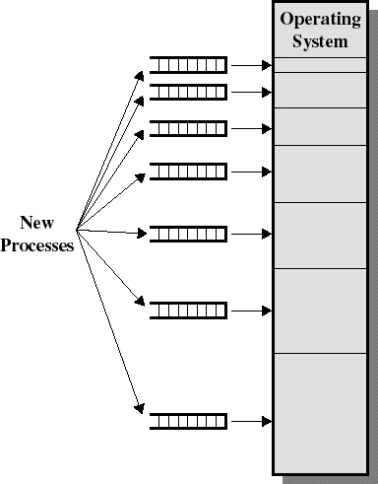
Placement Algorithm with Partitions
Unequal-size partitions: use of multiple queues
  assign each process to the smallest partition within which it will fit
  A queue for each partition size
  tries to minimize internal fragmentation
  Problem: some queues will be empty if no processes within a size range is present

Slide 15
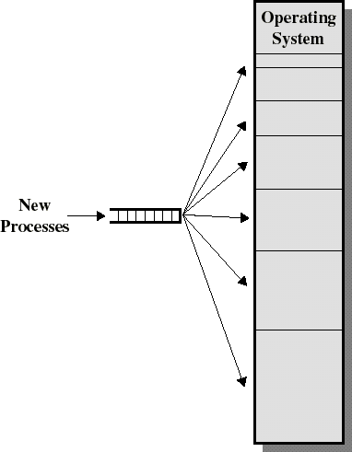
Placement Algorithm with Partitions
Unequal-size partitions: use of a single queue
  When its time to load a process into main memory the smallest available partition that will hold the process is selected
  increases the level of multiprogramming at the expense of internal fragmentation

Slide 16
Dynamic Partitioning
Partitions are of variable length and number
Each process is allocated exactly as much memory as it requires
Eventually holes are formed in main memory. This is called external fragmentation
Must use compaction to shift processes so they are contiguous and all free memory is in one block
Used in IBM’s OS/MVT (Multiprogramming with a Variable number of Tasks)

Slide 17
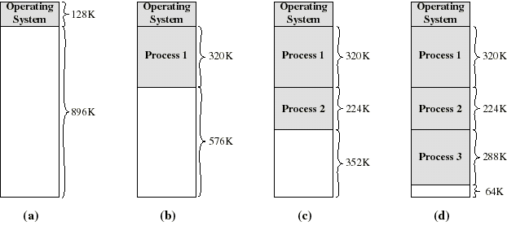
Dynamic Partitioning: an example
A hole of 64K is left after loading 3 processes: not enough room for another process
Eventually each process is blocked. The OS swaps out process 2 to bring in process 4

Slide 18
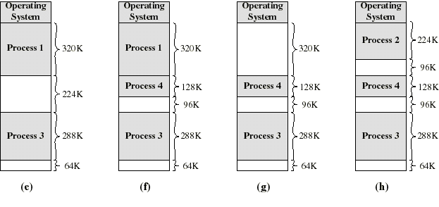
Dynamic Partitioning: an example
another hole of 96K is created
Eventually each process is blocked. The OS swaps out process 1 to bring in again process 2 and another hole of 96K is created...
Compaction would produce a single hole of 256K

Slide 19
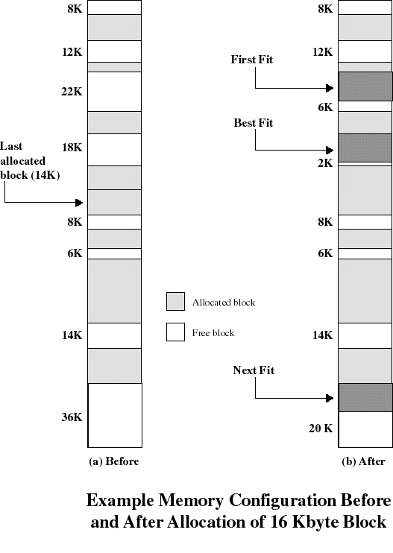
Placement Algorithm
Used to decide which free block to allocate to a process
Goal: to reduce usage of compaction (time consuming)
Possible algorithms:
  Best-fit: choose smallest hole
  First-fit: choose first hole from beginning
  Next-fit: choose first hole from last placement

Slide 20
Placement Algorithm: comments
Next-fit often leads to allocation of the largest block at the end of memory
First-fit favors allocation near the beginning: tends to create less fragmentation then Next-fit
Best-fit searches for smallest block: the fragment left behind is small as possible
  main memory quickly forms holes too small to hold any process: compaction generally needs to be done more often

Slide 21
Replacement Algorithm
When all processes in main memory are blocked, the OS must choose which process to replace
  A process must be swapped out (to a Blocked-Suspend state) and be replaced by a new process or a process from the Ready-Suspend queue
  We will discuss later such algorithms for memory management schemes using virtual memory

Slide 22
Buddy System
A reasonable compromize to overcome disadvantages of both fixed and variable partitionning schemes
A modified form is used in Unix SVR4 for kernal memory allocation
Memory blocks are available in size of 2^{K} where L <= K <= U and where
  2^{L} = smallest size of block allocatable
  2^{U} = largest size of block allocatable (generally, the entire memory available)

Slide 23
Buddy System
We start with the entire block of size 2^{U}
When a request of size S is made:
  If 2^{U-1} < S <= 2^{U} then allocate the entire block of size 2^{U}
  Else, split this block into two buddies, each of size 2^{U-1}
  If 2^{U-2} < S <= 2^{U-1} then allocate one of the 2 buddies
  Otherwise one of the 2 buddies is split again
This process is repeated until the smallest block greater or equal to S is generated
Two buddies are coalesced whenever both of them become unallocated

Slide 24
Buddy System
The OS maintains several lists of holes
  the i-list is the list of holes of size 2^{i}
  whenever a pair of buddies in the i-list occur, they are removed from that list and coalesced into a single hole in the (i+1)-list
Presented with a request for an allocation of size k such that 2^{i-1} < k <= 2^{i}:
  the i-list is first examined
  if the i-list is empty, the (i+1)-list is then examined...

Slide 25
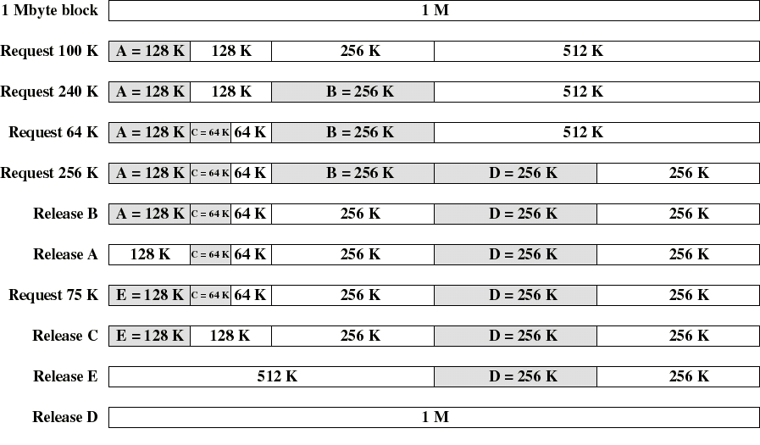
Example of Buddy System

Slide 26
Buddy Systems: remarks
On average, internal fragmentation is 25%
  each memory block is at least 50% occupied
Programs are not moved in memory
  simplifies memory management
Mostly efficient when the size M of memory used by the Buddy System is a power of 2
  M = 2^{U} “bytes” where U is an integer
  then the size of each block is a power of 2
  the smallest block is of size 1
  Ex: if M = 10, then the smallest block would be of size 5

Slide 27
Relocation
Because of swapping and compaction, a process may occupy different main memory locations during its lifetime
Hence physical memory references by a process cannot be fixed
This problem is solved by distinguishing between logical address and physical address

Slide 28
Address Types
A physical address (absolute address) is a physical location in main memory
A logical address is a reference to a memory location independent of the physical structure/organization of memory
Compilers produce code in which all memory references are logical addresses
A relative address is an example of logical address in which the address is expressed as a location relative to some known point in the program (ex: the beginning)

Slide 29
Address Translation
Relative address is the most frequent type of logical address used in pgm modules (ie: executable files)
Such modules are loaded in main memory with all memory references in relative form
Physical addresses are calculated “on the fly” as the instructions are executed
For adequate performance, the translation from relative to physical address must by done by hardware

Slide 30
Simple example of hardware translation of addresses
When a process is assigned to the running state, a base register (in CPU) gets loaded with the starting physical address of the process
A bound register gets loaded with the process’s ending physical address
When a relative addresses is encountered, it is added with the content of the base register to obtain the physical address which is compared with the content of the bound register
This provides hardware protection: each process can only access memory within its process image

Slide 31
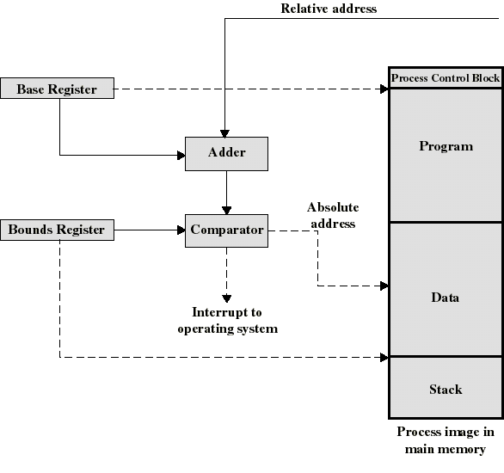
Example Hardware for Address Translation

Slide 32
Simple Paging
Main memory is partition into equal fixed-sized chunks (of relatively small size)
Trick: each process is also divided into chunks of the same size called pages
The process pages can thus be assigned to the available chunks in main memory called frames (or page frames)
Consequence: a process does not need to occupy a contiguous portion of memory

Slide 33
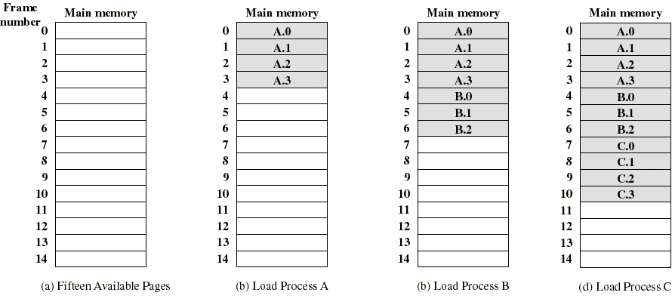
Example of process loading
Now suppose that process B is swapped out

Slide 34
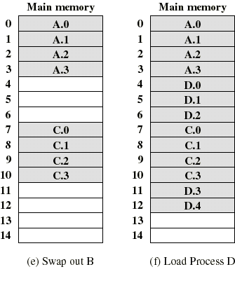
Example of process loading (cont.)
When process A and C are blocked, the pager loads a new process D consisting of 5 pages
Process D does not occupied a contiguous portion of memory
There is no external fragmentation
Internal fragmentation consist only of the last page of each process

Slide 35
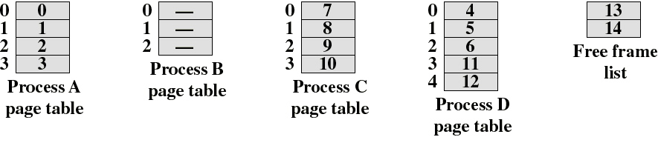
Page Tables
The OS now needs to maintain (in main memory) a page table for each process
Each entry of a page table consist of the frame number where the corresponding page is physically located
The page table is indexed by the page number to obtain the frame number
A free frame list, available for pages, is maintained

Slide 36
Logical address used in paging
Within each program, each logical address must consist of a page number and an offset within the page
A CPU register always holds the starting physical address of the page table of the currently running process
Presented with the logical address (page number, offset) the processor accesses the page table to obtain the physical address (frame number, offset)

Slide 37
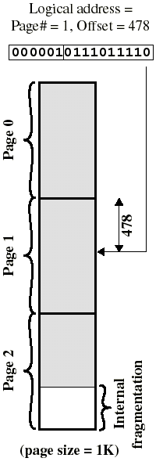
Logical address in paging
The logical address becomes a relative address when the page size is a power of 2
Ex: if 16 bits addresses are used and page size = 1K, we need 10 bits for offset and have 6 bits available for page number
Then the 16 bit address obtained with the 10 least significant bit as offset and 6 most significant bit as page number is a location relative to the beginning of the process

Slide 38
Logical address in paging
By using a page size of a power of 2, the pages are invisible to the programmer, compiler/assembler, and the linker
Address translation at run-time is then easy to implement in hardware
  logical address (n,m) gets translated to physical address (k,m) by indexing the page table and appending the same offset m to the frame number k

Slide 39
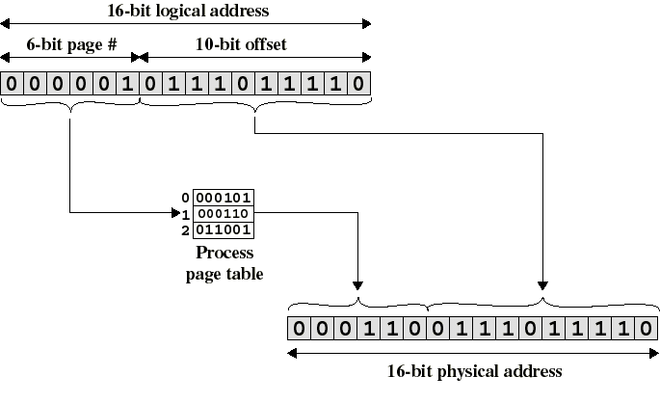
Logical-to-Physical Address Translation in Paging

Slide 40
Simple Segmentation
Each program is subdivided into blocks of non-equal size called segments
When a process gets loaded into main memory, its different segments can be located anywhere
Each segment is fully packed with instructs/data: no internal fragmentation
There is external fragmentation; it is reduced when using small segments

Slide 41
Simple Segmentation
In contrast with paging, segmentation is visible to the programmer
  provided as a convenience to organize logically programs (ex: data in one segment, code in another segment)
  must be aware of segment size limit
The OS maintains a segment table for each process. Each entry contains:
  the starting physical addresses of that segment.
  the length of that segment (for protection)

Slide 42
Logical address used in segmentation
When a process enters the Running state, a CPU register gets loaded with the starting address of the process’s segment table.
Presented with a logical address (segment number, offset) = (n,m), the CPU indexes (with n) the segment table to obtain the starting physical address k and the length l of that segment
The physical address is obtained by adding m to k (in contrast with paging)
  the hardware also compares the offset m with the length l of that segment to determine if the address is valid

Slide 43
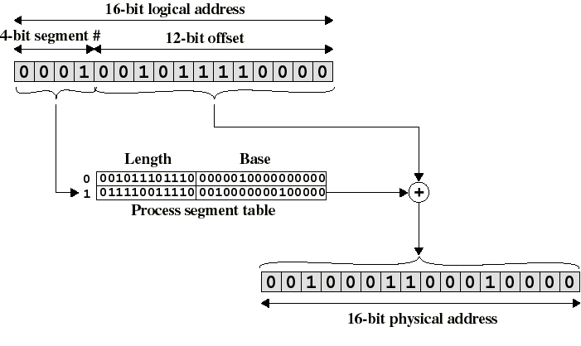
Logical-to-Physical Address Translation in segmentation

Slide 44
Simple segmentation and paging comparison
Segmentation requires more complicated hardware for address translation
Segmentation suffers from external fragmentation
Paging only yield a small internal fragmentation
Segmentation is visible to the programmer whereas paging is transparent
Segmentation can be viewed as commodity offered to the programmer to organize logically a program into segments and using different kinds of protection (ex: execute-only for code but read-write for data)
  for this we need to use protection bits in segment table entries

