Slide 1
Virtual Memory
Chapter 8

Slide 2
Characteristics of Paging and Segmentation
Memory references are dynamically translated into physical addresses at run time
  a process may be swapped in and out of main memory such that it occupies different regions
A process may be broken up into pieces (pages or segments) that do not need to be located contiguously in main memory
Hence: all pieces of a process do not need to be loaded in main memory during execution
  computation may proceed for some time if the next instruction to be fetch (or the next data to be accessed) is in a piece located in main memory

Slide 3
Process Execution
The OS brings into main memory only a few pieces of the program (including its starting point)
Each page/segment table entry has a present bit that is set only if the corresponding piece is in main memory
The resident set is the portion of the process that is in main memory
An interrupt (memory fault) is generated when the memory reference is on a piece not present in main memory

Slide 4
Process Execution (cont.)
OS places the process in a Blocking state
OS issues a disk I/O Read request to bring into main memory the piece referenced to
another process is dispatched to run while the disk I/O takes place
an interrupt is issued when the disk I/O completes
  this causes the OS to place the affected process in the Ready state

Slide 5
Advantages of Partial Loading
More processes can be maintained in main memory
  only load in some of the pieces of each process
  With more processes in main memory, it is more likely that a process will be in the Ready state at any given time
A process can now execute even if it is larger than the main memory size
  it is even possible to use more bits for logical addresses than the bits needed for addressing the physical memory

Slide 6
Virtual Memory: large as you wish!
  Ex: 16 bits are needed to address a physical memory of 64KB
  lets use a page size of 1KB so that 10 bits are needed for offsets within a page
  For the page number part of a logical address we may use a number of bits larger than 6, say 22 (a modest value!!)
The memory referenced by a logical address is called virtual memory
  is maintained on secondary memory (ex: disk)
  pieces are bring into main memory only when needed

Slide 7
Virtual Memory (cont.)
  For better performance, the file system is often bypassed and virtual memory is stored in a special area of the disk called the swap space
    larger blocks are used and file lookups and indirect allocation methods are not used
By contrast, physical memory is the memory referenced by a physical address
  is located on DRAM
The translation from logical address to physical address is done by indexing the appropriate page/segment table with the help of memory management hardware

Slide 8
Possibility of trashing
To accommodate as many processes as possible, only a few pieces of each process is maintained in main memory
But main memory may be full: when the OS brings one piece in, it must swap one piece out
The OS must not swap out a piece of a process just before that piece is needed
If it does this too often this leads to trashing:
  The processor spends most of its time swapping pieces rather than executing user instructions

Slide 9
Locality and Virtual Memory
Principle of locality of references: memory references within a process tend to cluster
Hence: only a few pieces of a process will be needed over a short period of time
Possible to make intelligent guesses about which pieces will be needed in the future
This suggests that virtual memory may work efficiently (ie: trashing should not occur too often)

Slide 10
Support Needed for
Virtual Memory
Memory management hardware must support paging and/or segmentation
OS must be able to manage the movement of pages and/or segments between secondary memory and main memory
We will first discuss the hardware aspects; then the algorithms used by the OS

Slide 11
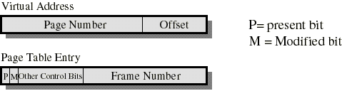
Paging
Typically, each process has its own page table
Each page table entry contains a present bit to indicate whether the page is in main memory or not.
  If it is in main memory, the entry contains the frame number of the corresponding page in main memory
  If it is not in main memory, the entry may contain the address of that page on disk or the page number may be used to index another table (often in the PCB) to obtain the address of that page on disk

Slide 12
Paging
A modified bit indicates if the page has been altered since it was last loaded into main memory
  If no change has been made, the page does not have to be written to the disk when it needs to be swapped out
Other control bits may be present if protection is managed at the page level
  a read-only/read-write bit
  protection level bit: kernel page or user page (more bits are used when the processor supports more than 2 protection levels)

Slide 13
Page Table Structure
Page tables are variable in length (depends on process size)
  then must be in main memory instead of registers
A single register holds the starting physical address of the page table of the currently running process

Slide 14
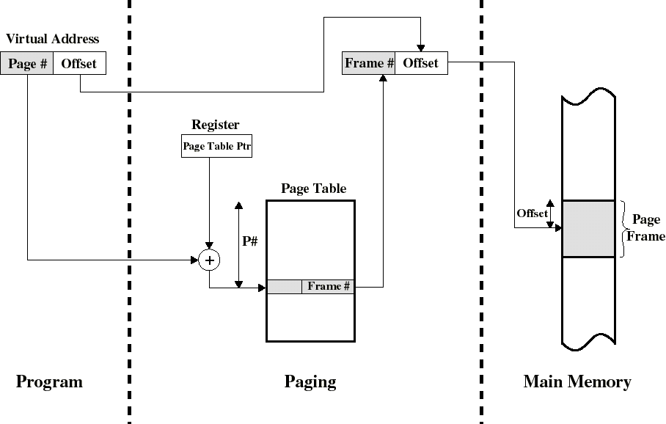
Address Translation in a Paging System

Slide 15
Sharing Pages
If we share the same code among different users, it is sufficient to keep only one copy in main memory
Shared code must be reentrant (ie: non self-modifying) so that 2 or more processes can execute the same code
If we use paging, each sharing process will have a page table who’s entry points to the same frames: only one copy is in main memory
But each user needs to have its own private data pages

Slide 16
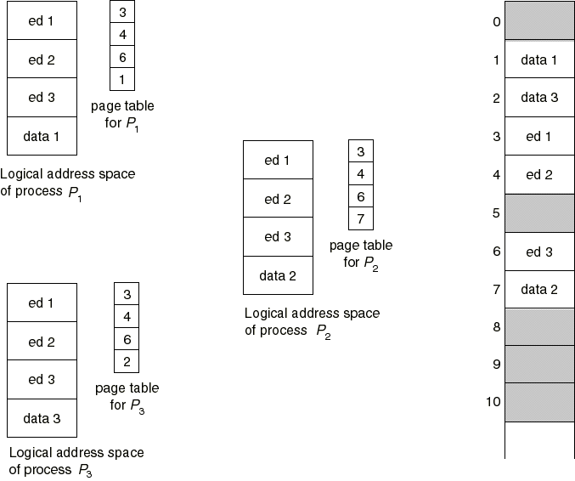
Sharing Pages: a text editor

Slide 17
Translation Lookaside Buffer
Because the page table is in main memory, each virtual memory reference causes at least two physical memory accesses
  one to fetch the page table entry
  one to fetch the data
To overcome this problem a special cache is set up for page table entries
  called the TLB - Translation Lookaside Buffer
    Contains page table entries that have been most recently used
    Works similar to main memory cache

Slide 18
Translation Lookaside Buffer
Given a logical address, the processor examines the TLB
If page table entry is present (a hit), the frame number is retrieved and the real (physical) address is formed
If page table entry is not found in the TLB (a miss), the page number is used to index the process page table
  if present bit is set then the corresponding frame is accessed
  if not, a page fault is issued to bring in the referenced page in main memory
The TLB is updated to include the new page entry

Slide 19
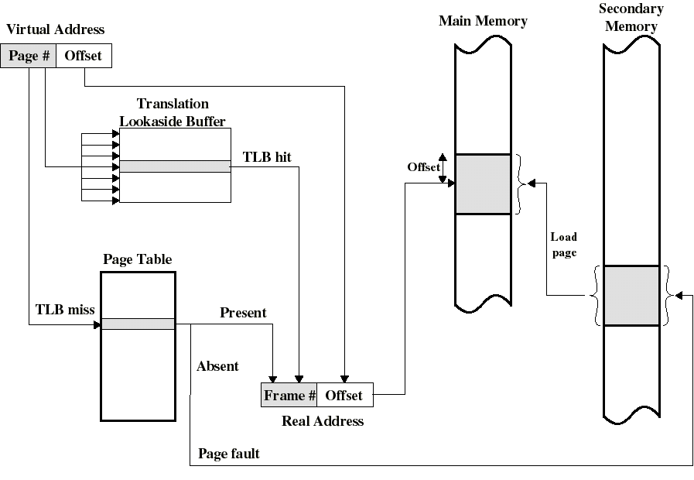
Use of a Translation Lookaside Buffer

Slide 20
TLB: further comments
TLB use associative mapping hardware to simultaneously interrogates all TLB entries to find a match on page number
The TLB must be flushed each time a new process enters the Running state
The CPU uses two levels of cache on each virtual memory reference
  first the TLB: to convert the logical address to the physical address
  once the physical address is formed, the CPU then looks in the cache for the referenced word

Slide 21
Page Tables and Virtual Memory
Most computer systems support a very large virtual address space
  32 to 64 bits are used for logical addresses
  If (only) 32 bits are used with 4KB pages, a page table may have 2^{20} entries
The entire page table may take up too much main memory. Hence, page tables are often also stored in virtual memory and subjected to paging
  When a process is running, part of its page table must be in main memory (including the page table entry of the currently executing page)

Slide 22
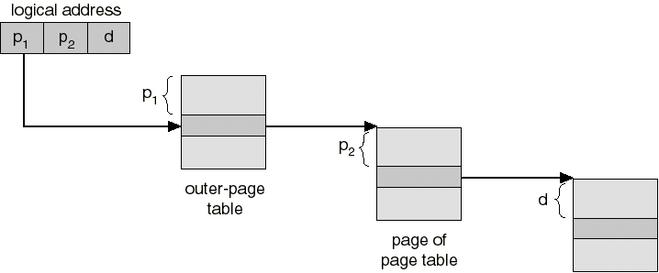
Multilevel Page Tables
Since a page table will generally require several pages to be stored. One solution is to organize page tables into a multilevel hierarchy
  When 2 levels are used (ex: 386, Pentium), the page number is split into two numbers p1 and p2
  p1 indexes the outer paged table (directory) in main memory who’s entries points to a page containing page table entries which is itself indexed by p2. Page tables, other than the directory, are swapped in and out as needed

Slide 23
Windows NT Virtual Memory (On Intel’s x86)
Uses paging only (no segmentation) with a 4KB page size
Each process has 2 levels of page tables:
  a page directory containing 1024 page-directory entries (PDEs) of 4 bytes each
  each page-directory entry points to a page table that contains 1024 page-table entries (PTEs) of 4 bytes each
  so we have 4MB of page tables per process
  the page directory is in main memory but page tables containing PTEs are swapped in and out as needed

Slide 24
Windows NT Virtual Memory (On Intel’s x86)
Virtual addresses (p1, p2, d) use 32 bits where p1 and p2 are each 10 bits wide
  p1 selects an entry in the page directory which points to a page table
  p2 selects an entry in this page table which points to the selected page
Upon creation, NT commits only a certain number of virtual pages to a process and reserves a certain number of other pages for future needs
Hence, a group of bits in each PTE indicates if the corresponding page is committed, reserved or not used

Slide 25
Windows NT Virtual Memory (On Intel’s x86)
A memory reference to an unused page traps into the OS (protection violation)
Each PTE also contains:
  a present bit
    If set: 20 bits are used for the frame address of the selected page.
    Else these bits are used to locate the selected page in a paging file (on disk)
  some bits identify the paging file used
  a dirty bit (ie: a modified bit)
  some protection bits (ex: read-only, or read-write)

Slide 26
Inverted Page Table
Another solution (PowerPC, IBM Risk 6000) to the problem of maintaining large page tables is to use an Inverted Page Table (IPT)
We generally have only one IPT for the whole system
There is only one IPT entry per physical frame (rather than one per virtual page)
  this reduces alot the amount of memory needed for page tables
The 1st entry of the IPT is for frame #1 ... the nth entry of the IPT is for frame #n and each of these entries contains the virtual page number
Thus this table is inverted

Slide 27
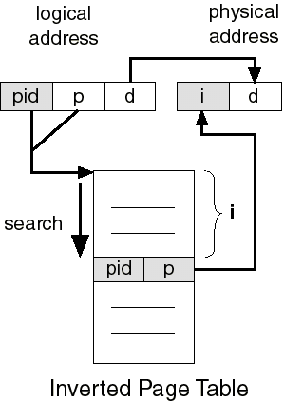
Inverted Page Table
The process ID with the virtual page number could be used to search the IPT to obtain the frame #
For better performance, hashing is used to obtain a hash table entry which points to a IPT entry
  A page fault occurs if no match is found
  chaining is used to manage hashing overflow

Slide 28
The Page Size Issue
Page size is defined by hardware; always a power of 2 for more efficient logical to physical address translation. But exactly which size to use is a difficult question:
  Large page size is good since for a small page size, more pages are required per process
    More pages per process means larger page tables. Hence, a large portion of page tables in virtual memory
  Small page size is good to minimize internal fragmentation
  Large page size is good since disks are designed to efficiently transfer large blocks of data
  Larger page sizes means less pages in main memory; this increases the TLB hit ratio

Slide 29
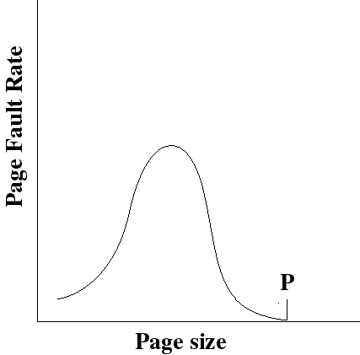
The Page Size Issue
With a very small page size, each page matches the code that is actually used: faults are low
Increased page size causes each page to contain more code that is not used. Page faults rise.
Page faults decrease if we can approach point P were the size of a page is equal to the size of the entire process

Slide 30
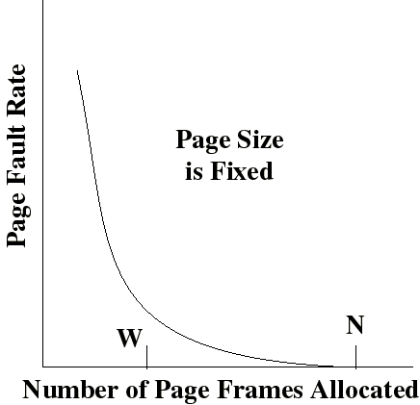
The Page Size Issue
Page fault rate is also determined by the number of frames allocated per process
Page faults drops to a reasonable value when W frames are allocated
Drops to 0 when the number (N) of frames is such that a process is entirely in memory

Slide 31
The Page Size Issue
Page sizes from 1KB to 4KB are most commonly used
But the issue is non trivial. Hence some processors are now supporting multiple page sizes. Ex:
  Pentium supports 2 sizes: 4KB or 4MB
  R4000 supports 7 sizes: 4KB to 16MB

Slide 32
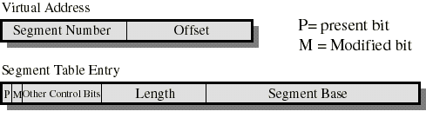
Segmentation
Typically, each process has its own segment table
Similarly to paging, each segment table entry contains a present bit and a modified bit
If the segment is in main memory, the entry contains the starting address and the length of that segment
Other control bits may be present if protection and sharing is managed at the segment level
Logical to physical address translation is similar to paging except that the offset is added to the starting address (instead of being appended)

Slide 33
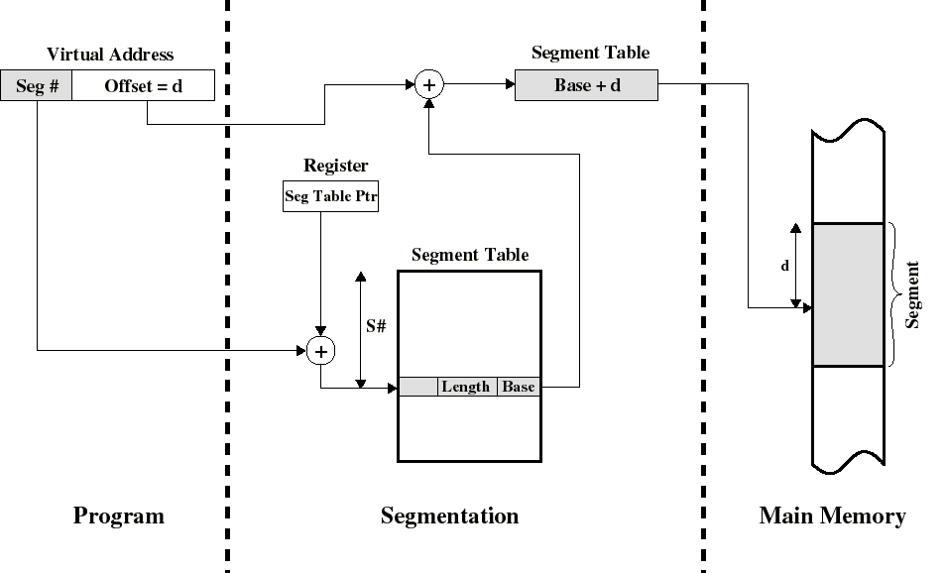
Address Translation in a Segmentation System

Slide 34
Segmentation: comments
In each segment table entry we have both the starting address and length of the segment
  the segment can thus dynamically grow or shrink as needed
  address validity easily checked with the length field
But variable length segments introduce external fragmentation and are more difficult to swap in and out...
It is natural to provide protection and sharing at the segment level since segments are visible to the programmer (pages are not)
Useful protection bits in segment table entry:
  read-only/read-write bit
  Supervisor/User bit

Slide 35
Sharing in Segmentation Systems
Segments are shared when entries in the segment tables of 2 different processes point to the same physical locations
Ex: the same code of a text editor can be shared by many users
  Only one copy is kept in main memory
but each user would still need to have its own private data segment

Slide 36
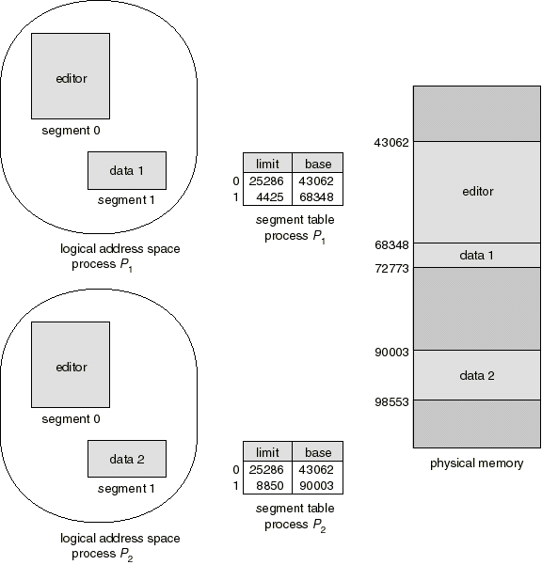
Sharing of Segments: text editor example

Slide 37
Combined Segmentation and Paging
To combine their advantages some processors and OS page the segments.
Several combinations exists. Here is a simple one
Each process has:
  one segment table
  several page tables: one page table per segment
The virtual address consist of:
  a segment number: used to index the segment table who’s entry gives the starting address of the page table for that segment
  a page number: used to index that page table to obtain the corresponding frame number
  an offset: used to locate the word within the frame

Slide 38
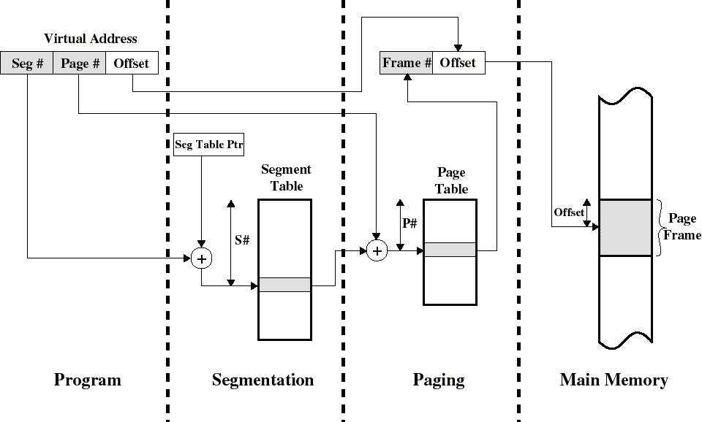
Address Translation in a (simple) combined Segmentation/Paging System

Slide 39
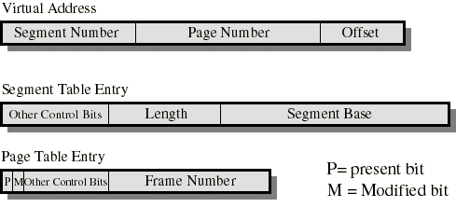
Simple Combined Segmentation and Paging
The Segment Base is the physical address of the page table of that segment
Present and modified bits are present only in page table entry
Protection and sharing info most naturally resides in segment table entry
  Ex: a read-only/read-write bit, a kernel/user bit...

Slide 40
Intel 386 segmentation and paging
In protected mode, the 386 (and up) uses a combined segmentation and paging scheme which is exploited by OS/2 (32-Bit version)
The logical address is a pair (selector, offset)
The selector contains a bit which selects either:
  the Global Descriptor Table; accessible by all processes
  the Local Descriptor Table; accessible only by the process who owns it (we have one LDT per process)
Two bits in the selector are for protection and the remaining 13 bits are use to select an 8-byte entry either in the LDT or the GDT called a descriptor

Slide 41
Intel 386 segmentation and paging
The 386 has 6 segment registers each having a 16-bit visible part that holds a selector and a 8-byte invisible part that contain the corresponding descriptor
  this avoids of having to read the LDT/GDT at each memory reference
The descriptor contains the base address and the length of the referenced segment
The 32-bit base address is added to the 32-bit offset to formed a 32-bit linear address (p1,p2,d) which is basically identical to the logical address format used by Windows NT
  2 levels of page tables indexed by p1 and p2 (10 bits each)

Slide 42
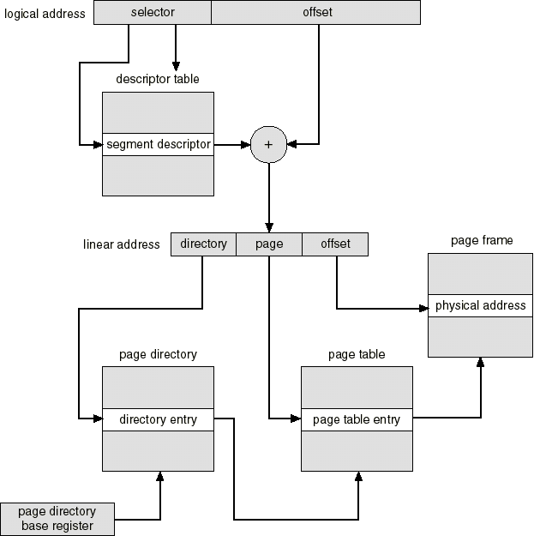
Intel 386 address translation

Slide 43
386 segmentation and paging: remarks
The segmentation part can be effectively disable by clearing the base address of each segment descriptor
Then the offset part of the logical address is identical to the linear address (p1,p2,d)
This is used by every OS that runs on 386 (and up) and uses only paging:
  Windows NT
  Unix versions: Linux, FreeBSD...

Slide 44
Operating System Software
Memory management software depends on whether the hardware supports paging or segmentation or both
Pure segmentation systems are rare. Segments are usually paged -- memory management issues are then those of paging
We shall thus concentrate on issues associated with paging
To achieve good performance we need a low page fault rate

Slide 45
Fetch Policy
Determines when a page should be brought into main memory. Two common policies:
  Demand paging only brings pages into main memory when a reference is made to a location on the page (ie: paging on demand only)
    many page faults when process first started but should decrease as more pages are brought in
  Prepaging brings in more pages than needed
    locality of references suggest that it is more efficient to bring in pages that reside contiguously on the disk
    efficiency not definitely established: the extra pages brought in are “often” not referenced

Slide 46
Placement policy
Determines where in real memory a process piece resides
For pure segmentation systems:
  first-fit, next fit... are possible choices (a real issue)
For paging (and paged segmentation):
  the hardware decides where to place the page: the chosen frame location is irrelevant since all memory frames are equivalent (not an issue)

Slide 47
Replacement Policy
Deals with the selection of a page in main memory to be replaced when a new page is brought in
This occurs whenever main memory is full (no free frame available)
Occurs often since the OS tries to bring into main memory as many processes as it can to increase the multiprogramming level

Slide 48
Replacement Policy
Not all pages in main memory can be selected for replacement
Some frames are locked (cannot be paged out):
  much of the kernel is held on locked frames as well as key control structures and I/O buffers
The OS might decide that the set of pages considered for replacement should be:
  limited to those of the process that has suffered the page fault
  the set of all pages in unlocked frames

Slide 49
Replacement Policy
The decision for the set of pages to be considered for replacement is related to the resident set management strategy:
  how many page frames are to be allocated to each process? We will discuss this later
No matter what is the set of pages considered for replacement, the replacement policy deals with algorithms that will choose the page within that set

Slide 50
Basic algorithms for the replacement policy
The Optimal policy selects for replacement the page for which the time to the next reference is the longest
  produces the fewest number of page faults
  impossible to implement (need to know the future) but serves as a standard to compare with the other algorithms we shall study:
    Least recently used (LRU)
    First-in, first-out (FIFO)
    Clock

Slide 51
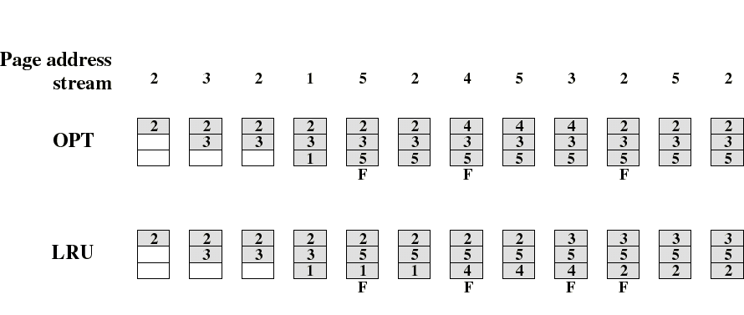
The LRU Policy
Replaces the page that has not been referenced for the longest time
  By the principle of locality, this should be the page least likely to be referenced in the near future
  performs nearly as well as the optimal policy
Example: A process of 5 pages with an OS that fixes the resident set size to 3

Slide 52
Note on counting page faults
When the main memory is empty, each new page we bring in is a result of a page fault
For the purpose of comparing the different algorithms, we are not counting these initial page faults
  because the number of these is the same for all algorithms
But, in contrast to what is shown in the figures, these initial references are really producing page faults

Slide 53
Implementation of the LRU Policy
Each page could be tagged (in the page table entry) with the time at each memory reference.
The LRU page is the one with the smallest time value (needs to be searched at each page fault)
This would require expensive hardware and a great deal of overhead.
Consequently very few computer systems provide sufficient hardware support for true LRU replacement policy
Other algorithms are used instead

Slide 54
The FIFO Policy
Treats page frames allocated to a process as a circular buffer
  When the buffer is full, the oldest page is replaced. Hence: first-in, first-out
    This is not necessarily the same as the LRU page
    A frequently used page is often the oldest, so it will be repeatedly paged out by FIFO
  Simple to implement
    requires only a pointer that circles through the page frames of the process

Slide 55

Comparison of FIFO with LRU
LRU recognizes that pages 2 and 5 are referenced more frequently than others but FIFO does not
FIFO performs relatively poorly

Slide 56
The Clock Policy
The set of frames candidate for replacement is considered as a circular buffer
When a page is replaced, a pointer is set to point to the next frame in buffer
A use bit for each frame is set to 1 whenever
  a page is first loaded into the frame
  the corresponding page is referenced
When it is time to replace a page, the first frame encountered with the use bit set to 0 is replaced.
  During the search for replacement, each use bit set to 1 is changed to 0

Slide 57
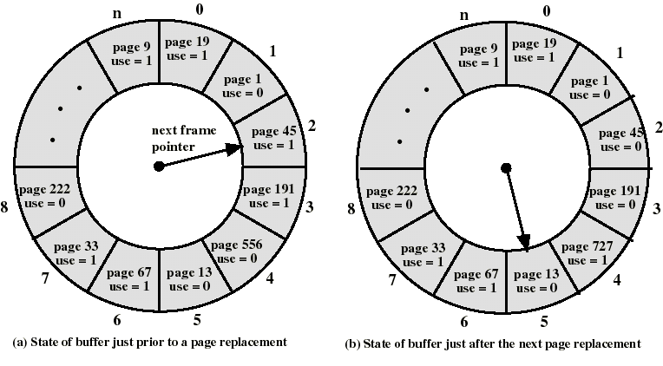
The Clock Policy: an example

Slide 58
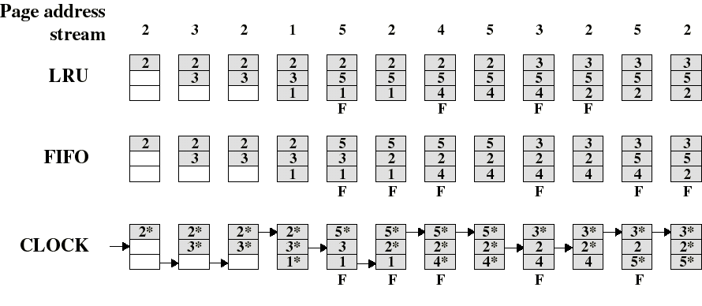
Comparison of Clock with FIFO and LRU
Asterisk indicates that the corresponding use bit is set to 1
Clock protects frequently referenced pages by setting the use bit to 1 at each reference

Slide 59
Comparison of Clock with FIFO and LRU
Numerical experiments tend to show that performance of Clock is close to that of LRU
Experiments have been performed when the number of frames allocated to each process is fixed and when pages local to the page-fault process are considered for replacement
  When few (6 to 8) frames are allocated per process, there is almost a factor of 2 of page faults between LRU and FIFO
  This factor reduces close to 1 when several (more than 12) frames are allocated. (But then more main memory is needed to support the same level of multiprogramming)

Slide 60
Page Buffering
Pages to be replaced are kept in main memory for a while to guard against poorly performing replacement algorithms such as FIFO
Two lists of pointers are maintained: each entry points to a frame selected for replacement
  a free page list for frames that have not been modified since brought in (no need to swap out)
  a modified page list for frames that have been modified (need to write them out)
A frame to be replace has a pointer added to the tail of one of the lists and the present bit is cleared in corresponding page table entry
  but the page remains in the same memory frame

Slide 61
Page Buffering
At each page fault the two lists are first examined to see if the needed page is still in main memory
  If it is, we just need to set the present bit in the corresponding page table entry (and remove the matching entry in the relevant page list)
  If it is not, then the needed page is brought in, it is placed in the frame pointed by the head of the free frame list (overwriting the page that was there)
    the head of the free frame list is moved to the next entry
  (the frame number in the page table entry could be used to scan the two lists, or each list entry could contain the process id and page number of the occupied frame)
The modified list also serves to write out modified pages in cluster (rather than individually)

Slide 62
Cleaning Policy
When does a modified page should be written out to disk?
Demand cleaning
  a page is written out only when it’s frame has been selected for replacement
    but a process that suffer a page fault may have to wait for 2 page transfers
Precleaning
  modified pages are written before their frame are needed so that they can be written out in batches
    but makes little sense to write out so many pages if the majority of them will be modified again before they are replaced

Slide 63
Cleaning Policy
A good compromise can be achieved with page buffering
  recall that pages chosen for replacement are maintained either on a free (unmodified) list or on a modified list
  pages on the modified list can be periodically written out in batches and moved to the free list
  a good compromise since:
    not all dirty pages are written out but only those chosen for replacement
    writing is done in batch

Slide 64
Resident Set Size
The OS must decide how many page frames to allocate to a process
  large page fault rate if to few frames are allocated
  low multiprogramming level if to many frames are allocated

Slide 65
Resident Set Size
Fixed-allocation policy
  allocates a fixed number of frames that remains constant over time
    the number is determined at load time and depends on the type of the application
Variable-allocation policy
  the number of frames allocated to a process may vary over time
    may increase if page fault rate is high
    may decrease if page fault rate is very low
  requires more OS overhead to assess behavior of active processes

Slide 66
Replacement Scope
Is the set of frames to be considered for replacement when a page fault occurs
Local replacement policy
  chooses only among the frames that are allocated to the process that issued the page fault
Global replacement policy
  any unlocked frame is a candidate for replacement
Let us consider the possible combinations of replacement scope and resident set size policy

Slide 67
Fixed allocation + Local scope
Each process is allocated a fixed number of pages
  determined at load time and depends on application type
When a page fault occurs: page frames considered for replacement are local to the page-fault process
  the number of frames allocated is thus constant
  previous replacement algorithms can be used
Problem: difficult to determine ahead of time a good number for the allocated frames
  if too low: page fault rate will be high
  if too large: multiprogramming level will be too low

Slide 68
Fixed allocation + Global scope
Impossible to achieve
  if all unlocked frames are candidate for replacement, the number of frames allocate to a process will necessary vary over time

Slide 69
Variable allocation + Global scope
Simple to implement--adopted by many OS (like Unix SVR4)
A list of free frames is maintained
  when a process issues a page fault, a free frame (from this list) is allocated to it
  Hence the number of frames allocated to a page fault process increases
  The choice for the process that will loose a frame is arbitrary: far from optimal
Page buffering can alleviate this problem since a page may be reclaimed if it is referenced again soon

Slide 70
Variable allocation + Local scope
May be the best combination (used by Windows NT)
Allocate at load time a certain number of frames to a new process based on application type
  use either prepaging or demand paging to fill up the allocation
When a page fault occurs, select the page to replace from the resident set of the process that suffers the fault
Reevaluate periodically the allocation provided and increase or decrease it to improve overall performance

Slide 71
The Working Set Strategy
Is a variable-allocation method with local scope based on the assumption of locality of references
The working set for a process at time t, W(D,t), is the set of pages that have been referenced in the last D virtual time units
  virtual time = time elapsed while the process was in execution (eg: number of instructions executed)
  D is a window of time
  at any t, |W(D,t)| is non decreasing with D
  W(D,t) is an approximation of the program’s locality

Slide 72
The Working Set Strategy
The working set of a process first grows when it starts executing
then stabilizes by the principle of locality
it grows again when the process enters a new locality (transition period)
  up to a point where the working set contains pages from two localities
then decreases after a sufficient long time spent in the new locality

Slide 73
The Working Set Strategy
the working set concept suggest the following strategy to determine the resident set size
  Monitor the working set for each process
  Periodically remove from the resident set of a process those pages that are not in the working set
  When the resident set of a process is smaller than its working set, allocate more frames to it
    If not enough free frames are available, suspend the process (until more frames are available)
      ie: a process may execute only if its working set is in main memory

Slide 74
The Working Set Strategy
Practical problems with this working set strategy
  measurement of the working set for each process is impractical
    necessary to time stamp the referenced page at every memory reference
    necessary to maintain a time-ordered queue of referenced pages for each process
  the optimal value for D is unknown and time varying
Solution: rather than monitor the working set, monitor the page fault rate!

Slide 75
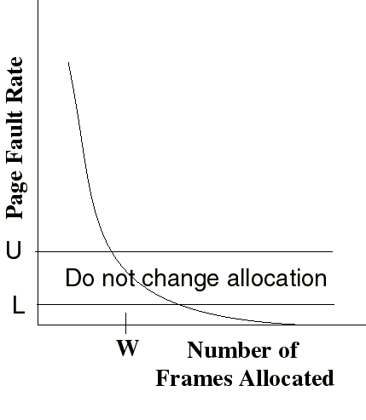
The Page-Fault Frequency Strategy
Define an upper bound U and lower bound L for page fault rates
Allocate more frames to a process if fault rate is higher than U
Allocate less frames if fault rate is < L
The resident set size should be close to the working set size W
We suspend the process if the PFF > U and no more free frames are available

Slide 76
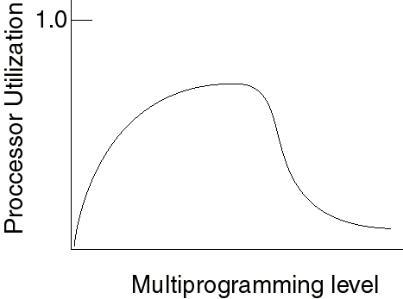
Load Control
Determines the number of processes that will be resident in main memory (ie: the multiprogramming level)
  Too few processes: often all processes will be blocked and the processor will be idle
  Too many processes: the resident size of each process will be too small and flurries of page faults will result: thrashing

Slide 77
Load Control
A working set or page fault frequency algorithm implicitly incorporates load control
  only those processes whose resident set is sufficiently large are allowed to execute
Another approach is to adjust explicitly the multiprogramming level so that the mean time between page faults equals the time to process a page fault
  performance studies indicate that this is the point where processor usage is at maximum

Slide 78
Process Suspension
Explicit load control requires that we sometimes swap out (suspend) processes
Possible victim selection criteria:
  Faulting process
    this process may not have its working set in main memory so it will be blocked anyway
  Last process activated
    this process is least likely to have its working set resident
  Process with smallest resident set
    this process requires the least future effort to reload
  Largest process
    will yield the most free frames

