Slide 1
Uniprocessor Scheduling
Chapter 9

Slide 2
CPU Scheduling
We concentrate on the problem of scheduling the usage of a single processor among all the existing processes in the system
The goal is to achieve
  High processor utilization
  High throughput
    number of processes completed per unit time
  Low response time
    time elapse from the submission of a request to the beginning of the response

Slide 3
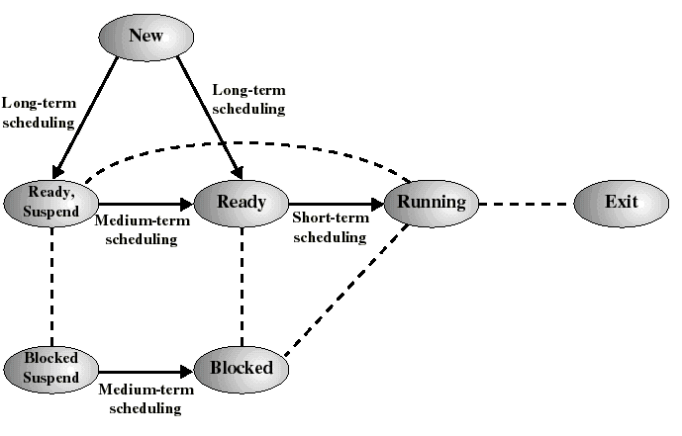
Classification of Scheduling Activity
Long-term: which process to admit
Medium-term: which process to swap in or out
Short-term: which ready process to execute next

Slide 4
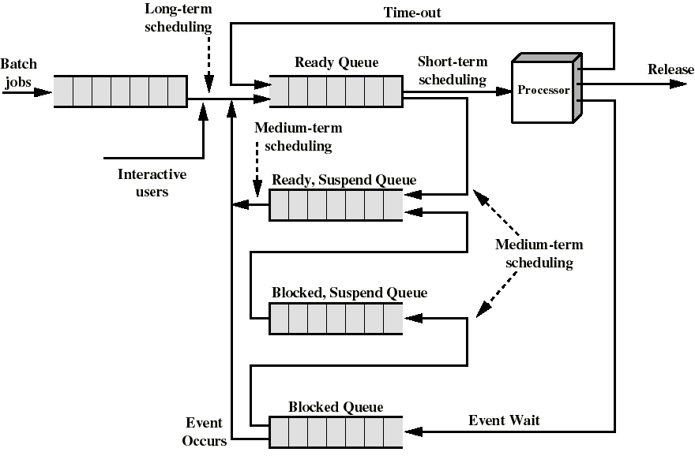
Queuing Diagram for Scheduling

Slide 5
Long-Term Scheduling
Determines which programs are admitted to the system for processing
Controls the degree of multiprogramming
If more processes are admitted
  less likely that all processes will be blocked
    better CPU usage
  each process has less fraction of the CPU
The long term scheduler may attempt to keep a mix of processor-bound and I/O-bound processes

Slide 6
Medium-Term Scheduling
Swapping decisions based on the need to manage multiprogramming
Done by memory management software and discussed intensively in chapter 8
  see resident set allocation and load control

Slide 7
Short-Term Scheduling
Determines which process is going to execute next (also called CPU scheduling)
Is the subject of this chapter
The short term scheduler is known as the dispatcher
Is invoked on a event that may lead to choose another process for execution:
  clock interrupts
  I/O interrupts
  operating system calls and traps
  signals

Slide 8
Short-Tem Scheduling Criteria
User-oriented
  Response Time: Elapsed time from the submission of a request to the beginning of response
  Turnaround Time: Elapsed time from the submission of a process to its completion
System-oriented
  processor utilization
  fairness
  throughput: number of process completed per unit time

Slide 9
Priorities
Implemented by having multiple ready queues to represent each level of priority
Scheduler will always choose a process of higher priority over one of lower priority
Lower-priority may suffer starvation
Then allow a process to change its priority based on its age or execution history
Our first scheduling algorithms will not make use of priorities
We will then present other algorithms that use dynamic priority mechanisms

Slide 10
Characterization of Scheduling Policies
The selection function: determines which process in the ready queue is selected next for execution
The decision mode: specifies the instants in time at which the selection function is exercised
  Nonpreemptive
    Once a process is in the running state, it will continue until it terminates or blocks itself for I/O
  Preemptive
    Currently running process may be interrupted and moved to the Ready state by the OS
    Allows for better service since any one process cannot monopolize the processor for very long

Slide 11
The CPU-I/O Cycle
We observe that processes require alternate use of processor and I/O in a repetitive fashion
Each cycle consist of a CPU burst (typically of 5 ms) followed by a (usually longer) I/O burst
A process terminates on a CPU burst
CPU-bound processes have longer CPU bursts than I/O-bound processes

Slide 12
Our running example to discuss various scheduling policies
Arrival
Time
Service
Time
Process
1
0
3
2
2
6
3
4
4
4
6
5
5
8
2
Service time = total processor time needed in one (CPU-I/O) cycle
Jobs with long service time are CPU-bound jobs
and are referred to as “long jobs”

Slide 13
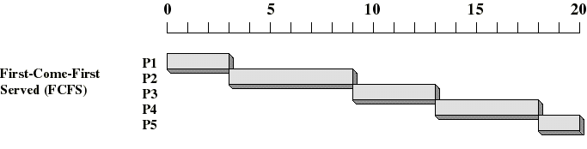
First Come First Served (FCFS)
Selection function: the process that has been waiting the longest in the ready queue (hence, FCFS)
Decision mode: nonpreemptive
  a process run until it blocks itself

Slide 14
FCFS drawbacks
A process that does not perform any I/O will monopolize the processor
Favors CPU-bound processes
  I/O-bound processes have to wait until CPU-bound process completes
  They may have to wait even when their I/O are completed (poor device utilization)
  we could have kept the I/O devices busy by giving a bit more priority to I/O bound processes

Slide 15
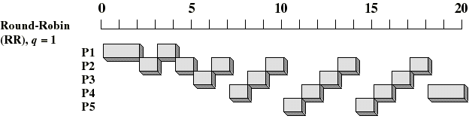
Round-Robin
Selection function: same as FCFS
Decision mode: preemptive
  a process is allowed to run until the time slice period (quantum, typically from 10 to 100 ms) has expired
  then a clock interrupt occurs and the running process is put on the ready queue

Slide 16
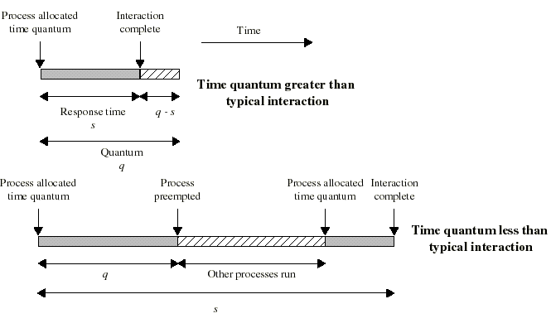
Time Quantum for Round Robin
must be substantially larger than the time required to handle the clock interrupt and dispatching
should be larger then the typical interaction (but not much more to avoid penalizing I/O bound processes)

Slide 17
Round Robin: critique
Still favors CPU-bound processes
  A I/O bound process uses the CPU for a time less than the time quantum and then is blocked waiting for I/O
  A CPU-bound process run for all its time slice and is put back into the ready queue (thus getting in front of blocked processes)
A solution: virtual round robin
  When a I/O has completed, the blocked process is moved to an auxiliary queue which gets preference over the main ready queue
  A process dispatched from the auxiliary queue runs no longer than the basic time quantum minus the time spent running since it was selected from the ready queue

Slide 18
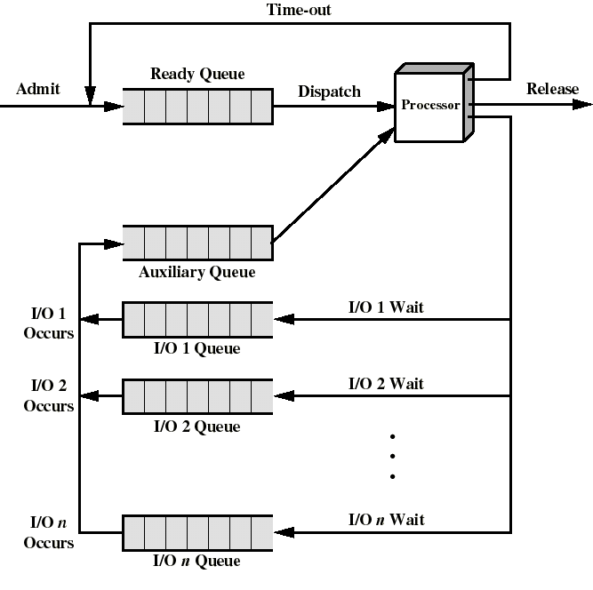
Queuing for Virtual Round Robin

Slide 19
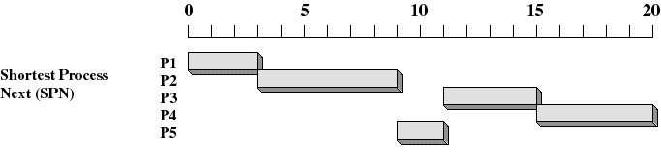
Shortest Process Next (SPN)
Selection function: the process with the shortest expected CPU burst time
Decision mode: nonpreemptive
I/O bound processes will be picked first
We need to estimate the required processing time (CPU burst time) for each process

Slide 20
Estimating the required CPU burst
Let T[i] be the execution time for the ith instance of this process: the actual duration of the ith CPU burst of this process
Let S[i] be the predicted value for the ith CPU burst of this process. The simplest choice is:
  S[n+1] = (1/n) Σ_{i=1 to n} T[i]
To avoid recalculating the entire sum we can rewrite this as:
  S[n+1] = (1/n) T[n] + ((n-1)/n) S[n]
But this convex combination gives equal weight to each instance

Slide 21
Estimating the required CPU burst
But recent instances are more likely to reflect future behavior
A common technique for that is to use exponential averaging
  S[n+1] = α T[n] + (1-α) S[n] ; 0 < α < 1
  more weight is put on recent instances whenever α > 1/n
By expanding this eqn, we see that weights of past instances are decreasing exponentially
  S[n+1] = αT[n] + (1-α)αT[n-1] + ... (1-α)^{i}αT[n-i] +
  ... + (1-α)^{n}S[1]
  predicted value of 1st instance S[1] is not calculated; usually set to 0 to give priority to to new processes

Slide 22
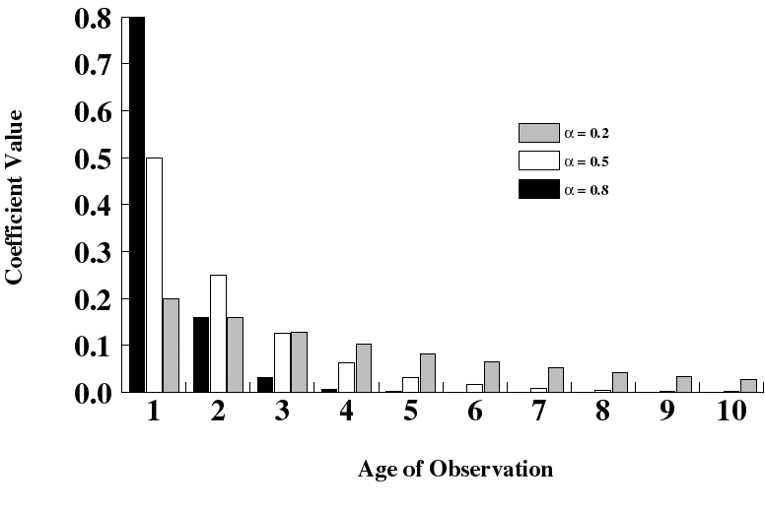
Exponentially Decreasing Coefficients

Slide 23
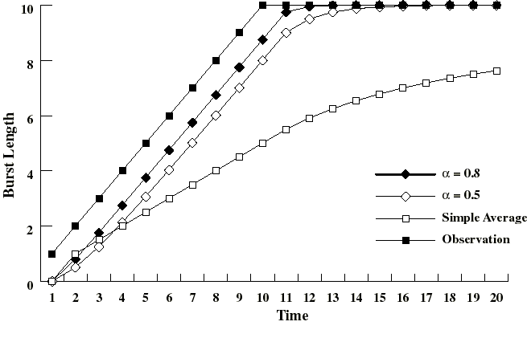
Exponentially Decreasing Coefficients
Here S[1] = 0 to give high priority to new processes
Exponential averaging tracks changes in process behavior much faster than simple averaging

Slide 24
Shortest Process Next: critique
Possibility of starvation for longer processes as long as there is a steady supply of shorter processes
Lack of preemption is not suited in a time sharing environment
  CPU bound process gets lower priority (as it should) but a process doing no I/O could still monopolize the CPU if he is the first one to enter the system
SPN implicitly incorporates priorities: shortest jobs are given preferences
The next (preemptive) algorithm penalizes directly longer jobs

Slide 25
Multilevel Feedback Scheduling
Preemptive scheduling with dynamic priorities
Several ready to execute queues with decreasing priorities:
  P(RQ0) > P(RQ1) > ... > P(RQn)
New process are placed in RQ0
When they reach the time quantum, they are placed in RQ1. If they reach it again, they are place in RQ2... until they reach RQn
I/O-bound processes will stay in higher priority queues. CPU-bound jobs will drift downward.
Dispatcher chooses a process for execution in RQi only if RQi-1 to RQ0 are empty
Hence long jobs may starve

Slide 26
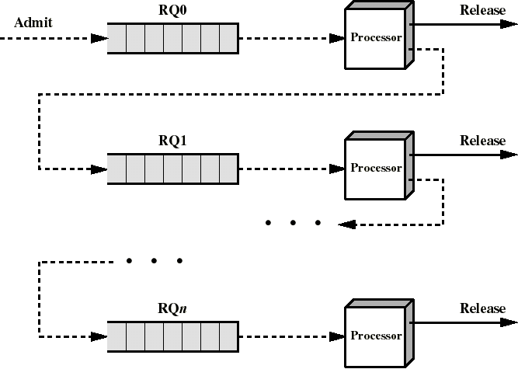
Multiple Feedback Queues
FCFS is used in each queue except for lowest priority queue where Round Robin is used

Slide 27
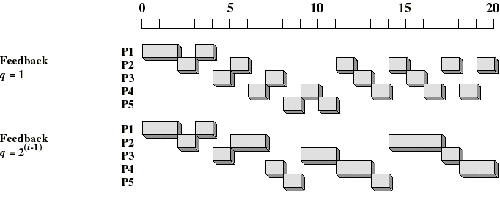
Time Quantum for feedback Scheduling
With a fixed quantum time, the turnaround time of longer processes can stretch out alarmingly
To compensate we can increase the time quantum according to the depth of the queue
  Ex: time quantum of RQi = 2^{i-1}
Longer processes may still suffer starvation. Possible fix: promote a process to higher priority after some time

Slide 28
Algorithm Comparison
Which one is best?
The answer depends on:
  on the system workload (extremely variable)
  hardware support for the dispatcher
  relative weighting of performance criteria (response time, CPU utilization, throughput...)
  The evaluation method used (each has its limitations...)
Hence the answer depends on too many factors to give any...

Slide 29
Fair Share Scheduling
In a multiuser system, each user can own several processes
Users belong to groups and each group should have its fair share of the CPU
This is the philosophy of fair share scheduling
Ex: if there are 4 equally important departments (groups) and one department has more processes than the others, degradation of response time should be more pronounced for that department

Slide 30
The Fair Share Scheduler (FSS)
Has been implemented on some Unix OS
Processes are divided into groups
Group k has a fraction Wk of the CPU
The priority Pj[i] of process j (belonging to group k) at time interval i is given by:
  Pj[i] = Bj + (1/2) CPUj[i-1] + GCPUk[i-1]/(4Wk)
    A high value means a low priority
    Process with highest priority is executed next
    Bj = base priority of process j
    CPUj[i] = Exponentially weighted average of processor usage by process j in time interval i
    GCPUk[i] = Exponentially weighted average processor usage by group k in time interval i

Slide 31
The Fair Share Scheduler (FSS)
The exponentially weighted averages use α = 1/2:
  CPUj[i] = (1/2) Uj[i-1] + (1/2) CPUj[i-1]
  GCPUk[i] = (1/2) GUk[i-1] + (1/2) GCPUk[i-1]
  where
    Uj[i] = processor usage by process j in interval i
    GUk[i] = processor usage by group k in interval i
Recall that
  Pj[i] = Bj + (1/2) CPUj[i-1] + GCPUk[i-1]/(4Wk)
The priority decreases as the process and group use the processor
With more weight Wk, group usage decreases less the priority

