Slide 1
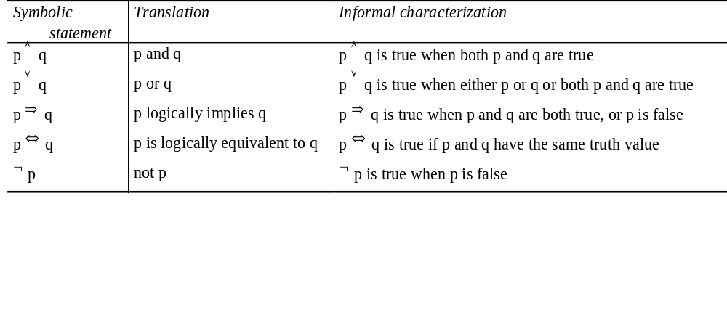
Logic - Propositional Logic
What is logic?
Propositions are statements that can be assigned a truth value
    Elephants are pink. true or false?
    Clyde is an elephant. true or false?
Operators for assigning truth values to combinations of propositions (sentences)
  If Clyde is an elephant and elephants are pink then Clyde is pink.

Slide 2
Logic - more formal → Predicate Logic
Involves entities and relations between entities.
Entities are expressed using:
  Variables : X, Y, Somebody, Anybody
  Constants : fido, fiffy, bigger, dog, has, bone
Logical operators (/logical constants) - connectors between relations
  and (∧), or(∨), not (¬), logically implies (⇒), logically equivalent (⇔), for all (∀), exists (∃)
Relations are expressed using:
  Predicates - express a simple relation among entities, or a property of some entity
    fido is a dog - dog(fido)
    fiffy is a dog - dog(fiffy)
    fido is bigger than fiffy - bigger(fido, fiffy)
  Formulae - express a more complex relation among entities
    if fido is bigger than fiffy, and fiffy has a bone, then fido can take the bone
    (bigger(fido, fiffy) ∧ has(fiffy,bone)) ⇒ can_take(fido,bone)
  Sentences - are formulae with no free variables

Slide 3
Logic - more formal → Prolog
Involves entities and relations between entities.
Entities are expressed using:
  Variables : X, Y, Somebody, Anybody
  Constants : fido, fiffy, bigger, dog, has, bone
  Note: There are no type definitions in logic
Logical operators (/logical constants) - connectors between relations
  and (,), or(;), not (not), is logically implied by (:-)
Relations are expressed using:
  Predicates - express a simple relation among entities, or a property of some entity
    fido is a dog - dog(fido)
    fido is bigger than fiffy - bigger(fido, fiffy)
  Rules - express a more complex relation among entities
    if fido is bigger than fiffy, and fiffy has a bone, then fido can take the bone
    can_take(fido,bone) :- bigger(fido,fiffy),has(fiffy,bone).
    Or more general:
    can_take(Dog1,bone) :- bigger(Dog1,Dog2), has(Dog2,bone).

Slide 4
History
Programming languages (computer architectures and design methods)
  conventional programming languages
  functional programming languages
  logical programming languages
Comparison
  variables
  instruction execution
  programming style
  program execution

Slide 5
Programming Comparison
Imperative and functional programming languages
‘procedural’ -> they describe how a sequence of instructions compute the result to a certain problem.
we concentrate on how to formulate a solution in terms of the primitive operations available
what you see is what is being done
Logical programming languages
specify the problem in a declarative style (facts about objects, relations between objects), describe what is the objective and sending this to the underlying system to prove it
the declarative approach lets us concentrate mostly on the nature of the problem
the program is just the surface, there are underlying mechanisms that help the program reach its goal

Slide 6
Logical Programming
A program in logic is a definition (declaration) of the world - establish the entities involved, and the relations between them.
Logical programs are used by establishing a theorem (goal/objective) and then asking the system to prove it, using the knowledge about the world from the programs
Satisfying the goal:
  yes, I can prove the goal using the information from the knowledge base
  no:
    I cannot prove the truth of the goal using the information from the knowledge base
    The goal is false according to the information available

Slide 7
Facts
Exams, assignments, taxes.
  exams.
  assignments.
  taxes
The earth is round. The sky is blue. The sun is hot.
  round(earth).
  blue(sky).
  hot(sun).
Beethoven was a composer that lived between 1770 and 1827.
  composer(beethoven,1770,1827).
fido is bigger than fiffy.
bigger(fido,fiffy)
  Exercise:
  John owns the book.
  John gives the book to Mary.
  This exercise is stupid.

Slide 8
Rules
They describe properties of the world that is being modeled (more complex relations between entities)
The general form of these properties
  p is true if (p₁ is true, and p₂ is true, and … and p_{n} is true)
Horn clause
  p :- p₁,p₂, … p_{n}.
Interpretation (Prolog) :
  in order to prove that p is true, the interpreter will decompose the problem in proving that each of p₁, p₂, … p_{n} is true
  p - the head of the rule
  p₁, p₂, … p_{n} - the body of the rule (subgoals)

Slide 9
Rules
If there is smoke there is fire
  fire :- smoke.
If the prof is boring, I leave
  leave(i) :- boring(prof).
Clifford is going to kill the teacher if he fails this course.
  kills(clifford, X) :- fails(clifford,csi2165), teaches(X,csi2165).
Exercises
1. Two intervals overlap if one border of one of them falls in between the other ones’ borders
2. Two persons are sisters if they are females and have the same parents.
Two people are contemporaries if their lives overlap.

Slide 10
Clauses
In Prolog, rules (and facts) are called `clauses`
Clause: <head> :- <body>
  you can conclude that <head> is true, if you can prove that <body> is true
Facts - clauses with an empty body: <head>
  you can conclude that <head> is true
Rules - normal clauses (full clauses)
Queries - clauses with an empty head: |?-<body>.
  Try to prove that <body> is true

Slide 11
Queries
The goal represented as a question.
  |?-round(earth). - is it true that the earth is round?
  (or simpler than that: is the earth round?)
  |?-round(X). - is it true that there are entities which are round?
  (or simpler than that: what entities are round?)
  |?-composer(beethoven,1770,1827). - is it true that beethoven was a composer who lived between 1770 and 1827)
  |?-owns(john,book). - is it true that john owns a book?
  (or simpler than that: does john own a book?)
  |?-owns(john,X). - is it true that john owns something?
  (or simpler than that: does john own something?)

Slide 12
Queries on Rules
Mary drinks beer. Terry drinks beer.
  drinks(mary,beer).
  drinks(terry,beer).
John likes everybody who drinks beer.
  likes(john,X) :- drinks(X,beer).
Does John like Mary?
  |?-likes(john,mary).
  yes
Who does John like?
  |?-likes(john,X).
  X = mary;
  X = terry;
  no

Slide 13
Queries on Facts
John likes apples, csi2165 and Mary.
  likes(john,apples).
  likes(john,csi2165).
  likes(john,mary).
Does John like apples?
  |?-likes(john,apples).
  yes
What does John like?
  |?-likes(john,X).
  X = apples;
  X = csi2165;
  X = mary;
  no

Slide 14
Example: A Prolog Program
Using a small database about composers and the date of their birth and death, find the pairs of contemporaries.
composer(beethoven,1770,1827).
composer(mozart,1756,1791).
composer(verdi,1813,1901).
composer(bach,1685,1750).
composer(haydn,1732,1809).
composer(vivaldi,1675,1741).
contemporaries(X,Y) :-
composer(X,B1,D1), composer(Y,B2,D2), X \= Y,
overlap(B1,D1,B2,D2).
overlap(B1,D1,B2,D2) :- B2 >= B1, B2 =< D1.
overlap(B1,D1,B2,D2) :- B1 >= B2, B1 =< D2.
facts
Program
rules

Slide 15
The Prolog Environment
Use a text editor to write a program
Load the program into the Prolog interpreter
Use the interpreter to query the program
{grd0}vnastase(3) prolog
Quintus Prolog Release 3.2 (Sun 4, SunOS 5.5)
Copyright (C) 1994, Quintus Corporation. All rights reserved.
301 East Evelyn Ave, Mountain View, California U.S.A. (415) 254-2800
Licensed to University of Ottawa
| ?- [example].
% compiling file /a/insite/users/vnastase/CSI2165C/example.pl
% example.pl compiled in module user, 0.010 sec 848 bytes
yes
| ?- composer(beethoven,B,D).
B = 1770,
D = 1827
| ?- contemporaries(beethoven,X).
X = mozart ;
X = verdi ;
X = haydn ;
no

Slide 16
Review
Predicates :
  composer(beethoven,1770,1827) → predicate
  composer → functor
  beethoven, 1770, 1827 → arguments
Rules :
  p :- p₁, p₂, … , p_{n}.
  p → head of the rule (is a predicate)
  p₁, p₂, … , p_{n} → the body of the rule (each p_{i} is a predicate)

Slide 17
Semantics - Declarative Semantics
Declarative semantics - telling Prolog what you know.
We usually tell Prolog what we know is true. ( if we don’t know if something is true, we assume it is false - closed world assumption)
Sometimes we tell it relations that we know are false. ( sometimes it is easier to show that the opposite of a relation is false, than to show that the relation is true)
I know (it is true) that the max between two numbers X and Y is X if X is bigger than Y.
  max(X,Y,X) :- X > Y.
  I know that the max between two numbers X and Y is Y if Y is bigger or equal to X.
  max(X,Y,Y) :- Y >= X.
  ?- max(1,2,X).
  __________________________________________________________
  I know that 0 is a positive integer.
  positive_integer(0).
  I know that X is a positive integer if there is another positive integer Y such that X is Y+1.
  positive_integer(X) :- positive_integer(Y), X is Y+1.
?- positive_integer(3).
?- positive_integer(X).

Slide 18
Semantics - Procedural Semantics
Procedural semantics - how do I prove a goal?
  max(X,Y,X) :- X > Y.
  max(X,Y,Y) :- Y >= X.
  ?- max(1,2,X).
  If I can prove that X is bigger then Y, then I can prove that the max between X and Y is X.
  or, if that doesn’t work,
  If I can prove that Y is bigger or equal to X, then I can prove that the max between X and Y is Y.
  ___________________________________
  positive_integer(0).
  positive_integer(X) :- positive_integer(Y), X is Y+1.
  ?- positive_integer(3).
  If I can prove that X is 0, then I can prove that X is a positive integer
  or,
  If I can prove that Y is a positive integer, and if X is Y+1, then I can prove that X is a positive integer.
  I can prove that Y is a positive integer if I can prove that Y is 0
  or
  If I can prove that Z is a positive integer, and if Y is Z+1, then I can prove ...

Slide 19
Example: Building a Knowledge Base
Genealogic Tree
Problem:1. build a knowledge base to represent the parent relationships that can be deduced from the tree
pam
tom
bob
bill
liz
Problem: 2. build predicates that describe the following family relationships:
grandparent/2
mother/2 father/2
brother/2 sister/2
aunt/2 uncle/2
ancestor/2
ann
pat
jim

Slide 20
Objects
Simple objects:
  constants :
    numbers (integer, floating point numbers)
    atoms (hello, *, ‘&?%’, ‘I`m not a variable’)
  variables:
    anonymous variables
    named variables
Complex objects
  lists
  other structures

Slide 21
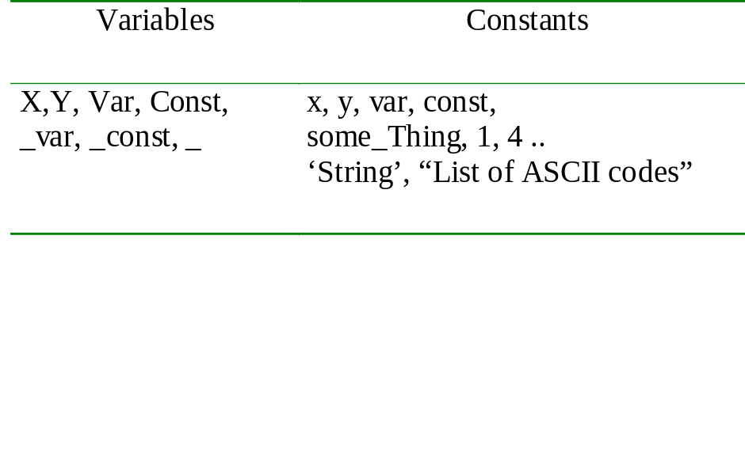
Variables
Names that stand for objects that may already or may not yet be determined by a Prolog program
  if the object a variable stands for is already determined, the variable is instantiated
  if the object a variable stands for is not yet determined, the variable is uninstantiated
a Prolog variable does not represent a location that contains a modifiable value, but it behaves more like a mathematical variable (and has the same scope)
An instantiated variable in Prolog cannot change its value
constants in Prolog : numbers, strings that start with a lowercase letter, anything between quotes (‘ or “)
variables in Prolog: names that start with an uppercase letter or with ‘_’
Examples:

Slide 22
Anonymous variables
a variable that stands in for some unknown object
is not instantiated to the object it stands in for
can stand in for non-identical objects
written _ in Prolog
|?- composer(X,_,_).
X = beethoven;
X = mozart;
…

Slide 23
Some Operators
for constants:
  number/1
  integer/1
  float/1
  atom/1
  atomic/1
Examples:
number(15) atom(my_atom).
number(0.001) atom(*)
number(4.2E+01) atom(`Even this?`)
integer(16) atom(15)
integer(1.0) atomic(a)
float(1) atomic(4)
float(1.5E-1) atomic(4.2E+01)
float(1.0)
for variables:
  var/1
  nonvar/1
  is/2
  =/2
  …
Examples:
var(X) X = abc, var(X)
var(x) X = abc, nonvar(X)
var(5) _ = abc, var(_)
nonvar(X) _ = abc, nonvar(_)
nonvar(abc) X is 5
Y = abc X is 5+1
Z = 4.2E+01 X = 5
var(X), X = abc X = 5+1 (number, atom,atomic ?)

Slide 24
Structures
Arguments of predicates are objects
Objects
  simple
  complex - structures
Structures - same form as predicates - we interpret them as objects
Actually, everything in Prolog is a structure !
Example:
  simple : 1st_may_1999
  complex: date(1,may,1999)
      happy(X) :- person(X), has(X,money).
  simple: ‘Vivi Nastase’
  complex: name(vivi,nastase)

Slide 25
Structures
Description:
  a person has:
    name - first name, last name
    birth date - day, month, year
    occupation
Prolog representation - example
  person(name(michael,jordan),birth_date(17,february,1963),occupation(`NBA player`))
functor arguments functor arguments functor argument
  functor arguments

Slide 26
Structures - exercise
Description:
  point in the 2D space
  rectangle
  triangle
  a country
    is located in a continent at a certain position
    has population
    has capital city which has a certain population
    has area

Slide 27
Structures - Exercise
Knowledge base:
  country(canada,location(america,north),population(25),capital(`Ottawa`,1),area(_)).
  country(usa,location(america,north),population(100),capital(`Washington DC`,17),area(_)).
Predicates:
  density/2
  bigger_country/2
  more_populated/2

Slide 28
Structures (a particular example)
How can we represent the courses a student takes?
  courses(csi2111, csi2114, csi2165)
  courses(csi2114, csi2115, csi2165, mat2343)
  courses(adm2302, csi2111, csi2114, csi2115, csi2165)
three different structures.
In general, how do we represent a variable number of arguments with a single structure?

Slide 29
Structures (a particular example - cont)
Consider a single structure courses/2:
the first argument - a course
the second argument - a courses/2 structure
courses( courses(
csi2111, csi2114,
courses( courses(
csi2114, csi2165,
courses( nil))
csi2165,
nil)))
That’s useful but too messy, better:
.(csi2111, .(csi2114, .(csi2165, nil)))
.(csi2114, .(csi2165, nil))

Slide 30
Lists
Functor name : .
Arity : 2
  first argument - can be anything - called the head of the list
  second argument - is be a list - called the tail of the list
Representing the lists:
  .(Head,Tail) = [Head|Tail] = [Head,HeadOfTail | TailOfTail] =
  [Head,HeadOfTail,HeadOfTailOfTail| TailOfTailOfTail] = … =
  [Head, Head1,Head2, …LastHead | []] = [Head, Head1, …, LastHead]
  (we don`t use `…` in representing lists, the form written above is just an example of how we can represent extensionally a list)

Slide 31
Lists
Examples:
  .(a,.(b,.(c,[])) = [a | [b,c]] = [a,b|[c]] = [a,b,c|[]] = [a,b,c] ;
  .(1, .(2, .(3, .))) = [1 | [2 | [3]]] = [1,2,3] ;
  .( name(homer,simpson), .(name(marge,simpson), .(name(bart,simpson), .(name(lisa,simpson), .(name(maggie,simpson), .))))) =
  [name(homer,simpson) | [name(marge,simpson) | […]]] =
  [name(homer,simpson), name(marge,simpson), …]
Exercise:
List Head Tail
[a,b,c]
[]
[[the,cat], sat]
[the, [cat, sat]]
[the, [dog, ate], bones]
[X+Y, x+y]

Slide 32
Operators for Structures
functor/3 :
  functor(name(vivi,nastase),Func,Arity).
  functor(a(_,_),Func,Arity)
  functor(Structure,country,4).
arg/3
  arg(1,name(michael,jordan),Arg1)
  arg(0,a(_,_),Arg0)
  arg(2,country(canada,location(america,north),_,_),Arg2)
=../2 - universal
  Term =.. [name,michael,jordan]
  date(1,may,1999) =.. [Functor|ArgList]

Slide 33
Matching, Unification and Instantiation
Prolog will try to find in the knowledge base a fact or a rule which can be used in order to prove a goal
Proving :
  match the goal on a fact or head of some rule. If matching succeeds, then:
  unify the goal with the fact or the head of the rule. As a result of unification:
  instantiate the variables (if there are any), such that the matching succeeds
  NB: variables in Prolog cannot change their value once they are instantiated !

Slide 34
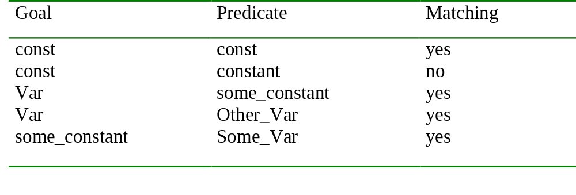
Matching
Matching: Prolog tries to find a fact or a head of some rule with which to match the current goal
Match: the functor and the arguments of the current goal, with the functor and the arguments of the fact or head of rule
Rules for matching :
  constants only match an identical constant
  variables can match anything, including other variables

Slide 35
Instantiation and Unification
Instantiation
the substitution of some object for a variable
a variable is instantiated to some object
composer(X,1770,1827) succeeds with X instantiated to beethoven
Unification
the instantiations done such that the two terms that match become identical
two terms match if:
  they are identical objects
  their constant parts are identical and their variables can be instantiated to the same object
  composer(X,1770,1827) unifies with composer(beethoven,1770,1827)
  with the instantiation X = beethoven

Slide 36
Unification
is done after Prolog has found a match between the current goal and a fact or the head of the rule
it attaches values to variables (instantiates the variables), such that the goal and the predicate are a perfect match:
  match:
    goal - composer(beethoven,B,D) with fact - composer(beethoven,1770,1827)
  unification:
    B will be instantiated to 1770
    D will be instantiated to 1827
  such that the goal will match the fact.
if the match is done on the head of some rule, then the instantiations done for the variables are also valid in the body of the rule:
  match:
    goal - contemporaries(beethoven,mozart) with head of rule - contemporaries(X,Y) :- composer(X,B1,D1), composer(Y,B2,D2), X \== Y, …
  unification:
    X will be instantiated to beethoven
    Y will be instantiated to mozart
    and now the rule will look:
    contemporaries(beethoven,mozart) :- composer(beethoven,B1,D1), composer(mozart,B2,D2), beethoven \== mozart, ...

Slide 37
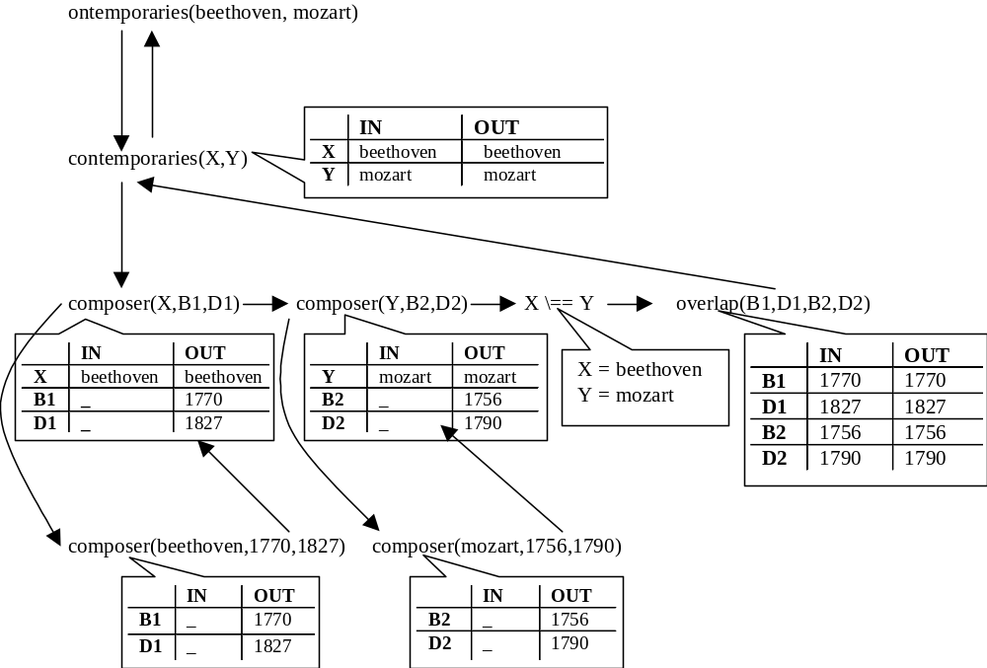
Unification
Facts : composer(beethoven,1770,1827). composer(mozart,1756,1790).
Rule: contemporaries(X,Y) :- composer(X,B1,D1), composer(Y,B2,D2), X \== Y, overlap(B1,D1,B2,D2).
Goal: ?-contemporaries(beethoven,mozart).

Slide 38
Instantiation and Unification - Exercise
unify with instantiations
donkey(X) donkey(calliope)
likes(jim,calliope) likes(jim,X)
likes(jim,X) likes(Y,calliope)
owns(X,Y) owns(jim,calliope)
owns(X,Y) owns(Y,X)
owns(jim,calliope) likes(jim,calliope)
owns(jim,calliope) owns(bill,calliope)
owns(jim,X,Y) owns(jim,calliope)

Slide 39
Structures Matching and Unification
Matching on structures:
  match the functor of the two structures
  match each argument of the two structures (if some argument is complex, match it according to the same rules)
Example:
  a(b,c) a(b,c) → match
  a(b,C) a(b,x) → C = x
  a(X) a(B,c) → don`t match

Slide 40
Structure Matching and Unification
Examples (assume the query is:
|? - Structure1 = Structure2.,
where the Structures take the form below)
Structure 1 = Structure 2: Instantiations:
a(b, X) = a(Y, c)
a(b, X) = a(X, Y)
a(b, X) = a(b, c(d))
a(b(X), Y) = a(Y, c)
a(b(c(X)), Y) = a(b(Y),c(Z))
a(b(c(X)), Y) = a(b(Y), Z)
[X,Y] = [john, skates]
[cat] = [H|T]
[[the,Y]|Z] = [[X,hare],[is,here]]
[H|T] = a(b, c(d))
[n(X,Y),a(1)] = [Name,Age]
X = a(b,c(d))
a(b, c) = X(b, c)

Slide 41
Structures - An Example
flight(from(montreal,airport(mirabel,ymx)), to(new_york,airport(la_guardia,lga))).
flight(from(montreal,airport(mirabel,ymx)), to(new_york,airport(jfk,jfk))).
flight(from(montreal,airport(dorval,yul)), to(new_york,airport(jfk,jfk))).
flight(from(toronto,airport(lbp,yyz)), to(montreal,airport(mirabel,ymx))).
flight(from(toronto,airport(lbp,yyz)), to(amsterdam,airport(schiphol,ams))).
flight(from(montreal,airport(mirabel,ymx)), to(amsterdam,airport(schiphol,ams))).
flight(from(new_york,airport(jfk,jfk)), to(berlin,airport(tempelhof,thf))).

Slide 42
Structures - An Example (cont)
Are there flights from Montreal to New York?
Which airport in Montreal do the flights to New York leave from?
Which airport in Montreal do the flights to New York leave from and which airport in New York do they arrive at?
Is there a flight to Berlin?
From where is there a flight to Berlin?
What is the name of the airport whose code is `ams` ?

Slide 43
Structures - Another View
We can view structures as trees:
person(name(michael,jordan),birth_date(17,february,1963),occupation(‘NBA player’))
.(football,.(tennis,.(formula1,.(basketball,[]))))
person
name
birth_date
occupation
michael jordan
17 february 1963
‘NBA player’
.
.
football
.
tennis
.
formula1
basketball
nil

Slide 44
Unification Operators - =
= \= = = \ = = is
= → unifies with : X = Y
  succeeds as long as X and Y can be unified
  X may or may not be instantiated
  Y may or may not be instantiated
  as a side effect, X and Y become bound together (they now refer to the same object)
|? - p1(a, [A, [B,C] ],25) = p1(C, [B, [D, E] ], 25).
A = B = D, C = E = a.
|? - a(b,X,c) = a(b,Y,c).
X = Y

Slide 45
Unification Operators - \=
\= → does not unify with : X \ = Y
  succeeds as long as X and Y cannot be unified
  both X and Y must be instantiated (why?)
  X and Y may have uninstantiated elements inside them
  no side effects
|? - [A, [B, C]] \= [A, B, C].
yes
|? - a(b,X,c) \= a(b,Y,c).
no

Slide 46
Unification Operators - ==
== → is already instantiated to: X == Y
  succeeds as long as X and Y are already instantiated to the same object
  in particular, any variable inside X and Y must be the same
  no side effects
|? - a(b,X,c) == a(b,Y,c).
no
|? - a(b,X,c) == a(b,X,c).
yes

Slide 47
Unification Operators - \==
\== → not already instantiated to: X \== Y
  succeeds as long as X and Y are not already instantiated to the same object
  no side effects
|? - A \== hello.
yes
|? - a(b,X,c) \== a(b,Y,c).
yes

Slide 48
Unification Operators - is
is → arithmetic evaluation : X is Exps
  succeeds a long as X and the arithmetic evaluation of Expr can be unified
  X may or may not be instantiated
  Expr must not contain any uninstantiated variables
  as a side effect, X is instantiated to the arithmetic evaluation of Expr
|? - 5 is ( ( 3 * 7 ) + 1 ) // 4
yes
|? - X is ( ( 3 * 4 ) +10) mod 6
X = 4

Slide 49
Some Predicates on Structures and Lists
is_list/1 - check that something is a list
is_structure/1 - check that something is a structure
add_em_up/2 - add the elements of a list of numbers
list_length/2 - compute the length of a list
member/2 - check that an element is a member of a list (assume list is flat)
member/2 - check that an element is a member of a list (can appear on any level)
member/2 - check that an element appears in a structure as an argument
appears/2 - check that an element appears in a structure - can also be a functor name
flatten/2 - flatten a list

Slide 50
Predicates for Structures and Lists is_list/1 and is_structure/1
A list is a particular kind of structure - it has a head which can be anything, and it has a tail which is also a list. It can also be empty :
is_list([]). The empty list is a list.
is_list([_|Tail]) :- is_list(Tail).
It is a structure that has a head and a tail, and the tail is also a list.
We are not interested in the values of the head and the tail, only in the fact that the argument has this particular format.
A structure has a particular format, too. It is composed of a functor and arguments (which can be themselves simple or structures, but that is of no interest to us when we check if an argument is a structure)
is_structure(My_Argument) :- functor(My_Argument,_,N), N > 0.
We are not interested in the name of the structure (its functor), we are interested just in the fact that our argument has a functor and has arguments, which tell us the fact that it is a structure.
Note: a list is a structure. (the functor is ‘.’, and it has 2 arguments - Head and Tail)

Slide 51
Predicates on Structures and Lists - member/2 (on lists)
An element is a member of a list if it is the first element in the list (head), or if it is somewhere in the rest of the list (tail).
A bit more formal:
member(X,List) if X is Head of List, or
member(X,List) if X is not the Head of List, but it is somewhere in the Tail of the List:
Prolog format:
member(X,[Head|Tail]) :- X = Head.
member(X,[Head|Tail]) :- X \= Head, member(X,Tail).
Because of the matching that Prolog does, we can simplify the above rules:
member(X,[X|_]). because at this point X is matched on the Head of the list, and if the matching succeeds, then we are not interested in the rest of the list.
member(X,[_|Tail]) :- member(X,Tail).
  because if the first rule has not succeeded it means that X is different than the Head of the List, so we are not interested in it’s value. And that also means that we should look for X in the Tail of the list.

Slide 52
Predicates on Structures and Lists - list_length/2
The length of an empty list is 0.
The length of a general list is the length of the Tail of the list, plus 1 (the Head counts for one since it is one element).
list_length([],0).
list_length([_|Tail],ListLength) :-
list_length(Tail,TailLength),
ListLength is TailLength + 1.
(we are not interested in what the Head of the list is or its value, it just matters to us that there is one )

Slide 53
Backtracking - the hidden trick
What happens when a goal fails?
halve(L,FirstHalf,SecondHalf) :-
append(FirstHalf,SecondHalf,L),
length(FirstHalf,HalfLength),
length(SecondHalf,HalfLength).
In order for Prolog to satisfy the goal: halve(L, FirstHalf, SecondHalf),
it must satisfy the goal: 1. append(FirstHalf, SecongHalf, L)
then it must satisfy the goal: 2. length(FirstHalf, HalfLength)
then it must satisfy the goal: 3. length(SecondHalf, HalfLength)
1, 2, 3 are called subgoals of the parent goal halve(L, FirstHalf, Second Half)
whenever a subgoal is satisfied, Prolog marks the subgoal if there is another way it can be satisfied
if a subsequent subgoal fails (cannot be satisfied in any way), Prolog backtracks to the to the most recent marked subgoal
if no previous subgoals can be redone, the parent goal fails.

Slide 54
Backtracking
halve([1,2],FH,SH)
halve(L,FirstHalf,SecondHalf) L = [1,2]
append(FirstHalf,SecondHalf,L) length(FirstHalf,HalfLength) length(SecondHalf,halfLength)
FirstHalf = [] HalfLength = 0 fail
SecondHalf = [1,2]
does not have another solution
FirstHalf = [1] HalfLength = 1 yes
SecondHalf = [2]

Slide 55
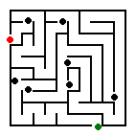
Backtracking
In the execution of a Prolog program, every time a certain
rule for a predicate is used, a choice is made - from all the
rules, this particular one was chosen. There are others to try
so if this one doesn’t lead to the right answer, we can come
back, and try the other possibilities - just like an intersection.
halve1    append1  length  length  Answer
 append2    append1  length  length  Answer
 append2    append1  length  …
…
If we arrive at one point from where there is no way to go (a predicate that is false),
turn back step by step to a point where a choice was made, and try an alternative.

Slide 56
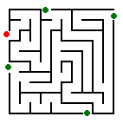
Backtracking
What happened in our previous examples when we pressed ‘;’?
When you press ‘;’is like you ask the system to find you another proof for the given goal.
To do that, it will ‘pretend’ that the last goal failed, and will try to satisfy it again.
It will stop when it has found another way to prove your goal, or if no such way was found.
There may be only one solution, or there may be many. We
can force backtracking, to find all solutions.

Slide 57
Backtracking - Example
likes(john,apples).
likes(john,csi2165)
likes(john,mary).
|? - likes(john,X).
First fact is found that matches the goal.
  → Unify likes(john,X) with likes(john,apples).
  → X is instantiated to apples
  → The goal has succeeded, the system prints out X = apples
We press ‘;’
  → the last goal failed (it is like the matching on the first fact has failed),
  → the variable becomes uninstantiated, and next facts are tried.
Second fact is found that matches the goal.
  → Unify likes(john,X) with likes(john,csi2165C).
  → X is instantiated to csi2165
  → The goal has succeeded, the system prints out X = csi2165
…

Slide 58
Backtracking - Example
member(X,[X|_]).
member(X,[_|Tail]) :- member(X,Tail).
?- member(X,[a,b,c]).
Find match - match with the head of the first rule
  → unify member(X,[a,b,c]) with member(X,[X|_])
  → instantiate X to a
  → (rule has no body and since matching has succeeded) goal has succeeded
  → display X = a
We press ‘;’
Find another match - match goal with head of second rule
  → unify member(X,[a,b,c]) with member(X,[_|Tail])
  → instantiate X to X, instantiate Tail to [b,c]
  → replace head of rule with the body, and try to satisfy the body of the rule
New goal (subgoal) member(X,[b,c])
Find match - match with head of the first rule
  → unify member(X,[b,c]) with member(X,[X|_])
  → instantiate X to b
  → (rule has no body and since matching has succeeded) goal has succeeded.
  → display X = b
…

Slide 59
Failure
When Prolog cannot satisfy a goal we say it fails.
We can force some predicate to fail
‘fail’ - built in Prolog predicate - it always fails
Example:
  |? - fail.
  |? - number(5).
  |? - number(5), fail.
  |? - number(abc).
  |? - number(abc), fail.
Why is such a predicate interesting?

Slide 60
Using ‘fail’ to Force Backtracking
How can we obtain all the solutions to a problem?
  We can press ‘;’
  We can use ‘fail’
Example:
  write everything that John likes:
    all_he_likes(Somebody) :- likes(Somebody,X), write(X),fail.
    all_he_likes(_).
  write all the elements of a list one by one:
    write_member(List) :- member(X,List), write(X),write(‘ ‘),fail.
    write_member(_).
  write all the decompositions of a list in two lists:
    decompose/1

Slide 61
Another Use for ‘fail’
We want a predicate consonant/1 which tells us whether the argument is a consonant or not.
There are around 20 consonants, but fortunately there are only 5 vowels. Everything that is not a vowel is a consonant (we assume)
  vowel(a).
  vowel(e).
  vowel(i).
  vowel(o).
  vowel(u).
  We could write the predicate consonant/1:
  if the argument is a vowel, then it is not a consonant (therefore it should fail)
  everything else is a consonant
  consonant(X) :- vowel(X), fail.
  consonant(_).
?

Slide 62
Cut
When the argument is a vowel, then we want the predicate to fail without trying any other way to satisfy the goal - cut the backtracking
Cut - ‘!’ - built in predicate that always succeeds
‘!’ has a very important side effect - cuts the backtracking
consonant(X) :- vowel(X),fail. consonant(X) :- vowel(X),!,fail.
consonant(_). consonant(_).

Slide 63
Cut
o(paper). b(X,Y,Z)
o(scissors).
o(rock).
o(X) ! p(Y,Z)
p(fred,wilma).
p(barney,betty). X = paper Y = fred
o(paper) Z = wilma
b(X,Y,Z) :- p(fred,wilma)
o(X) ,
!, Y = barney
p(Y,Z). Z = betty
p(barney,betty)

Slide 64
Cut
factorial/2:
  factorial(0,1) :- !.
  factorial(1,1) :- !.
  factorial(N,Result) :-
  N1 is N-1,
  factorial(N1,PrevResult),
  Result is PrevResult*N.

Slide 65
Cut
member(X,[X|_]).
member(X,[_|Tail]) :- member(X,Tail).
member(X,[X|_]) :- !.
member(X,[_|Tail]) :- member(X,Tail).
How do these two definitions of the member predicate behave differently?

Slide 66
Common Uses of ‘cut’
In places where we want to tell the Prolog system that it has found the right rule for a particular goal. Here the cut says: “if you get this far, you have picked the correct rule for this goal”
In places where we want to tell the system to fail a particular goal immediately without trying for alternative solutions. Here we use the cut in conjunction with the fail predicate to say: “if you get here, you should stop trying to satisfy this goal”
In places where we want to terminate the generation of alternative solutions through backtracking. Here the cut says: “ if you get here, you have found the only solution to this problem, and there is no point in ever looking for alternatives” (or maybe it is your choice to have only one solution to the problem)

Slide 67
Cut
Advantages of using cut:
  the program will be faster because it will not waste time attempting to satisfy goals that you can tell beforehand will never contribute to a solution
  the program may occupy less of the computer’s memory space because more economical use of memory can be made if backtracking points do not have to be recorded for later examination
  in some cases, including a cut may mean the difference between a program that will run and a program that will not
Disadvantage
  the program is less readable
  you should be careful using it, the program may not behave they way you want it to

Slide 68
Cut
Example: Adam and Eve had no parents. Everybody else has two.
  number_of_parents(adam,0) :- !.
  number_of_parents(eve,0) :- !.
  number_of_parents(X,2).
|? - number_of_parents(eve,X).
X = 0.
|? - number_of_parents( eve,2).

Slide 69
Cut
Alternative definition:
  number_of_parents(adam,N) :- !, N = 0.
  number_of_parents(eve,N) :- !, N = 0.
  number_of_parents(X,2).
Alternative definition:
  number_of_parents(adam,0).
  number_of_parents(eve,0).
  number_of_parents(X,2) :- X \= adam, X \= eve.
  (what would be the difference if the third rule was:
  number_of_parents(X,2) :- X \== adam, X \== eve. ? )

Slide 70
Closed World Assumption
Closed World Assumption means that Prolog’s world is closed : everything in the universe that is true is provable from the facts and rules in some knowledge base. Everything else is false.
Sometimes is easier, in order to prove that something is false, that its opposite is true and then negate it

Slide 71
Negation
In order to negate a goal:
  if it is true, the predicate should return false
  if it is false the predicate should return true.
  negate_goal(Goal) :-
  Goal,
  !,
  fail.
  negate_goal(_).
Built in prolog predicate that does negation: not
negate_goal(Goal) equivalent with not Goal

Slide 72
Negation
A letter is a consonant if it is not a vowel:
  vowel(a).
  vowel(e).
  vowel(i).
  vowel(o).
  vowel(u).
  consonant(X) :- not vowel(X).

Slide 73
Negation
not does not behave like a logic not
  likes(ken,beer).
  likes(rob,beer).
  likes(mom,juice).
  |? - not likes(ken, beer).
  |? - not likes(mom, beer).
  |? - likes(Who, beer).
  |? - not likes(Who, beer).

Slide 74
Clause Ordering
In order to satisfy a goal, Prolog will try to match it with each fact and head of rule in the knowledge base, and they are tried in the order in which they were written in the knowledge base (/file).
In pure logic programming, the order of clauses in a program should not affect the outcome of the program, but ...

Slide 75
Clause Ordering
Delete all occurrences of an element from a list:
  delete_all_1(E, [], []).
  delete_all_1(E, [E | Tail], List) :-
  delete_all_1(E, Tail, List).
  delete_all_1(E, [NotE | Tail], [NotE | NewTail]) :-
  delete_all_1(E, Tail, NewTail).
|? - delete_all_1(b, [a,b,c,d,b,e,b,f],X).

Slide 76
Clause Ordering
Another definition (we switch the order of the second and third rules in the previous definition):
  delete_all_2(E, [], []).
  delete_all_2(E, [NotE | Tail], [NotE | NewTail]) :-
  delete_all_2(E, Tail, NewTail).
  delete_all_2(E, [E | Tail], List) :-
  delete_all_2(E, Tail, List).
|? - delete_all_2(b, [a,b,c,d,b,e,b,f],X).

Slide 77
Clause Ordering
Yet another definition (same clause order as the previous definition, only that this time it works):
  delete_all_3(E, [], []).
  delete_all_3(E, [NotE | Tail], [NotE | NewTail]) :-
  E \== NotE,
  delete_all_3(E, Tail, NewTail).
  delete_all_3(E, [E | Tail], List) :-
  delete_all_3(E, Tail, List).
|? - delete_all_3(b, [a,b,c,d,b,e,b,f],X).

Slide 78
Clause Ordering as Control
person(adam, [tv, ‘21-25’, p1]).
person(beth, [reading, ‘16-20’, p2]).
person(carl, [music, ‘31-35’, p1]).
person(dave, [reading, ‘36-40’, p2]).
person(edna, [music, ‘31-35’, p2]).
person(fred, [music, ‘26-30’, p1]).
person(anna, [sports, ‘31-35’, p1]).
person(hank, [sports, ‘26-30’,p1]).
match_ person(Person1, Person2, HowWellTheyMatch) :-
person(Person1, Profile1),
person(Person2, Profile2),
Person1 \== Person2,
compare_profiles(Profile1, Profile2, HowWellTheyMatch).
compare_profiles([Int, Age, Type], [Int, Age, Type], perfect).
compare_profiles([Int, _, Type], [Int, _, Type], good).
compare_profiles([_, Age, Type], [_, Age, Type], ok).
compare_profiles([_, _, Type], [_, _, Type], basic).

Slide 79
Clause Ordering as Control
person(adam, [tv, ‘21-25’, p1]).
person(beth, [reading, ‘16-20’, p2]).
person(carl, [music, ‘31-35’, p1]).
person(dave, [reading, ‘36-40’, p2]).
person(edna, [music, ‘31-35’, p2]).
person(fred, [music, ‘26-30’, p1]).
person(anna, [sports, ‘31-35’, p1]).
person(hank, [sports, ‘26-30’,p1]).
match_ person(Person1, Person2, HowWellTheyMatch) :-
person(Person1, Profile1),
person(Person2, Profile2),
Person1 \== Person2,
compare_profiles(Profile1, Profile2, HowWelTheyMatch).
compare_profiles([Int, Age, Type], [Int, Age, Type], perfect) :- !.
compare_profiles([Int, _, Type], [Int, _, Type], good) :- !.
compare_profiles([_, Age, Type], [_, Age, Type], ok) :- !.
compare_profiles([_, _, Type], [_, _, Type], basic).

Slide 80
The Prolog Database
The facts and rules (clauses) in a Prolog program are often referred to as the Prolog Database. Querying the Prolog program is analogous to querying a database.
All the Prolog programs we have seen so far have been static databases: the facts and rules are entered by the programmer before execution, and remain unchanged during execution.
There are built in predicates that allow us to modify the database dynamically: assert/1 and retract/1
NB: assert/1 and retract/1 affect only the working memory of Prolog, not your program file

Slide 81
Assert
This built in predicate allows us to add clauses to the Prolog Database during execution.
There are three forms for this predicate:
  assert/1 → adds a clause at the end of the database
  asserta/1 → adds a clause at the beginning of the database
  assertz/1 → adds a clause at the end of the database

Slide 82
Assert
Example:
  plays(carol,bass).
  plays(benny,banjo).
  plays(mike,guitar).
|?- plays(Person,Instrument).
|?-assert(plays(ken,piano)).
|?-plays(Person,Instrument).

Slide 83
Retract
This predicate allows us to delete clauses. A handy feature of retract/1 is that it will instantiate any uninstantiated variables in its argument.
It is backtrackable!
It has only one form: retract/1 → it will retract the first clause that matches its argument.

Slide 84
Retract
Example:
  plays(carol,bass).
  plays(benny,banjo).
  plays(mike,guitar).
  plays(ken,piano).
?- retract(plays(Person,Instrument)).
?- retract(plays(mike,guitar)).

Slide 85
Example of Assert - Reducing the Complexity of a Program
The Fibonacci sequence - a sequence of numbers in which each number is the sum of the two previous numbers in the sequence
1, 1, 2, 3, 5, 8, 13, …
The standard recursive solution for finding the Nth number in the Fibonacci sequence:
fibonacci(1,1).
fibonacci(2,1).
fibonacci(N,FibN) :-
N1 is N-1,
N2 is N-2,
fibonacci(N1,FibN1),
fibonacci(N2,FibN2),
FibN is FibN1 + FibN2.
This program is extremely inefficient. How inefficient is it?

Slide 86
Example of Assert
To find out how inefficient fibonacci/2 is, we count how many recursive calls are involved in finding the Nth number in the sequence.
Counter:
  init_counter(Counter) :-
  CounterClause = ..[Counter,0],
  assert(CounterClause).
  incr_counter(Counter) :-
  CounterClause =.. [Counter,Value],
  retract(CounterClause),
  NewValue is Value+1,
  NewCounterClause =.. [Counter,NewValue],
  assert(NewCounterClause).

Slide 87
Example of Assert
We use the counter to count the recursive calls - before each recursive call we increment our counter (which was initialized at the beginning of the session).
fibonacci(1,1).
fibonacci(2,1).
fibonacci(N,FibN) :-
incr_counter(rec_calls),
N1 is N-1,
N2 is N-2,
fibonacci(N1,FibN1),
fibonacci(N2,FibN2),
FibN is FibN1 + FibN2.
(the incr_counter(rec_calls) subgoal assumes that there is a fact in the Prolog database rec_calls(Num). Num will get incremented every time Prolog enters the recursive clause of fibonacci/2. We must initialize (init_counter(rec_calls)) before using the fibonacci/2 program.)

Slide 88
Example of Assert
The problem with fibonacci/2 is the fact that it cannot remember the answers to previous calls, which means that it must recompute every number in the sequence each time it’s called. We can give it memory, though by using assert.
fibonacci(1,1).
fibonacci(2,1).
fibonacci(N,FibN) :-
incr_counter(rec_calls),
N1 is N-1,
N2 is N-2,
fibonacci(N1,FibN1),
fibonacci(N2,FibN2),
FibN is FibN1 + FibN2,
asserta(fibonacci(N,FibN)).
Now, whenever the program computes the Nth number in the sequence, it asserts it as a fibonacci/2 fact, before the other clauses for fibonacci/2.

Slide 89
Example of Assert - Results
?- init(rec_calls), fibonacci(7,F7), rec_calls(RC).
F7 = 13,
RC = 5
?- init(rec_calls), fibonacci(8,F8), rec_calls(RC).
F8 = 21,
RC = 1
?- init(rec_calls), fibonacci(20,F20), rec_calls(RC).
F20 = 6765,
RC = 12
?- init(rec_calls), fibonacci(30,F30), rec_calls(RC).
F30 = 832040,
RC = 10

Slide 90
Example of Retract
How can we find and keep all the solutions to some query?
  Find
    use ‘;’ - its manual
    use ‘fail’ - at each step the variables become uninstantiated
  Keep
    use assert to keep partial results in the memory

Slide 91
Example of Retract
likes(john,apples).
likes(john,2165).
likes(john,mary).
all_he_likes(X) :-
likes(X,Y),
write(X), write(‘ likes ‘), write(Y),nl,
fail.
all_he_likes(_).
find_all_he_likes(X,[Y|Rest]) :- find_all_he_likes(X,[Y|Rest]) :-
retract(likes(X,Y)), retract(likes(X,Y)),
find_all_he_likes(X,Rest). find_all_he_likes(X,Rest),
asserta(likes(X,Y)).
find_all_he_likes(_,[]). find_all_he_likes(_,[]).

Slide 92
Example of Retract
A general predicate : findall/3
findall(X,G,L)
X - a variable - input argument
G - a goal which contains X - input argument
L - a list which contains all the - output argument
values of X for which the
goal G is satisfied

Slide 93
Example of Retract - findall
findall(X,G,L) - solve in two steps:
  first - find and keep each instantiation for X for which G succeeds
    call the goal - since G contains the variable X, when the goal has succeeded it means that it has instantiated X
    assert the value of X, so that it can be found when needed
  second - gather the values of X in a list L
    go through all the values saved for X, and gather them in a list

Slide 94
Example of Retract - Findall
findall(X,G,_) :-
asserta(found(mark)),
call(G),
asserta(found(X)),
fail.
findall(_,_,L) :-
collect_found([],M),
!, L = M.
collect_found(S,L) :-
get_next(X), !,
collect_found([X|S],L).
collect_found(L,L).
get_next(X) :- retract(found(X)), !, X\== mark.

Slide 95
Other Examples
Reverse a list:
    reverse([],[]).
    reverse([H|T],Rev) :-
    reverse(T,RevTail),
    append(RevTail,[H],Rev).
The effects of assert/1 and retract/1 last only for the current session of work. We can use a file to store the additional assertions that we have made. We need input/output predicates.
reverse([],[]).
reverse([H|T],[X|Rev]) :-
assert(foo(H)),
reverse(T,Rev),
retract(foo(X)).

Slide 96
The clause/2 Predicate
clause(+Head,-Body) - unifies Head and Body with the respective head and body of a clause. Head must be instantiated.
Example:
  Suppose we have the rules for the member/2 predicate:
  member(X,[X|_]) :- !.
  member(X,[_|Tail]) :- member(X,Tail).
  ?-clause(member(X,Y), Body).
  X = _0084
  Y = [ _0084| _0128]
  Body = ! ;
  X = _0084
  Y = [ _0124| _0128]
  Body = member( _0084, _0128)

Slide 97
Input / Output - Character Input
get(?Char)
  Reads the next character from the standard input device (the keyboard) skipping non-printing characters (blanks,tabs, etc)
  Unifies the ASCII value of the character with Char
  |? - get(Char).
  A
  Char = 65
  |? - get(65).
  B
  no
  |? - get(Char).
  A
  Char = 65

Slide 98
Input / Output - Character Input
get0(?Char)
  Reads the next character from the standard input device (the keyboard) without skipping non-printing characters
  Unifies the ASCII value of the character with Char
  |? - get0(Char).
  A
  Char = 65
  |? - get(65).
  B
  no
  |? - get0(Char).
  % here I typed a space
  Char = 32
get0_noecho(?Char) - same as get0/1, only it does not echo the character to the standard output

Slide 99
Input/Output - Character Input - Example
Reading a sentence:
  get_sentence(Sentence) :-
  get0(FirstChar),
  get_characters(FirstChar,Sentence).
  get_characters(46,[46]) :- !. 46 is the ASCII code for ‘.’
  get_characters(Char, [Char|RestOfSentence]) :-
  get0(NextChar),
  get_characters(NextChar,RestOfSentence).

Slide 100
Input/Output - Character Input
name(?Atom,?List)
  converts an atom to a list of ASCII values, or viceversa
  converts a list of ASCII values to an atom
  |? - name(vivi,ViviList).
  ViviList = [118,105,118,105]
  |? - name(Atom,[65,66]).
  Atom = ‘AB’
  |? - get_sentence(S), name(A,S).

Slide 101
Input/Output - Character Output
put(+Char) - writes Char to the standard output device.
  getpasswd(Password) :-
  get0_noecho(FirstChar),
  getpwchars(FirstChar,Password).
  getpwchars(13,[]) :- !. - 13 is the code for <Enter>
  getpwchars(Char, [Char|RestOfPassword]) :-
  put(42), - 42 is the code for *
  get0_noecho(NextChar),
  getpwchars(NextChars,RestOfPassword).

Slide 102
Input/Output - Term Input
read(-Term) - reads a term from the standard input device
  |? - read(X).
  a(b,c,[atom]).
  X = a(b,c,[atom]).
  |? - read(X), functor(X,F,A).
  stru(arg,[1,2,3],argthree).
  X = stru(arg,[1,2,3],argthree)
  F = stru
  A = 3
  |? - read(X).
  4.2E+01.
  X = 42
  |? - read(X), Y is X.
  3 * 2 + 1.
  X = 3 * 2 + 1.
  Y = 7

Slide 103
Input/Output - Term Output
write(+Term) - writes the term Term to the standard output device
  |? - write(‘hello world!’).
  hello world!
  |? - write(4.2E+01).
  42.0
  |? - write([1,2,3,4]).
  [1,2,3,4]
nl - writes a newline to the standard output device
  |? - nl,nl,write(‘hello world!’),nl,nl.
  hello world!
  yes

Slide 104
Input/Output - Example
  likes(john, apples).
  likes(john,beer).
  likes(john,hockey).
  nice_writing :-
  likes(X,Y),
  write_nicely(likes,X,Y),
  fail.
  nice_writing.
  write_nicely(Functor,X,Y) :-
  convert(X,NewX),
  write(NewX), write(‘ ‘),write(Functor),write(‘ ‘), write(Y), write(‘.’),nl,
  !.
  convert(X,NewX) :-
  name(X,[First|Rest]),
  upper(First,Capital),
  name(NewX,[Capital|Rest]).
  upper(X,Y) :- Y is X - 32.

Slide 105
Input/Output - Redirecting
Redirecting standard output:
  tell(+Filename) - opens the file named Filename for writing and makes it the current output file (instead of the standard out)
  told - closes the file that was opened for writing by tell/1.
Redirecting standard input:
  see(+Filename) - opens the file named Filename for reading and makes it the current input file (instead of the standard in).
  seen - ends input from the file opened by see/1 and closes the file
  |? - see(‘facts.pl’),tell(‘see_tell_ex’),
  write_facts,
  seen,told.
  write_facts :-
  read(Fact),
  Fact =.. [Name,X,Y],
  write_nicely(Name,X,Y),
  write_facts.
  write_facts.

Slide 106
Explicit File Input/Output
open(-Handle,+Filename,+Access) → opens the file named Filename. Access can be:
  r → read
  w → write
  a → append
  rw → read/write
  ra → read/append
create(-Handle,+Filename) → opens a new file (whose name will be Filename) for writing. If a file named Filename already exists, the new file will overwrite the existing file
close(+Filename) → closes the file whose name is Filename

Slide 107
Reading Programs
consult(+Filename) - reads a program from a file
  effect: all clauses in the file Filename are read and will be used by Prolog when answering further questions from the user.
  if another file is ‘consulted’ at some later time during the same session, clauses from this new file are simply added at the end of the current set of clauses.
reconsult(+Filename) - similar to consult
  effect: if there are clauses in the file Filename

Slide 108
Data Types
Prolog is not a typed language like Pascal or C. That is, when we write a Prolog program, we can use objects without telling the interpreter what are the types of the objects.
But Prolog has a sort of typing: integer, float, atom, structure, list, …

Slide 109
Abstract Data Types
Built-in data types in a programming language are
  primitive (integer, float, atom) or
  complex (it is made up of other built-in types, either primitive or complex)
Abstract data-types are normally not built-in. They usually represent kinds of complex objects in the world and the operations that are performed on these objects.
There is no special notation for abstract data types in Prolog. The format of an abstract data type is arbitrary; its interpretation is based on convention.

Slide 110
Abstract Data Types
trees:
  create a new tree
  search through a tree for an element
  insert an element in a tree
  traverse a tree
  delete an element from a tree
stacks:
  create a new stack
  push an element onto a stack
  pop an element off a stack
queues:
  create a new queue
  add an element to the end of a queue
  remove an element from the front of a queue
  check the element at the front of a queue
  check if a queue is empty

Slide 111
Binary Trees
Each node in a binary tree has two children
The children are themselves binary trees (subtrees)
The empty tree is represented by nil
We use the following structure to represent binary trees:
  t( Node, LeftSubTree, RightSubTree)
Create a new binary tree with one node:
?-new_tree(10,Tree).
Tree = t(10,nil,nil)
new_tree(Root, t( Root, nil, nil) ).

Slide 112
Binary Trees
Check for the occurrence of element X in a binary tree:
member_of_tree(X, t( X, _, _) ) :- !.
member_of_tree(X, t( _, LeftSubTree, _) ) :-
member_of_tree(X, LeftSubTree).
member_of_tree(X, t( _, _, RightSubTree) ) :-
member_of_tree(X, RightSubTree).

Slide 113
Binary Trees
Insert a new node as the left (or right) child of some other node in a binary tree.
?-new_tree(10,T),
ins_left(5,10,T,T2),
ins_right(15,10,T2,T3),
ins_left(12, 15, T3, T4).
10
10
5
10
5
15
10
5
15
12

Slide 114
Binary Trees
ins_left( New, Node, t( Node, LT, RT), t( Node, t(New, LT, nil), RT) ).
ins_left( New, Node, t( Root, LT, RT), t( Root, NewLT, RT) ) :-
Root \= Node,
ins_left( New, Node, LT, NewLT).
ins_left( New, Node, t( Root, LT, RT), t( Root, LT, NewRT) ) :-
Root \= Node,
ins_left( New, Node, RT, NewRT).

Slide 115
Binary Trees
1
Traversing a tree:
  pre-order - visit the node,
then visit the left subtree,
then visit the right subtree
1, 2, 3, 4, 5, 6, 7
  in-order - visit the left subtree,
then visit the node,
visit the right subtree
3, 2, 1, 6, 5, 4, 7
  post-order - visit the left subtree,
then visit the right subtree,
then visit the node
3, 2, 6, 5, 7, 4, 1
2
4
3
5
7
6
1
2
4
3
5
7
6
1
2
4
3
5
7
6

Slide 116
Binary Trees
pre_order( nil, []).
pre_order( t( Node, LT, RT), [Node|Rest]) :-
pre_order( LT, LeftNodes),
pre_order( RT, RightNodes),
append( LeftNodes, RightNodes, Rest).
in_order( nil, []).
in_order( t( Node, LT, RT), NodesList) :-
in_order( LT, LeftNodes),
in_order( RT, RightNodes),
append( LeftNodes, [Node|RightNodes], NodesList).
post_order( nil, []).
post_order( t( Node, LT, RT), NodesList) :-
post_order( LT, LeftNodes),
post_order( RT, RightNodes),
append( LeftNodes, RightNodes, List),
append( List, [Node], NodesList).

Slide 117
Binary Trees
Search through a tree for a subtree that has a certain element as root:
search_tree( Root, t( Root, LT, RT), t( Root, LT, RT) ).
search_tree( Node, t( Root, LT, _), SubTree) :-
Node \= Root,
search_tree( Node, LT, SubTree).
search_tree( Node, t( Root, _, RT), SubTree) :-
Node \= Root,
search_tree(Node, RT, SubTree).

Slide 118
Binary Search Trees
Binary Search Trees (BST) are a special kind of binary trees - given any node N, all the nodes in the left subtree of N are less than N, and all the nodes in the right subtree of N are greater than N.
Inserting a node in a BST:
insert( Node, nil, bst( Node, nil, nil)).
insert( Node, bst( Node, LT, RT), bst( Node, LT, RT)).
insert(Node, bst( Root, LT, RT), bst( Root, NewLT, RT)) :-
Node < Root,
insert(Node, LT, NewLT).
insert( Node, bst( Root, LT, RT), bst( Root, LT, NewRT)) :-
Node > Root,
insert( Node, RT, NewRT).

Slide 119
Binary Search Trees
Delete a node from a binary search tree:
delete( Node, bst( Node, nil, nil), nil) :- !.
delete( Node, bst( Node, nil, RT), RT) :- !.
delete( Node, bst( Node, LT, RT), bst( MaxOfLT, NewLT, RT) ) :-
delete_max(LT, NewLT, MaxOfLT).
delete( Node, bst( Root, LT, RT), bst(Root, NewLT, RT) ) :-
Node < Root,
delete( Node, LT, NewLT).
delete( Node, bst( Root, LT, RT), bst( Root, LT, NewRT) ) :-
Node > Root,
delete( Node, RT, NewRT).
delete_max( bst( Root, LT, nil), LT, Root).
delete_max( bst( Root, LT, RT), bst( Root, LT, NewRT), Max) :-
RT \== nil,
delete_max( RT, NewRT, Max).

Slide 120
General Trees
In general, the nodes of a tree may have any number of children. We use a structure t( Node, Children) where Children is a list of subtrees ( t/2 structures)
The following tree could be used as a spell checker for the words be, bee, been, beer, bit, bite:
t( top, [ t( b,
[ t( e, [ nil,
t( e, [ nil,
t( n, [nil]),
t( r, [nil])],
[ t( i, [ t( t, [ nil,
t( e, [nil])] )] )] )] ).

Slide 121
Stacks
A stack is a list with a restriction on accessing the elements: the last element added to the list must be the first element to come out of the list.
  when we add an element, we push it onto the stack
  when we remove an element, we pop it off the stack
Exercise: write the following predicates:
  new_stack(-NewStack) - creates an empty stack
  pop( ?Element, +OldStack, -NewStack) - pops one element off the stack
  push( +Element, +OldStack, -NewStack) - pushes one element onto the stack

Slide 122
Queues
A queue is a list in which the first element added to the list must be the first element that comes out of the list.
  when we add an element, we enqueue it
  when we remove an element we dequeue it
  we can check the element at the head of the queue
  we can test if the queue is empty
Exercise: implement the following predicates:
  new_queue(-NewQueue) - creates an empty queue
  enqueue(+Element,+OldQueue, -NewQueue) - enqueues an element
  dequeue(-Element, +OldQueue, -NewQueue) - dequeues an element
  head_of_queue(-Head, +Queue) - check the head of a queue
  empty_queue(+Queue) - checks if a queue is empty

Slide 123
Graphs
A graph is defined by:
  set of nodes - could be a simple list
  set of edges (arcs) - the form of representing the edges depends on the type of graph (directed, not directed, the arcs have costs attached or not, etc).

Slide 124
Representing a Graph
Represent each edge as separate facts:
connected(a,b).
connected(b,c).
connected(d,b).
connected(d,c).
- directed graph:
arc( a, b, 3).
arc( b, c, 1).
arc( d, b, 2).
arc( c, d, 3).
b
a
c
d
b
3
1
a
2
c
3
d

Slide 125
Representing a Graph
Represent the whole graph as one data object. We can represent it as a pair of two sets - one of nodes, one of edges:
G1 = graph( [a,b,c,d], [ e(a,b), a(b,c), e(d,c), e(b,d)]).
G2 = graph( [a,b,c,d], [ a(a,b,3), a(b,c,1), a(c,d,3), a(d,b,2)]).
Represent the graph by associating to each of its nodes a list of neighbours:
G1 = [ [a, [b]], [b, [a,c,d]], [c, [b,d]], [d, [b,c]] ]
G2 = [ [a, [b/3]], [b, [c/1]], [c, [d/3]], [d, [b/2]]
etc.

Slide 126
Finding a Path Through a Graph
G - graph; A, Z - two nodes in the graph; P - path between A and Z
find_path(+A,+Z,+G, -P)
to find an acyclic path P, in G, between A and G:
If A = Z then P is [A]
otherwise find an acyclic path P1, from some node Y to Z, and find a path from A to Y, avoiding the nodes in P1.

