Slide 1
Avatar layered creation tool
Decoupling of CI and CD during development of blockchain related avatar

Slide 2
History of avatar creation process
Voronio Diagram as Template
Art as Template, based on voronio Diagram
Crowd supported art and avatar variation

Slide 3

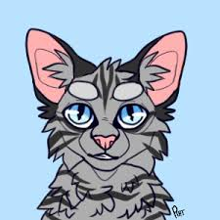

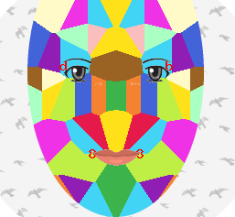


Voronio Diagram as template for avatar
Attempt for mapping all possible properties in one unique avatar

Slide 4
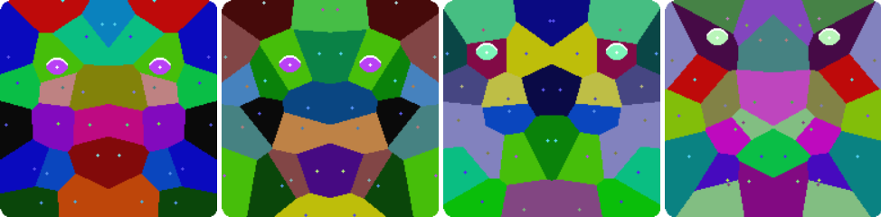
Attempt to create an unique avatar
Based on hash 256 with an output of 32 bytes
Organized as mirrored face shaped rectangle
8 |  |  |  | 4
1 | 0 | 0 | 0 | 0 | 1 | 0 | 0
F |  |  |  | 2
1 | 1 | 1 | 1 | 0 | 0 | 1 | 0
X
6bit = position, 2 bit =color
Y
6bit = position, 2 bit =color

Slide 5
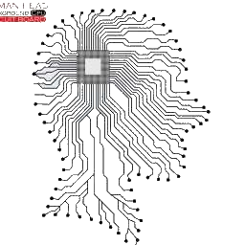
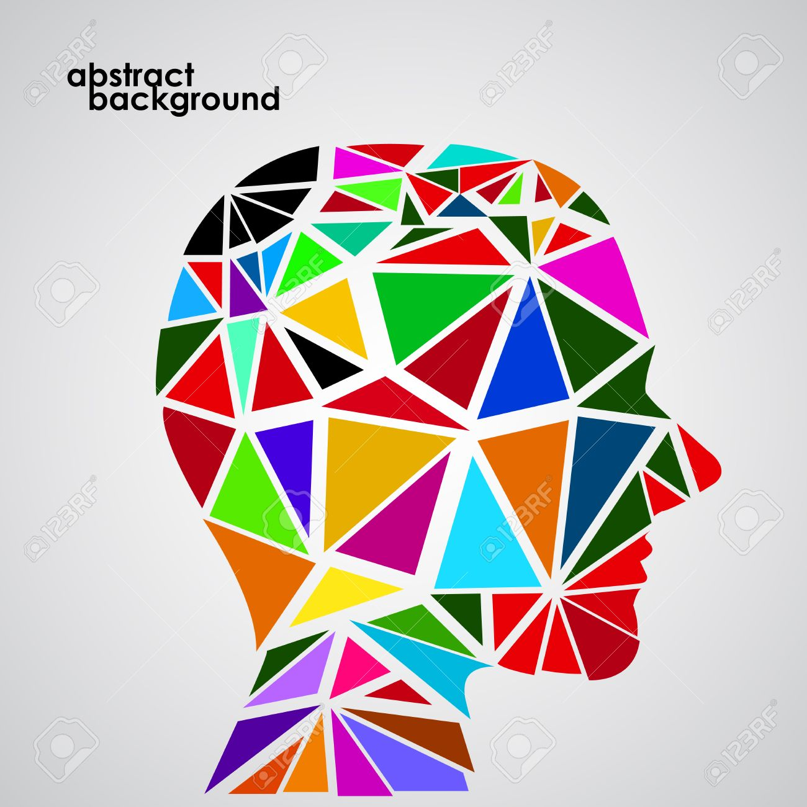
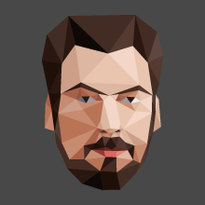
Combination of voronio and art
based on idea by Vladyslav Kobylchenko
difficult to memorize
end points were decoded by an 1-8 matrix
defined as final head shape
based on idea by Vladyslav Kobylchenko
Fixed position of triangles
Based of hash256 all possible properties decoded into colors and variable shapes of triangles
low polygon effect by photoshop,
based of hash256 all possible properties decoded into colors and variable shapes of head properties

Slide 6
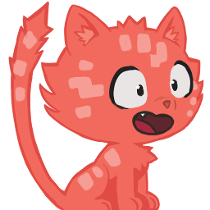

Crowd supported art and variation
background
body
fur
eyes
mouth
Fur
others
more
background
body
arms
foots
eyes
mouth
accessorie
hairs

Slide 7

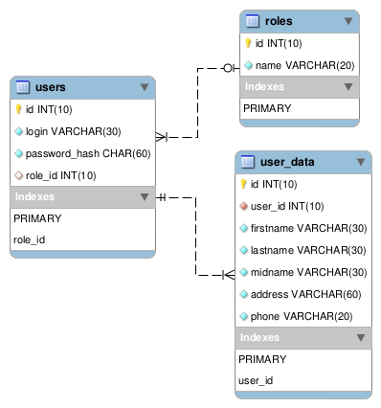
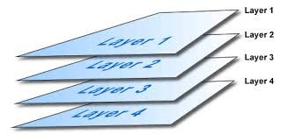
Layered generation tool
User and Role
Avatar creating process
Database overview
Api Overview

Slide 8
Layered generation tool / Roles
User
  Every user with an profile and possible avatar owner
Designer
  Create and upload ideas as avatars and different shapes
Supervisor
  Act as moderator, keep all activities clean
Developer
  Reuse avatar api, create own wallet, web service, customer support
Admin

Slide 9
Avatar creating process
Avatar algorithm based on several layered images
composite of these layers is fixed by designer
Each layer is filling up determinded by random selection from a number of pictures
start point is hashing the given wallet address by sha256
result hash value is hashed again with md5 hash
last 6 characters of this result will be interpreted as hex value and transformed into decimal value
based on this decimal value a seed for random number generator is given
used php "srand" method is based on random number generation according to the mersenne twister method (1997 by Makoto Matsumoto)

Slide 10
Database partitial overview
HASHTAG
APIKEY
PROFILE
ROLE
CATEGORY_HASHTAG
USER_CATEGORY
USER
CATEGORY
LAYER
FILE

Slide 11
Api Overview
for developers
for user
management
for avatar
creation process
for common
cases
Apikey
Signup
Login
Logout
Close
Profile
Password
Role
Designer
Create
Category
Hashtag
Layer
Upload
Price
Title
Currency

Slide 12
Example for user interaction (password)
User want to renew his password
User navigate to password forget page
Api call for password after user selected role and inserted identify and eMail
User get confirmation eMail
User has 15 min time to confirm
User click link inside confirmation eMail
User is guided to web interface
Web interface called api for confirmation password process

Slide 13
Example for user interaction (eMail)
Password reset instruction!
This given token is around 15 minutes alive. Follow this link above and reset your password.
Reset-Token: a340806392314cd452eae3800271e01e127659944986473b7176454a9878dd5c
External link: a340806392314cd452eae3800271e01e127659944986473b7176454a9878dd5c
Browser link: http://13.209.194.1:5000/api/?module=ff206b0edf705eb7538c49c8f7401436&token=a340806392314cd452eae3800271e01e127659944986473b7176454a9878dd5c
Best regards.
Avarkey

Slide 14
Outlook into the future of avarkey
Each avatar
  has different priced layers
  is an unique product
  can be owned only by one user supported by smart contract on blockchain
  can be used by several users in there wallets for mapping wallet addresses
Owned but unused avatars
  can be traded or auctioned on avarkey marketplace

