Slide 1

Welcome to the Air Canada Global Sales University
In partnership with ACTA, Air Canada is pleased to offer the Air Canada Global Sales University, providing you with the opportunity to explore and learn about Air Canada’s products, destinations, and services. Successfully completing the curriculum will earn you your Air Canada Expert (ACE) certification, an acknowledgement of your commitment to ongoing education and expertise in selling the Air Canada family of products.

Slide 2

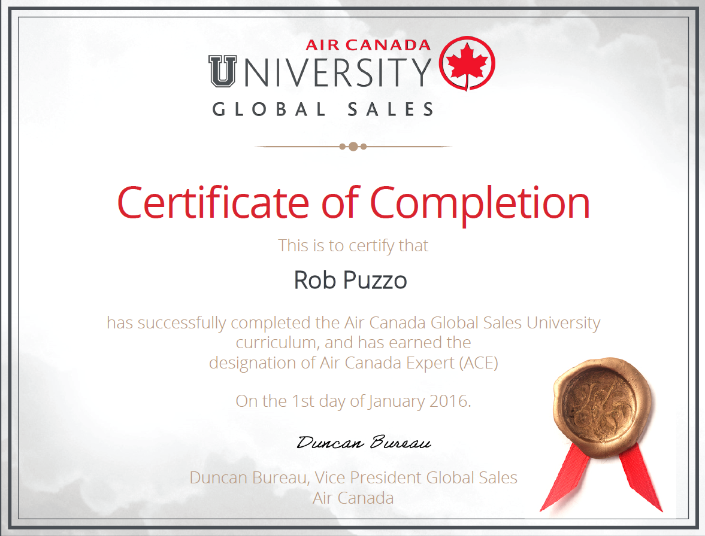

Completing the 16 online modules, attaining a score of 80% or higher on each, will earn you a Captains badge.
You will then be invited to complete two of three online, interactive certification exams to demonstrate the skills and knowledge acquired.
Successfully completing the certification exams will earn you Air Canada Expert (ACE) status and your Air Canada Expert certificate.

Slide 3


The certification will be accompanied by the Air Canada Expert Recognition Kit, which includes:
Air Canada Expert graduation certificate.
Air Canada Expert recognition pin.
Air Canada Expert logo for inclusion on your business card or electronic communications.
Air Canada Expert window decal.
Inducted into our ACE Hall of Fame.

Slide 4

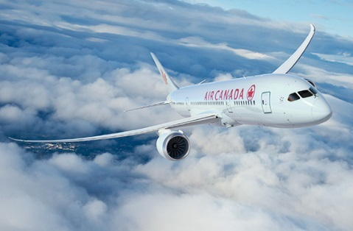




Bonus! Successfully completing all 16 online modules and all 3 case studies by December 31st, 2016 will make you eligible to win a spot on one of three exclusive Air Canada ACE fams to be conducted in 2017 to exciting Air Canada destinations worldwide, in partnership with the Ritz Carleton Hotels.

Slide 5
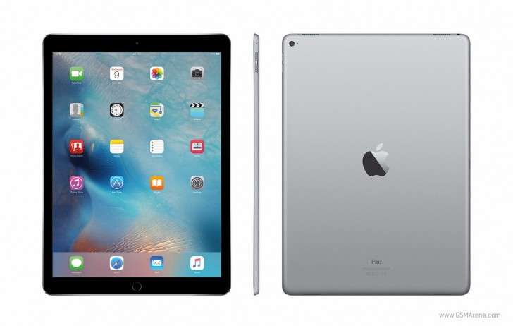
Extra Bonus! Successfully complete the online modules and all 3 case studies by November 30th, 2016 to be eligible to win one of three Apple IPad Pros.

Slide 6
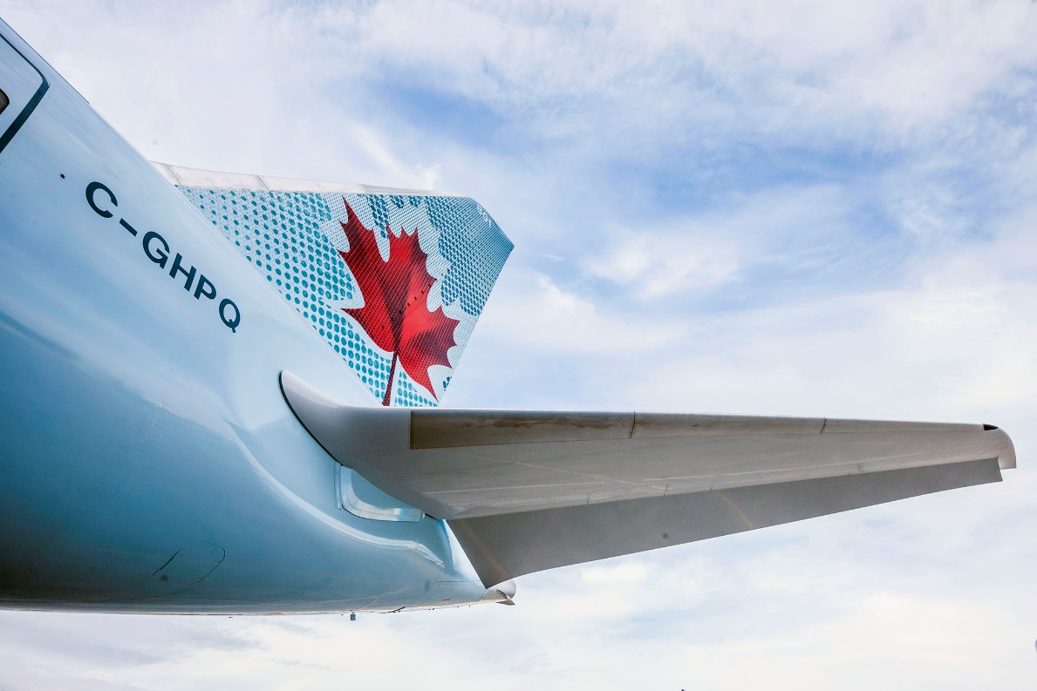
Thank You
From all of us at Air Canada, thank you for your continued support and your engagement with the Air Canada Global Sales University.

