Slide 1
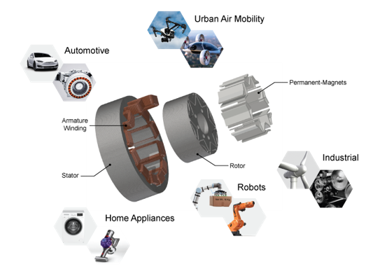

Slide 2
Electromagnetic analysis
Thermal analysis
Noise and Vibration analysis
Structural analysis

Slide 3
Stator Cooling
Coolant In
Coolant Out
Oil In
Oil In
Oil Out
Heat flow
Oil
Oil
Heat flow
Heat flow
Heat flow
Heat flow
Heat flow
Water Cooling
Spray Oil Cooling
Stator Oil Cooling
In-slot Oil Cooling
Rotor Cooling
Oil Out
Coolant
In
Heat flow
Coolant
Out
Coolant
In/Out
Heat flow
Oil
In/Out
Heat flow
Heat flow
Oil Out
Shaft In-direct Cooling
Shaft In-direct Cooling
Shaft Direct Cooling

Slide 4
Forced heat gen.
from IGBT/MOSFET
BAT Coolant Reservoir
P
P
Substrate
BAT EWP 2
BAT EWP 1
Baseplate
PE Coolant Reservoir
P
Heat sink
Coolant
PE EWP
ICCU
HV BAT
Heat transfer from inverter
INVERTER
BAT PTC Heater
BAT Coolant Radiator
PE Coolant Radiator
Heat
Source
BAT Chiller
TRACTION MOTOR
Forced heat gen.
from copper wire
3-Way Valve
Heat Transfer
Radiator
3-Way Valve
Oil
Heat transfer from traction motor

