Slide 1
Steam Collaborative Recommendation Systems
By Eric Plog, Data Scientist

Slide 2
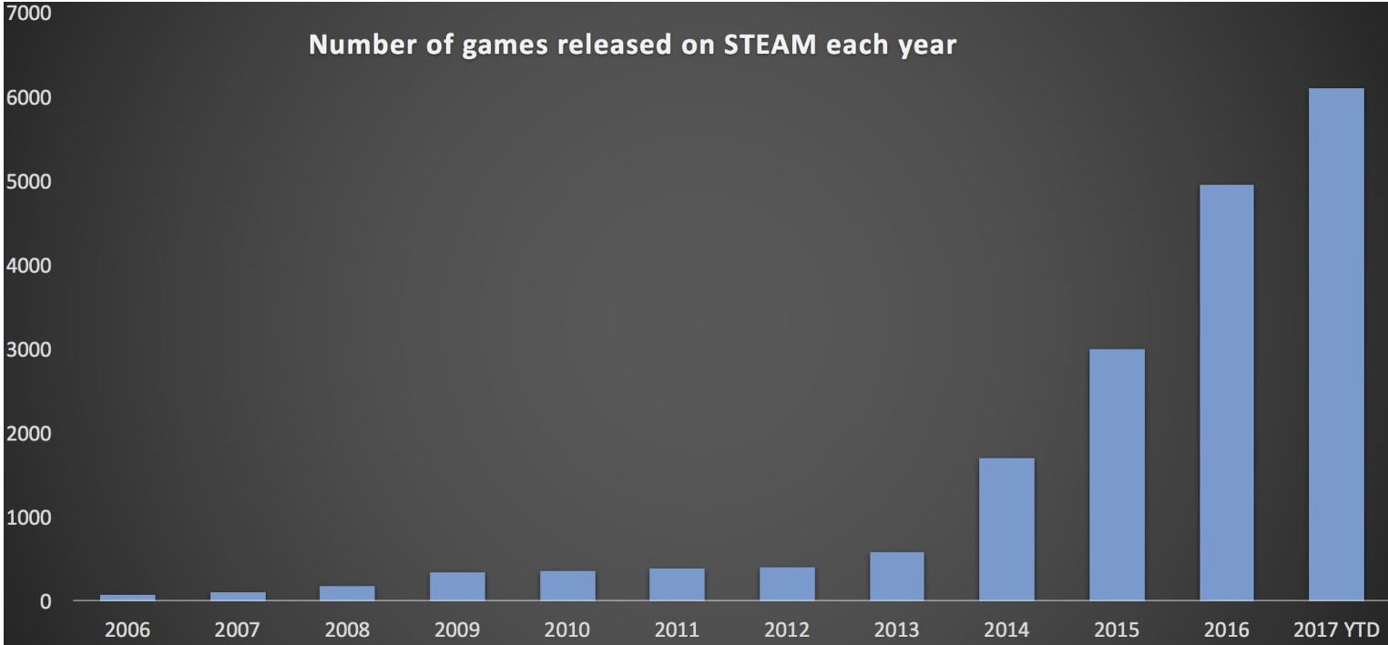
Problem Statement
Why is it so hard to accurately recommend games to users on the Steam platform?
During 2017 alone, 6,000 Steam games were released, almost as much as from 2005 to 2015. In addition, Steam boasts 130 million active users.
Notes:
Source: vg247.com

Slide 3
Further Complications
Players who browse the store looking for a game, and players who arrive already knowing the title they're looking for
Players who come to the store once a month, and players who visit multiple times a day
Players who just want to buy the latest AAA title, and players who want to search for hidden gems
Players who want to play titles earlier in their development, and get involved in their evolution
Players who want games with specific attributes, such as a type of gameplay, support for a specific technology, translation to their local language, etc.

Slide 4
Procedures Performed
Obtain the data
Data Munging and Exploratory Data Analysis (EDA)
Game to Game Collaborative Recommender Systems
User to User Collaborative Recommender System
svdRec Game Recommendation System

Slide 5
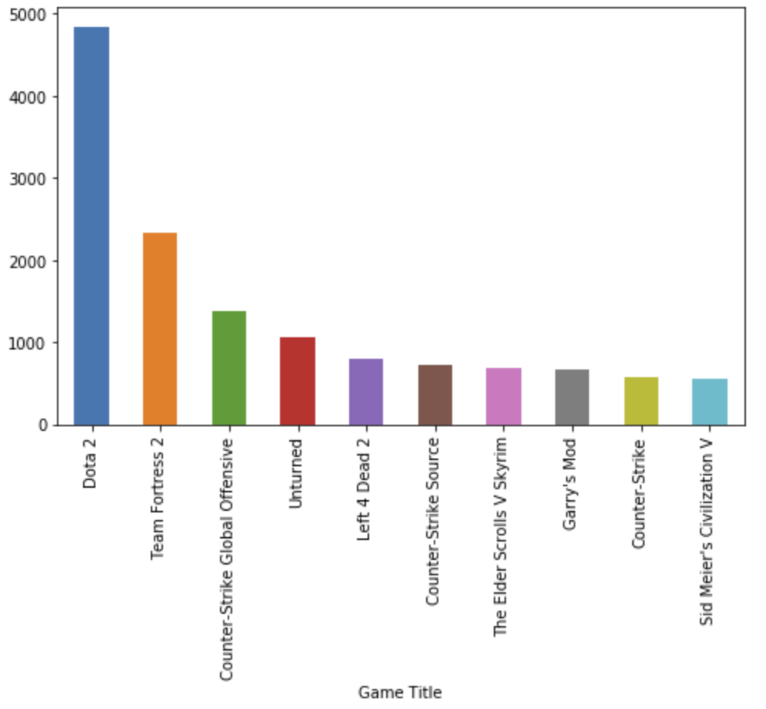
EDA – Most Unique Users per Game Title

Slide 6
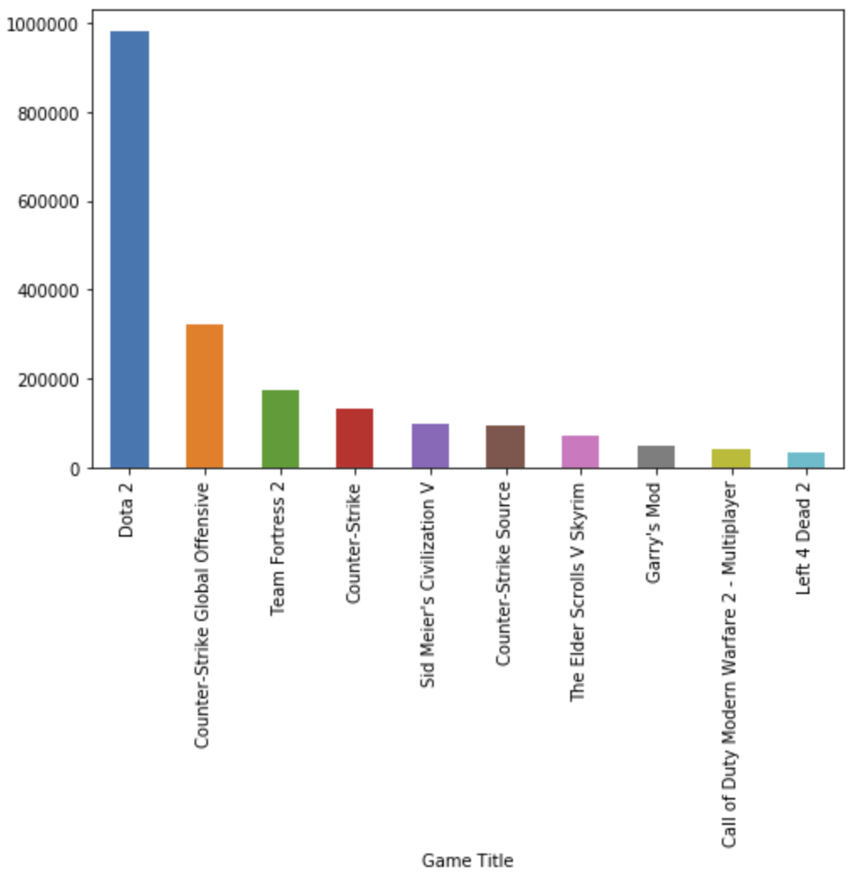
EDA – Most Hours Played per Game Title

Slide 7
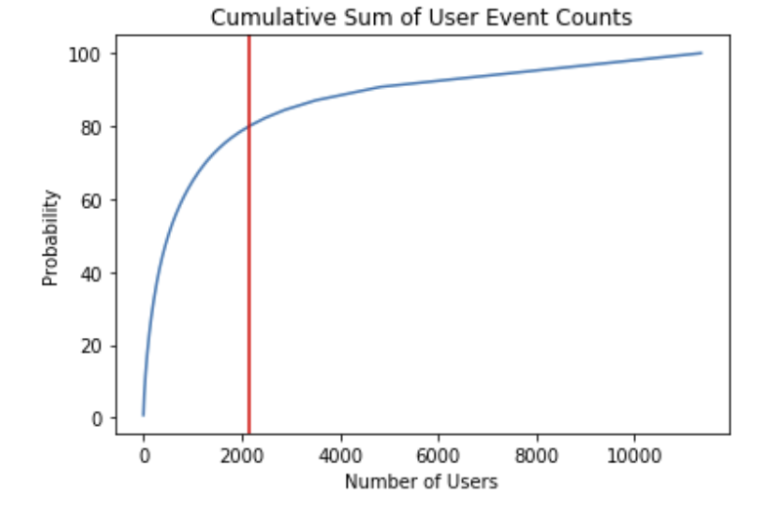
Cumulative Sum of User Counts

Slide 8
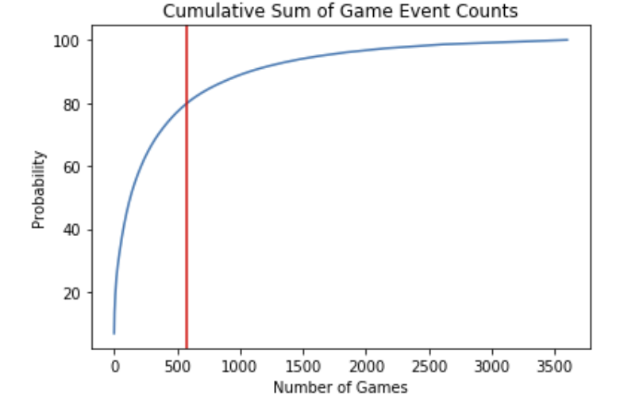
Cumulative Sum of Game Counts

Slide 9
Metrics Utilized to Create U-U and G-G Collaborative Recommender Systems
Pairwise distance with a metric of Spearman’s Correlation provided the best results on both user to user and game to game recommender systems.
Pairwise distance computes the distance matrix from a vector array X and Y.
Spearman's correlation measures the strength and direction of monotonic association between two variables.
A monotonic relationship is a relationship that does one of the following: (1) as the value of one variable increases, so does the value of the other variable; or (2) as the value of one variable increases, the other variable value decreases.
Notes:
http://www.statstutor.ac.uk/resources/uploaded/spearmans.pdf
https://statistics.laerd.com/statistical-guides/spearmans-rank-order-correlation-statistical-guide.php

Slide 10
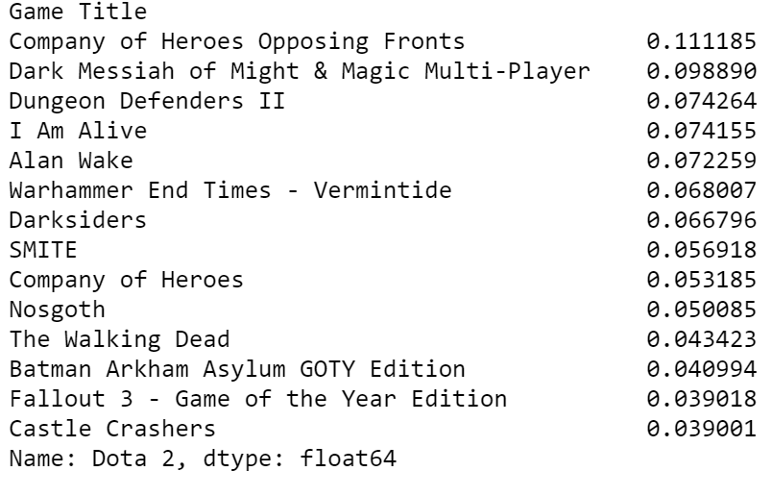
Results – Game to Game Recommender
Results for Dota 2 when Hours Played greater than 50

Slide 11
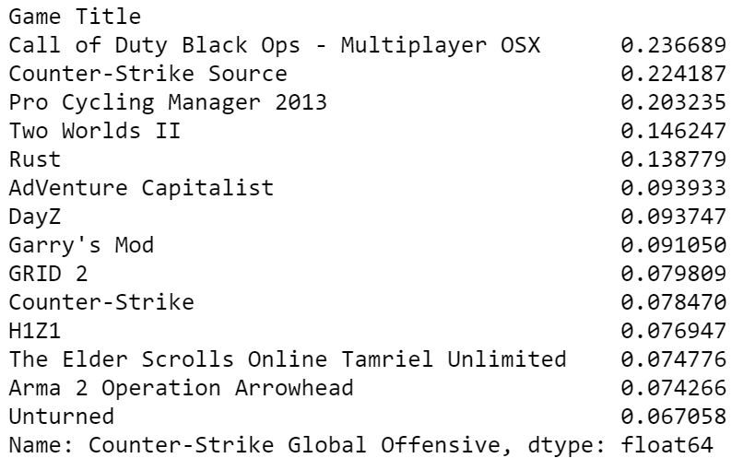
Results – Game to Game Recommender
Results for CS:GO when Hours Played greater than 50

Slide 12
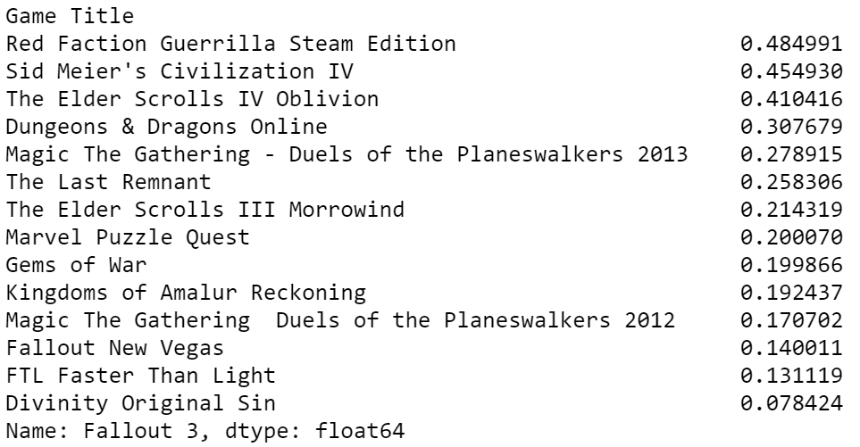
Results – Game to Game Recommender
Results for Fallout 3 when Hours Played greater than 50

Slide 13
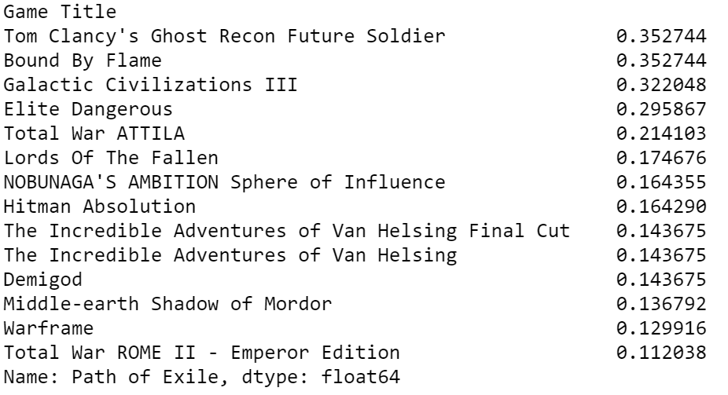
Results – Game to Game Recommender
Results for Path of Exile when Hours Played greater than 50

Slide 14
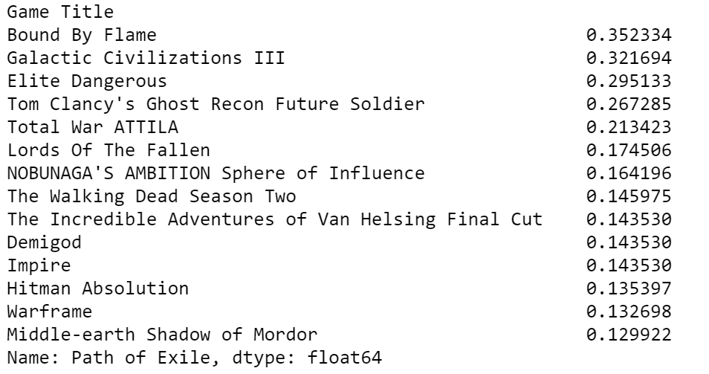
Results – Game to Game Recommender
Results for Path of Exile when Hours Played greater than 40

Slide 15
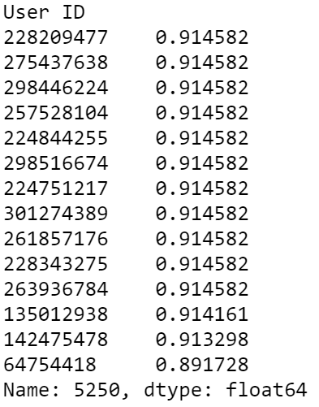
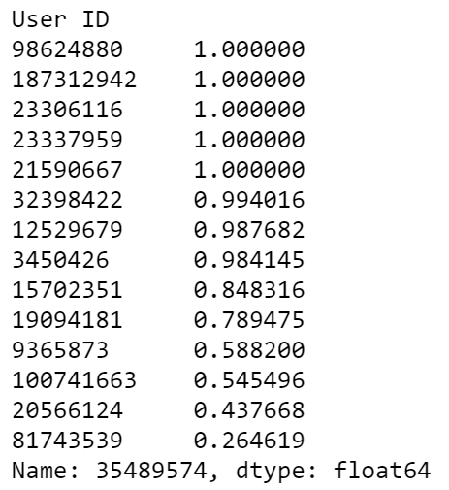
Results – User to User Recommender

Slide 16
Results – svdRec Game Recommender
Game Tested: Dota 2
Games Recommended:
Counter Strike Global Offensive
Counter Strike
Team Fortress 2
Counter Strike Source

Slide 17
Next Steps
Continue to try additional filters to optimize the recommenders
Utilize the Steam Web API to generate additional data including: Metacritic Rating, game information and further user details
Utilize the additional data gathered from 2018 to test current recommender systems
Test out clustering techniques to group users by hours played and create different recommenders for each group
Turn recommender system into a Flask application

