Slide 1
PETR 5313: CRN 38950, Fall 2017
Numerical Application in Petroleum Engineering,
Lesson 01: Basic Calculation
Ekarit Panacharoensawad, PhD
Terry Fuller Petroleum Engineering Research Building Room 236
ekarit.panacharoensawad@ttu.edu
Copyleft: No rights reserved
Cite as: Panacharoensawad, E. (2017) "Numerical application in petroleum engineering, Lesson 01: Basic Calculation", presentation slide for Texas Tech PETR 5313 Fall 2017

Slide 2
Outline
LibreOffice & Excel VBA
Printing number to worksheet cells
Write 1 to 1000
Matrix operation
Solver
Coding practice: non-pythonic way of finding the prime number in the range of 0 to 2000. (VBA, LibreOffice)

Slide 3
Programming in Spreadsheet
LibreOffice is free in Ubuntu (free OS) in case you don't want to pay for Excel.
Libre in French / Spanish means ‘free’
Programming Steps
1: Write Flow Chart (especially for the first time programming)
2: Break the whole tasks into sub-tasks
3: Code and test / debug each sub-tasks separately
VBA and OpenOffice.org Basic are very similar!
VBA Code can directly be used in OOBasic
  Use Option VBASupport 1

Slide 4
OpenOffice.org (OOo) Basic Language Reference
If statement (branching)
https://wiki.openoffice.org/wiki/Documentation/BASIC_Guide/Branching
Loop
https://wiki.openoffice.org/wiki/Documentation/BASIC_Guide/Loops
Brief tutorial
https://wiki.openoffice.org/wiki/Documentation/BASIC_Guide
More reference
http://www.pitonyak.org/OOME_3_0.pdf

Slide 5
Objective
The objective of this lesson is for the learner to know how to use VBA and OpenOffice BASIC. In addition, the learner is expected to write similar program (See homework) that shown in the lecture.
The majority of the learning occur when you do the homework!
It may seem easy. You can actually tell, once you did it (not before).

Slide 6
Quick Review of Programming
Adding value of A by 1
A = A + 1
Summation over V(i) for every I
Sum = 0
For i = 1 to N
Sum = Sum + V(i)
Next i
The code above is in VBA / OOo Basic

Slide 7
Quick Review of Programming…
Swapping (= is the assignment operator)
A = 3 ‘now A = 3 B = ? C = ?
B = 20 ‘now A = 3 B = 20 C = ?
C = A ‘now A = 3 B = 20 C = 3
A = B ‘now A = 20 B = 20 C = 3
B = C ‘now A = 20 B = 3 C = 3
The code above is in VBA / OOo Basic

Slide 8
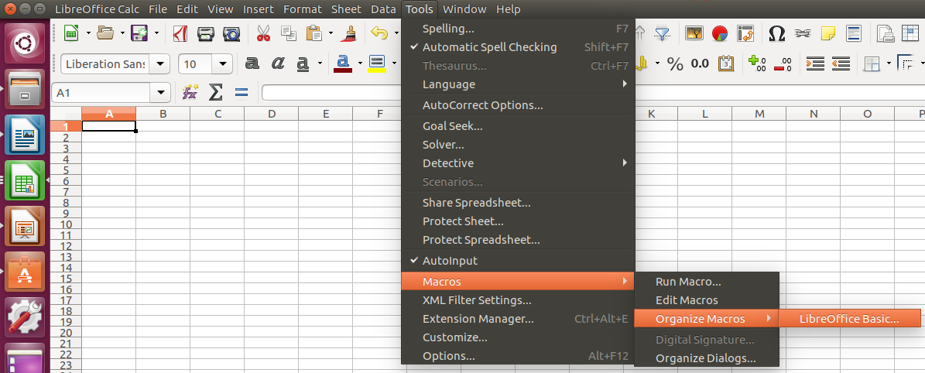
Lesson 01. Code 01 (L01C01)
Create new macro in LibreOffice Calc (or alt+F11)

Slide 9
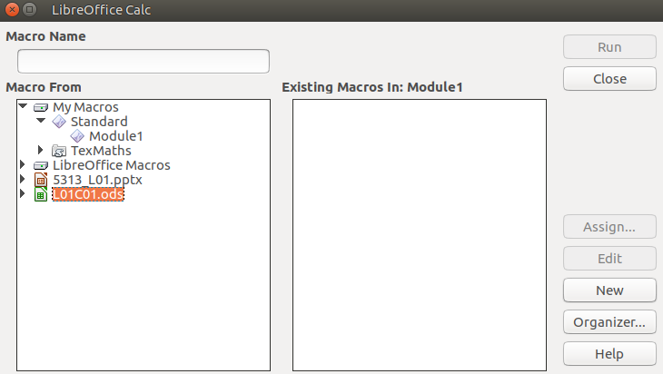
Creating Macro: LibreOffice Calc
Click "New"

Slide 10
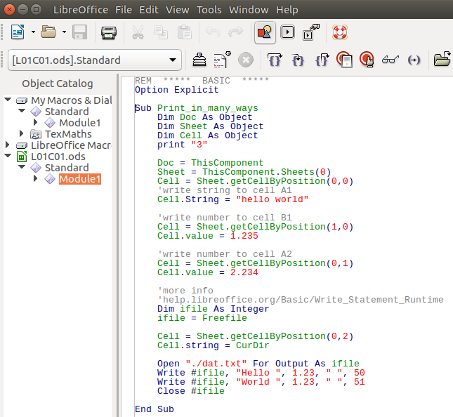

Slide 11
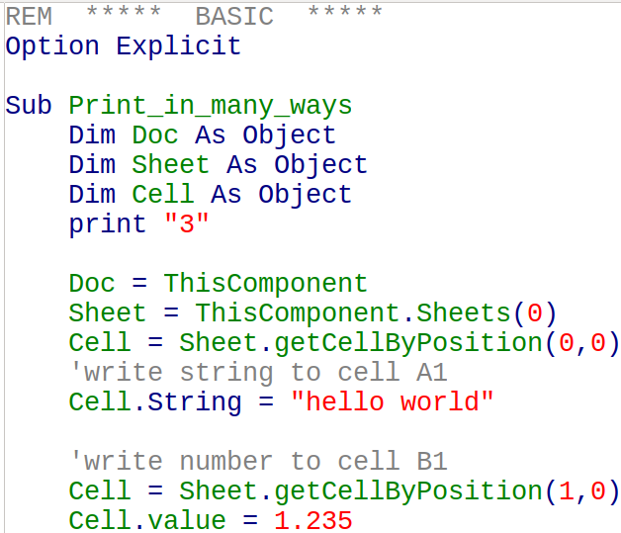

Slide 12
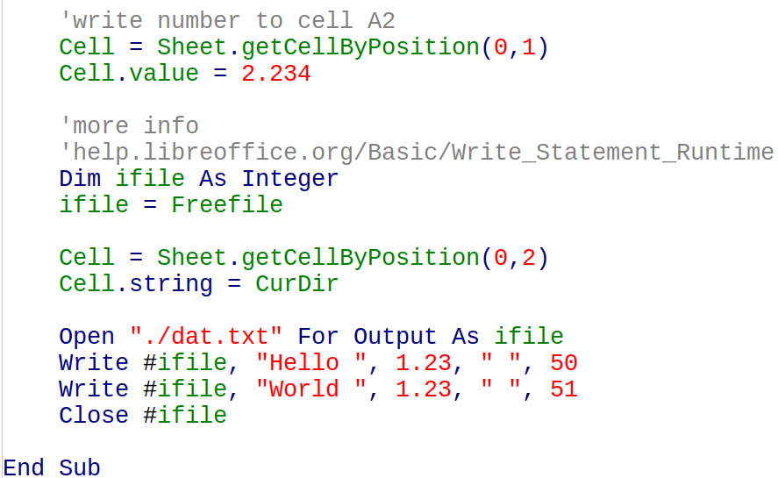

Slide 13
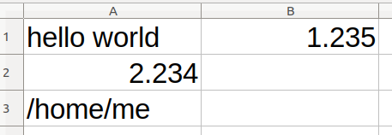

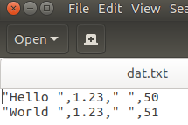
L01C01 LibreOffice Calc Macro: Result
Print to worksheet MsgBox output (print)
Print to file (print whatever we put in, line-by-line, character-by-character)

Slide 14
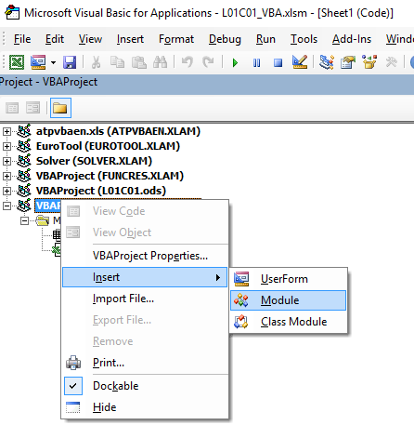
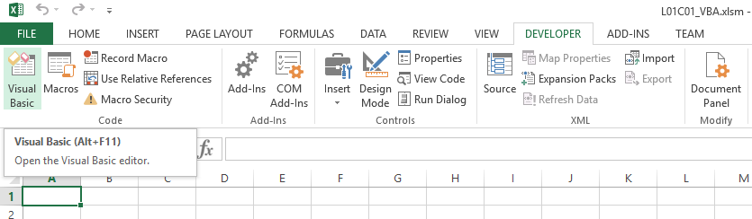
Quick Coding with VBA
Access VBA screen
Press Alt+F11
Developer tab + click “Visual Basic”
Create Module
Right click + insert + module

Slide 15
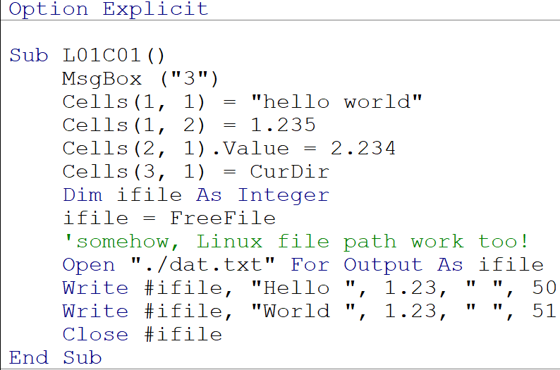
L01C01_VBA

Slide 16
L01C01_VBA…
Syntax are very similar to OOo Basic
Different parts
ThisComponent
VBA use (row, col), row/col start with 1
OOo use (col, row), row/col start with zero
A2 is Cells(2, 1)
OOo can use Print directly
VBA use MsgBox

Slide 17
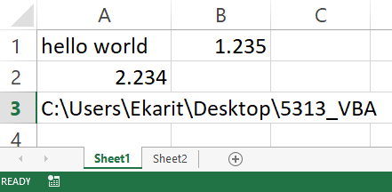

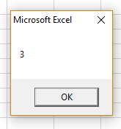
L01C01_VBA: Output

Slide 18
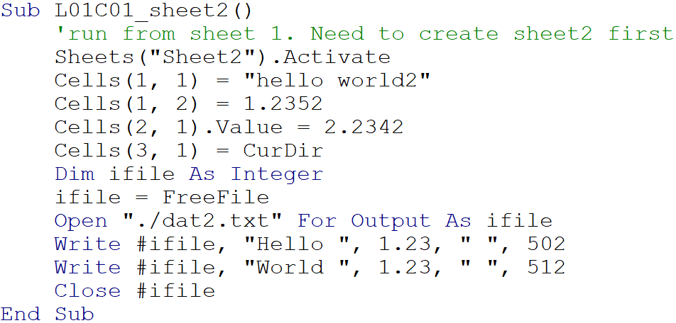
L01C01_VBA: Write sheet 2

Slide 19
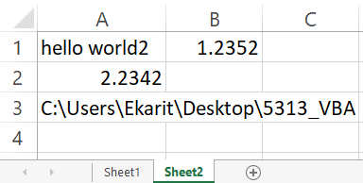

L01C01_VBA: Write sheet 2: Output

Slide 20
Run VBA on OpenOffice Basic Directly: L01XC01
Add
Option VBASupport 1
Option Compatible
Online conversion
https://www.business-spreadsheets.com/vba2oo.asp

Slide 21
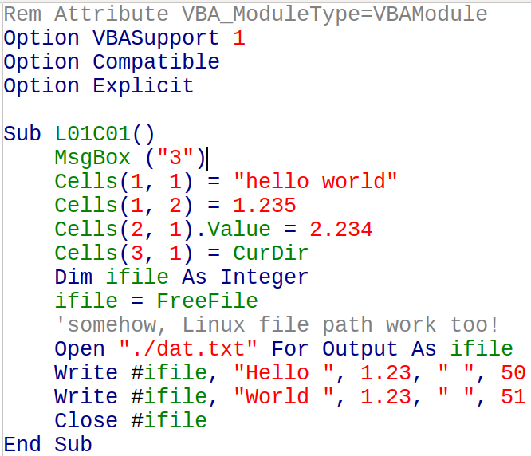
L01XC01
VBA to Basic

Slide 22
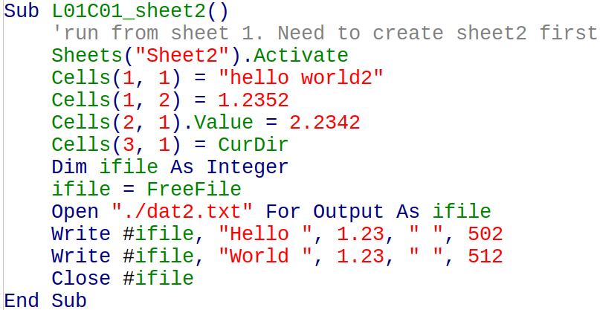
VBA Code on LibreOffice Calc

Slide 23
L01C02_Print with for loop / if
Objective 1: print 1 to 100, 10 number per row, 1 number in each cell
Objective 2: in sheet 2, print 30 to 60 in column 1 and check if each number is a prime number or not
Objective 3: in sheet 3, print all prime number to cell in column 1, for the number in the range of 1 to 20000
  Print the last 10 prime number in column 2 in the descending order
  How many prime number do we have in this range?
    Print this value to "D2"

Slide 24
L01C02_Objective 1: Approach
Use nested for loop
Write from left to right, first. Then, writing down.
Let's define
  The index for row as i
  The index for column as j
Let's have
  i = 1
  j goes from 1 to 10
  i = 2
  j goes from 1 to 10 (Again!)

Slide 25
L01C02_Objective 1: One way to think
Nested for loop give
i = 1, j = 1, 2, 3, ..., 10
i = 2, j = 1, 2, 3, ..., 10
...
i = 10, j = 1, 2, 3, ..., 10
Value output:
out = j (for i = 1, is OK only for the 1st row)
out = j + 10 (for i = 2, is OK only for the 2nd row)
out = j + 20 (for i = 3, is OK only for the 3rd row)
out = j + (i - 1) * 10, (is OK for i^{th} row)

Slide 26
L01C02_Objective 1: Pseudo code
For i = 1 to 10
For j = 1 to 10
out = j + (i - 1) * 10
print out to the cell row i, column j
Next j
Next i

Slide 27
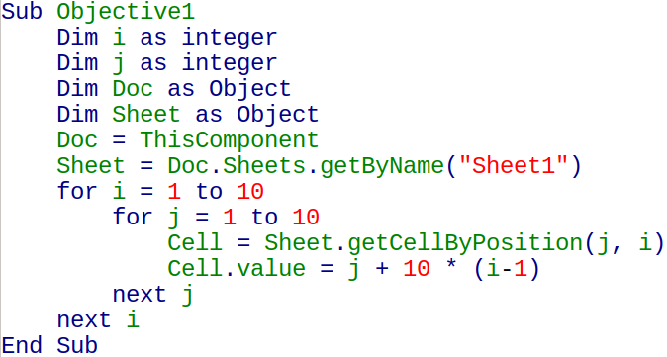
L01C02_Objective 1: Code

Slide 28
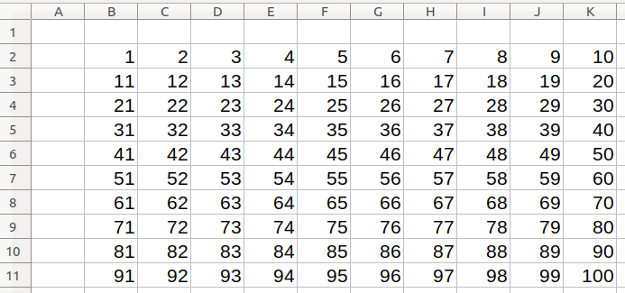
L01C02_Objective 1: Result

Slide 29
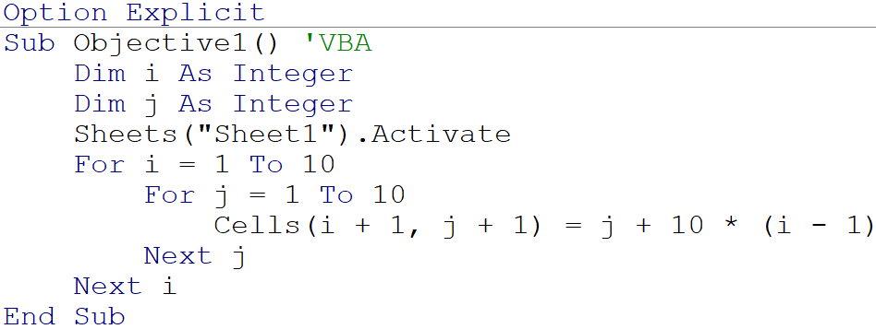
L01C02_Objective 1: VBA Code

Slide 30
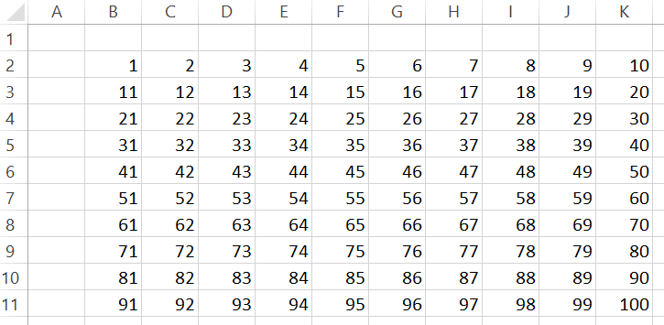
L01C02_Objective 1: VBA Result

Slide 31
Possible Quiz1 (10 minutes)
Hand-Writing-Code
Write (by hand, on paper) either VBA code or OpenOffice.org Basic (OOo Basic) code for
Printing i ^ 0.5 for i = 1, 2, 3, … , 100 onto worksheet
Each row contain 10 numbers / print 10 rows totally
One number per cell
Need to use for loop
Write Option Explicit as the first statement
Write the value not string (9.53939 not “91^0.5”)
You may want to practice serval times to memorize it

Slide 32
L01C02_O2: Check if prime: Approach
Input range is 30 to 60
From 0 to 60, prime numbers are Solution (From google)
2, 3, 5, 7, 11, 13, 17, 19, 23, 29, 31, 37, 41, 43, 47, 53, 59, 61
Even number is not a prime number, except 2
  Decrease the domain by half
The positive divisor of a prime number is itself and one.
We need to know the prime number below 30 too, in order to tell if the number above 30 is a prime number or not

Slide 33
L01C02_O2: Thinking Approach
Solution: 2, 3, 5, 7, 11, 13, 17, 19, 23, 29, 31, 37, 41, 43, 47, 53, 59, 61
Let's use for loop with if statement
Conditions
In the range of 30 to 60, if the number is an even number, it is not a prime number
Otherwise, check if it is divisable by any number below it
Use MOD (modulo to find the remainder after division)

Slide 34
L01C02_O2
Thinking Out Loudly
#1 | #2 | mod | #1 | #2 | mod
31 | 1 | 0 | 31 | 17 | 14
31 | 2 | 1 | 31 | 18 | 13
31 | 3 | 1 | 31 | 19 | 12
31 | 4 | 3 | 31 | 20 | 11
31 | 5 | 1 | 31 | 21 | 10
31 | 6 | 1 | 31 | 22 | 9
31 | 7 | 3 | 31 | 23 | 8
31 | 8 | 7 | 31 | 24 | 7
31 | 9 | 4 | 31 | 25 | 6
31 | 10 | 1 | 31 | 26 | 5
31 | 11 | 9 | 31 | 27 | 4
31 | 12 | 7 | 31 | 28 | 3
31 | 13 | 5 | 31 | 29 | 2
31 | 14 | 3 | 31 | 30 | 1
31 | 15 | 1 | 31 | 31 | 0
31 | 16 | 15
Is 31 a prime number or not?
31 MOD 2 = 1
31 MOD 3 = 1
31 MOD 4 = 3
...
MOD result is always greater than 0
Do we need to check all # < 31?
  No, we can check just prime # <31.
  This will be a lot quicker!

Slide 35
L01C02_O2: Steps
Get the value to be checked (x) if it is a prime number or not
Get the list of the prime number for the range of [2, x-1]
Do MOD(x, p) where p is in the list from the step 2
  Whenever MOD = 0, exit the loop (break)
  If MOD <> 0, keep on doing
  If MOD <> 0, for all, then x is the prime number
Note: Try to avoid a recursive algorithm
Difficult to debug
Can be an exponential time complexity if not done correctly
Step 2 requires the previous call of step 2 that is not exist

Slide 36
L01C02_O2: Revised procedure
Creating the list of prime number from 1 to 60 then select the values that are >= 30 and <= 60
Assume the known prime number to be [2, 3]
Start with 5
Check all prime number less than 5 (which is 2 & 3)
  If no MOD(y, n) = 0 for n = 2, 3, ... , y-1
  If any MOD(y, n) = 0, y is not the prime number
Either keep y as prime # or discard, then move to the next number

Slide 37
L01C02_O2: Step by step
For only odd numbers starting from 5
Check #5
Check MOD(5,3)
  add #5 to the list
Check #7
Check MOD(7,3)
Check MOD(7,5)
  add #7 to the list
Check #9
Check MOD(9,3)
  MOD = 0
Check #11
Check MOD(11,3) ...
Keep checking until 60

Slide 38
L01C02_O2: Data Structure
Adding value to list
Dim p_list(1 to 5) as integer 'including 1 & 5
Typically, array starts from zero
If the list is full, double the capacity
  Redim preserve p_list(1 to n*2) as integer
Check if the list is full
Ubound(p_list) to get the upper bound
Compare the Upper bound value with the number of the prime numbers that are found

Slide 39
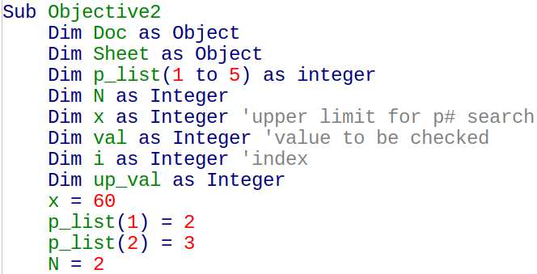
L01C02_O2: Code part 1/3

Slide 40
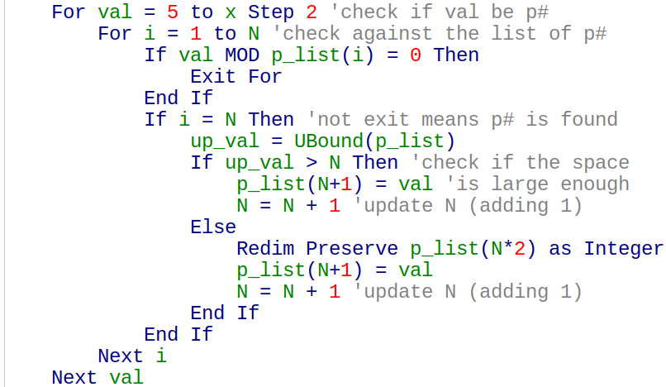
L01C02_O2: Code part 2/3

Slide 41
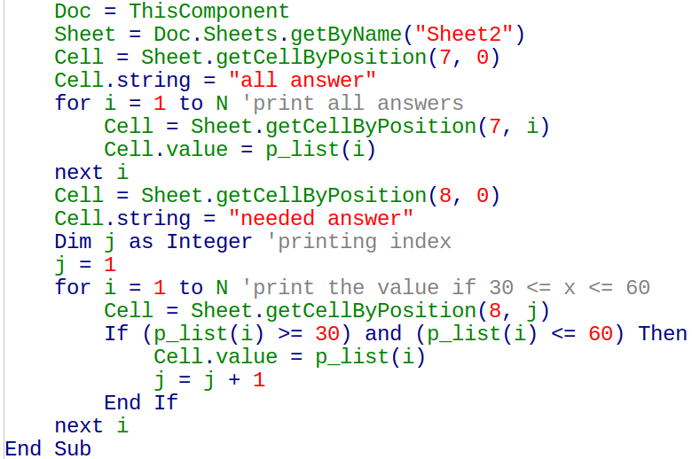
L01C02_O2: Code part 3/3

Slide 42
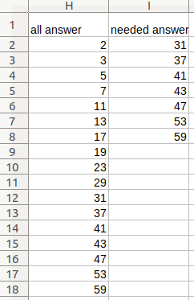
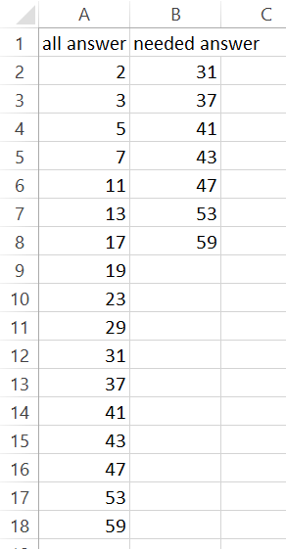
L01C02_O2: Result
Equivalent result from VBA code

Slide 43
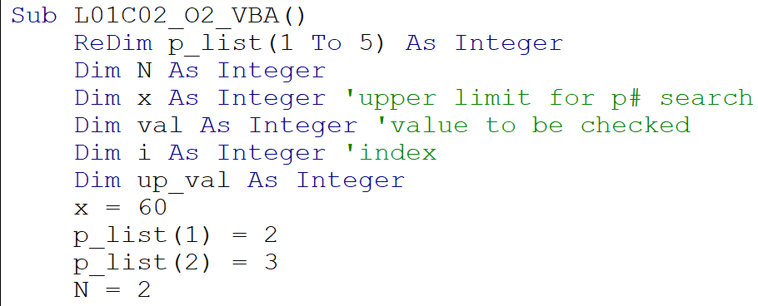
L01C02_O2: VBA Code part 1/3
Notice that p_list was declared with ReDim not Dim

Slide 44
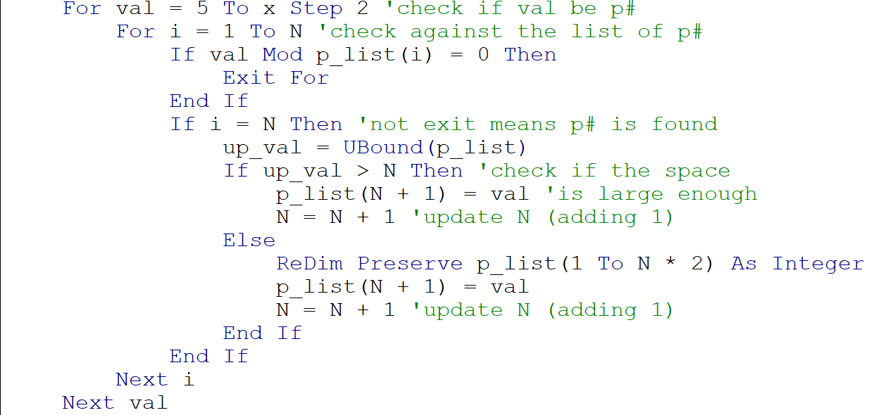
L01C02_O2: VBA Code part 2/3

Slide 45
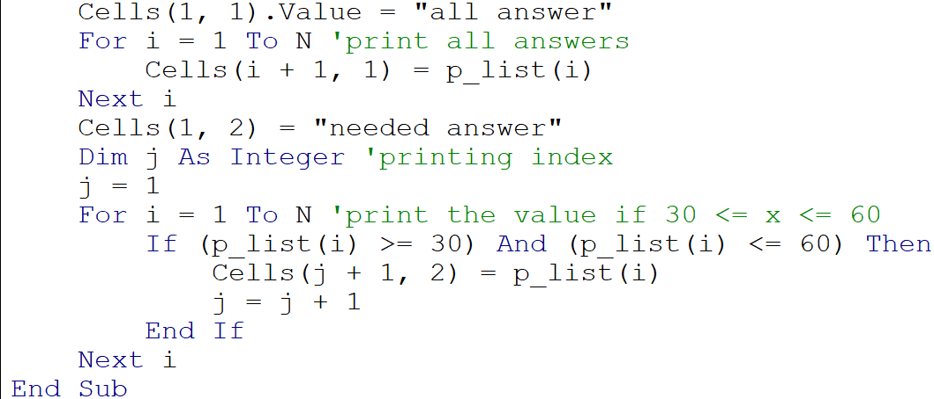
L01C02_O2: VBA Code part 3/3

Slide 46
VBA VS OpenOffice.org Basic
VBA is not free, but OOoB is free
VBA capitalize letter & adjust spacing automatically (OOoB doesn’t)
Some different in row column reference to cell
VBA use (row, col) while OOoB use (col, row)
VBA & OOoB both can ReDim Preserve
Array declare with a specified size Dim A(5) as Long, cannot be ReDim (in VBA, but can be ReDim in OOo Basic)
WPS Office for Linux/Ubuntu (paid version) has VBA and very close to Excel (free version does not have VBA)

Slide 47
L01C02_O3: Do it later as a homework
Hint
Use code from C02O2
Use step -1 to move backward in for loop
You just need to change the L01C02_O2 code a little, then it should work (if you do it with LibreOffice Calc).
For doing it in VBA, see the next couple of slides
It is my intention to put the code in L01C02_O2 in a picture format, so that you have an opportunity to practice.

Slide 48
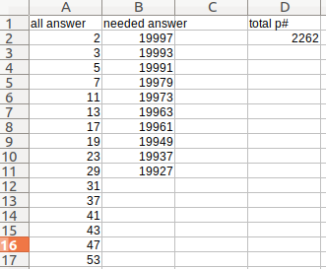
L01C02_O3: Expected Result
Note: Column 1 has many more number

Slide 49

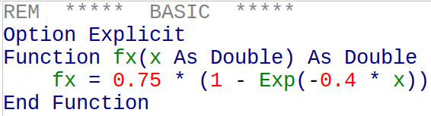
User-Defined Function: OOoB
x As Double means, fx takes input as Double
fx( ) as Double, means, output or fx is Double
If the function in Basic is change, press Ctrl + Shift + F9 to update every cells

Slide 50

User-Defined Function: VBA
f(x) = 0.75 * (1 – exp(-0. 4 * x))
Function call from Excel worksheet
=fx(A10)
  Put value from cell “A10” as the value of “x” in function fx
Function can also be called from VBA subroutine

Slide 51
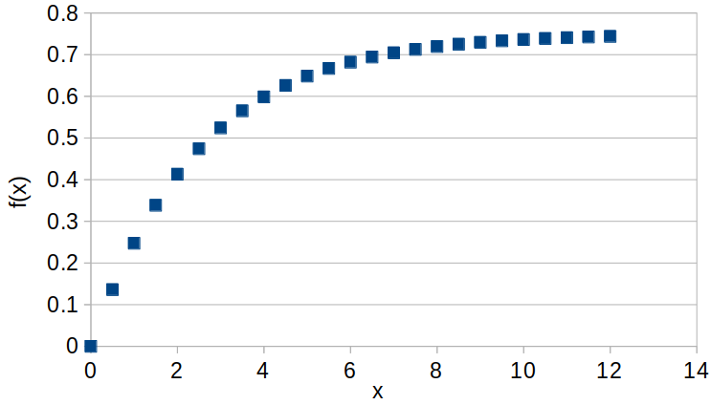
Solver: L01C03 (both Excel and Calc)
Non-linear solver can be used to find unknown constants in non-linear equation
Example: Data from non-linear function f(x) = 0.75 * (1 – exp(-0.4 * x)) are generated. For f(x) = A * (1 – exp( - B * x )), solver can find A and B that are allow the best fit with the data easily

Slide 52
Solver: Step-By-Step (both Excel & Calc)
Create
Column A: x values from 0 to 12, at the interval of 0.5
Column B: f(x) true values
Column C: f(x) true values created from VBA function (just for practice)
Column D: f(x) predicted values
  based on the initial guess of A = 1 and B = 1
Column E: (true – predict) ^ 2

Slide 53
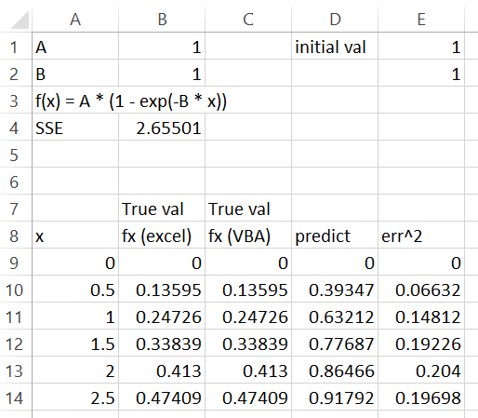
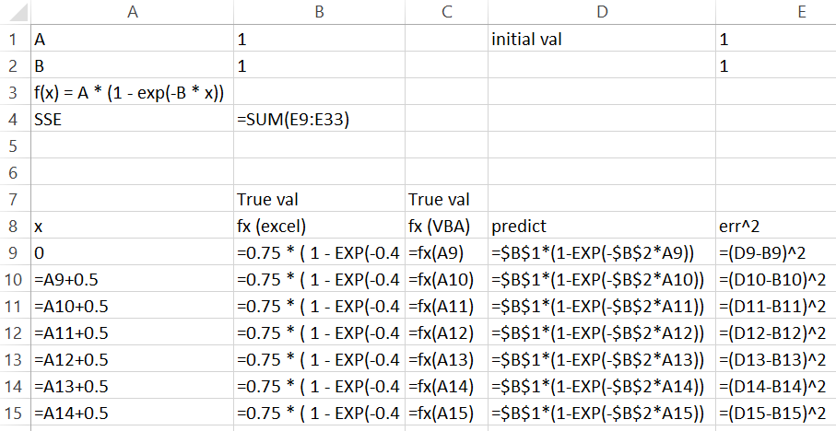
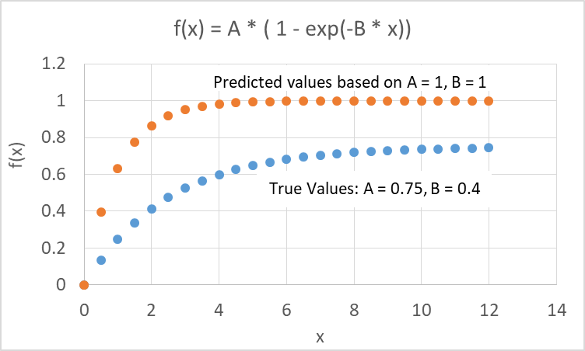
Solver: Step-By-Step…
1
Actual input (ctrl + ` or ~) (Excel)
Normal view
Graphs
2
2
3
1
3

Slide 54
LibreOffice Calc: Solver
Default linear Solver cannot be used to solve non-linear problem
Need to download and install non-linear solver
https://extensions.openoffice.org/fr/project/solver-nonlinear-programming-beta
https://apps.ubuntu.com/cat/applications/precise/libreoffice-nlpsolver/
  apt://libreoffice-nlpsolver
Tool >> Extension Manager >> Add nlpsolver.oxt

Slide 55
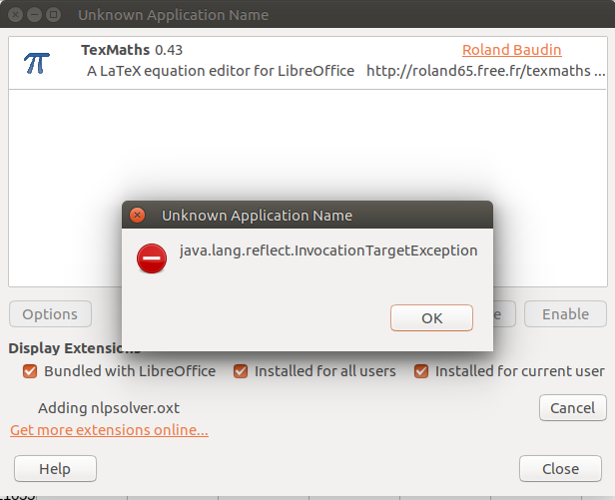
Calc: Solver Extension
First, I got error message during the installation
Then, try to install by https://apps.ubuntu.com/cat/applications/precise/libreoffice-nlpsolver/
Something is installed, but nothing pop-up yet. I retry the nlpsolver.oxt again, then, it works.

Slide 56
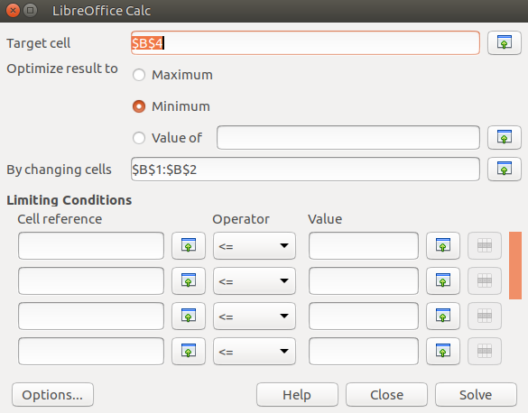

Slide 57
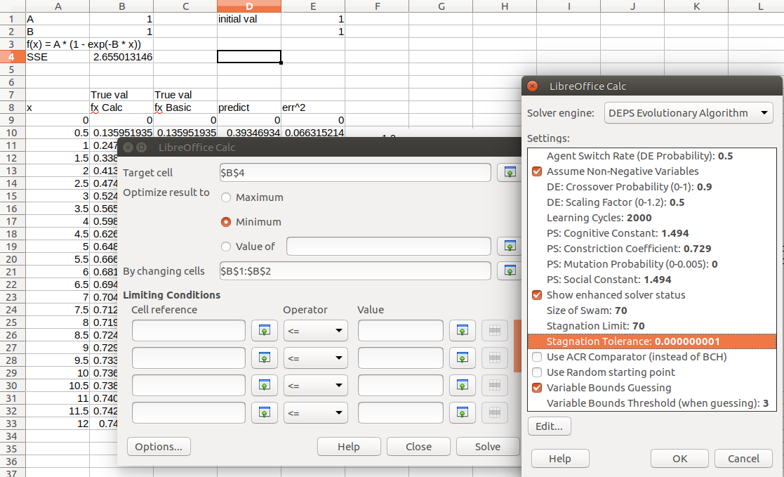

Slide 58
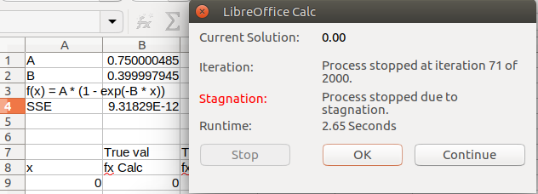
LibreOffice Calc Solver
Check Sum Square Error (reach solution in 2.65 seconds)
9.3E-12 is very low already

Slide 59

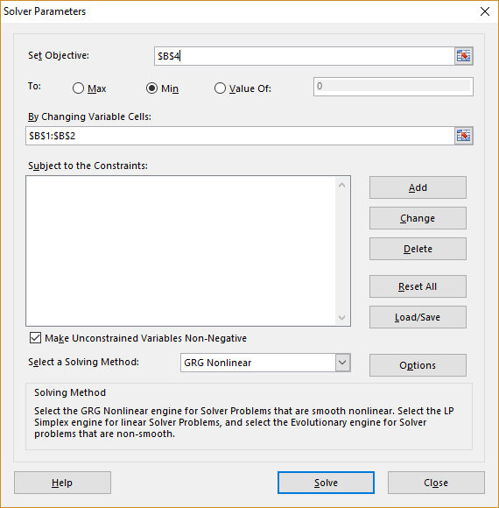
Excel Solver: Step-By-Step …
Data >> Solver
Set Objective: $B$4
To: Min
By Changing Variable Cells: $B$1:$B$2
Select a Solving Method:
  GRG NonLinear

Slide 60
Excel Solver: Step-By-Step …
Solver help us to adjust the unknown constant in the equation until the sum-square-error becomes the minimum value.
Then, we can do a curve fitting with non-linear equation
Problem:
What kind of non-linear equation that should be used for the curve fitting
One of the solution:
Use LabFit: http://zeus.df.ufcg.edu.br/labfit/
For Linux, you may try: goo.gl/ndN9eX

Slide 61
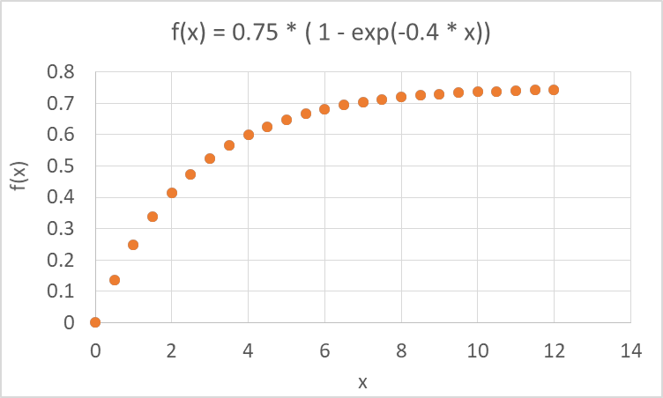
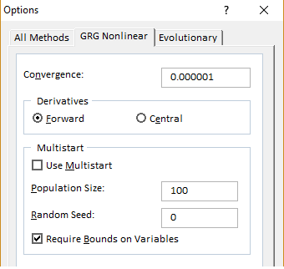
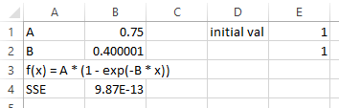
Excel Solver: Result
You may decrease convergence criterion to get more accuracy

Slide 62
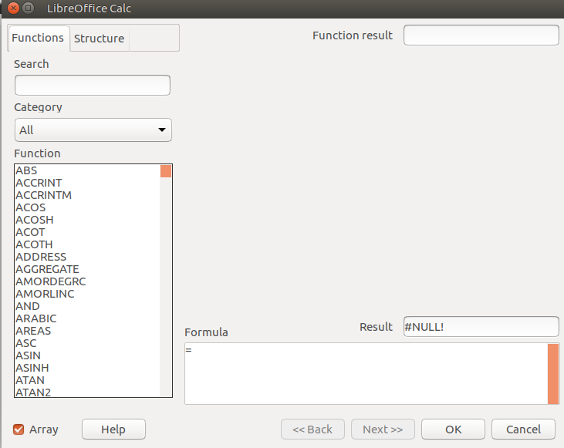

LibreOffice Calc: Matrix Transpose: L01C04
Create 6 x 3 matrix with random number (use =RAND())
Then copy to A1:C6. Copy again, but paste just value (so it does not change any more)
Click on E1
Type =Transpose(A1:C6)
Press Shift + Ctrl + Enter
Otherwise, select array option in function wizard

Slide 63

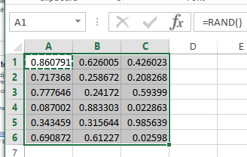
Excel: Matrix Transpose: L01C04
Create 6 x 3 matrix with random number (use =RAND())
Then copy to A1:C6. Copy again, but paste just value (so it does not change any more)
Click on E1
Type =Transpose(A1:C6)
Press Enter, get #VALUE! (it is OK)
Highlight E1:J3
Press F2 + Ctrl + Shift + Enter

Slide 64
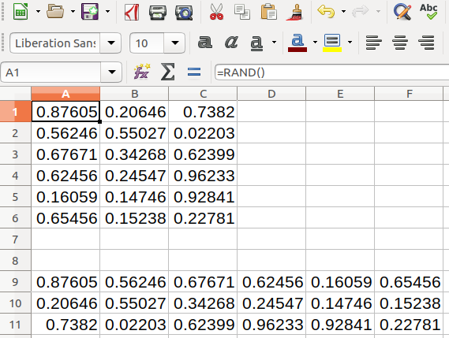

Slide 65
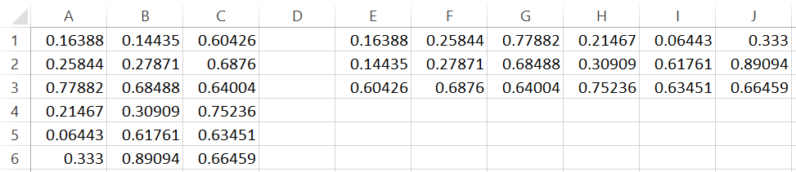
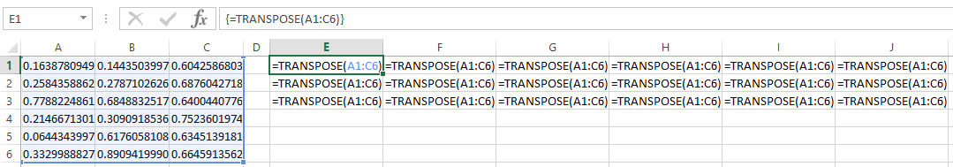
Excel: Matrix Transpose: L01C04: Result
This converses M_{ij} to M_{ji}
Actual value (ctrl + `)

Slide 66
Excel/Calc: Matrix-Matrix Operation: L01C04S2
Excel: F2 + Ctrl + Shift + Enter
  Just press enter without F2 + Ctrl + Shift + Enter will give just one output value or error message (do this first is OK)
  Highlight enough output cells then press F2 + Ctrl + Shift + Enter while the active cell has the formula
Calc: Shift + Ctrl + Enter
Matrix-Matrix Multiplication: use MMULT with
Matrix Inversion: use MINVERSE

Slide 67
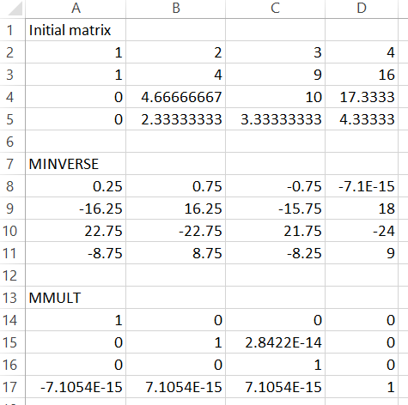
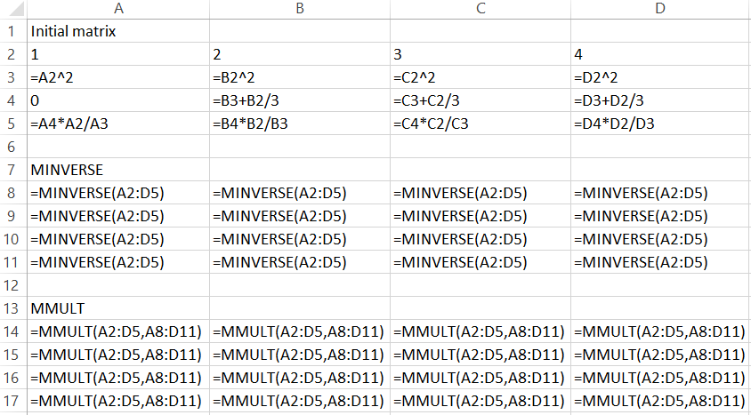
Excel: Matrix-Matrix Operation…
Actual Value (Ctrl + `)
Normal View
MM⁻¹ = I
This part can be found in sheet 2 of L01C04.xlsm

Slide 68
Programming with 2D Array
To complete this basic programming part, the learner should be able to
Passing parameters to and from function
Passing 2D array parameters
Passing 2D array between VBA/OOB Function and Worksheet
Understand how to use For Loop with 2D array
Let’s see more example / practice more with
Matrix Transpose and Matrix Multiplication

Slide 69
VBA: Transpose
Shape of matrix is given in B1 and B2
B1 = number of row
B2 = number of column
The first (top left) value in matrix is given in B5
Output the transpose such that it won’t overlap with the given matrix value with 2 cell whitespace gap.

Slide 70
VBA: Transpose: L01C05
O1_a: subroutine to calculate transpose
O1_b: same as O1_b, but shorter
O1_c: show how to send and get array from a function
O1_d: function used for O1_c
O1_e: function to be called from the worksheet
  Need to do F2 Ctrl Shift Enter

Slide 71
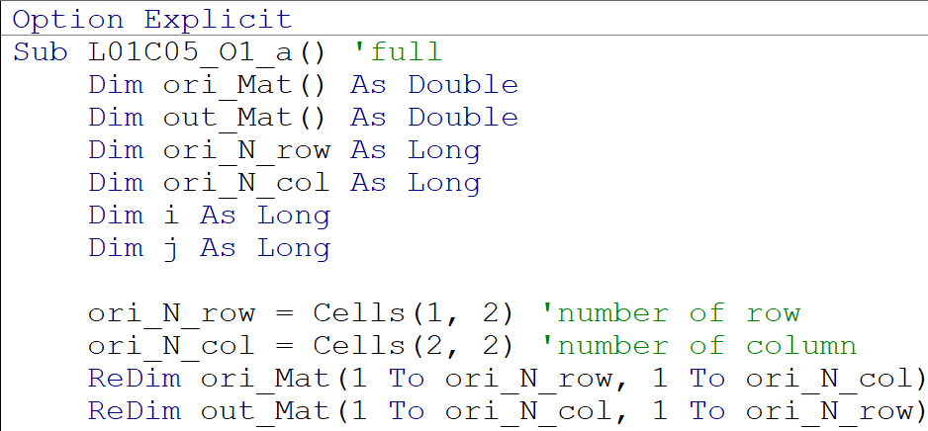
L01C05_O1_a: part(1/2)

Slide 72

L01C05_O1_a: part(2/2)

Slide 73


Slide 74


Slide 75

L01C05_O1_c: (continue)
The order of the argument passing to other function must match to the parameter’s order of the receiving function

Slide 76

Function for L01C05_O1_c

Slide 77
Convert VBA to OpenOffice Basic
L01C05_O1 a to d
Just add Option VBASupport 1, then works properly
  For a to c
  Except O1_d
  Need to Dim before ReDim when use in OOB

Slide 78

VBA in OOB
Added line, otherwise, runtime error

Slide 79

Transpose function to be called from workbook

Slide 80

L01C05_O1_e: Output

Slide 81

Direct Function Call: F2 + Ctrl Shift Enter

Slide 82


myMTrans with Option VBASupport 1
Press Shift + Ctrl + Enter (instead of just Enter)

Slide 83

OOBasic Version
First line, Need
Option VBASupport 1
Added line, otherwise, runtime error

Slide 84
More Programming Practice
To fully appreciate and understand how to do VBA programming, perform matrix multiplication with and without using MMULT in VBA
O2_a: matrix multiplication subroutine
  Show how to use range
O2_b: use Excel MMULT function
  Show how to use WorksheetFunction
  Use UBound and LBound to get array size (no need to send size together with matrix anymore)

Slide 85

myMMult part 1/2

Slide 86

myMMult part 2/2

Slide 87




Slide 88

L01C05_O2_b: Part(1/2)

Slide 89

L01C05_O2_b: Part(2/2)

Slide 90
myMMult: OOBasic (without VBASupport 1)
New Tricks
Use current active sheet
Use no need to pass array shape (use UBound for shape)
Output at the calling location
Works the same way as MMULT
By Learning how to pass array to/from worksheet, you will be able to write a lot more complicated algorithms

Slide 91

myMMult: OOB Version

Slide 92


Slide 93

Output

Slide 94

Output & Expected Homework
From myMTrans, a learner can write a function that take 3 arguments from workbook, and output the multiplication of those 3, without using any automatic function (use just for and if).
This function should require F2+CSE / SCE to run

Slide 95
Expected Homework
Create function taking value from worksheet and calculate (matrix ^ 4)^T
Use solver to the parameter that make the
  (Mat^4)^T = a certain 3x3 matrix
  Will be asked to use solver together with VBA/OOo Function

Slide 96
Application with VBA/OOBasic
Help to debug/develop program in Python / C++
Help to directly show a complicated algorithm step-by-step via worksheet and user define function
With just we learn about Worksheet + VBA/OOBasic, we can show the working principle in a step-by-step fashion for
  Newton method, Gaussian elimination, RK4, RKF45, Trapezoidal/Simpson integration, Gradient Descent optimization, Levenberg Marquardt optimization, and many more numerical methods

Slide 97
Tool/Program/OS used for making these slides
LibreOffice Calc/Impress Version 5.3.1.2
Ubuntu 17.04 (64-bit, Intel Core i7, ram 8 GB)
Windows 10 (Excel 2013)
KolourPaint Version 16.12.3 (crop / copy-paste /edit picture)
Take Screenshot Version 1.18.1-0ubuntu1

