Slide 1
Quick way to debug .py script
  Use Spyder to open .py file
  F12 to add break point, then run step-by-step
  Ctrl + F5 to start debug
  Ctrl + F10 to move step by step
  The highlight purple line indicates the current step

Slide 2
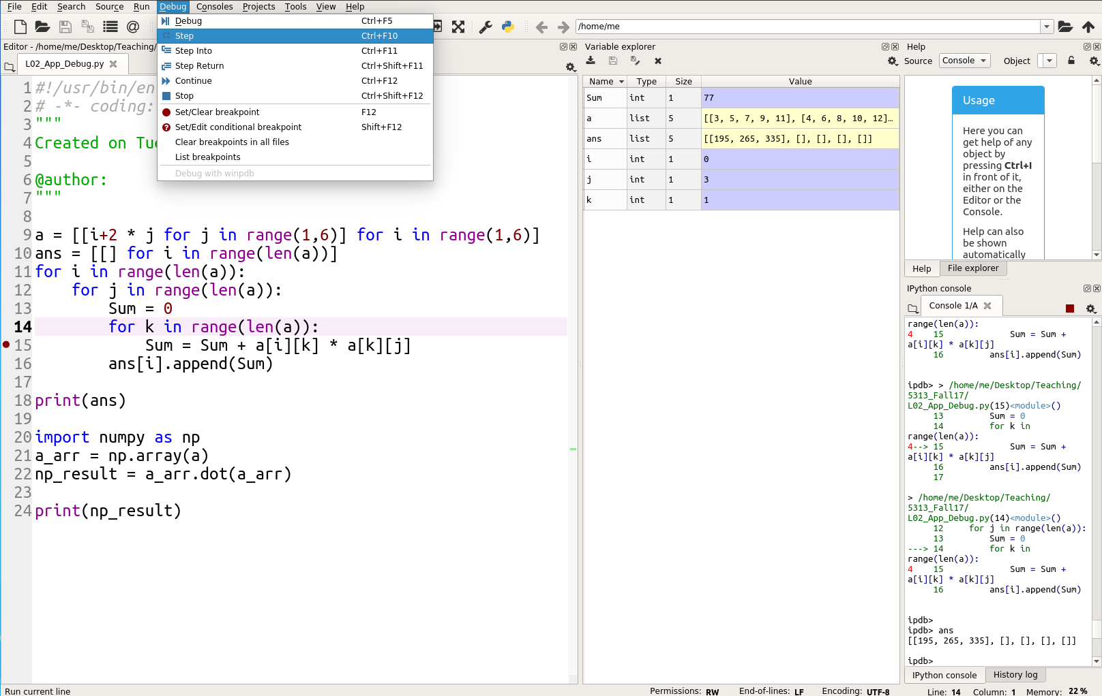

Slide 3
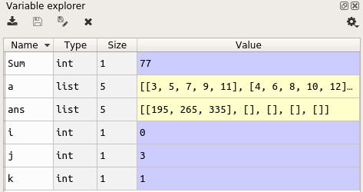
Spyder Component
Variable Explorer Show Value in real time

Slide 4
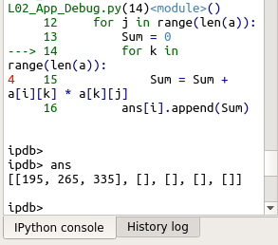
Spyder Component
Type script in ipdb> to help in debug
  Ex: type “ans” make python to show the detail of variable ans

Slide 5
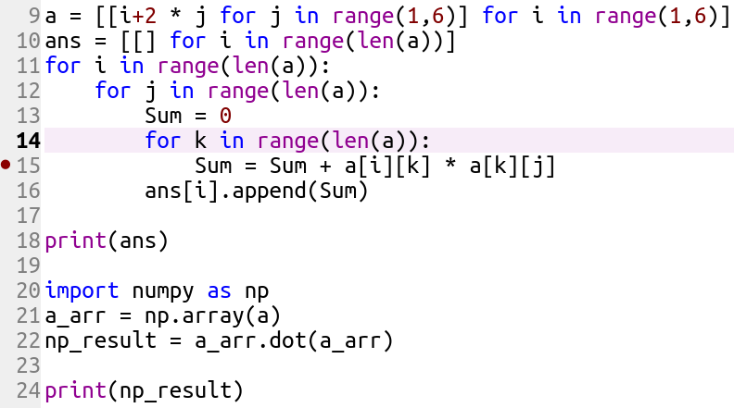
Debugging Tips
Check
  Location of sum = 0
  Initialization
  Limit of loop
  Data type
Help debug by
  Print everything out
  Debug small part first
  Make code clean

