Slide 1
PETR 5313: CRN 38950, Fall 2017
Numerical Application in Petroleum Engineering,
Lesson 04: Root Finding
Ekarit Panacharoensawad, PhD
Terry Fuller Petroleum Engineering Research Building Room 236 ekarit.panacharoensawad@ttu.edu
Copyleft: No rights reserved
Cite as: Panacharoensawad, E. (2017) "Numerical application in petroleum engineering, Lesson 04: Root Finding", presentation slide for Texas Tech PETR 5313 Fall 2017

Slide 2
Outline
  Successive Method
    With Calculator
  Bisection Method
    Direct
    Scipy source code
    Scipy code
  Newton Method
    Direct
    Scipy code

Slide 3
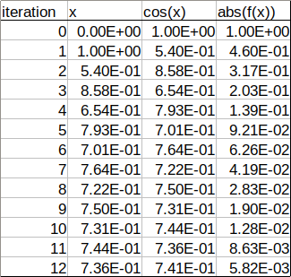
Successive Method (fixed-point iteration)
Solve
  Rearrage:
  Initial guess = 1
  Put 1 as x into cos(x)
  Calculate right hand side value
  Take it as the new x
  Repeat previous steps

Slide 4
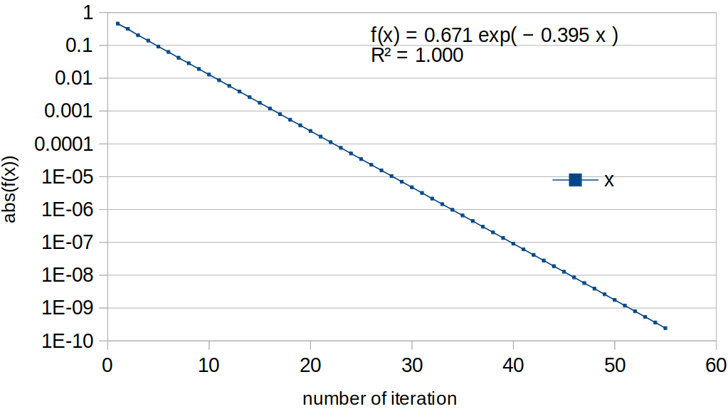
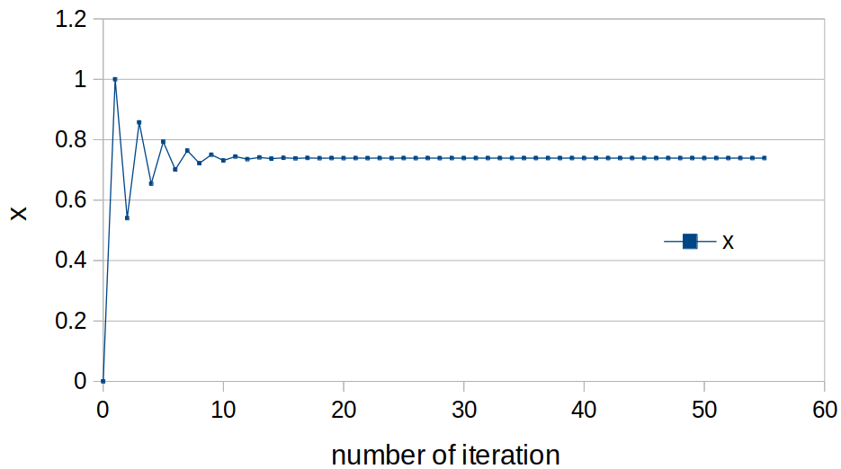
Fixed-point iteration
  X fluctuates and approach an asymptotic line
  Error |f(x)| decrease exponentially
  Need 57+ iteration to have repeated answer (9 digits)
Ans = 0.739085133

Slide 5
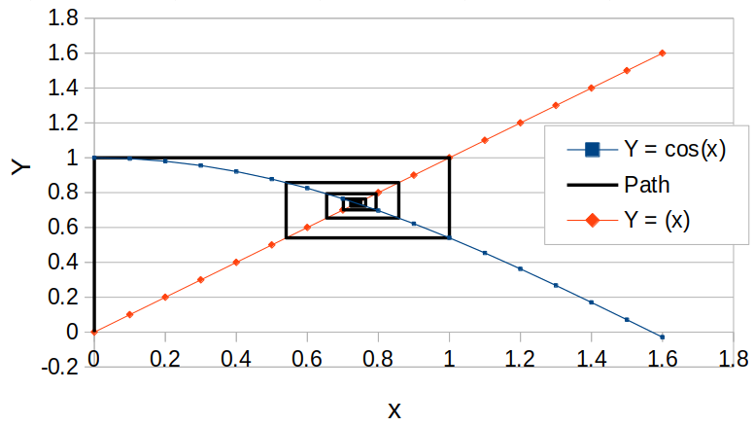
Calculation Path
  RHS function is used to map x_{i} to x_{i+1}

Slide 6
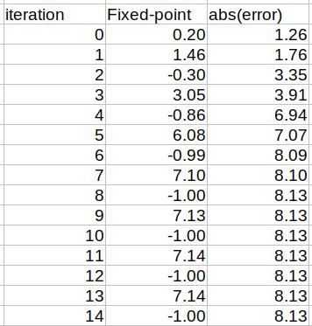
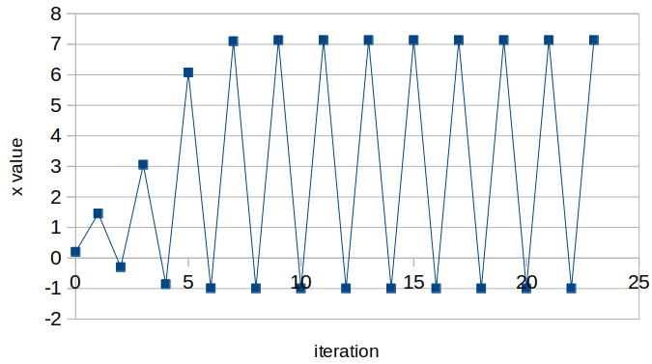
Fixed-point iteration does not always converge
Solving x = 3*EXP(-x)-1 with fixed-point iteration
L04.ods, sheet C02

Slide 7
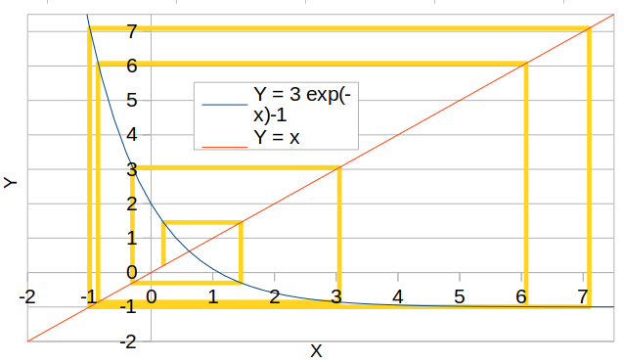
Calculation Path for solving x = 3*EXP(-x)-1

Slide 8
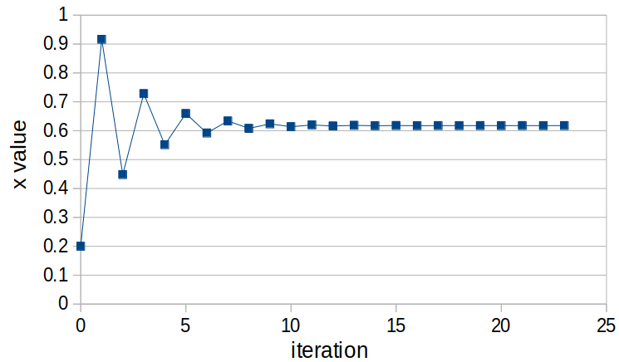
Fixed-point: solving x = 3*EXP(-x)-1 after rearranging
Rearrange the equation to: x = -ln((x+1)/3)

Slide 9
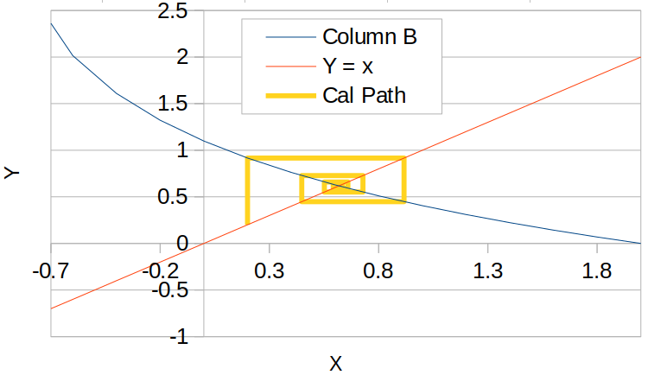
Fixed-point iteration path: after rearrange
Solve:
x = -ln((x+1)/3)
FPI appears to converge when RHS eq has the slope of not less than -1 (roughly speaking)

Slide 10
FPI for various cases of equation
Near the cross point, the RHS equation can be approximated as a linear function
Slope of LHS ( f(x) = x ) is 1
RHS slope = -1 → infinite loop
RHS slope > -1 → converge
RHS slope < -1 → diverge

Slide 11
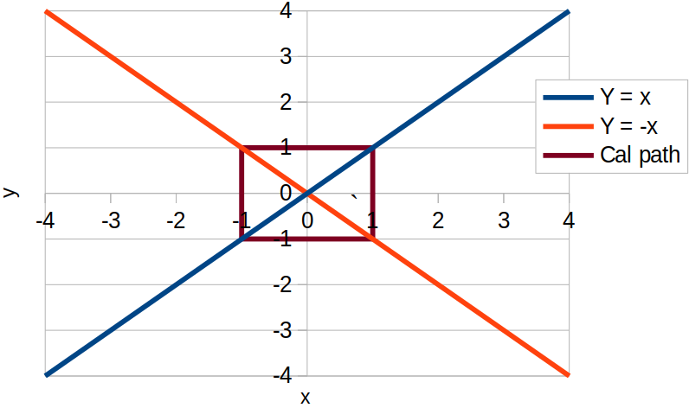
RHS slope = -1: Infinite Loop of FPI / not converge

Slide 12
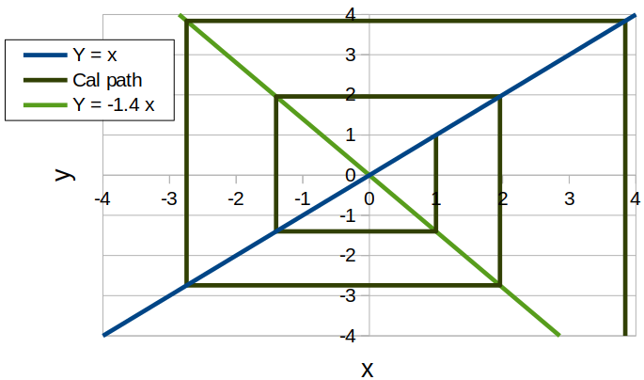
RHS slope < -1: FPI diverges

Slide 13
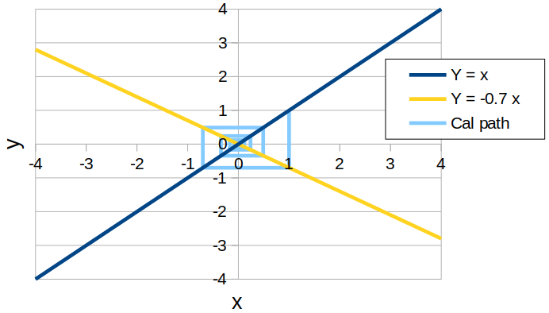
RHS slope > -1: FPI converge

Slide 14
Implementation
In calculator: see how it works
  Prepare to do this in an exam / quiz
In Excel:
  See L04.ods
In VBA / OOBasic
  Do it as a homework
In Python
  See in class (L04.ipnb)

Slide 15
Bisection Method
Working principle
  Divide into half and check each section for the answer
  If the answer is in the left portion, define the new search domain to be the left portion
  If the answer is in the right portion, define the new search domain to be the right portion
  The search domain shrink until it is smaller than
    The answer is then

Slide 16
Bisection Calculation Step
1) Define the function in the form of
2) Define L and R (left and right sides of the domain)
3) Find the middle point,
4) Calculate , , and
  If value of at any point is zero, return that point
5) Compare , , and , to find if
  Or
6) Update the search domain, L and R

Slide 17
Solving Colebrook-White Equation
  Solve at Re = 10⁵, d = 0.052 m, ε = 150 micron
  Rearrange

Slide 18
Bisection Pseudo Code
f = lambda x: …
L = 1E-9 ; R= 1
For 1 to max_iteration
  M = 0.5 * ( L + R )
  fL = f(L); fR = f(R); fM = f(M)
  if sign(fL) * sign(fM) == -1: R = M
  if sign(fR) * sign(fM) == -1: L = M
  else: ‘error occur’, break
  Check for convergence
Show L04_RootFinding.ipynb
After this slide

Slide 19
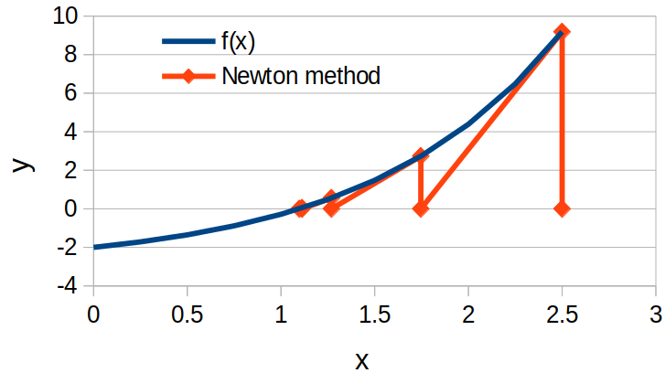
Newton-Raphson Method
  Move along the slope to reach the next point
  L04C05.ods
  Show ipynb

Slide 20
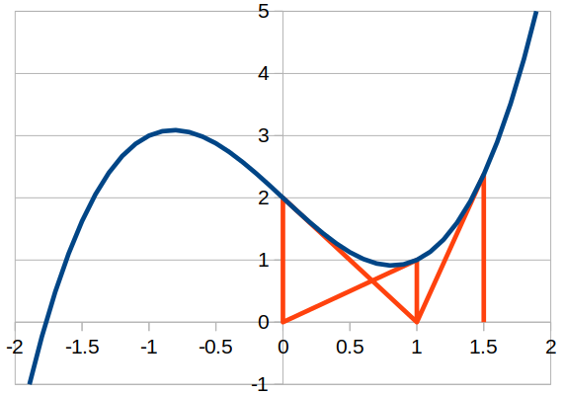
Case where Newton method does not converge
Some initial condition leads to infinite loops
  Changing back and forth, but does not reach the solution
https://en.wikipedia.org/wiki/Newton%27s_method#Starting_point_enters_a_cycle

Slide 21
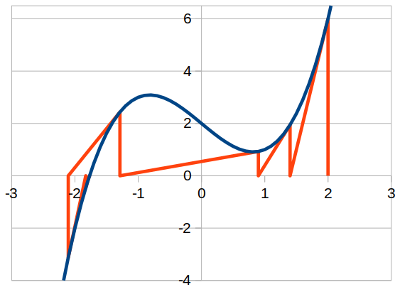
Newton Method (change initial condition)
Change the initial condition can help the convergence
See L04.ods (sheet C05)
https://en.wikipedia.org/wiki/Newton%27s_method#Starting_point_enters_a_cycle

Slide 22
Newton Method: Slope calculation
To not directly taking the derivative, use central finite difference
  Epsilon for stopping calculation criteria cannot be smaller than this epsilon
    Otherwise, the derivative approximation won’t be accurate enough to get the next point
  Double precision has about 15 significant digit,
  If f(x) and f(x+eps) are too close, the difference may have high error

Slide 23
Convergence Requirement
Fixed-point:
  Linear / not always
Bisection
  Linear / always
Newton-Raphson
  Quadratic / not always
Bisection
  Continuous
  Non-differentiable also works
Newton-Raphson
  Continuous
  Differentiable

Slide 24
We will also learn
Unpacking list / dict
  Passing *arg / **kwarg to function
Class object
  Method / operator overloading (__add__)
Sympy / mpmath
  .evalf / N() / integrate / diff / lambdify
  Ei function
Show ipynb for the implementation part

