Slide 1
PETR 5313: CRN 38950, Fall 2017
Numerical Application in Petroleum Engineering,
Lesson 05: System of Linear Equation
Ekarit Panacharoensawad, PhD
Terry Fuller Petroleum Engineering Research Building Room 236 ekarit.panacharoensawad@ttu.edu
Copyleft: No rights reserved
Cite as: Panacharoensawad, E. (2017) "Numerical application in petroleum engineering, Lesson 05: System of Linear Equation", presentation slide for Texas Tech PETR 5313 Fall 2017

Slide 2
Outline
  Solving dense matrix
    Gaussian elimination + back-substitution
    LU Decomposition
    Iterative method
  Tridiagonal
    Thomas algorithm

Slide 3
Gaussian elimination
Eliminate to get upper (right) triangular matrix
Reference: Wikipedia

Slide 4
Gaussian elimination...

Slide 5
Gaussian elimination: 3 nested loop
  Loop from k = 0 to k = n – 2 (index for diagonal terms)
    Index of row that has the leading (pivot) element L_{kk}
    To make any L_{ij} which is directly below L_{kk} to be zero
  Loop from i = k+1 to i = n – 1
    The number of rows that are below L_{kk}
  Loop through each member in the row
    From j = k + 1 to j = n
    @ j = n, we have the augmented column (B from AX = B)

Slide 6
Back Substitution

Slide 7
Partial Pivoting
  If the diagonal element of the pivoting row is zero, then we have division by zero (get nan)
  If the pivoting element is a lot smaller than the one below it, we get high error / unstable
  See ipynb

Slide 8
LU Decomposition
AX = B when B keeps changing
  Gaussian elimination need to be done for each pair of (A, B)
  LU Decomposition factorize A into L and U
    No need to redo the factorization for each B
Ref: https://rosettacode.org/wiki/LU_decomposition
Ref: https://en.wikipedia.org/wiki/LU_decomposition

Slide 9
LU Decomposition ...
or
Use forward substitution to get UX or Y
  or
Use backward substitution to get X based on Y
Ref: https://rosettacode.org/wiki/LU_decomposition

Slide 10
LU Decomposition ...
Set diagonal terms of L to be 1 (to get unique solution of L, U)
Ref: https://rosettacode.org/wiki/LU_decomposition

Slide 11
LU Decomposition ...
Ref: https://rosettacode.org/wiki/LU_decomposition

Slide 12
LU Decomposition ...
Ref: https://rosettacode.org/wiki/LU_decomposition
From
The general forms are

Slide 13
LU Decomposition: Python Implementation
Do from top to bottom
  Left to right (i for row, and j for column)
for i in range(1, N):
#loop for L
for j in range(i): #A[a:b] is [a,b) not [a,b]
Sum = A[0:j,j].dot(A[i,0:j])
A[i,j] = (A[i,j] - Sum)/A[j,j]
#loop for U
for j in range(i,N):
Sum = A[0:i,j].dot(A[i,0:i])
A[i,j] = A[i,j] - Sum

Slide 14
LU: Forward & backward substitution
Forward formula
Backward formula

Slide 15
Determinant of PLU
Determinant can be calculate from sum(cofactor * A[0,:])
Determinant of either L or U is the product of its diagonal terms
Determinant of P is where s is the number of times that switching occur

Slide 16
Determinant of P
Swith 1 & 4, then switch 1 & 2, get
Row 1 (new) = Row 2 (old)
Row 2 (new) = Row 4 (old)
Row 3 (new) = Row 3 (old)
Row 4 (new) = Row 1 (old)
Permutation matrix is the result of the multiplication of E (row-switching transformation)

Slide 17
Determinant of P
Switch 1 time (odd times), causes determinant to be come -1
Switch even number of times, get det(P) =1

Slide 18
Determinant of A

Slide 19
Inverse from PA = LU
Inverse of upper triangular matrix = lower triangular matrix
Inverse of lower triangular matrix = lower triangular matrix
http://www.mcs.csueastbay.edu/~malek/TeX/Triangle.pdf
https://en.wikipedia.org/wiki/Invertible_matrix

Slide 20
Other LU algorithm (code adusted from wikipedia C)
N = 3
for i in range(N):
for j in range(i+1,N):
A[ j, i] = A[ j, i] /A[ i, i]
for k in range(i+1, N):
A[j,k] = A[j,k] - A[j,i] * A[i,k]

Slide 21
Other LU algorithm (reference)
  http://www4.ncsu.edu/~kksivara/ma505/handouts/lu-pivot.pdf
  http://chandraacads.blogspot.jp/2015/12/c-program-for-matrix-inversion.html
  http://www.netlib.org/lapack/double/dgbtrf.f
  http://www.netlib.org/lapack/double/dgetrf.f
  goo.gl/1fw8jg
    Fortran source code in LAPACK
  http://www.math.iit.edu/~fass/477577_Chapter_7.pdf

Slide 22
Matrix Inversion (Gauss-Jordan)
  Append matrix I (identity matrix) to the right-hand-side
  Do Gaussian elimination to get upper triangular matrix on the left
  Do Gaussian elimination again (backward), to get only the diagonal terms (on the left)
  Division with the diagonal element of the left part
See ipython notebook

Slide 23
Cholesky Decomposition
Only work for
  Hermitian matrix
    Transpose of the complex conjugate stay the same
    For real matrix,
  Positive-definite or positive semi-definite
    or for any x
    Positive definite is the subset of positive semi-definite
      Positive definite = symmetric too
Positive-definite is equivalent to all positive Eigen values

Slide 24
Cholesky Decomposition
For matrix with only real number Cholesky decomposition give
  or
  L is unique if A is a positive definite matrix
  If the element in the diagonal of L is allowed to be zero, positive semi-definite can be factorized into L and L^{T}
    But the algorithm does not work
http://eprints.ma.man.ac.uk/1193/01/covered/MIMS_ep2008_56.pdf

Slide 25
Cholesky Decomposition
  Can be used to check if the matrix is positive definite or note without calculate each Eigen values
Algorithm
https://en.wikipedia.org/w/index.php?title=Cholesky_decomposition

Slide 26
Cholesky Decomposition ...
Roughly 2 times faster than LU

Slide 27
Iterative Method for system of linear equation
Jacobi method
  Only for diagonally dominant
    May need full pivoting (switch both row & column) to get diagonally dominant matrix (expensive)
Gauss-Seidel method
  Diagonally dominant or positive definite matrix
Iterative method is for large dense matrix / large sparse matrix
  300 x 300 use direct method
  large = matrix doesn’t fit RAM or sparse 100k x 100k
http://homepage.divms.uiowa.edu/~atkinson/m171.dir/sec_8-6.pdf

Slide 28
Application for iterative method
Discretized form from finite volume / finite different / finite element is usually in the form of large sparse matrix
  Better solved by iterative method

Slide 29
Jacobi Method
https://en.wikipedia.org/wiki/Jacobi_method

Slide 30
Jacobi Method...
https://en.wikipedia.org/wiki/Jacobi_method

Slide 31
Jacobi Method...
See ipynb for source code
https://en.wikipedia.org/wiki/Jacobi_method

Slide 32
Export Calculation Data to LibreOffice Calc
import pandas as pd
col1 = A.dot(ans)
col2 = b
dt = pd.DataFrame(data = np.hstack([col1,col2,col1-col2]),
columns=['A.dot(ans)','b', 'A.dot(ans) - b'])
dt.to_csv('Jacobi_result.csv')
  Export via numpy.savetxt
  np.savetxt(fname = 'jacobi_via_np.csv', X =
np.hstack([col1,col2,col1-col2]), delimiter=',')
Export via pandas

Slide 33
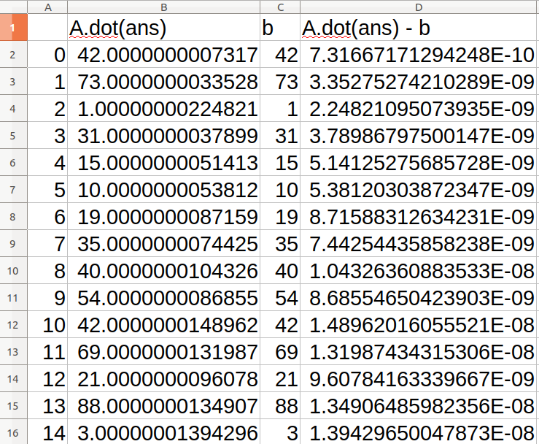
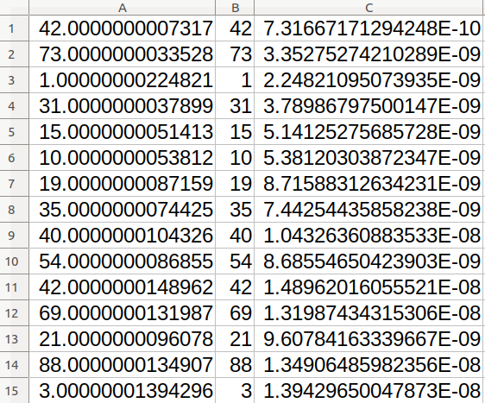
CSV export result
Export via pandas Export via numpy

Slide 34
Jacobi Convergence Criteria
Maximum absolute Eigenvalue of (D⁻¹R) < 1 (standard cond’)
  Take absolute value of each Eigenvalue of D-1R first
  The maximum Eigenvalue should be less than 1
  If not, it does not converge
  Eigenvalues of A are from
  Thus,
    Because is non-invertible matrix
Sufficient condition

Slide 35
Gauss-Seidel Method
https://en.wikipedia.org/wiki/Gauss%E2%80%93Seidel_method

Slide 36
Gauss-Seidel Method ...
https://en.wikipedia.org/wiki/Gauss%E2%80%93Seidel_method

Slide 37
Gauss-Seidel Method...
Use forward substitution to solve for
https://en.wikipedia.org/wiki/Gauss%E2%80%93Seidel_method

Slide 38
Gauss-Seidel Method: Convergence Criteria
Gauss-Seidel method converge either
  A is symmetric positive-definite
  A is strictly or irreducibly diagonally dominant
    strictly diagonally dominant
    Irreducibly diagonally dominant
      Irreducible matrix where at least on one row
      and the rest are
      Irreducible matrix:
      Cannot be reduced to an upper triangular matrix with P

Slide 39
Successive Over-Relaxation (SOR)

Slide 40
SOR
L and U are strictly lower and upper diagonal matrices, respectively.

Slide 41
SOR...
If omega = 1, we have Gauss-Seidel method
or
For omega > 1, the next x is based more on b, U, and D
  This is to move to the answer faster
  Omega < 1, move to the answer slower

Slide 42
Fast method for sparse matrix
  Thomas method (only fully cover this)
  Conjugate Gradient for A x = b
    scipy.sparse.linalg.cg
    Need hermitian positive definite matrix
  Generalized Minimal RESidual iteration for A x = b
    scipy.sparse.linalg.gmres
    OK for non-symmetric system, not for any invertible matrix
  For both A and A-1 are sparse, use
    scipy.sparse.linalg.inv
  LU Decomposition: scipy.sparse.linalg.splu

Slide 43
Thomas Algorithm: For tridiagonal matrix
It is important for solving system of linear equations obtained from PDE discretization
https://en.wikipedia.org/wiki/Tridiagonal_matrix_algorithm

Slide 44
Thomas Algorithm ...

Slide 45
Thomas Algorithm: Derivation
Update equation 2 by: eq2 * b1 – eq1 * a2
This eliminate x1
https://en.wikipedia.org/wiki/Tridiagonal_matrix_algorithm

Slide 46
Thomas Algorithm: Derivation...
Eliminate x2 in the third row by
Update eq3 by: eq3 * b2_new - eq2_new * a3
b2_new is the new coefficient of x2 after the update in 2nd row

Slide 47
Thomas Algorithm: Derivation...
Elimination of x2 in row 3 gives
or
https://en.wikipedia.org/wiki/Tridiagonal_matrix_algorithm

Slide 48
Thomas Algorithm: Derivation...
Writing the updated equation in the recursive way (relative to the previously updated coefficient, instead of the original coefficient), we have
Eq2 with update as
https://en.wikipedia.org/wiki/Tridiagonal_matrix_algorithm

Slide 49
Thomas Algorithm: Derivation...
Eq 3 with update become
Or
Or

Slide 50
Thomas Algorithm: Derivation...
For the first row, we have
For any i^{th} row, we have

Slide 51
Thomas Algorithm: Derivation...
For each i^{th} row, divide the whole row with
Then,
become and

Slide 52
Thomas Algorithm: Derivation...
Now, we have
and

