Slide 1
PETR 5313: CRN 38950, Fall 2017
Numerical Application in Petroleum Engineering,
Lesson 07: Linear Regression
Ekarit Panacharoensawad, PhD
Terry Fuller Petroleum Engineering Research Building Room 236 ekarit.panacharoensawad@ttu.edu
Copyleft: No rights reserved
Cite as: Panacharoensawad, E. (2017) "Numerical application in petroleum engineering, Lesson 07: Linear Regression", presentation slide for Texas Tech PETR 5313 Fall 2017

Slide 2
Linear Regression: Outline
  Closed-form for least square linear regression
  Regularization, L1, L2, elastic net
  Data Preparation
    Scaling
  Coding the model
    Making pipeline
    Making user define estimator (user class)
  Model performance
    Test / Train / Validation sets
    Cross-validation
    Learning curve

Slide 3
Linear least squares closed-form solution
Regression model
Linear equation

Slide 4
Least squares: Getting beta values
1 Data point case
Residual: actual - prediction

Slide 5
Least squares: Getting beta values...
Many Data points case
To get a unique solution, we need n < m.

Slide 6
Least squares: Getting beta values...
Many Data points case (notice m and n in beta and y)

Slide 7
Least squares: Getting beta values...
The best fit line does not pass through every points
  We just need to find betas that minimize the sum square error (SSE)
n columns in X must be linearly independent to get unique solution
https://en.wikipedia.org/wiki/Linear_least_squares_(mathematics)

Slide 8
One reason for sum square error
If we use just sum of absolute distance to the lines,
  A and B C are equally good
If we use sum square error, (equivalent to use area)
  We give more weight to the larger deviation cases
A
B
Area from case B is less than the area from case A

Slide 9
Least squares: Getting beta values...
Betas that allow SSE to be minimized is defined as
value that minimize SSE can be found from and set the result to be zero

Slide 10
Least squares: Getting beta values
At min(SSE), derivative = 0

Slide 11
Least squares: Getting beta values
is only for one j value
We actually have n of the above equation (j = 1, 2, …, n)
is mxn matrix. is mx1 matrix. is nx1 matrix.
In matrix form, we have
is nx1 matrix

Slide 12
Least squares: Getting beta values...

Slide 13
Least squares: Getting beta values...

Slide 14
Least squares: Getting beta values...

Slide 15
Least squares: Getting beta values...
can be calculated by solving system of linear equation
Ax = b
In this case

Slide 16
Polynomial Regression (still linear)
After setting x from degree 0 to degree n, the rest is the same

Slide 17
Polynomial Regression
First import the class PolynomialFeatures
  from sklearn.preprocessing import PolynomialFeatures
Second: Create a variable to be that class
  poly = PolynomialFeatures(degree = 3)
Third: Use class method to create polynomial matrix
  x_poly = poly.fit_transform(x.reshape(-1,1))
  x.reshape(-1,1) is for make a column vector
  X = [x1, x2, x3, x4]
  x.reshape(-1,1) = [ [x1], [x2], [x3], [x4]]
-1 in reshape means, adjust the number of row automatically

Slide 18
Polynomial Regression
x = np.linspace(-100,100,200) create array of 1 row, 200 members.
Start and End indices of .linspace function are inclusive
x.shape gives x(200, )
x_poly = poly.fit_transform(x.reshape(-1,1)) gives
array([[1., -100. , 10000., -1000000.],
[1.,-98.995, 9800.005, -970151.254],
.., ..., ..., ... ,
......[1., 100. , 10000., 1000000.]

Slide 19
Polynomial Regression (manual)
x = np.linspace(-100,100,200)
y = 3*x**3 - 7*x**2 + 16*x - 19
poly = PolynomialFeatures(degree = 3)
x_poly = poly.fit_transform(x.reshape(-1,1))
XTX = x_poly.T.dot(x_poly)
XTy = x_poly.T.dot(y.reshape(-1,1))
Beta = sp.linalg.solve(XTX,XTy)
In : Beta
Out: array([[-19.], [-16.], [ -7.], [ 3.]])

Slide 20
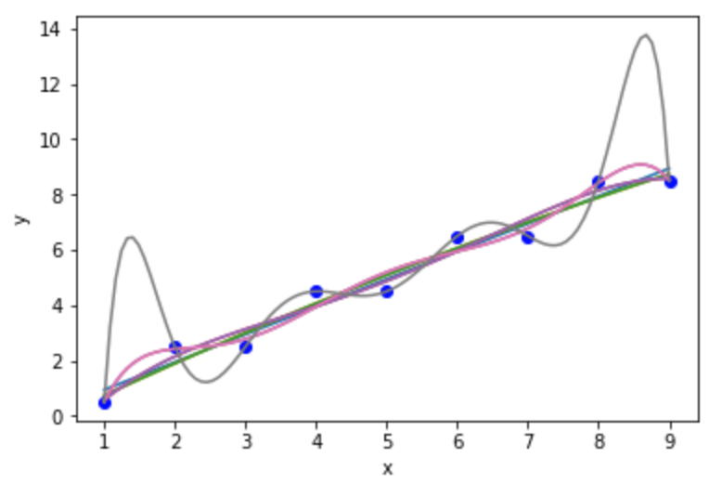
Over-fitting
Higher degree of polynomial can fit data better, but cannot extrapolate
Which line have highest r2 score?
  Deg 8 line
Which line is promising
for extrapolation?
  Deg 1 line

Slide 21
Checking the model performance
Train-Test-Split
  Separate 20% of the data out and use them at the end (test data set)
  Use 80% of the data (train dataset) to train the model
Over-fitting
  Model can match (memorize) the train dataset very well but cannot be used to accurately predicting the test data set
Under-fitting
  Model cannot predict the train dataset

Slide 22
Train-Test-Split Code
from sklearn.model_selection import train_test_split
x_train, x_test, y_train, y_test = (
train_test_split(x , y, test_size = 0.2,
random_state = 2))
random_state is to allow a repeatable result
Same random state means that the sample will be shuffled the same way.

Slide 23
Data Leaking and Leaking type
Data leaking is dangerous because we may think that the model is good, but when we really use it in the real world, it does not work
Leaking Type
Not using test set at the end
    Looking at the test set and do data preprocessing and model selection
    Adjust the hyper parameters (parameters in model) to make a good match with the test set
Use the answer to predict other answers
  Use one or more of the target values (dependent variable) as the feature (independent variable)

Slide 24
Data Leaking in time series data
Leaking Type
Looking from the hindsight
  Use the data to be predicted as the input
  Preprocessing / Model assumptions are based on the information that is not known at the time of the prediction
  Accidentally shuffle the train dataset, causing the future information to be available at the model prediction time

Slide 25
Cross-Validation (concept)
Cross-validation is the way to tell model performance of various models without using the test dataset
Situation: We have 100 models and want to find the best
These 100 model can be the same algorithm with just different hyper-parameters in the model
1) Exclude the test set from the cross-validation process
2) Divide the rest of the data into k-folds (groups)
One group is used as the validation group, the rest is used as the training group. Validate the model k-times to get the cross-validation score (can be average). Then do this for every model.

Slide 26
Cross Validation Score Code
cross_val_score Function is for calculating the score (e.g. r2_score) by equally splitting the x domain into 3 folds (default value)
  Data in 1 fold is used as the test set
  Data in another 2 folds are for training the model
  Once each fold is used as the test set, test scores from each training are reported
By default, cross_val_score use KFold function with default value (no shuffle) to create train/test sets

Slide 27
Cross Validation Score Code
from sklearn.model_selection import cross_val_score
for deg in range(1,9):
poly = PolynomialFeatures(degree = deg)
x_poly = poly.fit_transform(x_train.reshape(-1,1))
model = LinearRegression()
CV = KFold(n_splits=5, shuffle=False)
score = cross_val_score(model, x_poly, y_train, cv = CV)
print(score, score.mean())

Slide 28
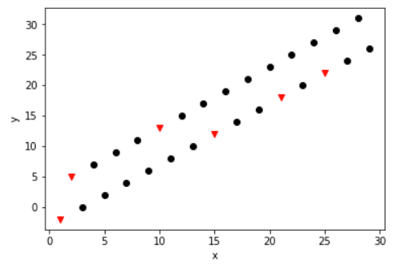
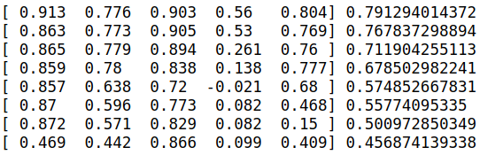
cross_val_score result
Result after training with polynomial degree 1 to 8
  Linear model is the best
x_train are black dots
Note that test set was not used in cross_val_score calculation

Slide 29
Regularization Method on Linear Regression
Regularization method is to penalize complicated models.
With no regularization
With L1 regularization
With L2 regularization

Slide 30
L_{p} norm
For
a = np.arange(1, 101, dtype = np.longdouble)
  Number from 1.0 to 100.0

Slide 31
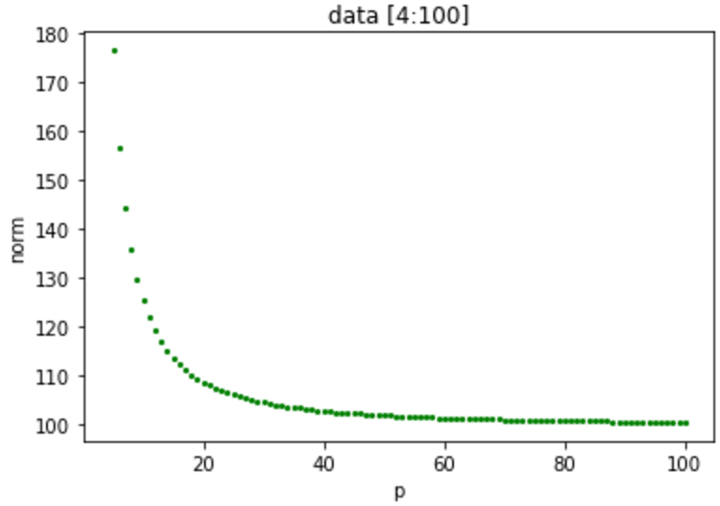
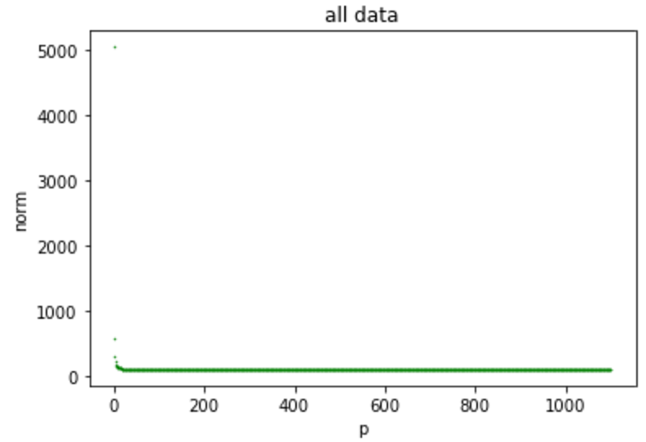
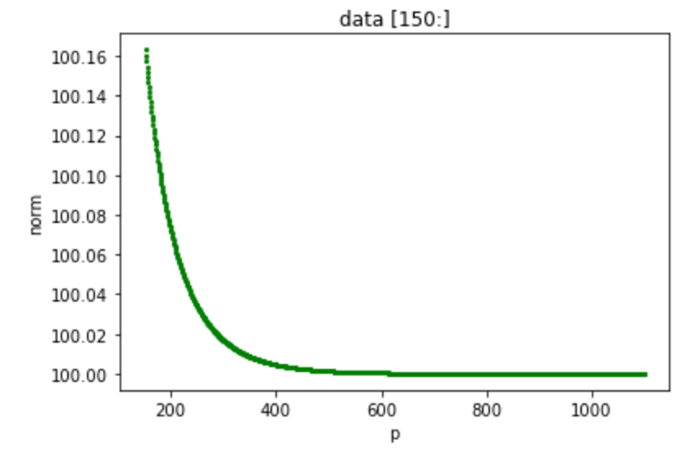
L_{p} norm
As p increases, the norm value put more weight on the large value
For [1,2,3,4,…,100], Norm value approaches infinity as

Slide 32
Elastic Net Regularization
For r = 0, Elastic net become Ridge regression
For r = 1, Elastic net become Lasso regression
For 0 < r < 1, Elastic net is the combination of L1 and L2 regularization methods
Better than Lasso, for correlated independent variables case
  Used in support vector machine classification (not cover)

Slide 33
L1 & L2 Regularization (LASSO & Ridge)
LASSO (Least Absolute Shrinkage and Selection Operator)
  Lasso (L1) tends to make the weight (slope) for irrelevant factor to be zero
Ridge Regression (L2, Tikhonov regularization)
  If we don’t know for sure that only fews features matter, avoid Lasso, use Ridge regression
Elastic net regularization: Better than Lasso for the case of
  Several features are strongly correlated
  There are more features than training instances
Elastic net has more hyper-parameter to be adjusted!

Slide 34
LASSO Implementation
from sklearn.linear_model import Lasso
model = Lasso(alpha=100, max_iter=1000000)
model.fit(x_poly,y_train)
score = cross_val_score(model, x_poly, y_train, cv = 5)
score, score.mean()
The above code declare model to be class Lasso with the initialization of alpha and max_iter parameters. After model is fit with the x_poly and y_train, then cross validation score is calculated

Slide 35
Time Complexity
sklearn.linear_model.LinearRegression
sklearn.linear_model.Ridge
  O(np²), assume that n ≥ p, p = number of coef_, n = number of data
  Do not require feature scaling
Sklearn.linear_model.SGDRegressor
  O(knp_{av}), k = number of iteration, p_{av} = average number of non-zero attributes per sample
  Require feature scaling
  Can do out-of-core fitting (data don’t fit in RAM)

Slide 36
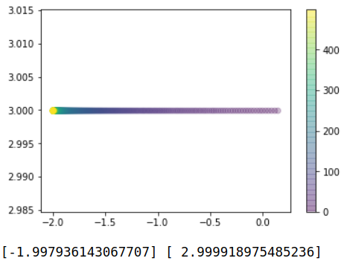
Stochastic Gradient Descent (without scaling)
sgd = SGDRegressor(max_iter = 2, penalty = None,
warm_start = True, #take the old fitting into consideration
fit_intercept=True, learning_rate='constant', eta0 = 1e-3)
ans = [[],[],[]]
for i in range(500):
sgd.fit(X.reshape(-1,1),y)
ans[0].append(sgd.intercept_)
ans[1].append(sgd.coef_)
ans[2].append(i)
plt.scatter(ans[0],ans[1],c=ans[2], alpha = 0.25)
plt.colorbar()
plt.show()
print(ans[0][-1],ans[1][-1])

Slide 37
Stochastic Gradient Descent (without scaling)
warm_start = True is used so that the result from the current iteration will be used in the next iteration
for i in range(500):
sgd.fit(X.reshape(-1,1),y)
In each iteration, sgd take at most 2 rows (max_iter = 2) to search for the fitting parameters (unknown constants) in the model. The training process is done after 500 iteration.

Slide 38
Stochastic Gradient Descent: Learning Rate
At each iteration, the next answer is calculated from
  W is the vector of unknown constant in the model (can be polynomial coefficient)
  Q is the cost function. Default value is sum-square-error
  Q(w) means that w is the input to calculate Q(w)
  Eta is the learning rate (step-size)
The objective is to move w into the direction that Error (or Q) will decrease quickest.

Slide 39
Stochastic Gradient Descent: Learning Rate
If the learning rate is too much, we may always pass the answer. If the learning rate is too small, we may stop before reaching the answer
Learning rate for SGDRegressor in sklearn
‘constant’
‘optimal’
‘invscaling’

Slide 40
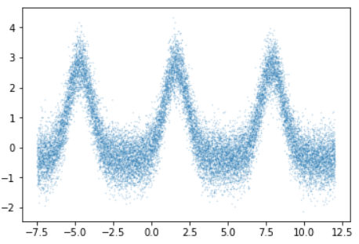
Incremental Learning with SGDRegressor
View of the data (10% of the total data, selected randomly)

Slide 41
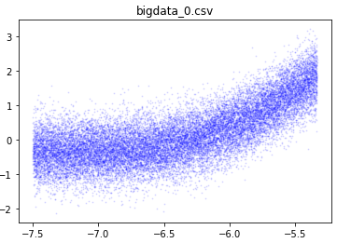
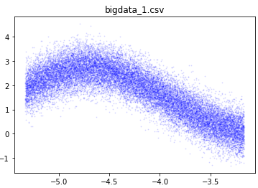
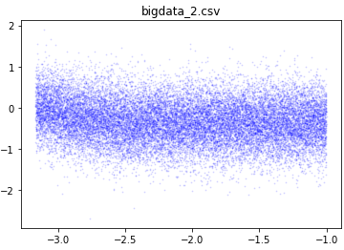
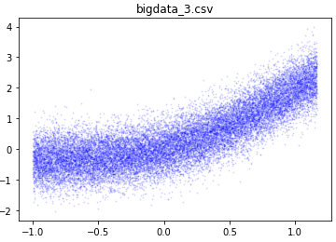
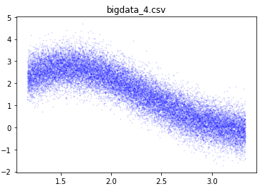
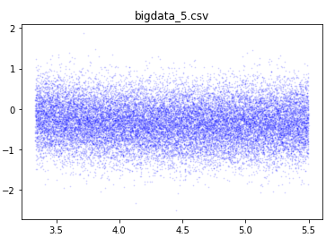
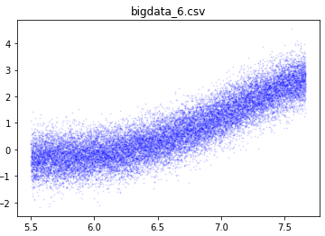
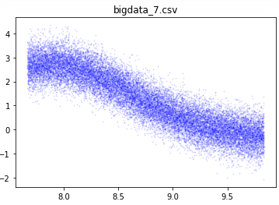
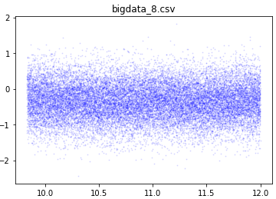
Incremental Learning with SGDRegressor
Create 9 files to keep each part of the data (21k lines each)
  Feed the data into SGD file by file
  Preprocessing (scaling) is based on the SD and x-bar of the data in the first file
    So that one scaling method is used for all data

Slide 42
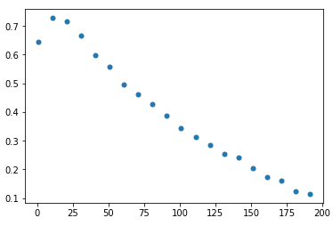
SGDRegressor Result
The plot is the r-squared value versus training iteration
Train the model to many times can
  Make step size decrease, model is not sensitive to later data
  Over-fit the model with noise in data

Slide 43
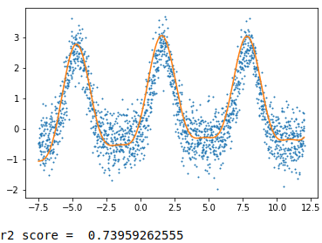
SGDRegressor Result...
We note that the model can fit the data correctly (if we stop early) even though it see only one part of the data at a time!
Bases for curve fittings are
C0 + C1*x + C2 sin(x) + C3 cos(x) +
(C0 + C1*x + C2 sin(x) + C3 cos(x))**2
True result is from
np.sin(x)*np.exp(np.sin(x))
Noise is from
noise = np.random.normal(size = y_.shape)
y_real = y_ + 0.5 * noise

Slide 44
Reference:
  Wikipedia
    https://en.wikipedia.org/wiki/Tikhonov_regularization
    https://en.wikipedia.org/wiki/Lasso_(statistics)
    Geron, A. “Hands-On Machine Learning with Scikit-Learn & TensorFlow”, O’Reilly, Boston, USA
  Scikit-learn documentation
    http://scikit-learn.org/
    http://scikit-learn.org/stable/modules/sgd.html
  Stackoverflow
    https://stackoverflow.com/questions/31443840/sgdregressor-nonsensical-result

