Slide 1
PETR 5313: CRN 38950, Fall 2017
Numerical Application in Petroleum Engineering,
Lesson 08: Interpolation, Extrapolation, and Integration
Ekarit Panacharoensawad, PhD
Terry Fuller Petroleum Engineering Research Building Room 236 ekarit.panacharoensawad@ttu.edu
Copyleft: No rights reserved
Cite as: Panacharoensawad, E. (2017) "Numerical application in petroleum engineering, Lesson 08: Interpolation - Extrapolation", presentation slide for Texas Tech PETR 5313 Fall 2017

Slide 2
Outline
  Interpolation
  Extrapolation
    1D data
    2D data
    Linear
    Cubic spline

Slide 3
Linear Interpolation
Draw a straight line connected two dots A and B to tell the f(x) value based on the give x value.

Slide 4
Method for interpolation
Given data:
Target: y value at x_{t} (val)
Manual
  Need to find x_{i} and x_{i+1} that x_{t} stays in between
    idx = np.abs(x-val).argmin()
      x is list, .argmin() find the index where minimum value occur
    idx2 = np.searchsorted(x, val) – 1
      This give the index on the left boundary

Slide 5
Method for interpolation
Automatic Function: numpy.interp
np.interp(val,x,y)
  This is to get y at x value equal to val
val can be list of values too
  This does interpolation several times

Slide 6
Linear Extrapolation
Extend a straight line outside the domain to get the value of y at an interested x
  Equation is the same as linear equation
Manual method
  Need to find if extrapolation is on left or right side of the domain
Automatic
  from scipy import interpolate
  Lin_inter = interpolate.interp1d(x,y,kind='linear'
  ,fill_value='extrapolate')
  y_sp = Lin_inter(val)

Slide 7
Interpolation for 2D data: Use Scipy
model = interpolate.interp2d(x = T_in,
y = P_in, z = Mu_in)
val = (70,3000)
z_pred = model(*val)
P_in.shape gives (11,)
T_in.shape gives (7,)
Mu_in.shape gives (11, 7)

Slide 8
Interpolation for 2D data: Manual
From (z,T) = (109.7, 66.7) and (93.5, 75) at P = 2550
  Find z at T = 70.0 (target) by linear interpolation
From (z,T) = (97.5, 66.7) and (81.2, 75) at P = 3040
  Find z at T = 70.0 (target) by linear interpolation
From (z,P) = (103.2, 2550) and (90.978, 3040) at T = 70
  Find z at P = 3000 (target) by linear interpolation

Slide 9
Simple Cubic Spline
Input: Slope + coordinate of 2 points
  (x1, y1), (x2, y2)
  Slope at (x1, y1) and (x2, y2)
Output:
  Curve that pass those 2 points and have the specified slope

Slide 10
Simple Cubic Spline: Curve fitting equation
q is the cubic spline prediction
k is the slope

Slide 11
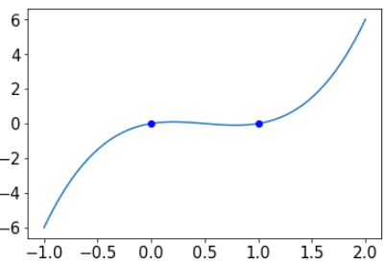
Simple Cubic Spline: Example
For
Find the interpolation / extrapolation curve from cubic spline
x = np.linspace(-1,2,100)
t = (x-x1)/(x2-x1)
a = k1*(x2 - x1) - (y2 - y1)
b = -k2*(x2 - x1) + (y2 - y1)
q = (1 - t)*y1 + t*y2 + t*(1 - t)*(a*(1 - t) + b*t)

Slide 12
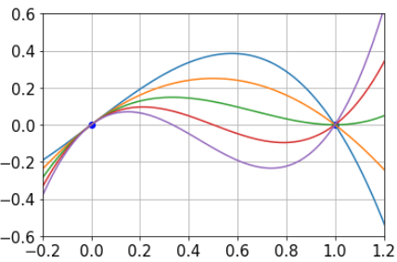
Simple Cubic Spline for Various Cases
For k2 in [-2, -1, 0, 1, 2], we have
Cubic spline adjusts the interpolation curve according to the specified slope

Slide 13
Cubic Spline for Multiple Points
Advantages of using cubic spline
  Cubic spline can approximate the slope between points accurately (in addition to the function value)
Use Cubic spline when trying to approximate the slope of function based on the samples of function values
Output properties
  q(x), q’(x), and q’’(x) are piecewise continuous functions!

Slide 14
Cubic Spline for Multiple Points: Natural B.C.
  When we have many points, we typically do not know the slope at each point.
  To use cubic spline without knowing the slope, the boundary condition on each end should be specified
  One simple and powerful assumption is that q’’(x0) and q’’(xn) = 0
    This is called “natural boundary condition”
    This mean that the curves are just straight at both ends location

Slide 15
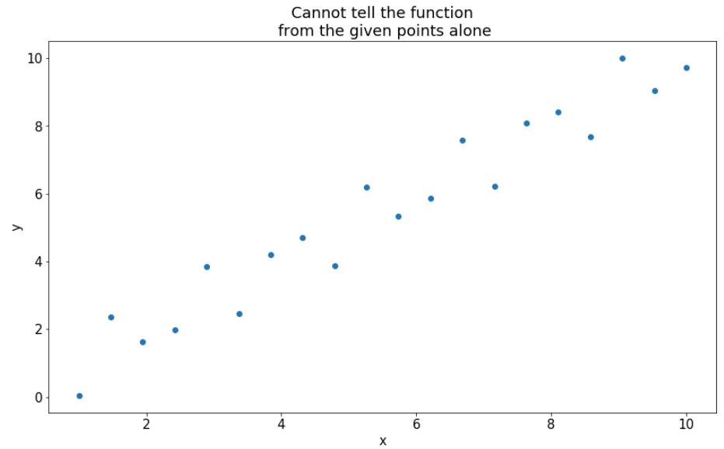
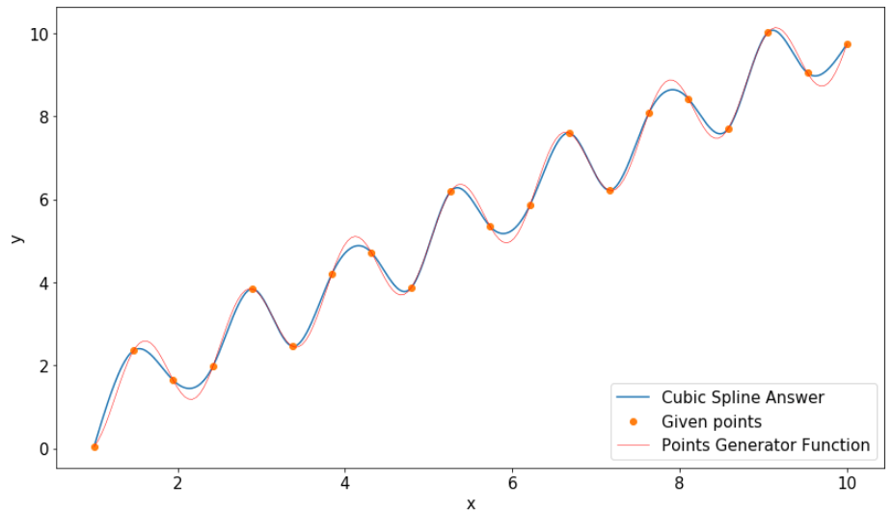
Cubic Spline for Multiple Points: Example
Cubic Spline solution was done by not knowing the function used to generate the data points
Before cubic spline interpolation
After cubic spline interpolation

Slide 16
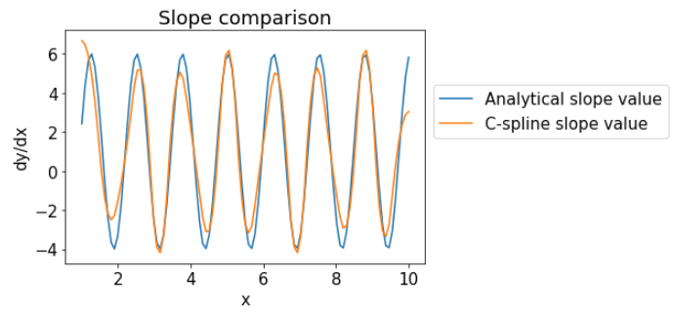
Cubic Spline for Multiple Points: Example
Slope from cubic spline is comparable to the analytical solution

Slide 17
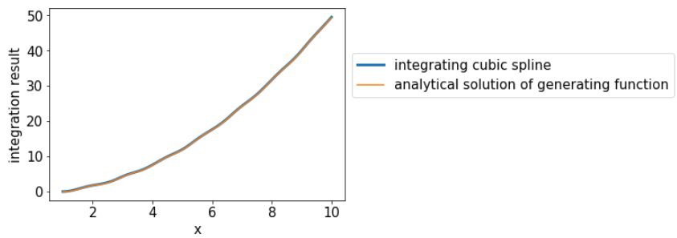
Cubic Spline for Multiple Points: Example
Integration of the approximation function is also close to the analytical solution of the original equation

Slide 18
Cubic Spline for Multiple Points: Calculation Steps
  Solve for slope at each points by assume the second derivative to be zero for the end points (natural B.C.)
  Once the slopes are obtained, use Simple cubic spline approach to get the interpolation value in each interval
Variable definition
  k = slope (to be calculated)
  x[i] = given x-coordinate of the point i
  y[i] = given y-coordinate of the point i

Slide 19
Cubic Spline: Slope Calculation
  Solve system of linear equations to get all k
for i = 0
for i = 1 to n-1
for i = n

Slide 20
Cubic Spline: Slope Calculation...
Derivation: https://en.wikipedia.org/wiki/Spline_interpolation

Slide 21
Cubic Spline: Slope Calculation...
Coefficient for system of linear equation

Slide 22
Cubic Spline: Solving Manually
B0 = 2*(x[1]-x[0])
C0 = x[1]-x[0]
D0 = 3*(y[1]-y[0])
Ai = [1.0/(x[i]-x[i-1]) for i in range(1,len(x)-1)]
Bi = [2 * (1.0/(x[i]-x[i-1]) + 1/(x[i+1]-x[i])) for i in range(1,len(x)-1)]
Ci = [1.0/(x[i+1]-x[i]) for i in range(1,len(x)-1)]
Di = [3*((y[i]-y[i-1])/(x[i]-x[i-1])**2 + (y[i+1]-y[i])/(x[i+1]-x[i])**2)
for i in range(1,len(x)-1)]
n = len(x) - 1 # the index is from 0 to n-1, not to n
An = x[n]-x[n-1]
Bn = 2*(x[n]-x[n-1])
Dn = 3*(y[n]-y[n-1])
AA = Ai+[An] # + operation for list is concatenation (similar to .append)
BB = [B0] + Bi + [Bn]
CC = [C0] + Ci
DD = [D0] + Di + [Dn]
CSpline = sp.sparse.diags(diagonals=[BB,AA,CC], offsets=[0,-1,1])

Slide 23
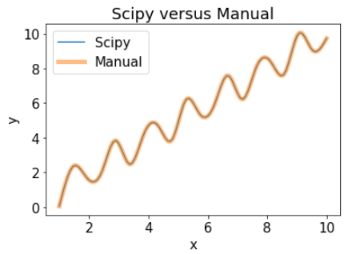
Cubic Spline: Using automatic function
model = sp.interpolate.CubicSpline(x,y,bc_type='natural')
y_pred = model(np.linspace(1,10,100))
Scipy automatic function is shorter and it is doing the same things with the manual implementation

Slide 24
Calculate Slope / Integrating Area from Cubic Spline
Get prediction of y, y’, and y’’
  y_pred = model(np.linspace(1,10,1000))
  y_slope_pred = model(np.linspace(1,10,1000),nu=1)
  y_slope2_pred = model(np.linspace(1,10,1000),nu=2)
Get integration result
  x_inte = np.linspace(1,10,101)
  y_inte = [model.integrate(1,i) for i in x_inte]

