Slide 1
PETR 5313: CRN 38950, Fall 2017
Numerical Application in Petroleum Engineering,
Lesson 09: Integration
Ekarit Panacharoensawad, PhD
Terry Fuller Petroleum Engineering Research Building Room 236 ekarit.panacharoensawad@ttu.edu
Copyleft: No rights reserved
Cite as: Panacharoensawad, E. (2017) "Numerical application in petroleum engineering, Lesson 09: Integration", presentation slide for Texas Tech PETR 5313 Fall 2017

Slide 2
Outline
  Trapezoidal
    Uniform discretization
    Non-uniform discretization
  Simpson Method
    Simpson 1/3
    Simpson 3/8
  Double integration
    Sympy
    Scipy dblquad
    Simpson twice!

Slide 3
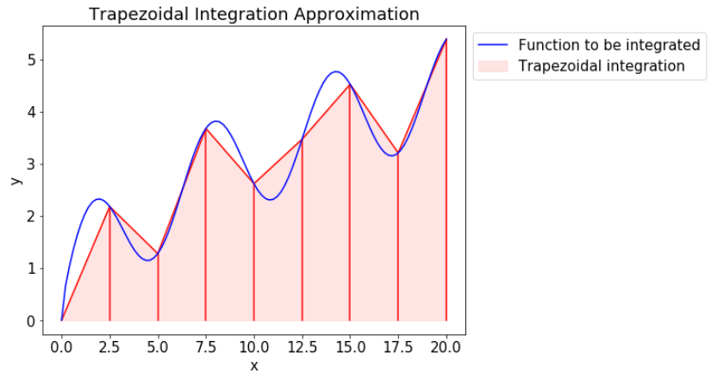
Trapezoidal Method
Approximate areas with several trapezoidal shapes and add them together

Slide 4
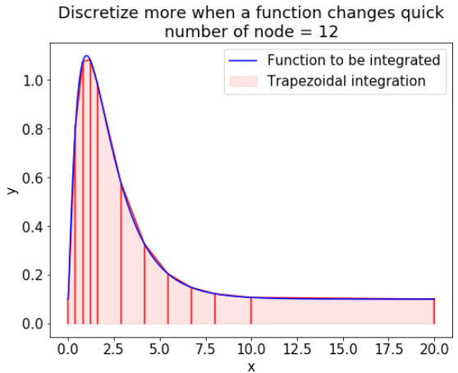
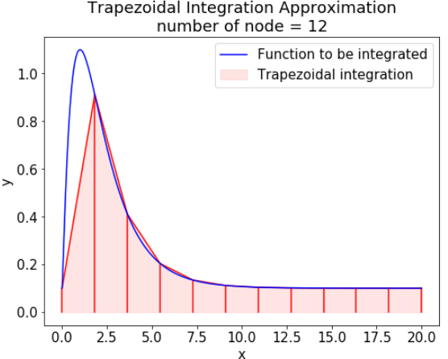
Trapezoidal Method: Non-uniform discretization
Discretize more where it is needed give better accuracy
  More point where function changes quick

Slide 5
Benefit of finer grids where it is needed
  Achieve a better accuracy with the same number of grid point
  Faster calculation with the same accuracy as compared to the uniform finer grids cases
  Less numerical error from adding small number together
Error from adding float together
  Float has about 15 – 16 significant digit
  More discretization is generally good, but too much can cause error

Slide 6
Error from adding numbers
It may seem that using trapezoidal with many sections just slow down the process, but give a more accurate answer.
  This is true, to a certain point
Consider
  Where is 1, 0.1, ...,
  When x is too small, error increases
[(0, 5.0),
(1, 5.0),
(2, 4.99999999999999),
(3, 4.999999999999916),
(4, 4.9999999999999485),
(5, 4.999999999995016),
(6, 4.999999999895295),
(7, 4.999999999633759)]
Summation result in the format of (a,b) where a is the negative value of the exponent of xi
b is the summation result

Slide 7
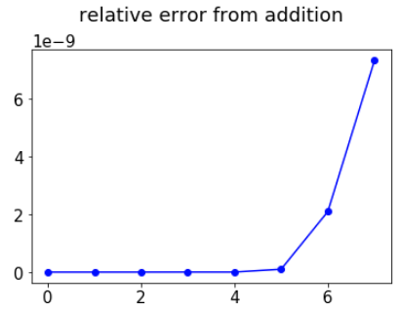
Error from adding numbers
If we can have 1e200 sections for trapezoidal calculation, will we get exact or very accurate solution? No, if we use float!
Error from adding small areas together increases quickly as each interval become smaller
Relative error
Negative value of the exponent
x = 10^(-0) to x = 10^(-7)

Slide 8
Simpson 1/3: Derivation Summary
  Quadratic polynomial is used to connect dot (instead of a straight line used in trapezoidal method)
  Lagrange polynomial interpolation is used to get the function approximation for that quadratic polynomial
  Then the function is integrated to get Simpson 1/3 rule
  This method requires function value at the middle point
  Cannot be used with non-uniform grids (unless re-deriving the formula)

Slide 9
Composite Simpson 1/3
  Single section has coefficient of 1-4-1
  Multiple sections has coefficient of 1-4-2-4-2-4-2-...-2-4-1
  Both end has coefficient of 1, in the middle is 4-2-4

Slide 10
Simpson 3/8
Simpson 3/8 is similar to Simpson 1/3, but the number of interval must be the multiplication of 3. m is just an integer. h is the interval size. Coefficient is 1-3-3-1 for a single set of 4 points

Slide 11
Numerical Error from Trapezoidal & Simpson method
Error of trapezoidal method is proportional to h²
Error of Simpson method is proportional to h⁴
Roughly speaking, h⁴ means as the interval decrease 10 times, the error decrease 10,000 times (or 100 for h² case).
Ability to give exact solution
  Simpson: 3rd degree (or less) polynomial
  Trapezoidal: Straight line equation

Slide 12
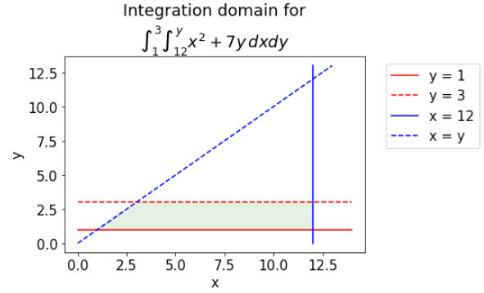
Double Integration
Integration Domain

Slide 13
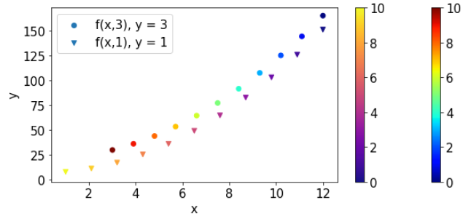
Double Integration
f(x,y) for y = 1 and y = 3.
Notice that when y = 3, we integrate from x = 12 to x = 3 (backward)

Slide 14
Double Integration...
Method 1: Use scipy.integrate.dblquad
fxy3 = lambda x,y: x**2+7*y
sp.integrate.dblquad(fxy3,1,3,lambda y:12, lambda y:y)
  Quick and easy
Method 2: Use Simpson Method twice
  Should know to fully understand the double integration idea

Slide 15
Double Integration: Use Simpson method twice!
Step 1: Create for every point in y domain
This work as one equation one unknown (which is y),
  so we have
  With the input of y, integration from a to y is done by Simpson method. Note that y in f(x,y) and the integration limit MUST be the same value

Slide 16
Double Integration: Use Simpson method twice...
Use Simpson method second time to integrate G(y) dy
y_fxy3 = np.linspace(1,3,11)
fxy3 = lambda x,y: x**2+7*y
# fy3 is the integration for x = 12 to y at a certain y
fy3 = lambda y: simps(fxy3(np.linspace(12,y,11),y),
np.linspace(12,y,11))
simps([fy3(i) for i in y_fxy3],y_fxy3)

