Slide 1
PETR 5313: CRN 38950, Fall 2017
Numerical Application in Petroleum Engineering,
Lesson 10: ODE
Ekarit Panacharoensawad, PhD
Terry Fuller Petroleum Engineering Research Building Room 236 ekarit.panacharoensawad@ttu.edu
Copyleft: No rights reserved
Cite as: Panacharoensawad, E. (2017) "Numerical application in petroleum engineering, Lesson 10: ODE", presentation slide for Texas Tech PETR 5313 Fall 2017

Slide 2
Outline
  Analytical solution via Sympy
  Numerical method
    Explicit Euler
    Implicit Euler
    Runge-Kutta 4th Order
    Butcher Tableau
    Backward Differentiation Formula
    Lobatto IIIC
    Dormand-Prince 5(4)
  System of ODEs / Higher order ODE / BC problem
  Scipy automatic functions

Slide 3
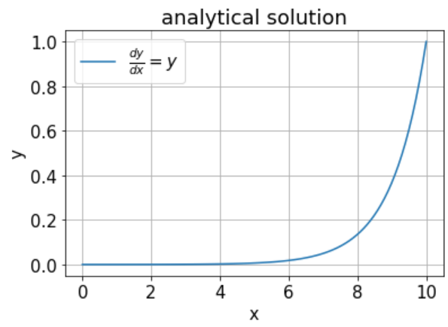
Analytical Solution: Question 1
Solve for x = 0 to x = 10 at x = 10 y = 1

Slide 4
Sympy Analytical Solution: Solving ODE
import sympy as sm
xs, ys = sm.symbols('x y')
fs = sm.Function('f')
y_sm = sm.dsolve(sm.Derivative(fs(xs),xs)-fs(xs), fs(xs))
#import statement
#define symbol x to be var xs
#define function f to be var fs
To solve for

Slide 5
Sympy Analytical Solution: Result
Result from sm.dsolve
y_sm is Eq(f(x), C1*exp(x))
y_sm.args is (f(x), C1*exp(x))
.args give tuple of symbols. They are l.h.s. and r.h.s. of the symbolic computation result

Slide 6
Sympy Analytical Solution: Solving for Constants
C1 = sm.symbols('C1')
C1_N = sm.solve(y_sm.args[1].subs(xs,10)-1,C1)
y_sol = y_sm.subs(C1,C1_N[0])
.subs(xs, 10) is for substituting x with 10
sm.solve is for symbolically solving equation(s)
sm.solve take
  1) equation to be solve
  2) symbol to be solved for

Slide 7
Sympy for Second Order Homogeneous Linear ODE
Question 2: Solve
At x = 0, y = 4, y'' = 5. Solve y for x = 0 to 1
E2 = sm.Derivative(fs(xs),xs,xs)
+ sm.Derivative(fs(xs),xs) – 6*fs(xs)
y2_sm = sm.dsolve(E2,fs(xs))
y2_sm
y2_sm.args[1]
Output:

Slide 8
Sympy Question2: Find constant values
At x = 0, y = 4, y' = 5
con1_q2 = sm.Eq(y2_sm.args[1].subs({xs:0}),4)
con2_q2 = sm.Eq(y2_sm.args[1].diff(xs)
.subs({xs:0}),5)
C1C2_N = sm.solve([con1_q2,con2_q2],[C1,C2])
C1C2_N

Slide 9
Sympy Boundary Value Problem: Question 3
BC: At x = 0, y = 1 and at x = 1, y' = 1
E3 = (sm.Derivative(fs(xs),xs,xs)
+ sm.Derivative(fs(xs),xs)
- 6*fs(xs) - sm.sin(xs) - xs)
y3_sm = sm.dsolve(E3,fs(xs)).rhs

Slide 10
Sympy Q3: Solve for constants
Passing list of equations and list of symbols to be solved for into sm.solve to get dictionary of answer (symbols : answer).
  The difference here is that we take derivative first (sm.diff), before substitute the right boundary condition
con1_q3 = sm.Eq(y3_sm.subs({xs:0}),1)
con2_q3 = sm.Eq(sm.diff(y3_sm,xs).subs({xs:1})
,1)
C1C2_q3 = sm.solve([con1_q3,con2_q3],[C1,C2])
y3_sol = y3_sm.subs(C1C2_q3)

Slide 11
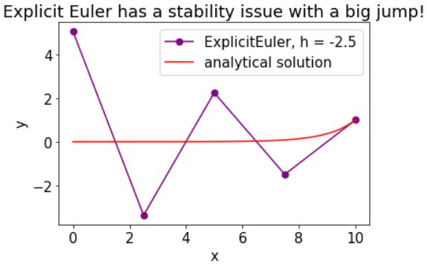
Explicit Euler Method
Use slope at the current point to estimate the next point.
  The next point is at the distance of h away from the current point.

Slide 12
Implicit Euler Method
Use the slope at the next point to calculate the next point
If we find the right y_{n+1}, then g(y_{n+1}) become zero
Newton method can be used to solve this 1 eq 1 unknown

Slide 13
Stability of Implicit Euler
Use the test function of
https://en.wikipedia.org/wiki/Stiff_equation#A-stability

Slide 14
Stability of Implicit Euler
Thus, this method is A-stable (stability region is the entire left half-plane)
Thus, this method is also L-stable

Slide 15
Explicit vs Implicit Euler
Is called the stability function
For simplicity, stability of ODE numerical method can be categorized as A-stable and L-stable
, then the method is A-stable
, then the method is L-stable
Implicit Euler is A- and L-stable (L-stable means very stable)
Explicit Euler is not A-stable (not quite stable)
Not stable means as h increases, answer may diverge

Slide 16
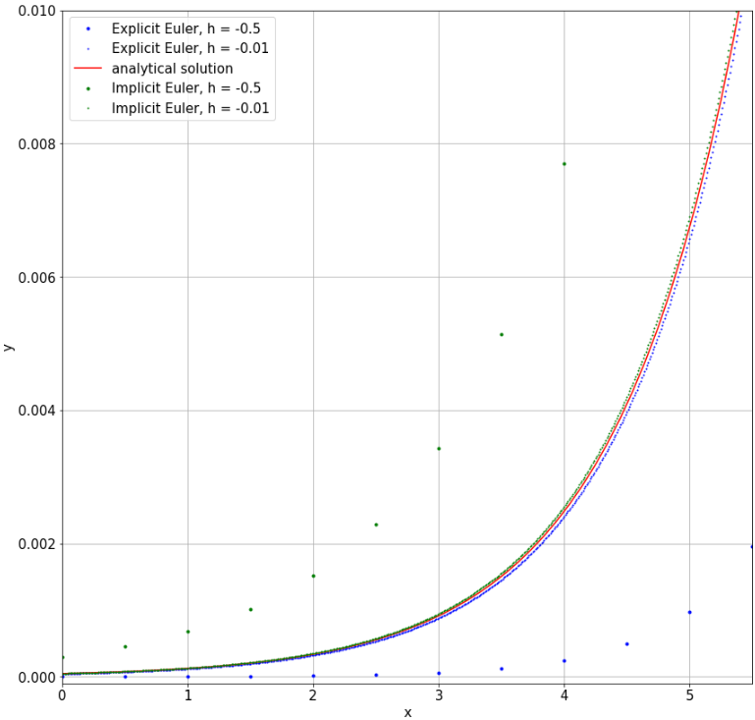
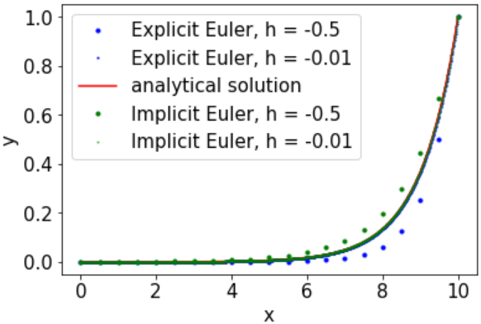
Explicit vs Implicit Euler (1st order accuracy)
Stable does not mean accurate!
Both are not accurate

Slide 17
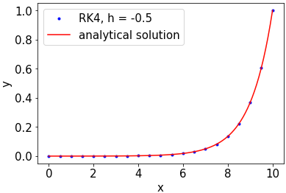
Runge-Kutta 4th order (RK4 , Explicit Method)
The next point is from the average slope of ends and middle points. RK4 is not A-stable method. Quick and accurate!

Slide 18
Butcher Tableau
The corresponding Butcher Tableau is
From

Slide 19
Butcher Tableau...
Explicit Euler
Implicit Euler
Runge-Kutta 4th Order
https://en.wikipedia.org/wiki/List_of_Runge%E2%80%93Kutta_methods#Forward_Euler

Slide 20
6-Step Backward Differentiation Formula (6-step BDF)
BDF is an implicit method
  Each step can be solved separately.
  For fully implicit BDF (need to solve everything simultaneously) see Akinfenwa et al 2013 (not cover)
  First step in BDF is the same as backward Euler (implicit Euler)
  Not A-stable, but still good for stiff ODE.
https://en.wikipedia.org/wiki/Backward_differentiation_formula
Akinfenwa, O.A., Jator, S.N. and Yao, N.M. (2013) Continuous block backward differntiation formula for solving stiff ordinary differential equations. Computer and Mathematics with Applications 65, pp. 996-1005

Slide 21
6-Step Backward Differentiation Formula

Slide 22
6-Step BDF
Use Newton-Raphson to solve for the only unknown in each step
  1st step, y_{n+1} is the only unknown.
  2nd step, y_{n+2} is the only unknown.
  ...
  6th step, y_{n+6} is the only unknown.
Get O(h⁶) order of accuracy (h = x_{n+6} – x_{n}).
  Accuracy can be less if Error from Newton-Raphson is high
    To get accurate result, more iteration in Newton-Raphson is needed, but this makes it slower.

Slide 23
Lobatto IIIC
Fully Implicit: L-stable good for stiff ODEs
http://homepage.math.uiowa.edu/~ljay/publications.dir/Lobatto.pdf

Slide 24
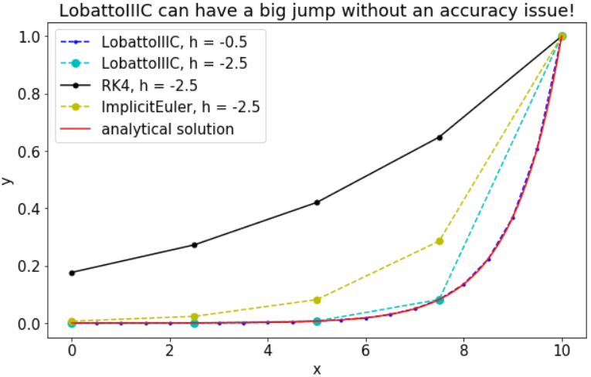
Lobatto IIIC Method (Fully Implicit)
Newton-Jacobian is needed to solve Lobatto IIIC equations
  Solve all 4 equations simultaneously
  Lobatto IIIC get less impact from a big step-size

Slide 25
Dormand-Prince 5(4): Explicit Method
Compare 5th and 4th answer to adjust the step size
  Use 5th order answer to get the next y, so that we have 5th order accuracy
err = abs(y5 - y4)
s = (abs(eps*h/2/err))**0.2 #step ratio

Slide 26
Dormand-Prince 5(4): Explicit Method
Step ratio is used to decide if h is too big or not
If s > a (a certain constant, e.g. 1), means that the selected h is small enough and we can move faster. Thus, the obtained result should be accepted.
If s < a (e.g. 1), the selected h is to large. h should be updated with h*s and the y5 need to be re-calculate with the new h.

Slide 27
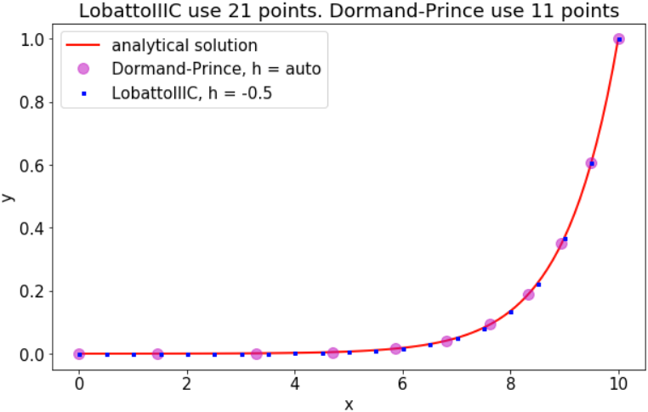
Dormand-Prince 5(4) uses less point and less error
  DP5 is better than LBIIIC in this case.
  Faster and more accurate because there is no Newton-Jacobian involve.
  DP5 discretizes more where it is needed.
average error from Dormand-Prince 5(4) = -2.97720218779e-05
average error from LobattoIIIC = -7.43312233914e-05
Notice that even though the first step is the same
Dormand-Prince method use less points (more efficient)

Slide 28
System of First Order ODEs
Question 3:
BC: At x = 0, y = 1 and at x = 1, y’ = 1
Numerical method cannot directly solve higher order ODE

Slide 29
Solving Boundary Value Problem: Shooting method
At x = 0, y = 1 At x = 1, y’ = 1
At x = 0, y’ = c
Define a function f as a black box solver.
  Take initial guess of y’ at x = 0
  Give y’ at x = 1, as an output
  where 1 is the y’ value at the right boundary
  Solve g(c) by Newton method or Bisection method

Slide 30
Creating ODE for shooting method with RK4
BC: At x = 0, y = 1 and at x = 1, y’ = 1
xi is a scalar quantity

Slide 31
RK4 2nd Order ODE: Calculation Steps

Slide 32
RK4 2nd Order ODE: Calculation Steps
  First, k0₁ and k1₁ must be calculated
    (does not matter which one first)
  Then, k0₂ and k1₂ can be calculated
    (does not matter which one first)
  Then, k0₃ and k1₃ can be calculated
    (does not matter which one first)
  Then, k0₄ and k1₄ can be calculated
    (does not matter which one first)
When calculate k0₃ and k1₃ everything must be specified at

Slide 33
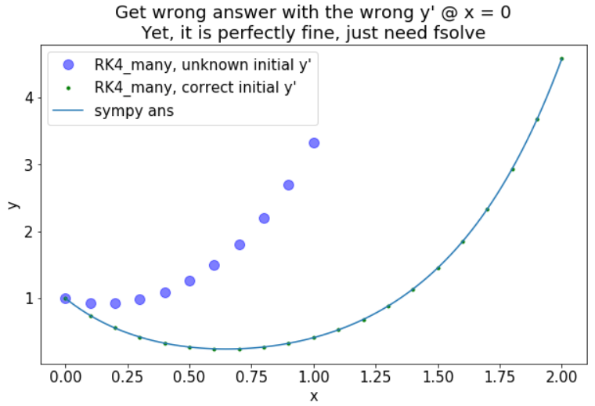
2nd ODE BVP result from RK4
BC: At x = 0, y = 1 and at x = 1, y’ = 1
Large blue-purple dots are from RK4 without Newton-Raphson
Green small dots are from from RK4 with Newton-Raphson to find the right initial y’ at x = 0

Slide 34
Higher Order ODE with LobattoIIIC
For 2nd Order, we have two sets of k1, k2, k3, and k4
  Need to solve 8 non-linear equation simultaneously

Slide 35
Higher Order ODE with LobattoIIIC
Each Eqi is a 2x1 column vector (we totally have 8 equations) with 8 unknown which are k1₁, k1₂, …, k4₁, k4₂
  Use numpy and scipy.optimize.fsolve to easily solve it

Slide 36
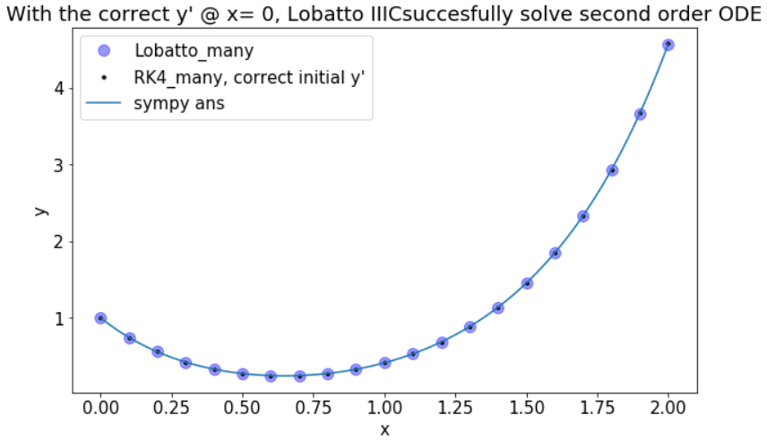
Higher Order ODE with LobattoIIIC
Lobatto IIIC is good for stiff ODEs

Slide 37
Dormand-Prince with higher order ODE
Calculate k1 to k6 as usual, but this time do it for f0 and f1
Get error for y[0] and y[1]
Adjust the step according to the term that provide a high error
  err = abs(y5 – y4).max()
For second order ODE,
  k, y, y4, y5 become 2x1 column vector
  fn become a function taking x and vector y as an input. fn returns 2x1 column vector

Slide 38
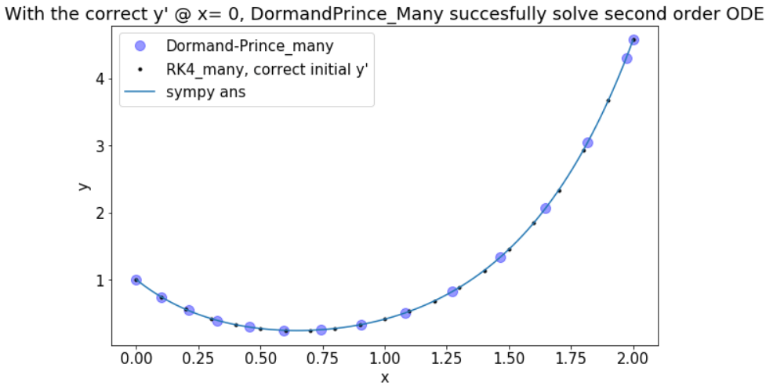
Dormand-Prince with higher order ODE...
dopri5(4) is the efficient method. It uses less points and gives better result. For stiff method, decrease epsilon in the model

Slide 39
Scipy Function for solving ODEs: dopri5
Steps
  Create scipy.integrate.ode object
    Specify the equation to be solved during the creation
  Set integration method for the created object
  Set initial condition for the new object
  Create user define function to retrieve intermediate data
  Set the function to be called during the run
    If we don’t have this, we will just get the final result, not the non-uniform distribution of the data

Slide 40
Scipy Function: Solving ODE
fnp1 = lambda x, y: y
sol = []
def solout(t,y):
sol.append([t,*y])
return None
ode_solver = integrate.ode(fnp1)
ode_solver.set_integrator('dopri5', atol = 0.01)
ode_solver.set_initial_value(1,10)
ode_solver.set_solout(solout)
ode_solver.integrate(0)
data = np.array(sol)
Next slides for step-by-step explanation

Slide 41
Scipy Function: Solving ODE
Create function to be solved
  fnp1 = lambda x, y: y
Create function to be called at each iteration to store intermediate answer
  sol = []
  def solout(t,y):
  sol.append([t,*y])
  return None

Slide 42
Scipy Function: Solving ODE
Creating object called ode_solver. Set the right-hand-side of ODE to be function fnp1
  ode_solver = integrate.ode(fnp1)
Set the method to be Dormand-Prince 5(4)
  ode_solver.set_integrator('dopri5', atol = 0.01)
Set the initial value of y to be 1 at x = 10
  ode_solver.set_initial_value(1,10)
Set the function to be called at each calculation step to be function name solout
  ode_solver.set_solout(solout)

Slide 43
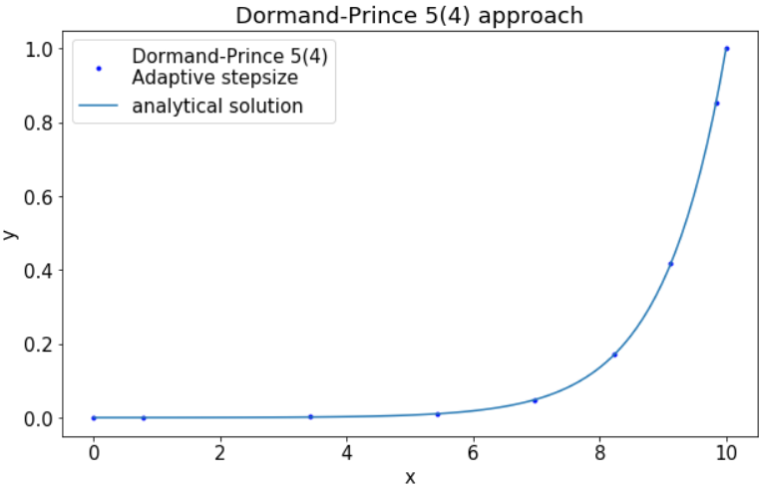
Scipy Function: Solving ODE...
Perform Dormand-Prince method until x reach x = 0
  ode_solver.integrate(0)
Retrieve the data from list sol to numpy array ‘data’
  data = np.array(sol)
Result from scipy:

Slide 44
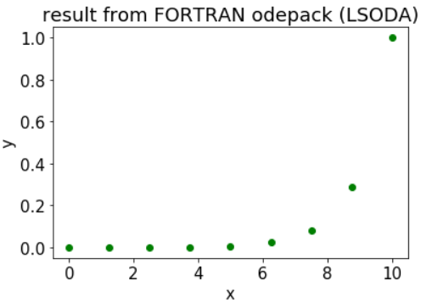
scipy.integrate.odeint
Odeint is quick to program, but we have less control. It will use LSODA library (automatic switching between implicit Adams and BDF). It is a constant step-size method.
f_odeint1 = lambda y, x: y
x_odeint1 = np.linspace(10,0,9)
y_result1 = integrate.odeint(f_odeint1, 1, x_odeint1)
plt.plot(x_odeint1, y_result1,'og')

Slide 45
Scipy Second Order ODE
Trick: Make function take y as a vector and return vector (same dimension as y)
sol2 = []
def solout2(t,y):
sol2.append([t,*y])
return None
f12q2 = lambda x,y: [y[1], 6 * y[0] - y[1]]
q2_ode = integrate.ode(f12q2)
q2_ode.set_integrator('dopri5')
q2_ode.set_initial_value([4,5],0)
q2_ode.set_solout(solout2)
q2_ode.integrate(5)

Slide 46
Scipy Second Order ODE...
Create function to retrieve intermediate calculation values
def solout2(t,y):
sol2.append([t,*y])
Create function to be solved (y = vector, output = vector)
f12q2 = lambda x,y: [y[1], 6 * y[0] - y[1]]
Set initial condition: y[0] = 4 and y[1] = 5 at x = 0
q2_ode.set_initial_value([4,5],0)

Slide 47
Scipy ODE: Boundary Value Problem
BC: @ x = 0, y = 1; @ x = 1, y' = 1
Steps: 1) Create BC function, 2) Create dy/dx r.h.s. function, 3) create initial guess, 4) use integrate.solve_bvp

Slide 48
Scipy ODE: Boundary Value Problem...
Specify boundary conditions
def bc_3(ya, yb):
return np.array([ya[0] - 1, yb[1] - 1])
Specify ODEs
def fun_3(x,y):
return np.vstack((y[1], np.sin(x) + x + 6 *
y[0]-y[1]))
Create domain x and initial guess y, then solve!
x_3 = np.linspace(0,1,100)
y_3 = np.ones((2,x_3.size))
sol_3 = integrate.solve_bvp(fun_3,bc_3,x_3,y_3)

Slide 49
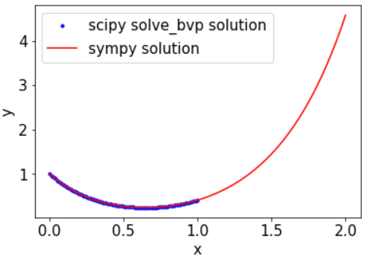
Scipy ODE: Boundary Value Problem...
sol_3 output is an object contain 1) x, 2) y, 3) y’, and 4) residual
#y = array[y[0], y[1]]
#y[1] is dy0/dx
#yp = array[[yp[0], yp[1]]
#yp[0] is dy0/dx
plt.plot(x_3,sol_3.y[0])

Slide 50
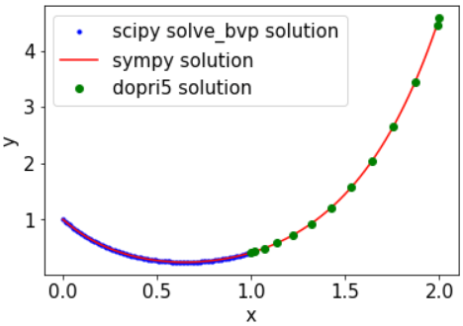
Scipy ODE: Boundary Value Problem...
Once Boundary Value Problem is solved, we obtain the right initial condition (y’ at x = 0) and both y’ and y and x = 1.
Next step is to use y and y’ at x = 1 as IC to solve for y from 1 to 2 (use integrate.ode as usual)
ode3 = integrate.ode(fun_3)
ode3.set_integrator('dopri5')
ode3.set_initial_value([sol_3.y[0][-1],
sol_3.y[1][-1]], 1)
ode3.set_solout(solout3)

