Slide 1
PETR 5313: CRN 38950, Fall 2017
Numerical Application in Petroleum Engineering,
Lesson 11: PDE
Ekarit Panacharoensawad, PhD
Terry Fuller Petroleum Engineering Research Building Room 236 ekarit.panacharoensawad@ttu.edu
Copyleft: No rights reserved
Cite as: Panacharoensawad, E. (2017) "Numerical application in petroleum engineering, Lesson 11: PDE", presentation slide for Texas Tech PETR 5313 Fall 2017

Slide 2
Outline
  Finite difference (to a certain depth)
    Partial derivative approximation
    Type of PDE
    Non-dimensionalize of PDE
    1D heat equation
      Forward in time/central in space
      Backward in time/central in space
      Crank-Nicolson
    2D heat equation
      Backward in time (forward scheme is for homework)
  Finite element (introduction to FEniCS)

Slide 3
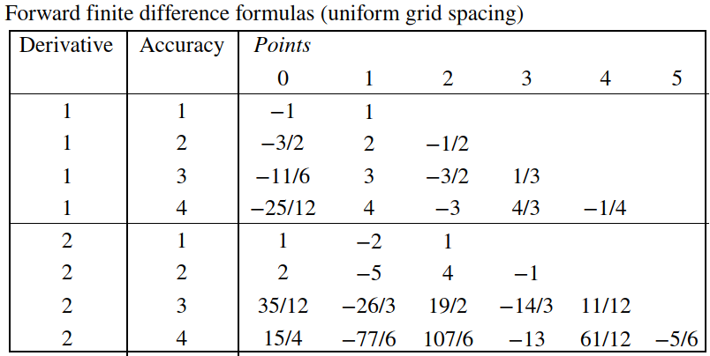
Partial derivative approximation: Forward scheme
Forward finite difference first order approximation

Slide 4
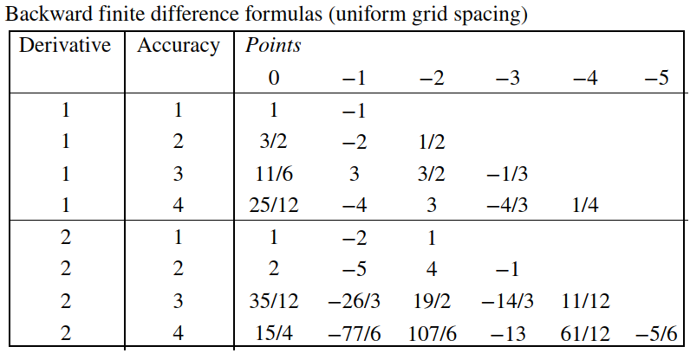
Partial derivative approximation: Backward scheme
From forward finite difference table, give all odd derivative coefficient with the opposite sign to get backward scheme.

Slide 5
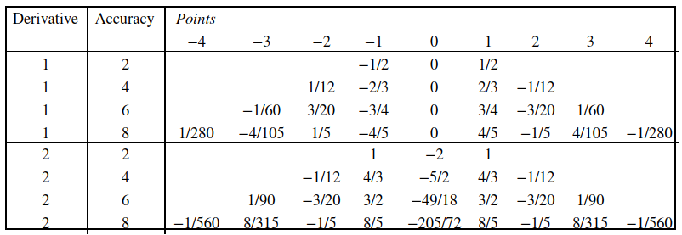
Partial derivative approximation: Central scheme
The table below is for uniform grid spacing.
For second derivative, use h² as the denominator (previous tables too)
https://en.wikipedia.org/wiki/Finite_difference_coefficient

Slide 6
Type of PDE
Elliptic – time-independent
Hyperbolic – time dependent and wavelike
Parabolic – time-dependent and diffusive
More formal definition

Slide 7
Elliptic PDE
Example: Poisson's equation (e.g. Gauss's law for electricity)
Example: Laplace equation (e.g. steady state heat transfer)
Solution is smooth, even if IC and BC are rough. One value at BC affect all solution points

Slide 8
Parabolic PDE
Example: Heat Equation (transient heat conduction in solid)
This gives one-way communication in time (the past impacts the future, but the future does not impact the past)
Cartesian / Cylindrical
https://en.wikipedia.org/wiki/Laplace_operator

Slide 9
Hyperbolic PDE
Example: Wave equation
The disturbance in BC cause wave to travel (propagate) at speed C. Not every points feel the disturbance all at once (Elliptic PDE is equivalent to every point feel the disturbance in BC, all at once).
http://mathworld.wolfram.com/EllipticPartialDifferentialEquation.html
https://en.wikipedia.org/wiki/Partial_differential_equation#Equations_of_second_order

Slide 10
Steps for solving PDE Numerically
0) Optional (but suggested) - Non-dimensionalize the PDE
1) Discretize the domain into discrete point in time and space
2) Use finite difference formula transform all partial derivatives into algebraic expressions as a function of point value
3) Arrange all algebraic equations into matrix form
4) Use numerical method in solving system of linear equation to get solution at each point
5) Visualize the solution at time-slice or space-slice

Slide 11
Solving 1-D Heat Equation
In this example, we will solve 1 dimension transient heat transfer copper. For 3 cm 1D copper bar, what will happen if we attach it to a hot heat source (at 50 C), if the copper bar temperature is at 20 C, initially.

Slide 12
1D Heat Equation: BC/Variable definition

Slide 13
1D Heat Equation: BC/Variable definition...

Slide 14
Non-dimensionalize Process
The dimensionless PDE form can be used for other question that has the same dimensionless form
Define:
This way, the solution will be in between 0 and 1

Slide 15
Non-dimensionalize Process...
Then, the relationship between dimensional/less are
and
Substituting into the governing equation, gives
or

Slide 16
Non-dimensionalize Process...
By defining the dimensionless time as,
We have
With the dimensionless form, BCs become,
At
At
IC becomes

Slide 17
Discretized form of PDE
Use forward difference in time, we have
Use Central difference in space, we have
Forward scheme can be unstable, the time step is restricted by CFL condition

Slide 18
CFL Condition (Courant-Friedrichs-Lewy Condition)
CFL condition is necessary but not sufficient for the convergence, meaning that even if the step size satisfies CFL condition, it can be still unstable
For heat equation: CFL Condition becomes
With C = 1, I got unstable result, let’s use C = 0.5
This means that for
We need
https://webcourse.cs.technion.ac.il/236861/Winter2007-2008/ho/WCFiles/numerical_schemes.pdf
https://en.wikipedia.org/wiki/Talk%3ACourant%E2%80%93Friedrichs%E2%80%93Lewy_condition
https://people.maths.ox.ac.uk/trefethen/4all.pdf

Slide 19
Discretized form of PDE...
Need 3 points at n, to get 1 point at n+1 (for forward scheme)

Slide 20
Discretization of Boundary Conditions
Dirichlet Boundary Condition
  Constant T boundary condition
Neumann Boundary Condition
  Constant flux at the boundary
Where B is the boundary point

Slide 21
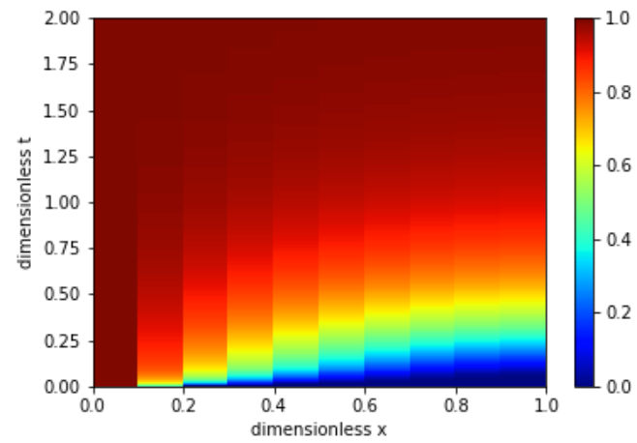
1D-Heat Equation: Dimensionless Result
Forward Euler (forward finite difference in time) result
For smaller x-grid spacing at the same t-grid spacing, the result is not stable.

Slide 22
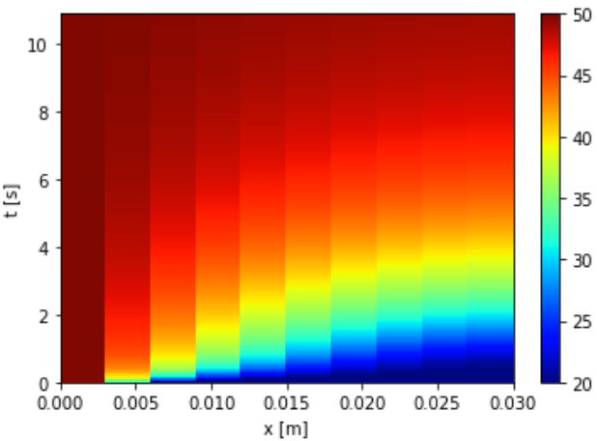
1D-Heat Equation: Dimensional Result
The result can be obtained by using the relationships between dimensionless and dimensional variable

Slide 23
Backward finite difference in time
Unconditionally stable (we can use smaller x-grid spacing)

Slide 24
Backward finite difference in time...
Solve system of linear equation to get
3 points at n+1 link to 1 point at n!

Slide 25
BC/Matrix Form

Slide 26
Backward Finite Difference: Matrix Form
Just need Thomas Algorithm to solve system of linear eqns

Slide 27
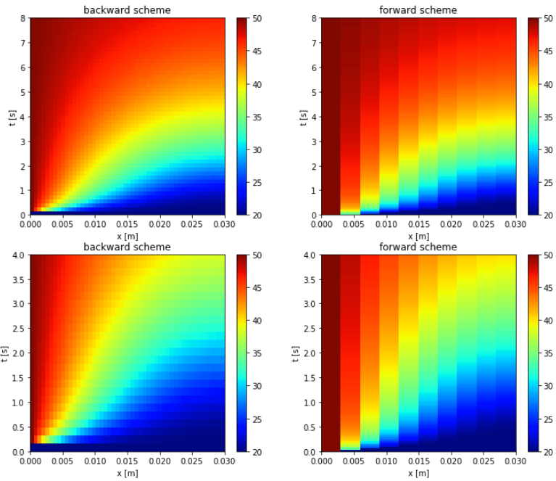
Results
Which one is the backward scheme?

Slide 28
Crank-Nicolson (second order in time)

Slide 29
Crank-Nicolson scheme
i-1,n+1
i,n+1
i+1,n+1
i-1,n
i,n
i+1,n
We need 3 points at n and 3 points at n+1 at the same time to predict 1 point at i and n+1
Crank-Nicolson is unconditionally stable, but can contain some
oscillation if

Slide 30
Crank-Nicolson Scheme
Crank-Nicolson is the average between forward and backward scheme

Slide 31
Crank-Nicolson Scheme
Dropping the tilde sign (but still means dimensionless), we get
Note that RHS is just a column matrix that can be evaluated right away (everything is defined at n, not n+1)

Slide 32
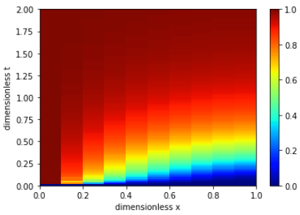
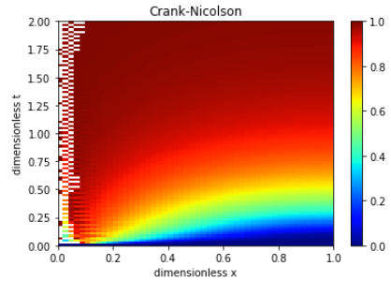
Crank-Nicolson with/without oscillation
Some oscillation occur when CFL is not satisfied
When CFL is satisfied
When CFL is not satisfied
Crank-Nicolson

Slide 33
2D Transient Heat Transfer
Dropping tilde sign but still means dimensionless, we get
Discretized form

Slide 34
2D Transient Heat Transfer...
We have
Rearranging (put n on rhs, n+1 on lhs), we have

Slide 35
2D Transient Heat Transfer...
We need 5 points (up/down/left/right/center) at n+1 and 1 point at n, for the equation for the point at i,n+1
We need to put it into a matrix form! How?

Slide 36
2D Transient heat: BC
No heat loss at any end

Slide 37
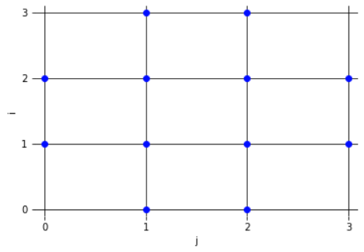
Starts with 4x4 mesh
We do not need (and must not have) equation for the corner point
How many times do we use the equation below?

Slide 38
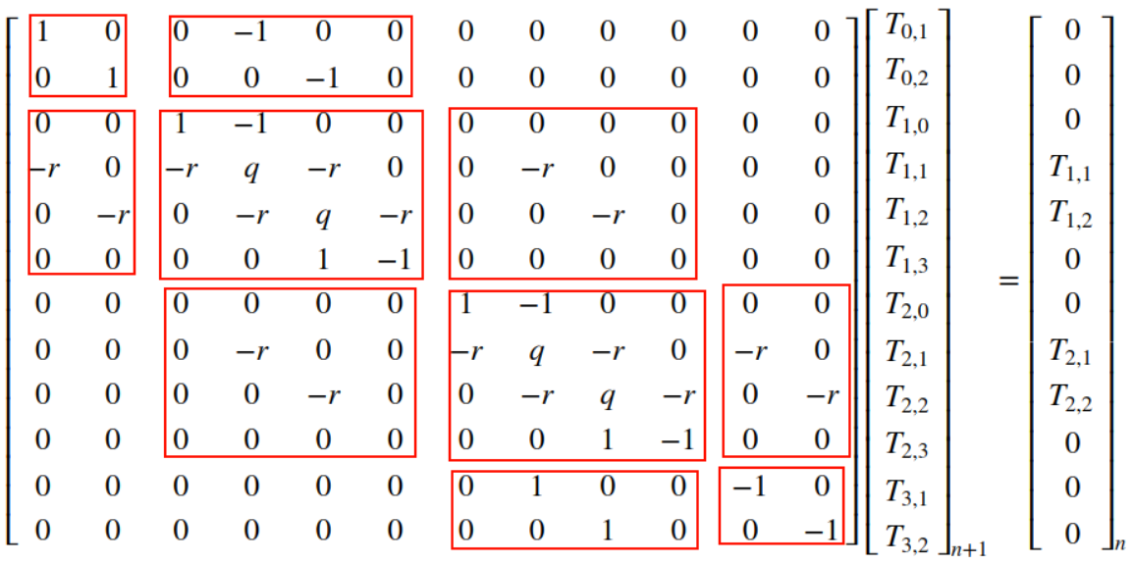
2D Transient Heat: Matrix Form (4x4 mesh)

Slide 39
2D Transient Heat: Matrix Form (NxN mesh)
  The discretized PDE in matrix form can be written in the block tri-diagonal matrix
  We must not have corner points, because we have no equation for them
    In this example, we exclude the corner points

Slide 40
2D Transient Heat: Sub-Matrix
Let’s go back a take a quick look on 4x4 case

Slide 41
2D Transient Heat: Sub-Matrix
is (N-2) x (N), The first and the last column is to exclude the connection to the corner points (the one above the corner point)

Slide 42
2D Transient Heat: Sub-Matrix
Only for non-BC points near the edge
is N x (N-2), the first and the last row of zeros is for left and right Neumann condition where the bottom point is not involved. This sub-matrix gives part of the equation for the non-BC points.

Slide 43
2D Transient Heat: Sub-Matrix (diagonal terms)
is NxN where the first and the last row is for BC at the left and right edge points. This sub-matrix is just part of the equation for non-BC points.

Slide 44
2D Transient Heat: Sub-Matrix (off-diagonal)

Slide 45
Creating the coefficient matrix: 2D Backward Heat
Involved Libraries
  scipy.sparse.diags: This is to create sparse sub-matrix that have diagonal and off-diagonal terms
  scipy.linalg.block_diag: This is to put several sub-matrix into a block diagonal matrix (put several block into the diagonal parts)

Slide 46
Creating the coefficient matrix: 2D Backward Heat...
Involved Libraries
  Scipy.sparse.bsr_matrix (block compressed row): This is to combine each off-diagonal blocks (A₁₂) togeters.
  scipy.sparse.linalg.splu: This is to create LU decomposition object for sparse matrix. Once object is created, object.solve(RHS) will give the answer
User define function: We need a function to change (back and forth) from NxN T-array to N**2 – 4 T-column vector.

Slide 47
2D Backward Heat: Calculation Step
0: Create initial condition for temperature, T-matrix
1: Create coefficient matrix
2: Do sparse LU decomposition of the coefficient matrix
3: For-loop
3.1: Create RHS matrix
3.2: LU.solve(RHS) to get T-matrix
3.3: Store T-matrix and move to the next time step
4: Show result as an animation or 2D plot at each time slice

Slide 48
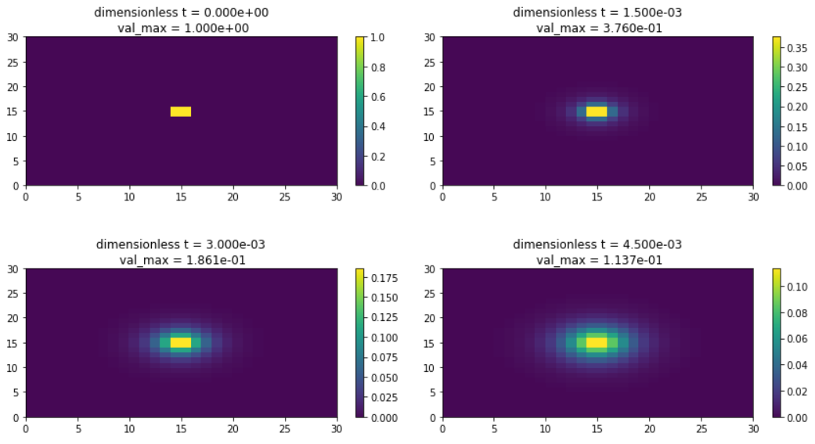
Result 2D transient heat (Relative view)
Maximum value decreases with time (but color is still yellow)
Even at 1 time step (top-right picture), many cell around the hot cell feel the heat

Slide 49
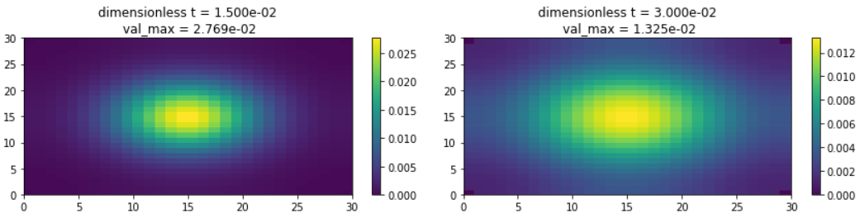
Result 2D transient heat (Relative view)
This is a backward scheme, so we can discretize more in space without the need to progress slowly in time.
See animation from L11_absolute_T.mp4 and L11_relative_T.mp4

Slide 50
FEniCS: Finite Element Method to solve PDE
Outline
  Brief view on FEM/FEniCS
To run FEniCS smoothly, either
  Install Ubuntu virtual machine on windows or
  Install Ubuntu as a separate OS
  Then, install FEniCS on Ubuntu/virtual machine with Ubuntu
https://fenicsproject.org/pub/tutorial/html/._ftut1004.html
https://fenicsproject.org/qa/7316/print-values-numerical-solution-neumann-boundary-problem
https://fenicsproject.org/qa/6450/get-field-value-at-mesh-vertex

Slide 51
FEM (FEniCS): Example
Once we define the problem (together with BC), we need to get the variational form
Multiplying the PDE by a function , integrating the resulting equation over the domain , and perform integration by parts of terms with second-order derivatives.

Slide 52
FEM with Dirichlet Boundary Condition:

Slide 54
FEM: Variational Form
From

Slide 55
FEM: Variational Form...
http://sfepy.org/doc-devel/solving_pdes_by_fem.html#sec-solving-pdes-fem
https://en.wikipedia.org/wiki/Integration_by_parts

Slide 56
FEM: Variational Form...

Slide 57
FEM: Test/Trial space
This equation should hold for all test function in some suitable space (so-called test space). The solution is in function space (so-called trial space). The test space and the trial space can be defined as

Slide 58
FEM - FEniCS
a = fn.dot(fn.grad(u), fn.grad(v))*fn.dx
L = f*v*fn.dx
u = fn.Function(V)
fn.solve(a == L, u, bc)

Slide 59
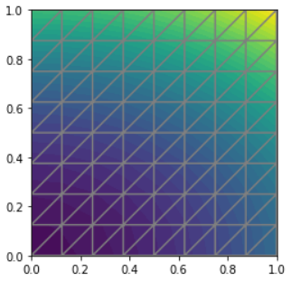
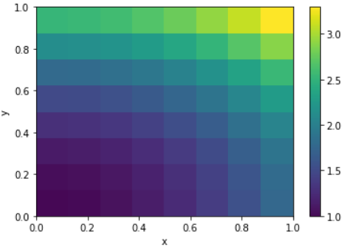
FEniCS Solution for the example question
https://fenicsproject.org/pub/tutorial/html/._ftut1004.html

Slide 60
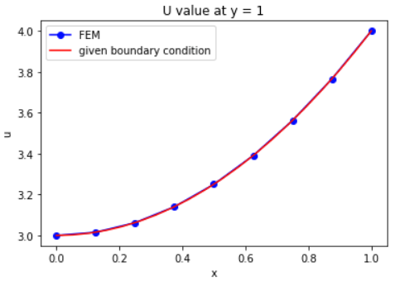
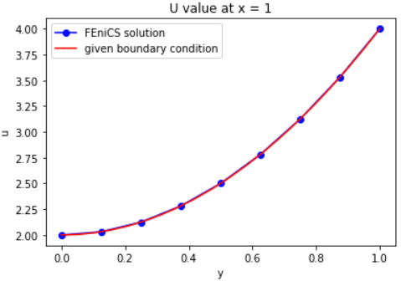
FEniCS Solution: Check answer on BC
FEniCS answer match with the given boundary conditions

Slide 61
Check if LHS == RHS
At x = 0.5 and y = 0, calculate LHS and check if it is -6
  Use 8 points forward scheme to estimate
  Use 9 points central scheme to estimate
https://en.wikipedia.org/wiki/Finite_difference_coefficient

