Slide 1


Slide 2
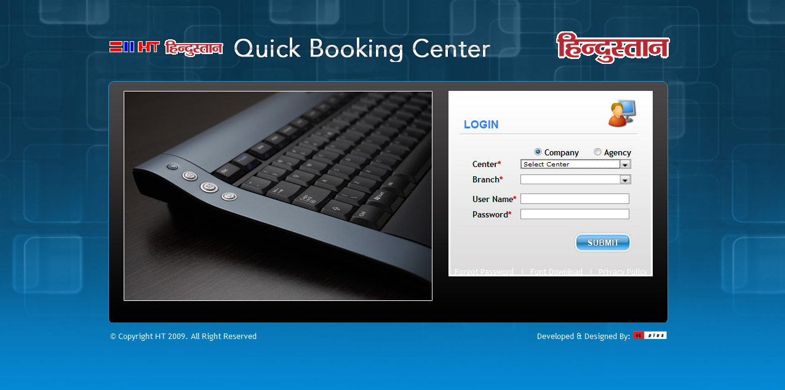
Login Page

Slide 3
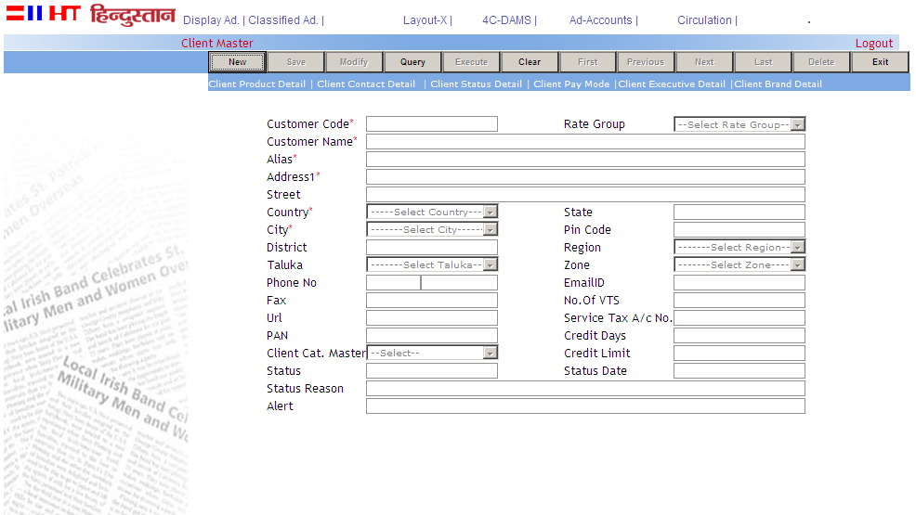
Client Master
If any client has some products then it will be mentioned in this tab.
In status details tab, client status is given as it is banned client or active client.
Client can be of two types, one is registered and other is walk-in client. For registered client, all related data is stored in the database. in this field, client name is mentioned e.g. Atlas.
Address is mentioned here of the client..

Slide 4
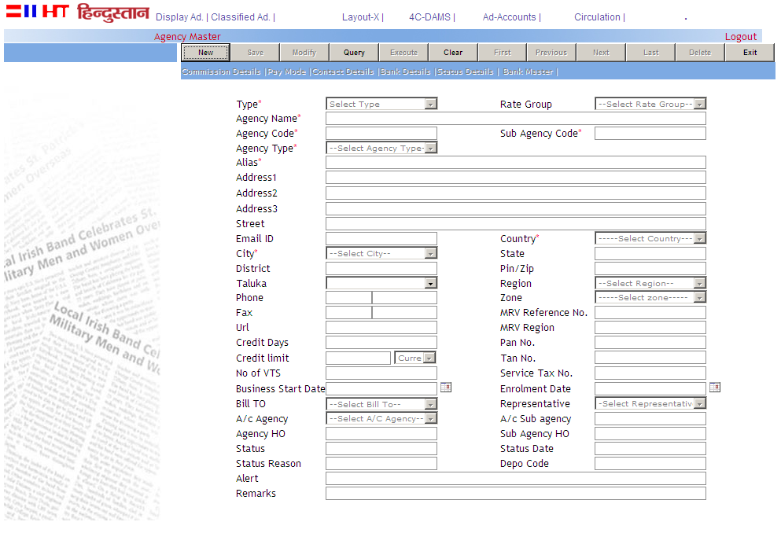
Agency Master
If the agency is working on commission basis then that commission is defined here.
in status details tab, Agency status is given as it is banned Agency or active Agency.
If any agency is a branch of other agency and working for that agency then agency type will be "Child" and if that agency is not a branch of any agency then it would be "Parent".
Agency Name is stored in this field.
Address of the Agency is mentioned here.

Slide 5
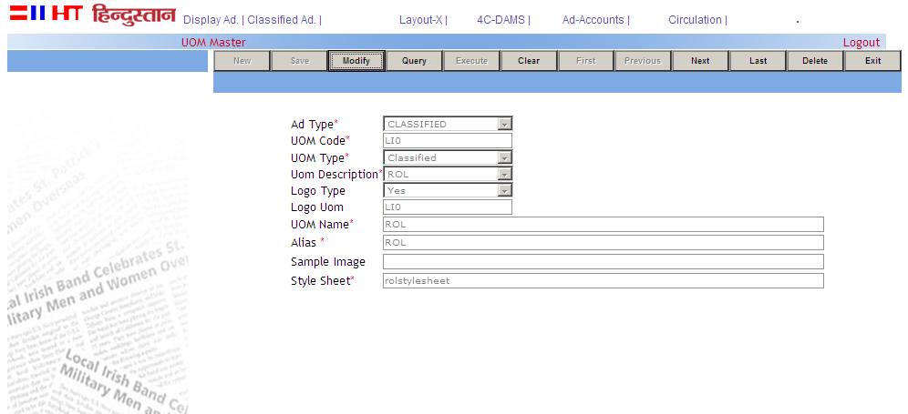

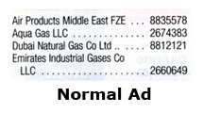

UOM Master
Style sheets can be defined according to advertisement types as for style sheets for classified ads or display ads.
Rate is charged according to the style sheet description as ROL style sheet charges on number of lines. for CD style sheet, charges on column centimeters.
This field is used for Logo attachment in the booking. if logo type is "yes" then logo would be attached with that style sheet. if it is "no" then no need to attach logo.
Style sheet Name is defined in this field as ROL,DROL,CD.
This is the ROL style sheet AD which contains matter with logo
This is the CD Style sheet AD which occupies 1-2 columns space
This is the Normal style Sheet which contains only matter

Slide 6
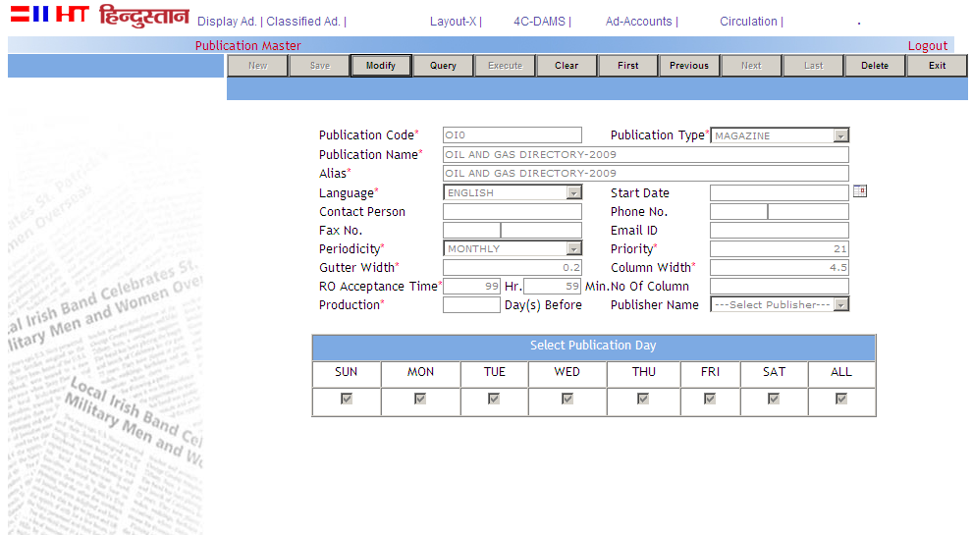
Publication Master
The act or an instance of making information public and any printed work offered for sale or distribution. It may be Magazine or Directory or Newspaper
In this field publication name is stored as Oil And Gas Directory(OAGD).
What is the language of the publication in which its editions is issued as English, Hindi.
Publication-edition issue cycle is mentioned in the field. as some editions have daily periodicity, some have weekly,yearly etc.
This is the gap between the two columns. As OAGD has 0.2 cm gutter width.
This is used to define the width of single column of the publication as here for OAGD, it is 4.5 cm.

Slide 7
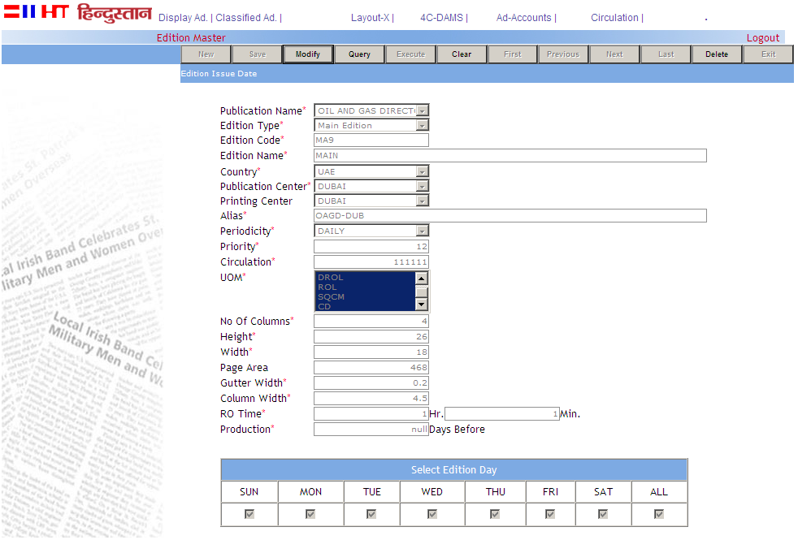
Edition Master
The act or an instance of making information public and any printed work offered for sale or distribution. It may be Magazine or Directory or Newspaper etc.
The entire number of copies of a publication issued at one time or from a single set of type. it may be directory edition or newspaper edition.
This is the center from which edition is issued. For example Oil and Gas directory is issued from Dubai so Dubai is the Publication Center of OAGD.
Edition issue cycle is mentioned in the field. as some editions have daily periodicity, some have weekly, yearly etc.
In which style sheets, ad will be booked in that edition in mentioned here.
These are the measurements of edition as total number of columns exist on the edition page, Height of the edition and width of the edition.
This is the gap between the two columns. As OAGD has 0.2 cm gutter width.

Slide 8
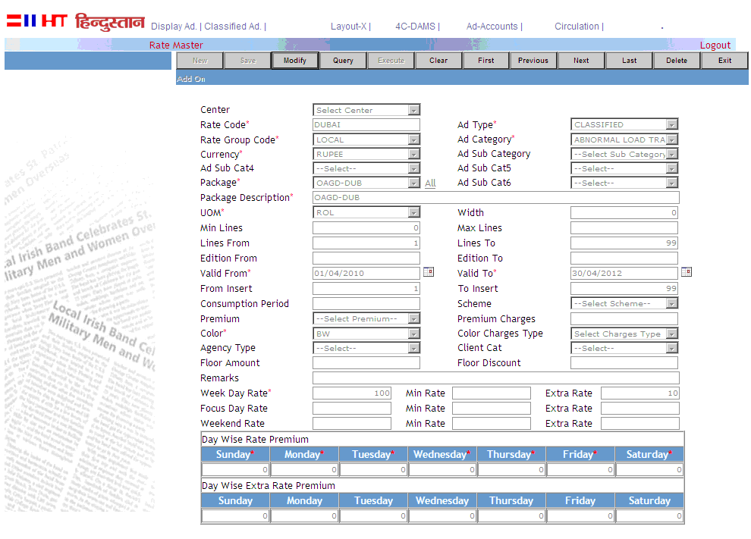
Rate Master
There are two types of Ads. First is Classified ads in which 1 to 2 columns of ad exist. Second is Display Ads in which more than two columns ads exist. Mostly Classified ads are saved in Directory booking.
All ads are categorized specifically as region wise and rates are defined according to that specific categories.
All the packages as Oil and gas Directory packages or Yellow Pages packages are displayed in this field. and rates are defined here for the selected directory's packages.
All the created style sheets are displayed here as ROL stylesheet( matter with logo ads) or DROL stylesheet(normal ads) or CD( 1-2 column image ads).
As in directory, there are some measurements to fetch the rates as according to lines/words/square centimeters etc. these fields assign the range at which rates will be driven.
Ad can be booked black & white or color and mostly both of them have different rates and we can open the rates separately.
Base rates will be defined in this field as for one line ad rate/CD rate.
If there are some extra line/size in any ad then that extra line/size rate is mentioned here.

Slide 9
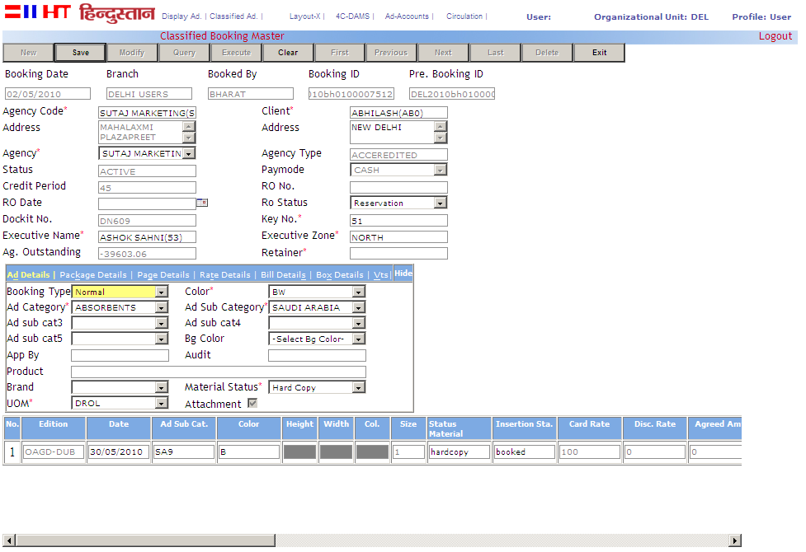
Normal Booking
There are some registered agencies and clients(reg. or walk-in) those book ads. for example, Atlas is the client of Oil and Gas Directory(OAGD) who book ads.
This field is used to make the booking Confirmed/Unconfirmed, means confirm booking is ready to publish but unconfirmed booking will not be published.
Those person who bring the business( booking) for the organization, are mentioned here.
Every booking has Some ad details which is stored in this tab. e.g. Booking type is Normal or FMG, what is the color of the ad and in which category( classification) ad will be booked and which style sheet is used to book that ad.
In which package, ad will be booked, is to be selected in this tab. e.g. ad will be booked for OIL and GAS Directory(OAGD) or Yellow Pages Directory. multiple package booking can be handled easily in this tab and all details of this package booking is displayed in the insertion grid(below of the tab).
In this tab, total rates is displayed here with all premiums and discounts.

Slide 10
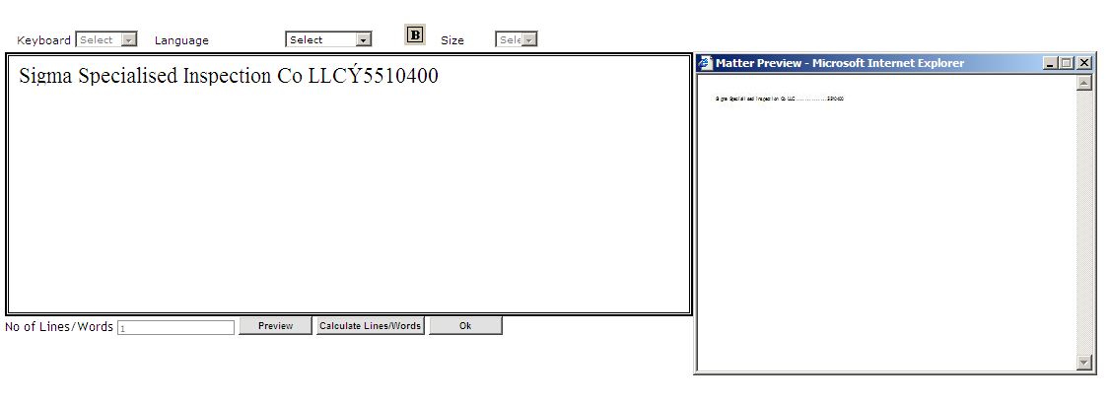
Classified Matter
Classified matter is composed here. For e.g. In directory there are many more numbers which are created from this classified matter box.
This is the preview of written matter. It is published as same in the directory

Slide 11
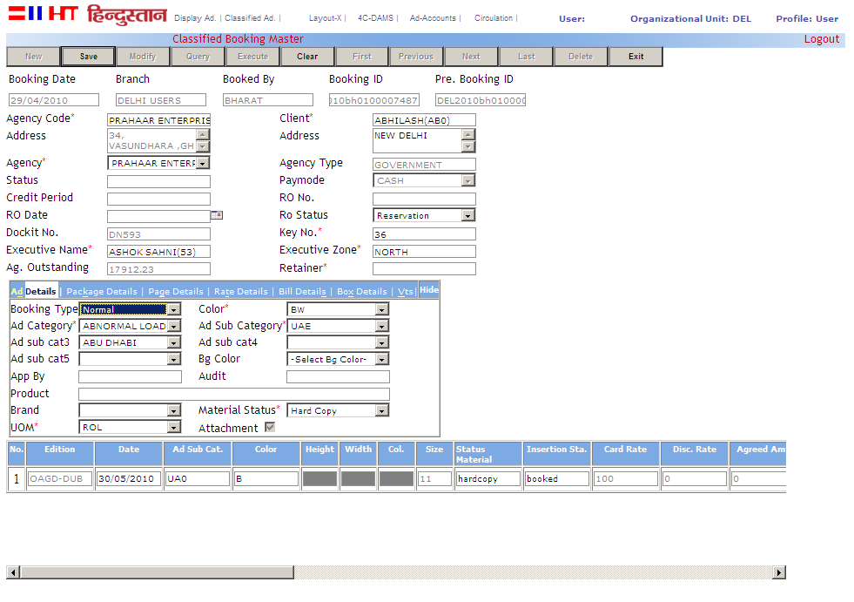
ROL Booking with Logo
This is the booking for ROL style sheet in which matter with logo Ads are created.

Slide 12
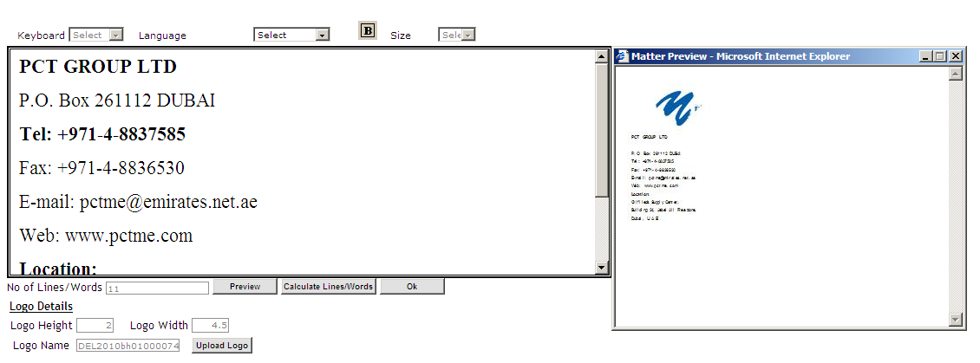
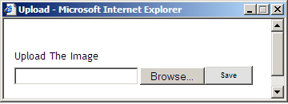
ROL Booking with Logo
This is the AD matter box in which we compose the matter.
For attach a logo with the matter, we have to click on the upload button, a small window appears as above. Browse the logo from here and save
This is preview of AD which contain matter with logo

Slide 13
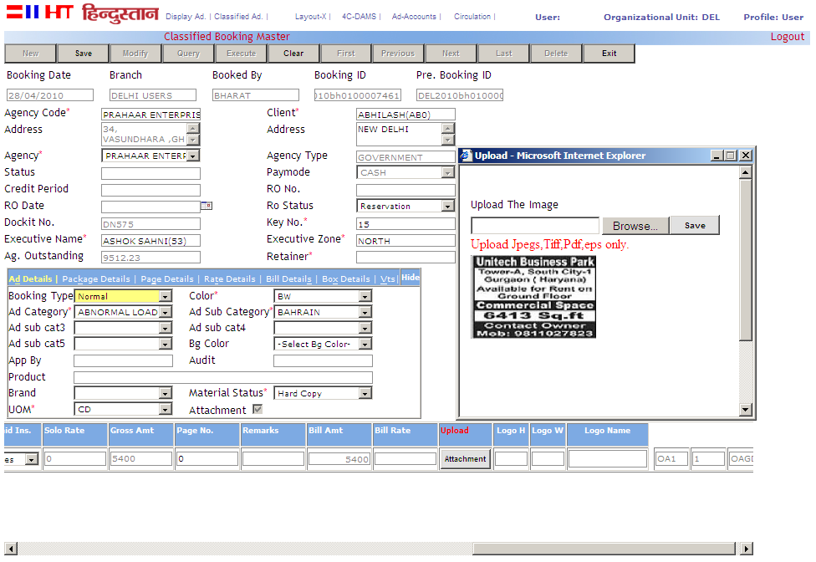
Classified Display Booking
This is the booking for CD style sheet in which CD image booking is created and this is the preview uploaded CD image.

Slide 14
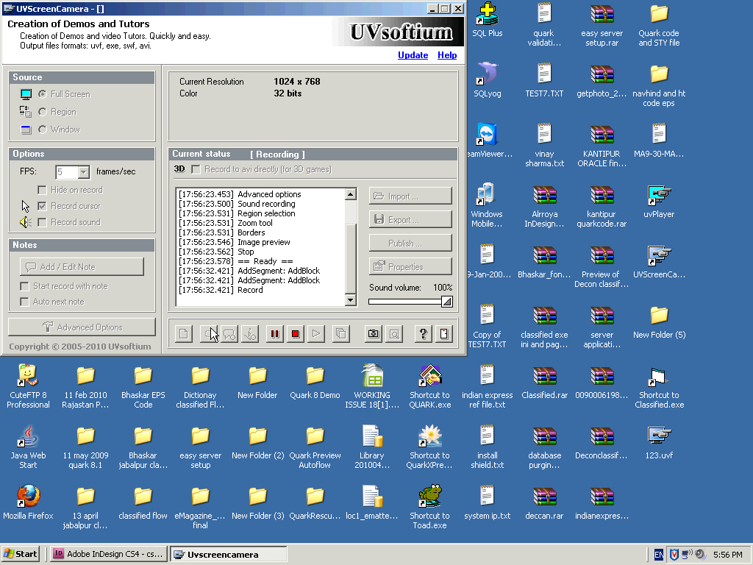
Pagination of Directory Pages
Please click to play the video

