Slide 1
Readme Crypto Price Discovery Tool CU ArgoML Project 2 Major Procedure and NN showcase case(window= 5,7,8,15,20)
Antonio Parolini, Edgar Pocaterra, Meina Bian, Michael Adut, Maxwell Snyder

Slide 2
Main Process
Alpacha API,
Close price(Decide for Crypto), 92 Technical Indicators;
https://alpaca.markets/
API for Stock and Crypto Trading
Apply PCA for feature deduction
identify the underlying dependencies of a dataset and to reduce its dimensionality significantly attending to them.
This technique is beneficial for processing data sets with hundreds of variables while maintaining, at the same time, most of the information from the original data set.
Once we have selected the principal components, the data must be projected onto them. A projection for one dimension
The final reduced dataset will explain certain of the variance of the original one
Build the Neural Network Model
Two Hidden Layers

Slide 3
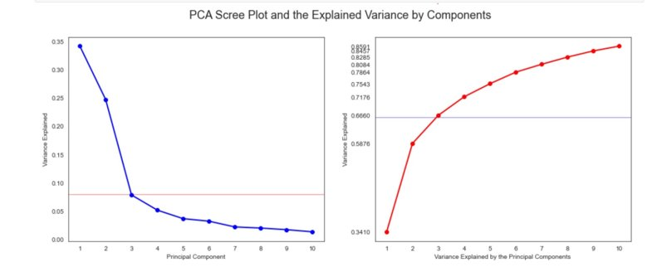
Process 1 PCA
Features dimensionality deduction through standardization. ​
PCA analysis which suggested using K=3 for the # of primary components​
Trans_fit feature data matrix to 3 Features Data for building the model
Standardize
Standardize the data (Center and scale).
Calculate
Calculate the Eigenvectors and Eigenvalues from the covariance matrix or correlation matrix (One could also use Singular Vector Decomposition).
Sort
Sort the Eigenvalues in descending order and choose the K largest Eigenvectors (Where K is the desired number of dimensions of the new feature subspace k ≤ d). (In our case K=3)
Construct
Construct the projection matrix W from the selected K Eigenvectors.
Transform
Transform the original dataset X via W to obtain a K-dimensional feature subspace Y.

Slide 4
Alternative to PCA Process CNN
Applying CNNs to a univariate 1D time series Data:
1) Import Keras libraries and dependencies
2) Define a function that extracts features and outputs from the sequence.
3) Reshape the input X in a format that is acceptable to CNN models
4) Design the CNN model architecture of convolutional layers
5)Train the model and test it on our univariate sequence.
(Conv-1D),
pooling(max-pooling in our case ),
flattening layer
fully connected neural layers.
Primary components of a Deep CNN model for time series forecasting. The primary layers of an ordinary CNN model.
1. Convolutional Layer
2. Pooling Layer
3. Fully Connected Layer
CNN vs RNN
More active research in CNN: there are some arguments that RNN / LSTM is becoming irrelevant. Whether it’s true or not, I think it depends on how we look at it.
CNNs are computationally cheaper than RNNs: CNN learns by batch while RNNs train sequentially. As such, RNN can’t use parallelization because it must wait for the previous computations.
CNNs don’t have the assumption that history is complete: Unlike RNNs, CNNs learn patterns within the time window. If you have missing data, CNNs should be useful.
CNNs can look forward: RNN models only learn from data before the timestep it needs to predict. CNNs (with shuffling) can see data from a broader perspective.

Slide 5
MLP
Metric for optimality criterion
Neural Networks & Statistics,
Minimize mean squared error (MSE).
Model Performance Tuning:
Reduce Overfitting With Dropout
Accelerate Training With Batch Normalization
Halt Training, Early Stopping,
monitor the loss on the training dataset a validation dataset ( a subset training set, not used to fit the model).
as loss for the validation set starts to show signs of overfitting, the training process can be stopped.

Slide 6
Requirement for main.v2 vast ai (GPU)version
hvplot==0.7.3
matplotlib==3.5.0
numpy==1.20.3
pandas==1.3.4
requests==2.26.0
scikit-learn==1.0.1
seaborn==0.11.2
ta==0.9.0
tensorflow==2.8.0

Slide 7
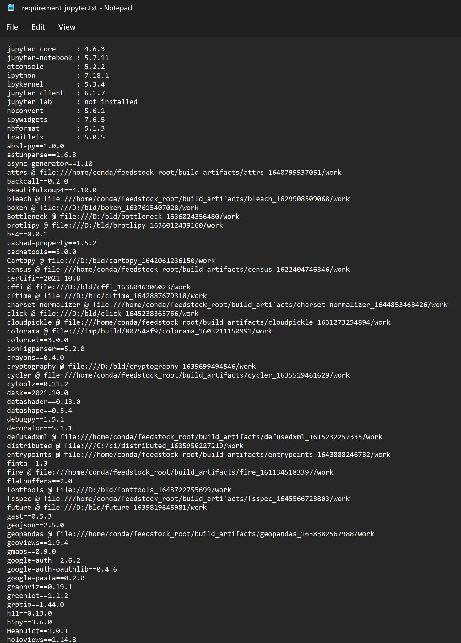
Requirement for main.v3 jupyter notebook version
jupyter core : 4.6.3
jupyter-notebook : 5.7.11
qtconsole : 5.2.2
ipython : 7.18.1
ipykernel : 5.3.4
jupyter client : 6.1.7
jupyter lab : not installed
nbconvert : 5.6.1
ipywidgets : 7.6.5
nbformat : 5.1.3
traitlets : 5.0.5
*all module version check file "requirement_jupyter.txt" as is shown in the right

Slide 8
Model Summary
Metric Mse
frequently adopted optimality criterion, in both the neural networks and the statistics communities, is minimizing the mean squared error (MSE).
Model | PCA | NN WINDOW(step) | MSE | Overfit (Loss Figure)
nn1_5 | 3 | 5 | 1764.1593 | No
nn1_7 | 3 | 7 | 1588.5481 | No
nn1_8 | 3 | 8 | 2178.061 | No
nn1_13 | 3 | 13 | 2159.9355 | Yes(tail/verysmall)
nn1_15 | 3 | 15 | 3100.3516 | YES(tail/small)
nn1_20 | 3 | 20 | 3095.867 | No

Slide 9
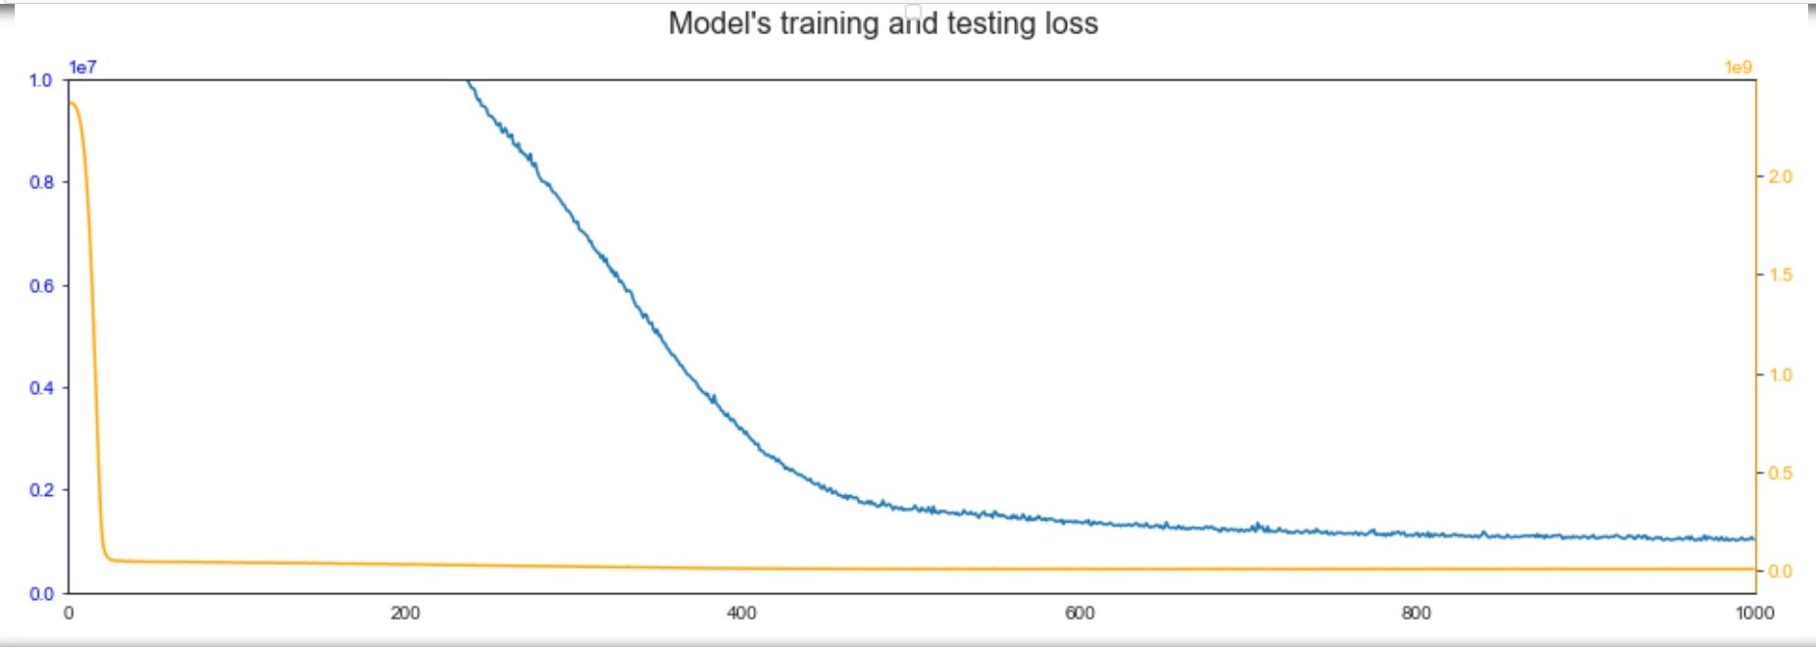
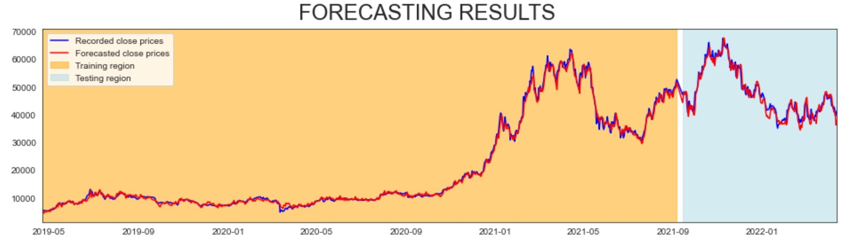
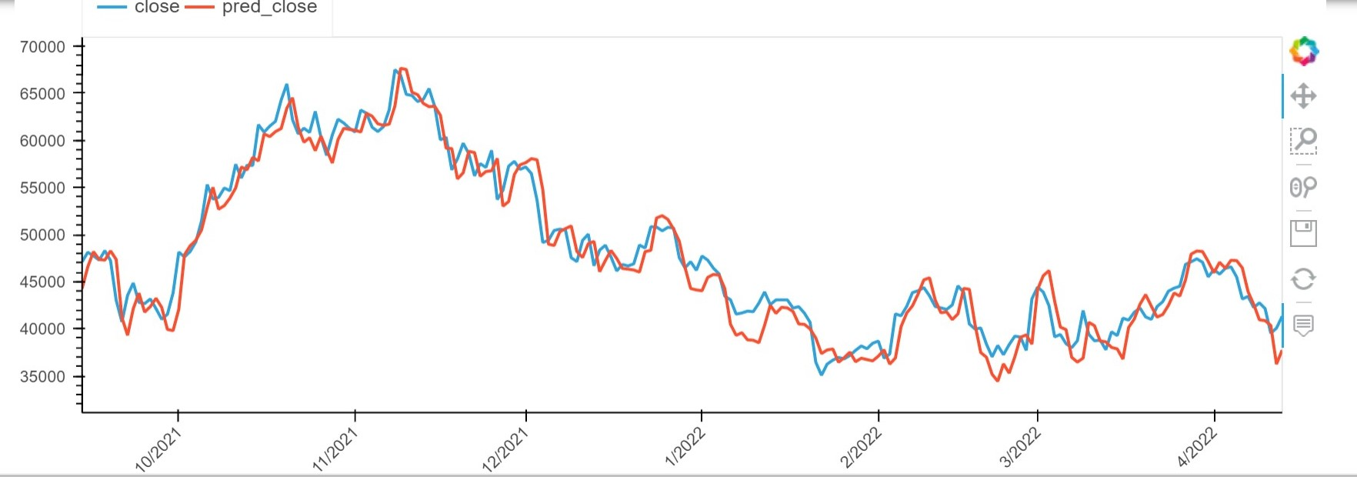
Model Results: 7-Day Window Showcase
No overfit and mse is the lowest with 1588.5481

Slide 10
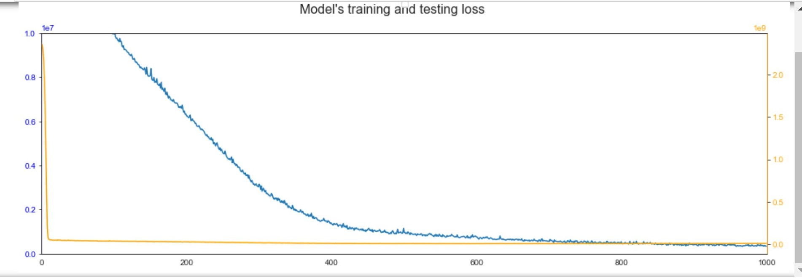
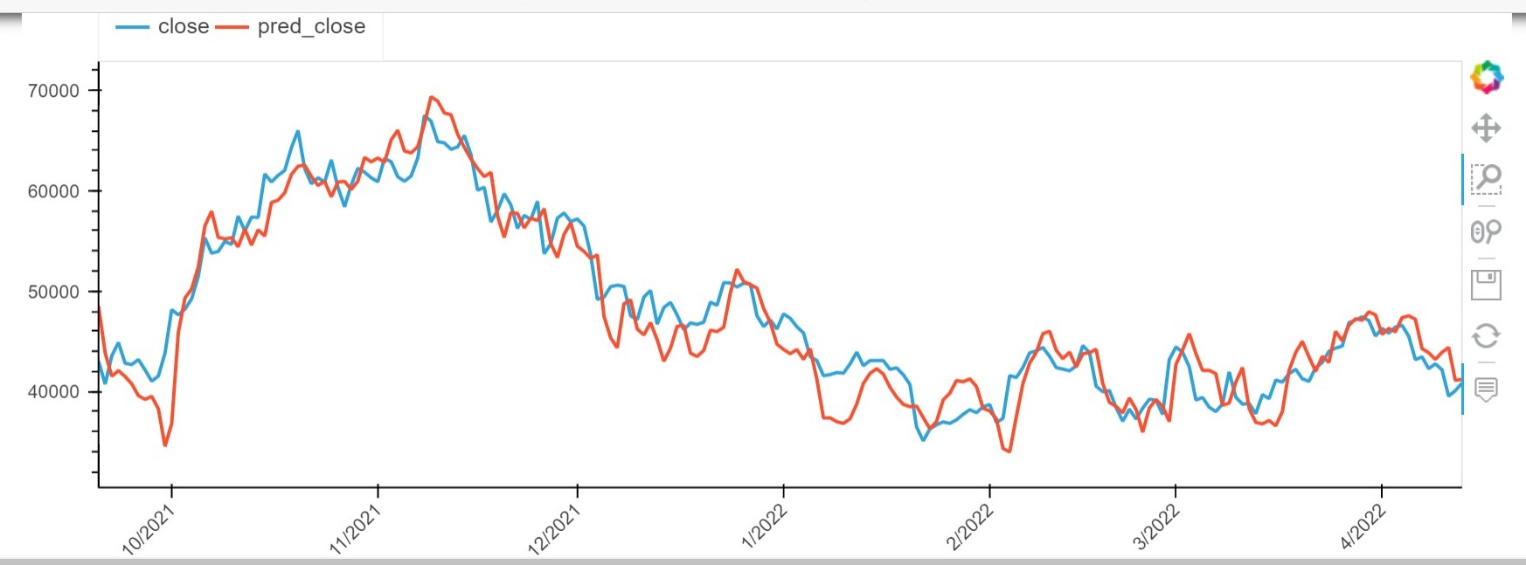
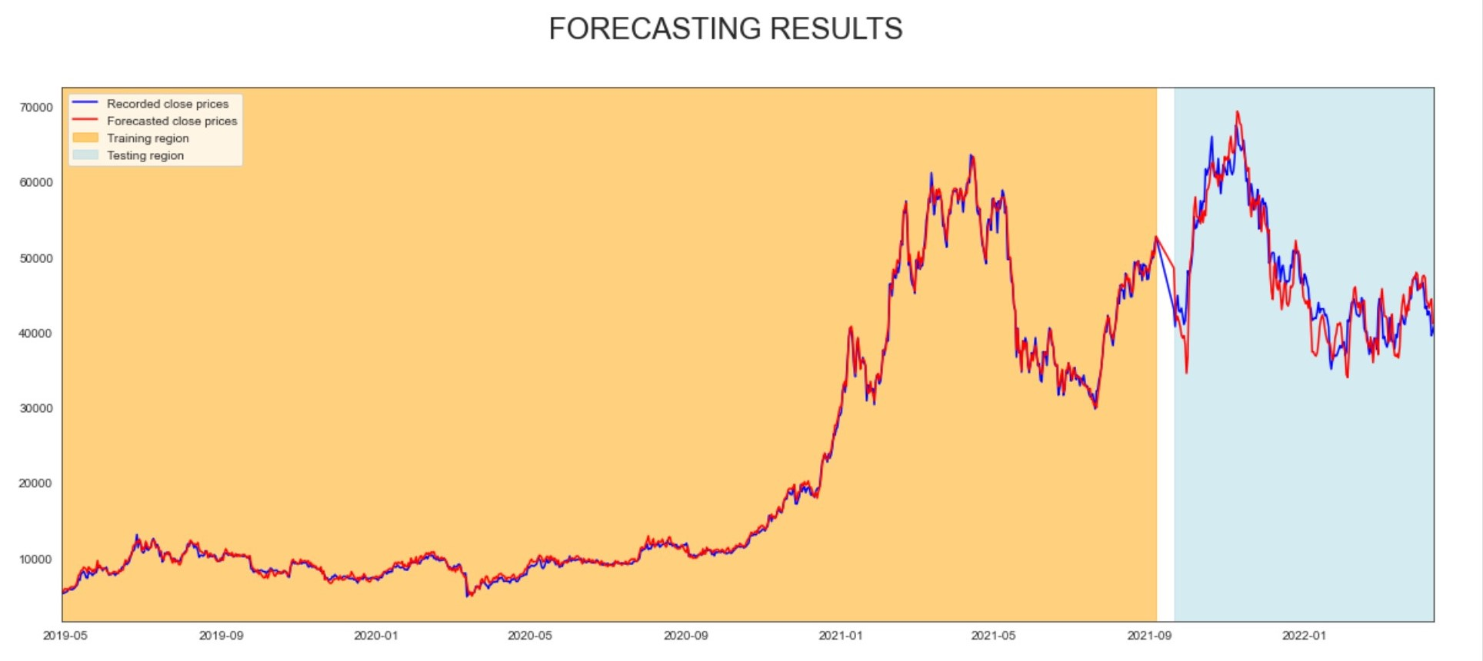
Model Results: 13-Day Window Showcase
Model start to overfit when window= 13.
when window= 13.

Slide 11
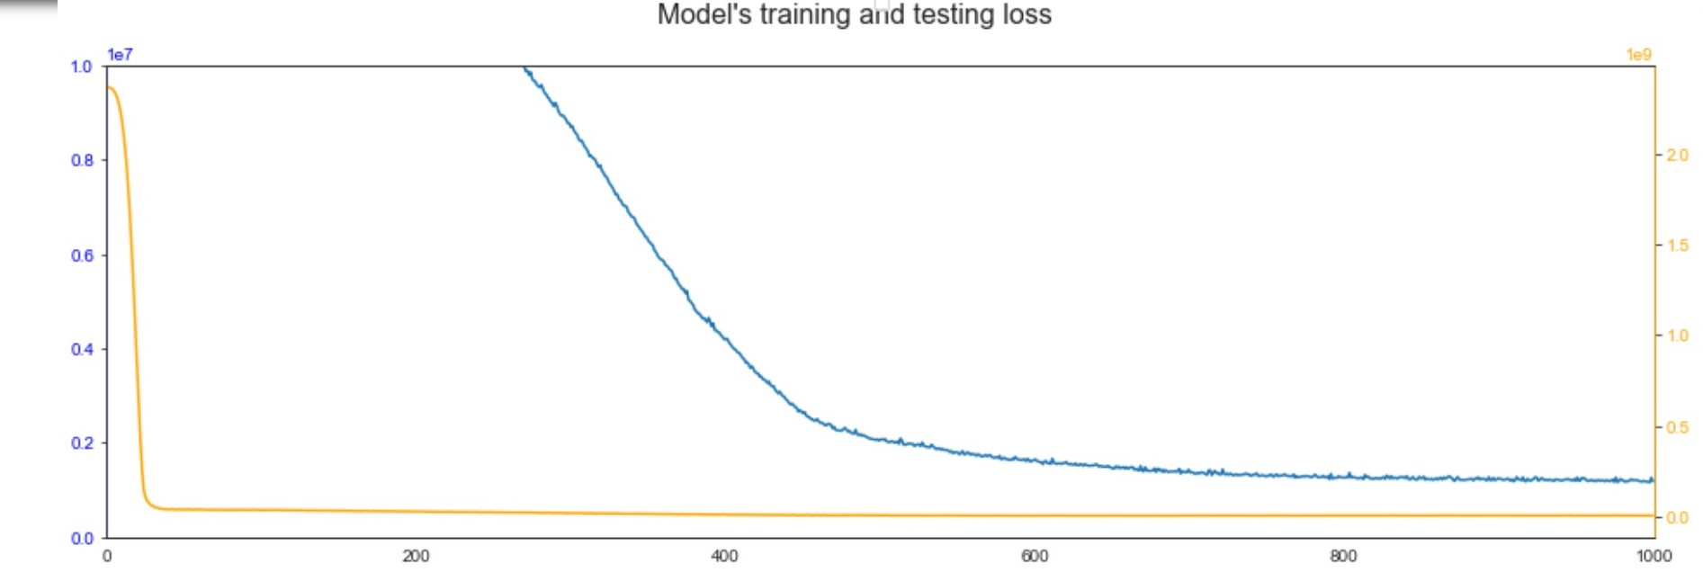
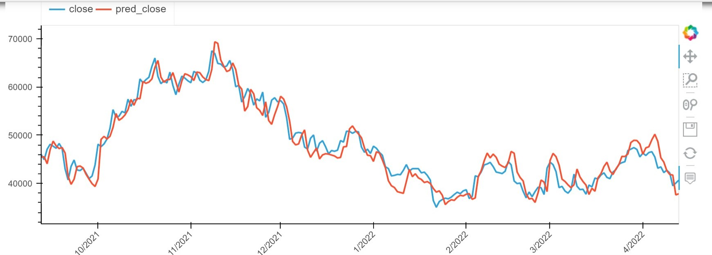
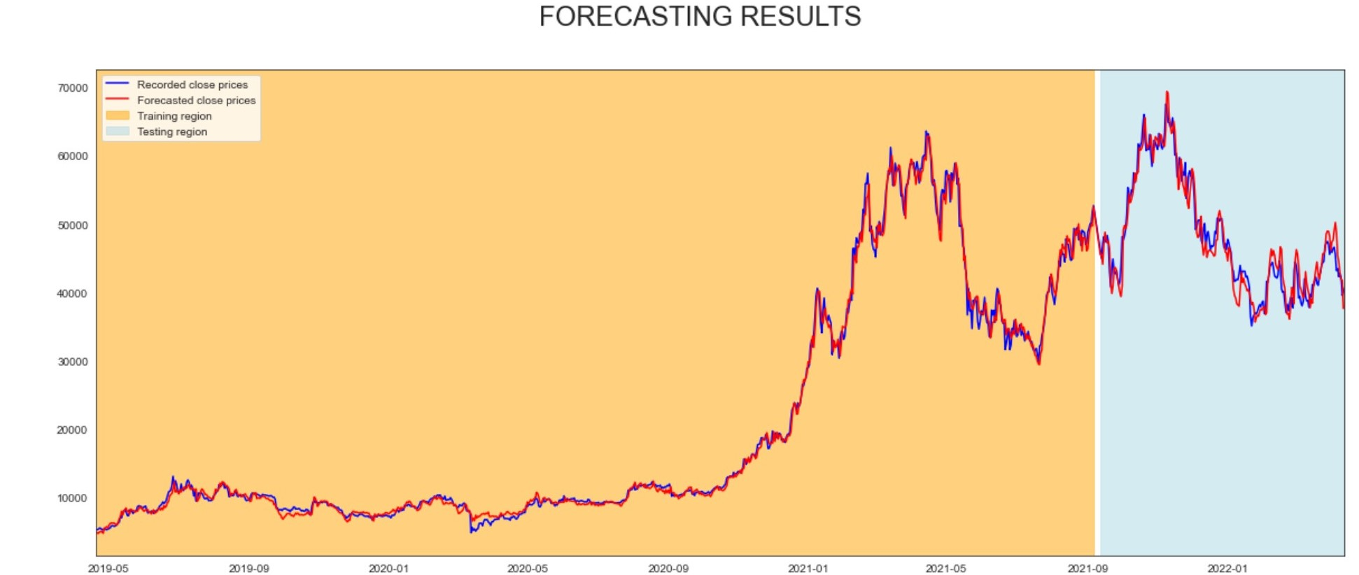
Model Results: 5-Day Window Showcase
No overfit, but with higher mse when window= 5 compared with window=7

Slide 12
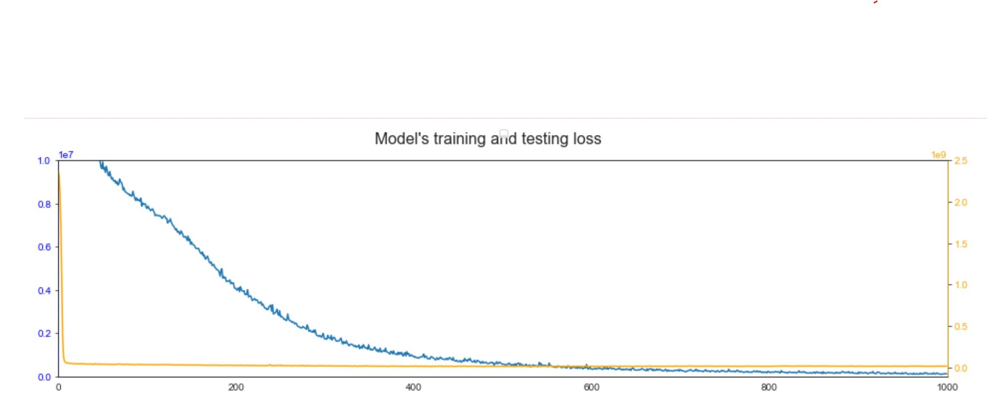
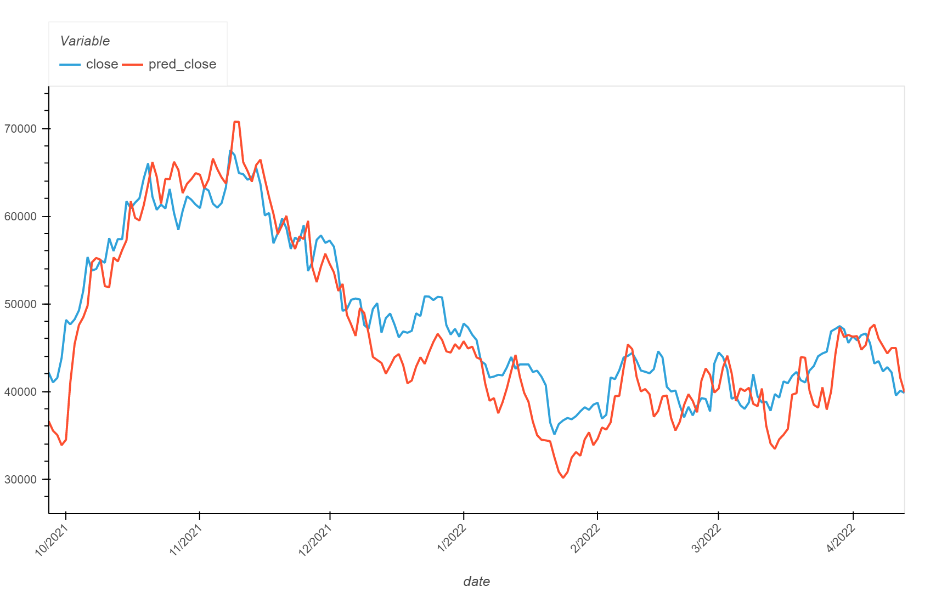
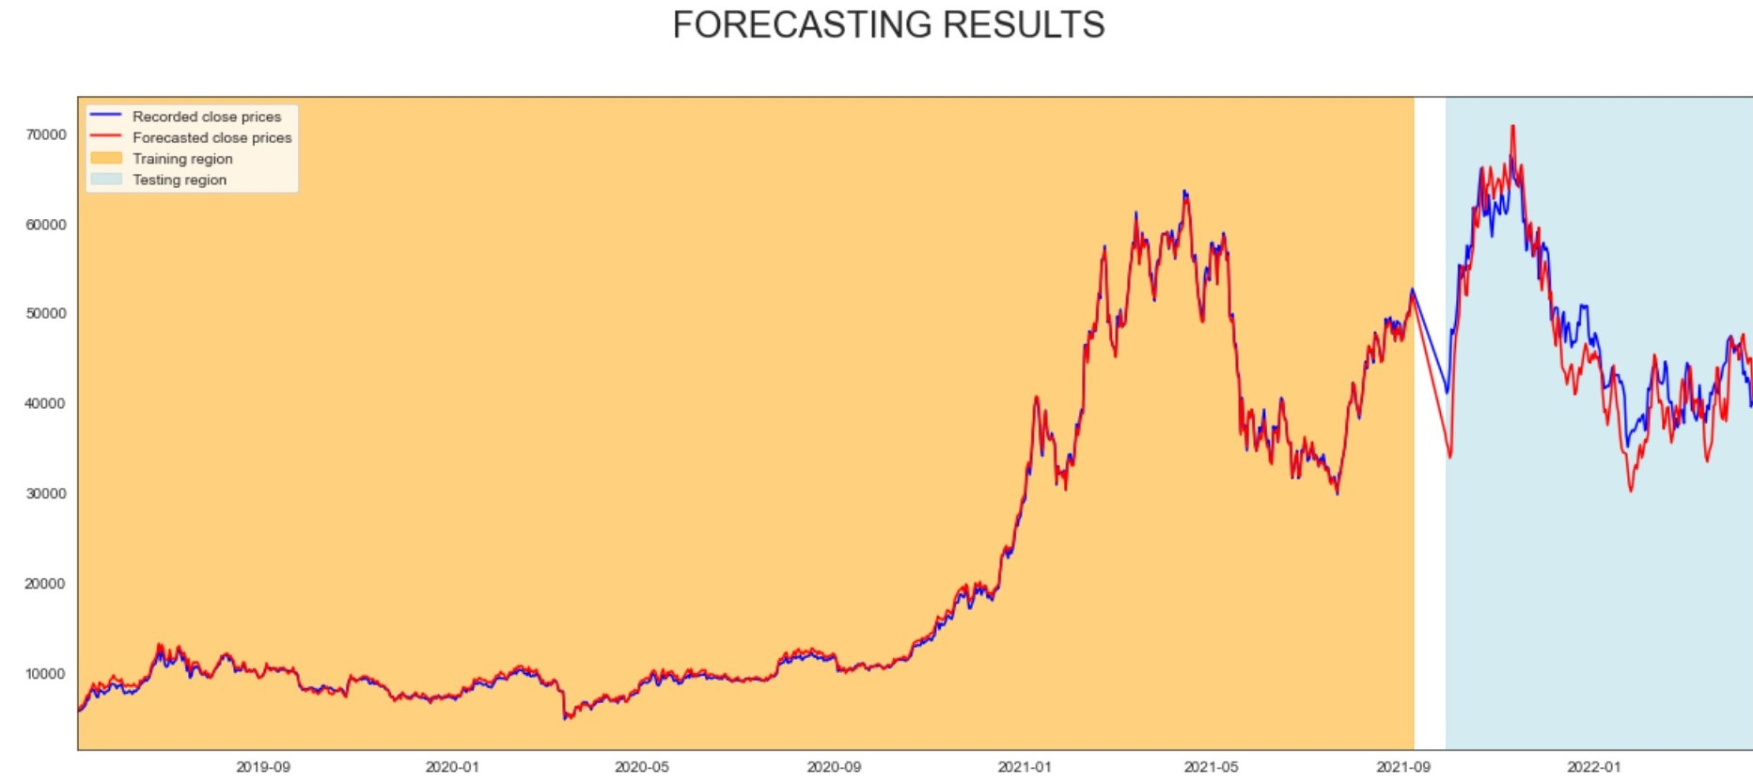
Model Results: 20-Day Window Showcase
Overfit enlarger when window = 20

Slide 13
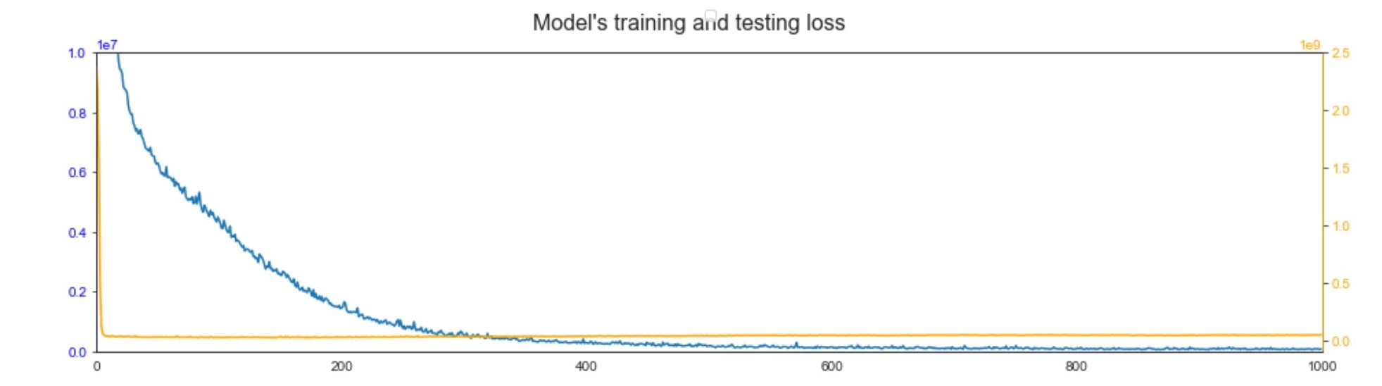
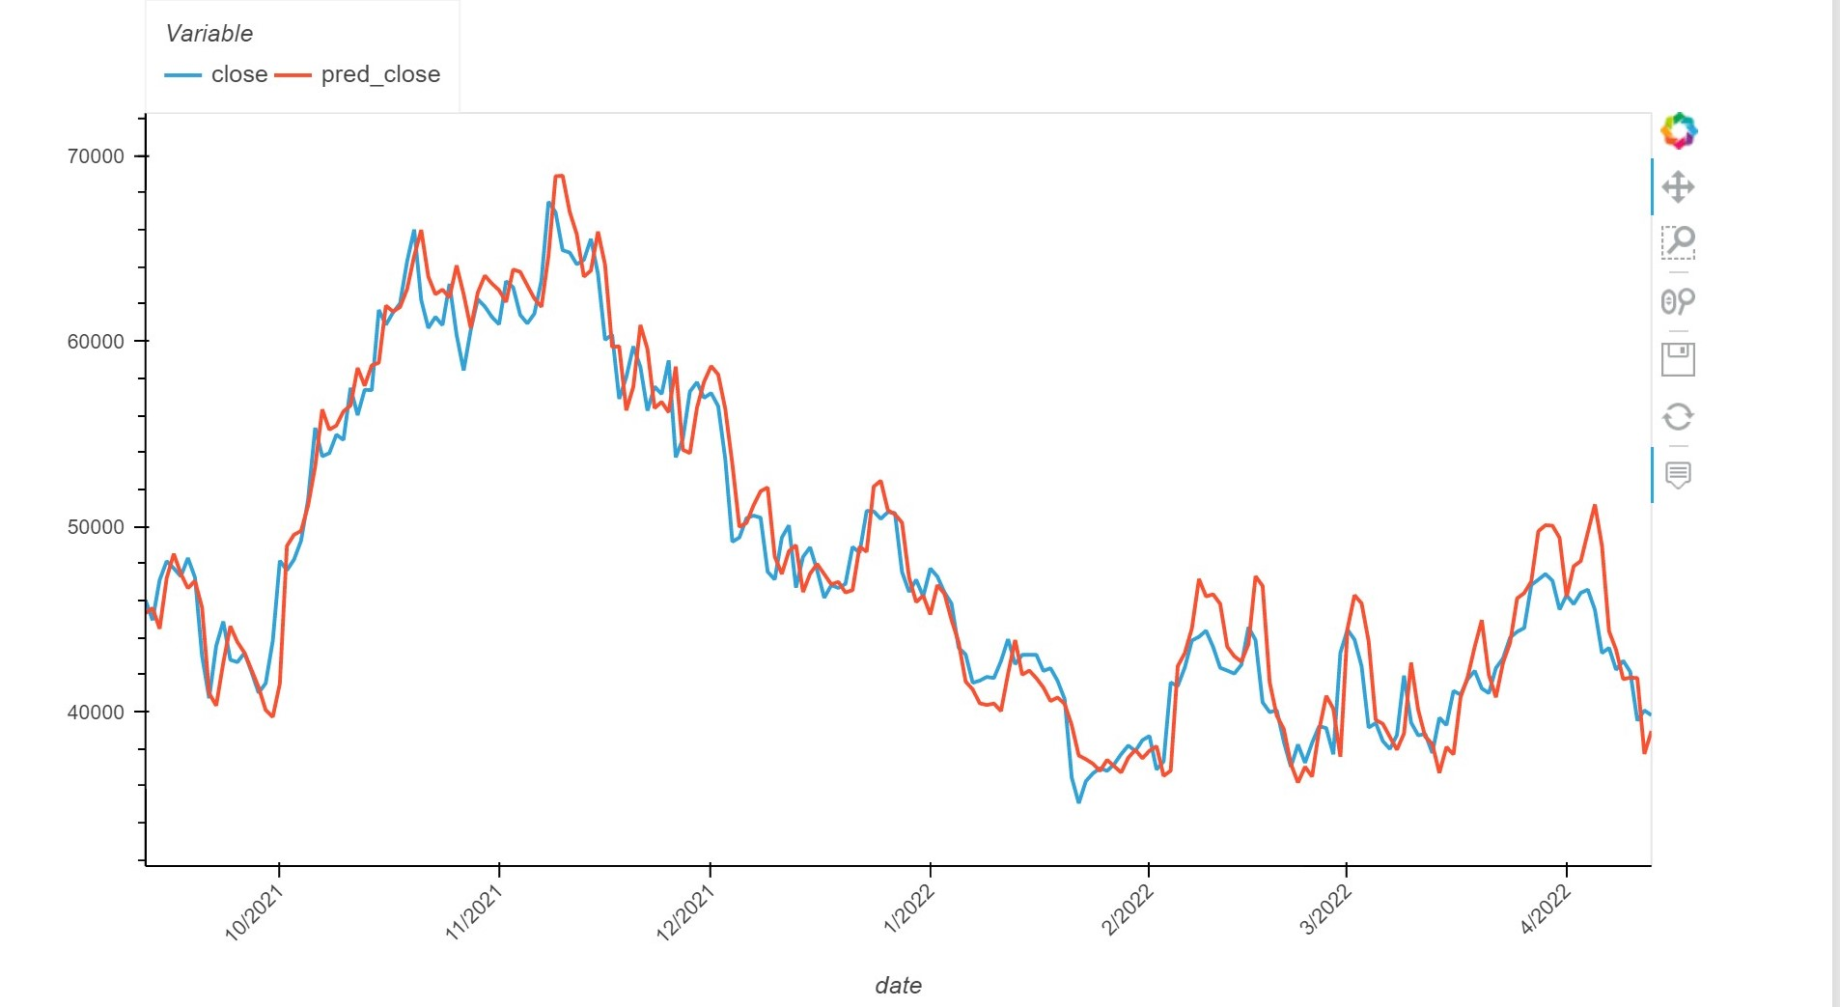
Model Results: 30-Day Window Showcase
Overfit enlarger when window = 30

