Slide 2
DB MFI
На основе микрофинансовой организации смотрим упрощенный подход к анализу кредитного процесса в банке:
https://www.db.com/cr/en/responsible-business/microfinance--social--venture--funds_.htm
https://www.db.com/us/docs/DB_Loan_Application.pdf

Slide 3
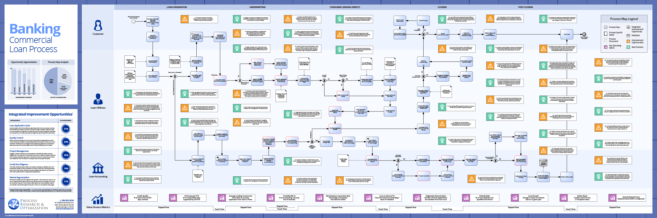

Slide 4
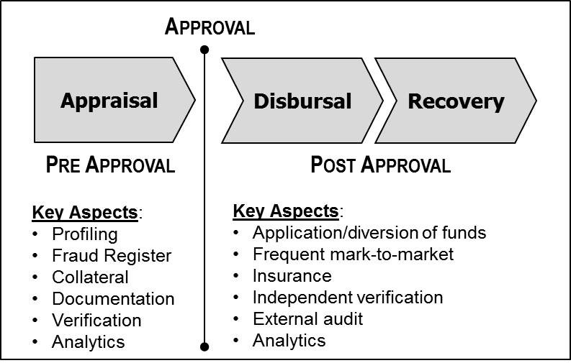

Slide 5
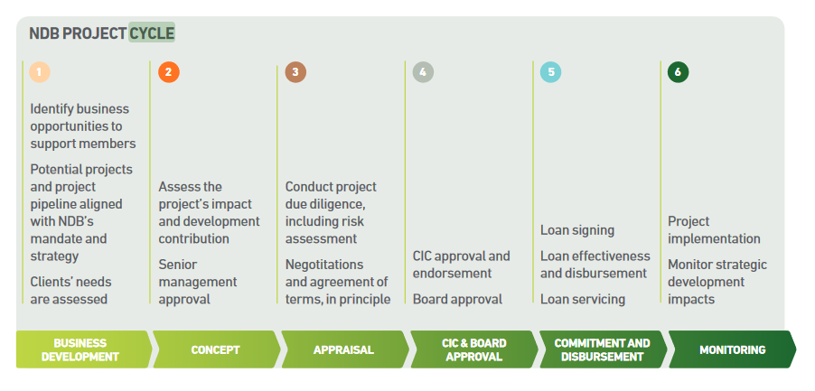
https://www.ndb.int/wp-content/uploads/2019/11/NDB_ARA_pages.pdf

Slide 6
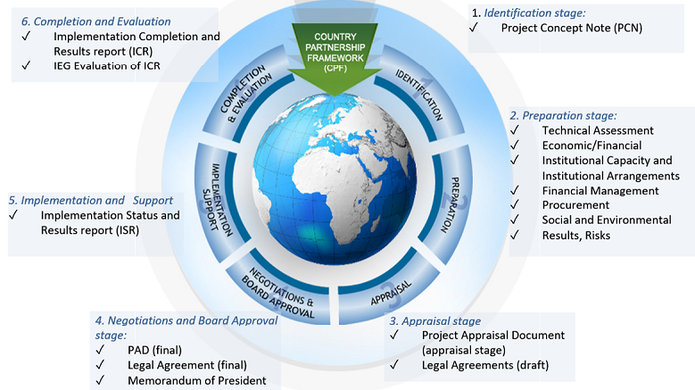
https://projects.worldbank.org/en/projects-operations/products-and-services/brief/projectcycle

Slide 7
IFC
https://www.ifc.org/wps/wcm/connect/corp_ext_content/ifc_external_corporate_site/solutions/ifc-project-cycle

Slide 8
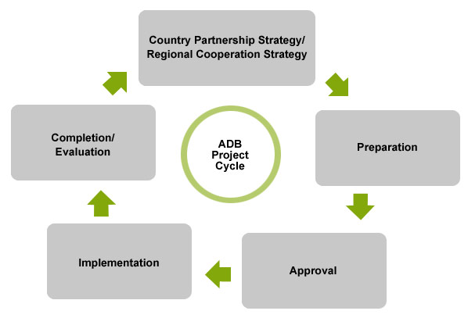
ADB
https://www.adb.org/site/public-sector-financing/operations/project-cycle

Slide 9
Дополнительные ссылки
Supranationals S&P
LOAN PROSPECTING AND THE LOSS OF SOFT INFORMATIONSumit AgarwalItzhak Ben-David https://www.nber.org/papers/w19945.pdf
Similar: https://www.nber.org/papers/w19472
Стандарты:
https://assets.kpmg/content/dam/kpmg/xx/pdf/2019/11/eba-draft-guidelines-on-loan-origination-and-monitoring.pdf

Slide 10
IRB (ВПОДК)
Bank of England
https://www.bis.org/publ/bcbsca05.pdf (старый)
Примеры раскрытия данных Basel Pillar 3
Русская терминология: https://bit.ly/2J5q5KR

