Slide 1
Self-organized criticality
Agustín Iñiguez
Eduardo Pavinato Olimpio
ICCP Presentation – 15/05/2015
TU Delft – Master Applied Physics

Slide 2
Outline
What is Self-organized criticality (SOC)?
Papers analyzed:
    Bak, P., Tang, C. & Wiesenfeld, K. Self-organized criticality. Physical Review A 38, 364–374 (1988).
    Kadanoff, L. P., Nagel, S. R., Wu, L. & Zhou, S. M. Scaling and universality in avalanches. Physical Review A 39, 6524–6537 (1989).
Where are these results applied?
Conclusions

Slide 3


What is SOC?
If general, critical phenomena must be an attractor
SOC arise in a natural random processes, no tuning parameter
Is it really general? Discussion comes later...
Per Bak
1948 - 2002

Slide 4
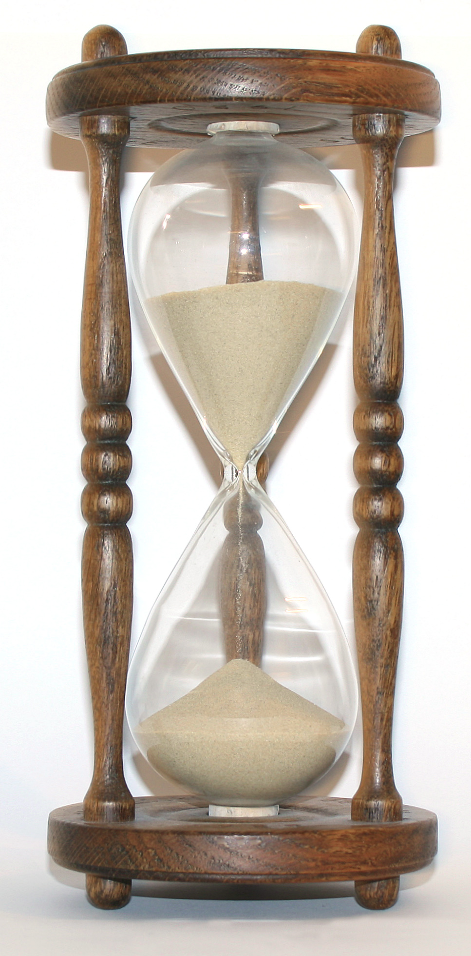

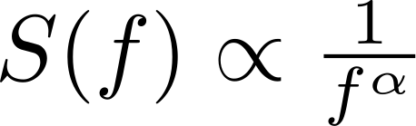


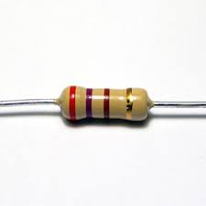


What is SOC?
Pink noise is ubiquitous
Is there a common principle for it?

Slide 5
What is SOC?
If general, critical phenomena must be an attractor
SOC arise in a natural random processes, no tuning parameter
Is it really general? Discussion comes later...
Per Bak
1948 - 2002

Slide 6

SOC algorithm
    Bak, P., Tang, C. & Wiesenfeld, K. Self-organized criticality. Physical Review A 38, 364–374 (1988)
N
Randomly distribute paperwork
If pile is too high, give one to each neighbor
N
Closed Boundary: distribute among available neighbors
Open Boundary: If no neighbor, throw away

Slide 7
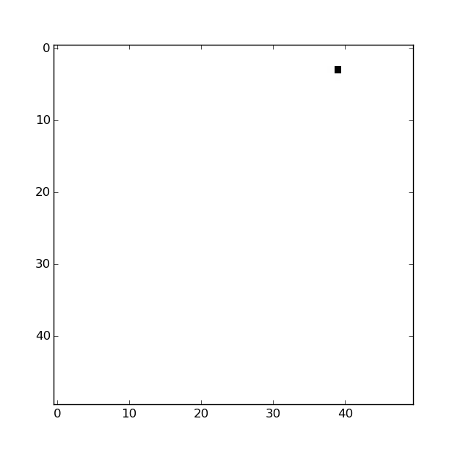
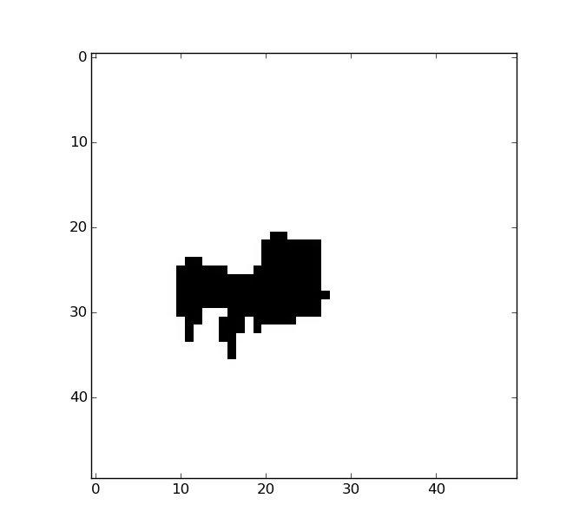
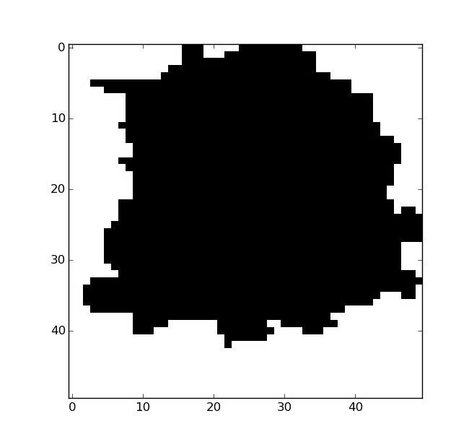
SOC analysis
    Bak, P., Tang, C. & Wiesenfeld, K. Self-organized criticality. Physical Review A 38, 364–374 (1988)
We are interested in the distribution events (or avalanche or relaxation events).

Slide 8
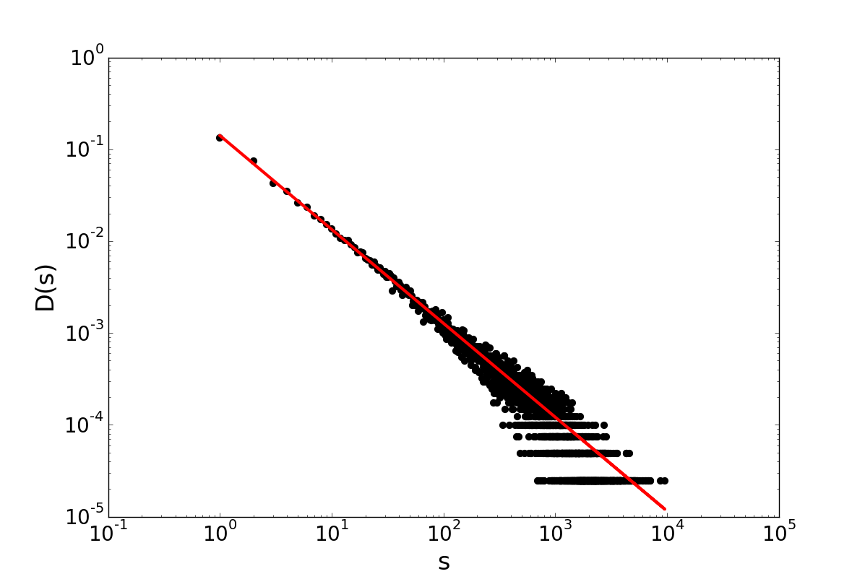
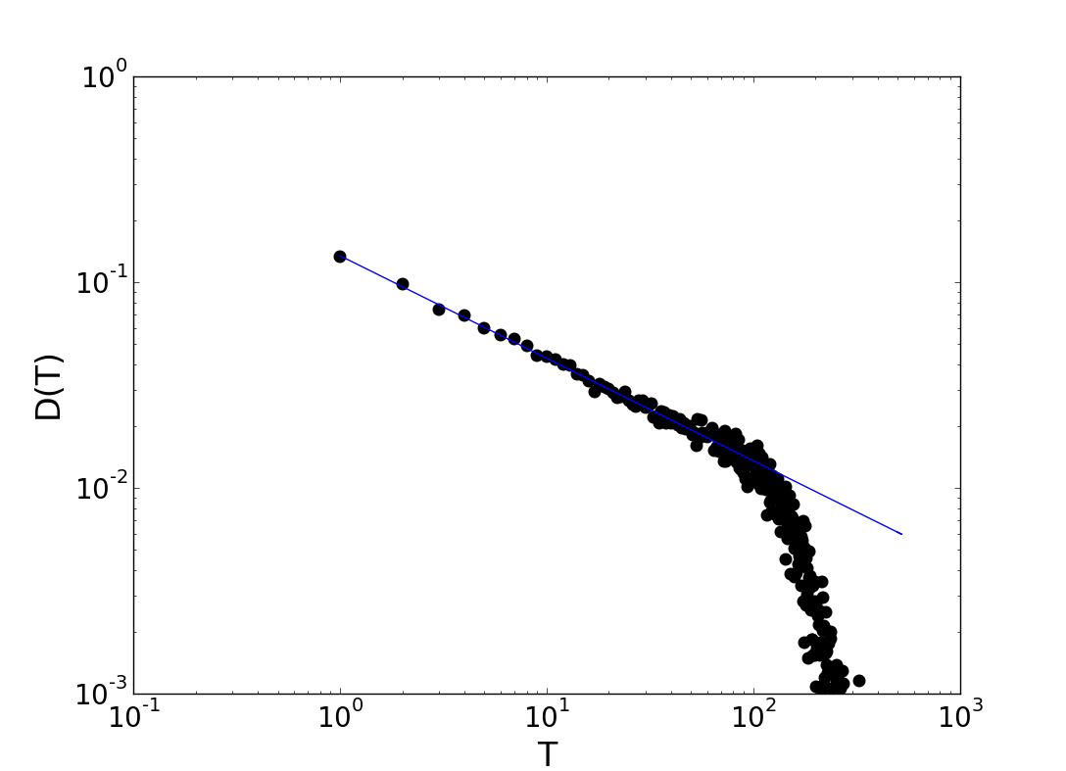





SOC results - 2D
    Bak, P., Tang, C. & Wiesenfeld, K. Self-organized criticality. Physical Review A 38, 364–374 (1988)
Normalized distribution of the time of the events weighted by the average ratio s/t
Normalized distribution of the size of events
50 x 50 system, 100000 papers distributed, open boundaries

Slide 9
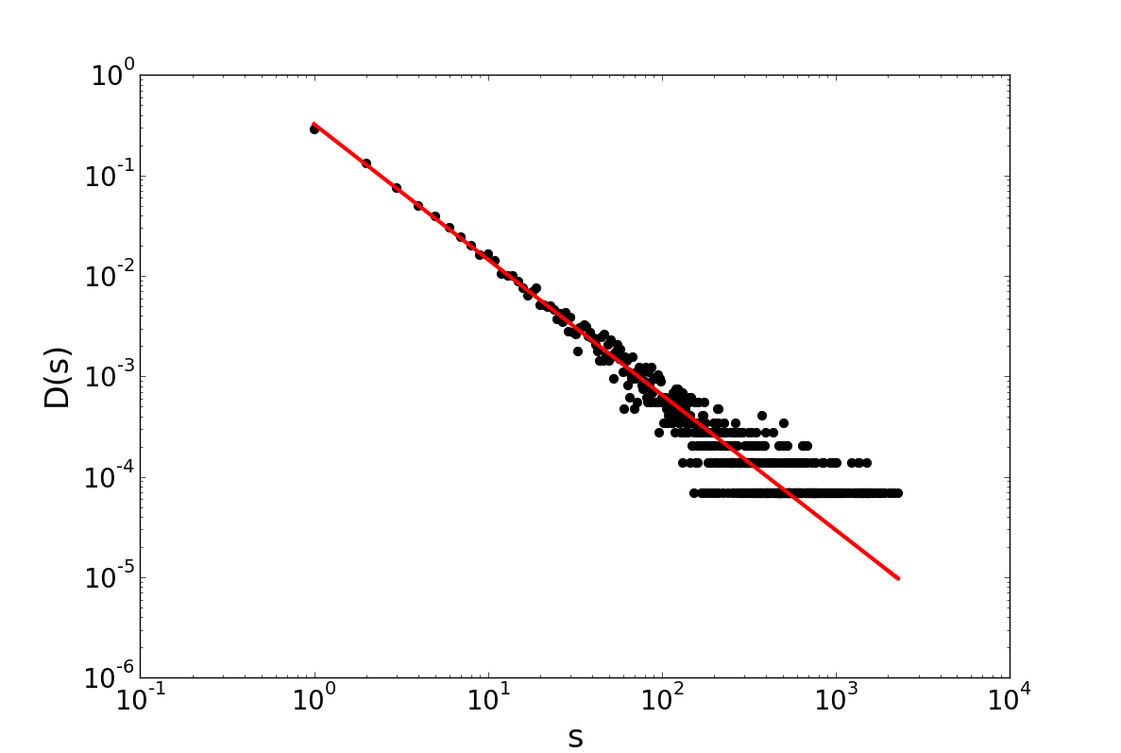
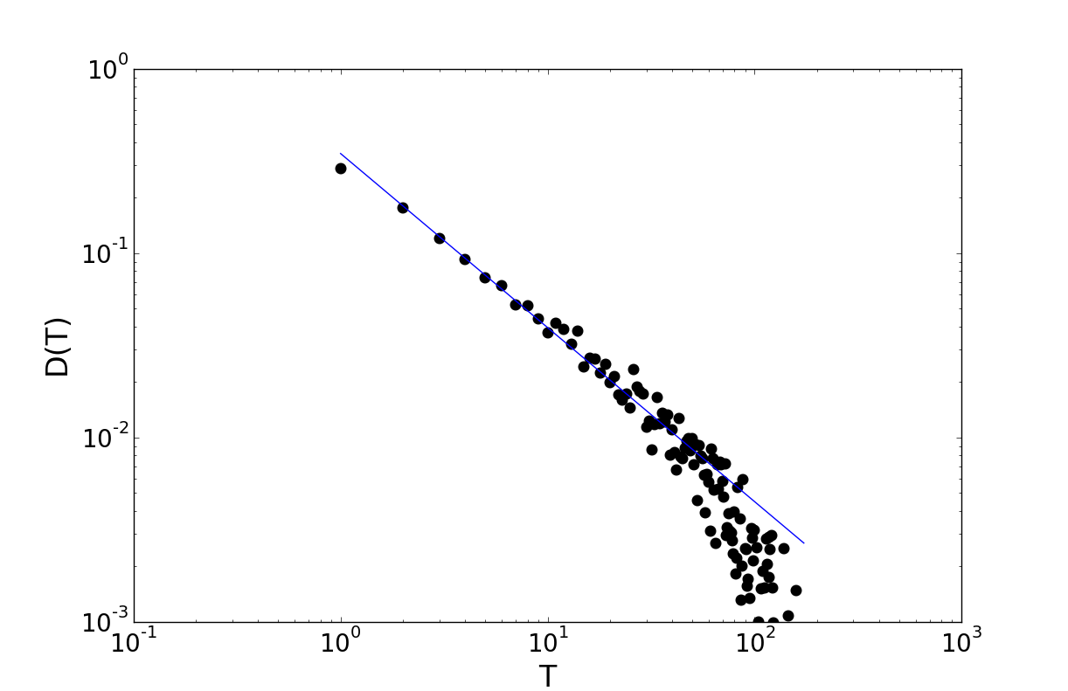


SOC results - 3D
    Bak, P., Tang, C. & Wiesenfeld, K. Self-organized criticality. Physical Review A 38, 364–374 (1988)
Normalized distribution of the time of the events weighted by the average ratio s/t
Normalized distribution of the size of events
20x20x20 system, 100000 papers distributed, open boundaries

