Slide 1
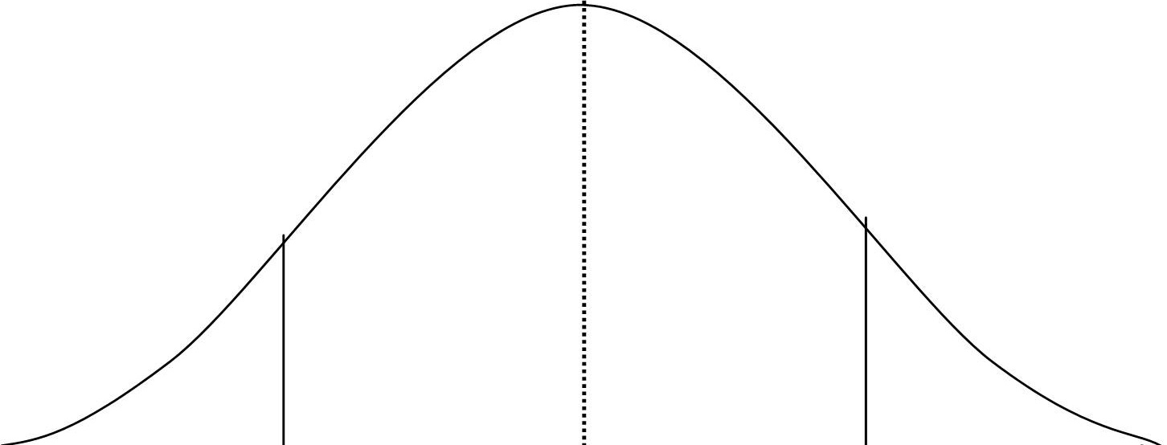
Unknown
Known

Slide 2
Intelligent Metadata Editor
Last Updated: 28 Jan 2020
Project Completion: 17 March 2020
Scopes
Status Summary
Color | Scope | Status summary / next steps | Stage
 | Middle-out compression | We’ve already got this covered from when we built it for The Platform® | ✅
 | 4K video support | Basically finished, going through code review tomorrow | ↓
 | User system | Wrapping up password resets and automated backups | ↓
 | Terms & conditions | Not started, should be easy though | ↑
Unknown
Known

