Slide 2
Using LSTM

Slide 3
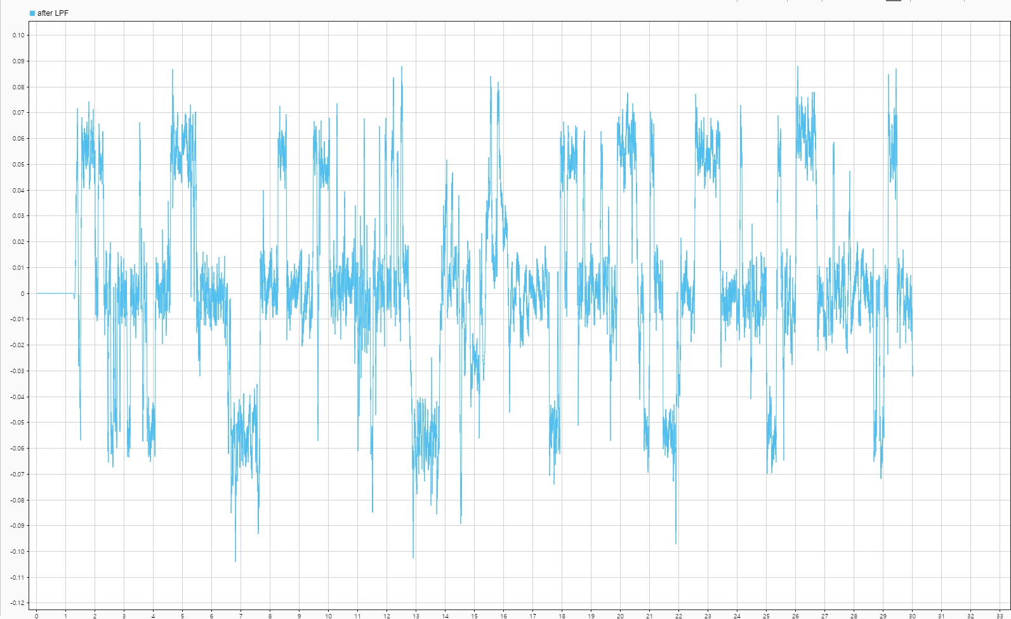
0.007s+1

Slide 4
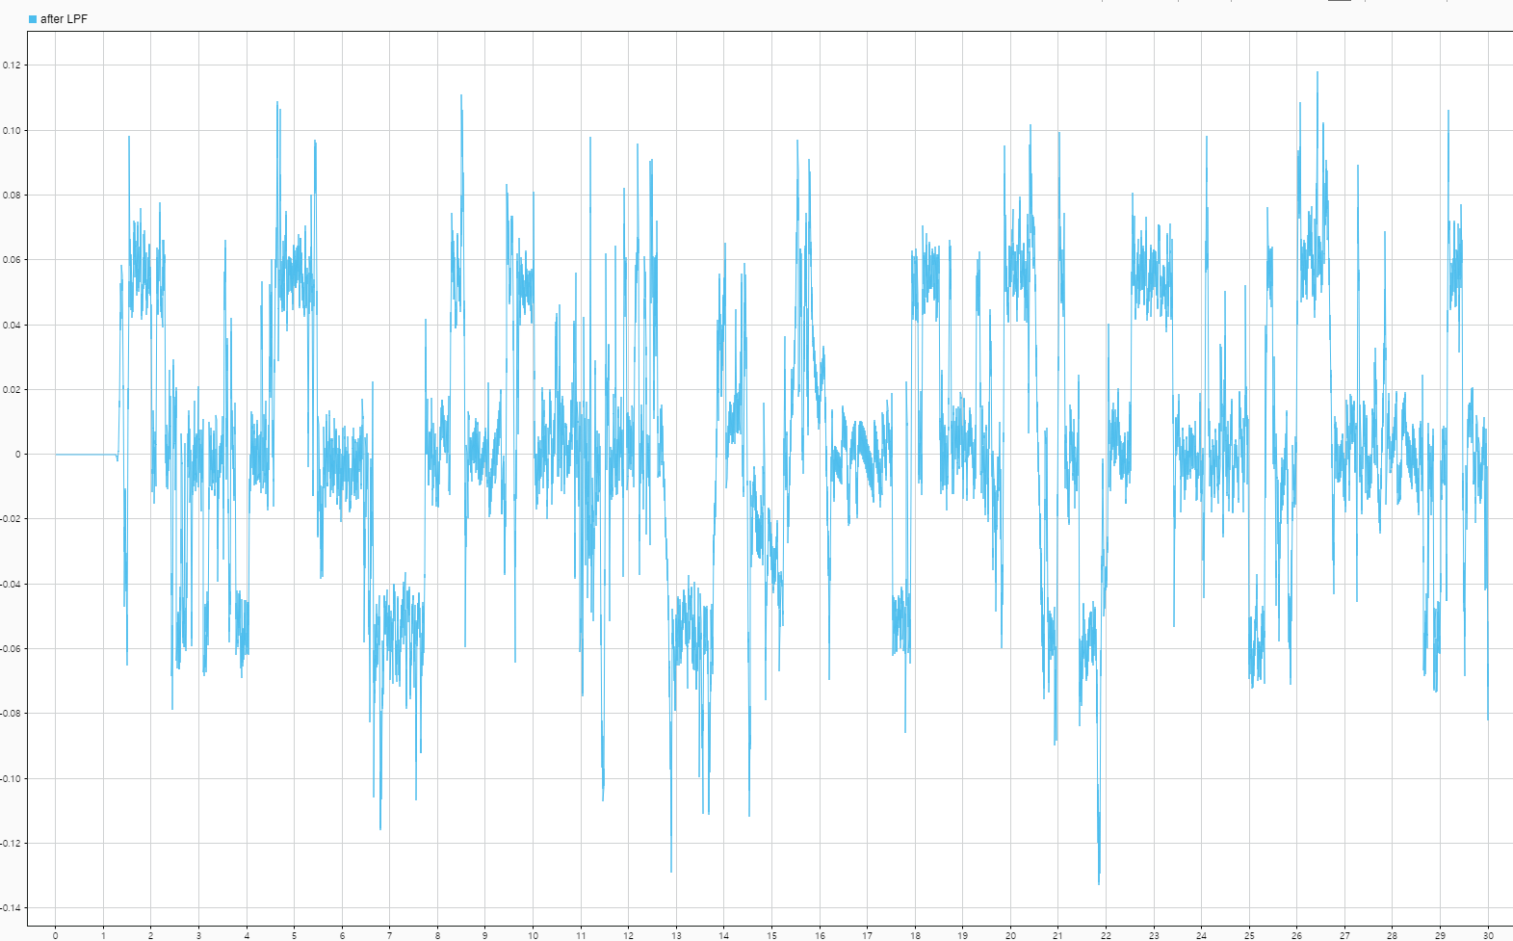
0.006s+1

Slide 5
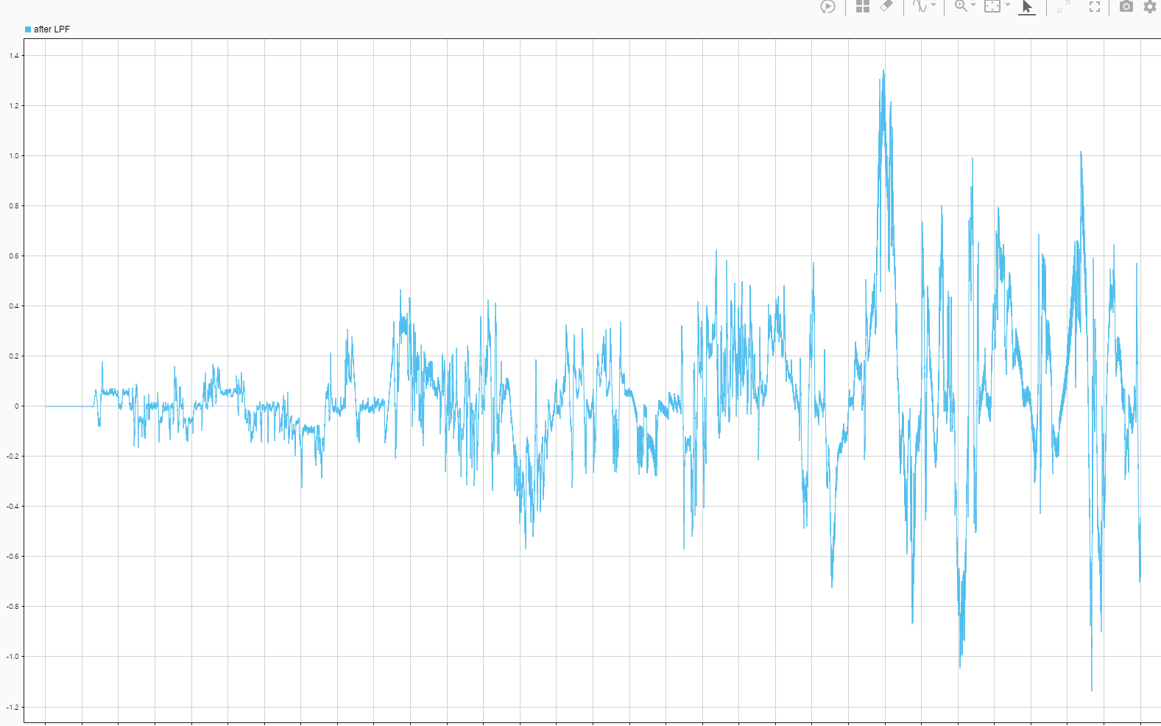
0.005s+1

Slide 6
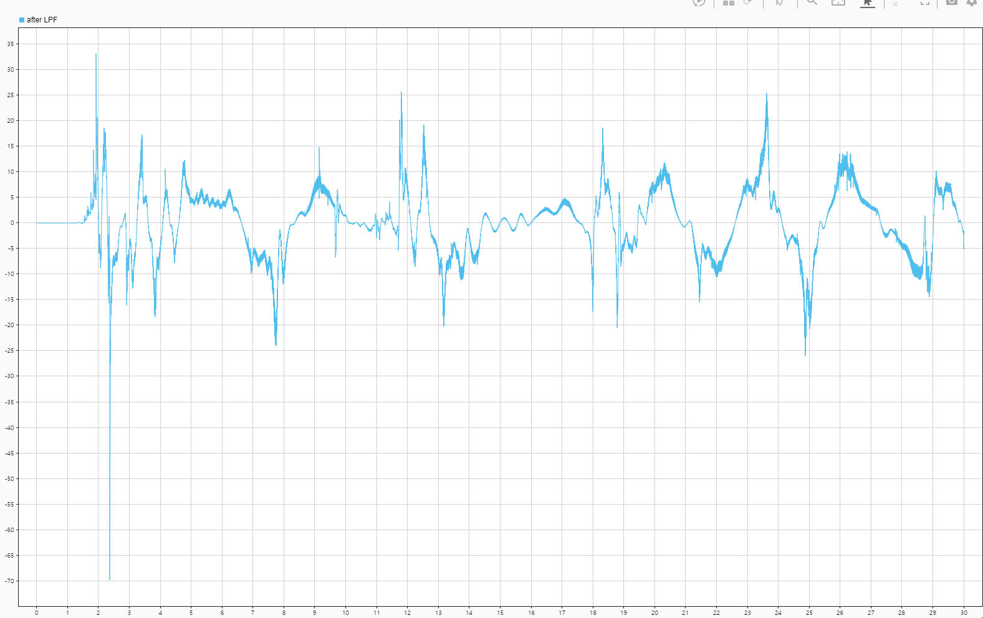
0.004s+1

Slide 7
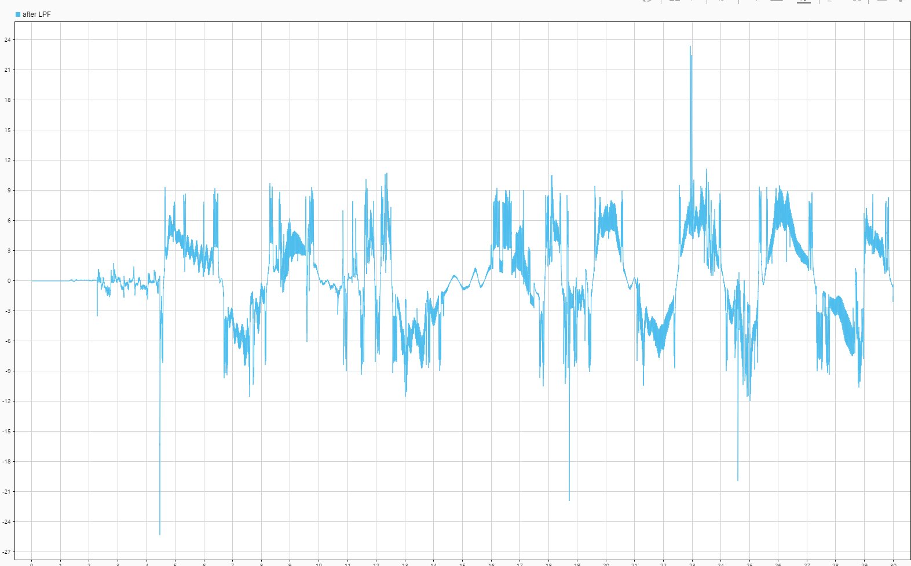
0.003s+1

Slide 8
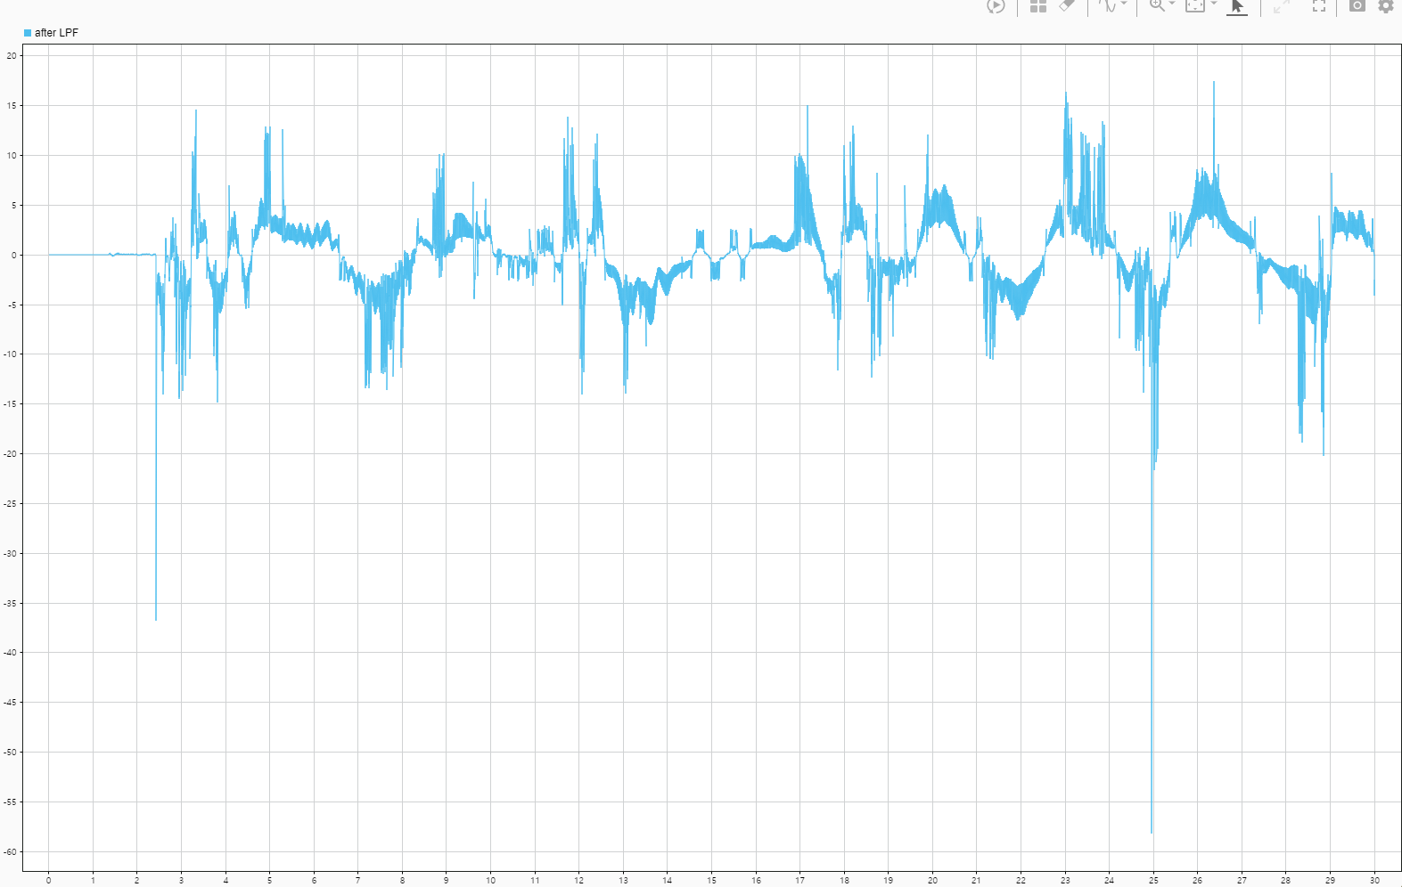
0.002s+1

Slide 9
No LSTM

Slide 10
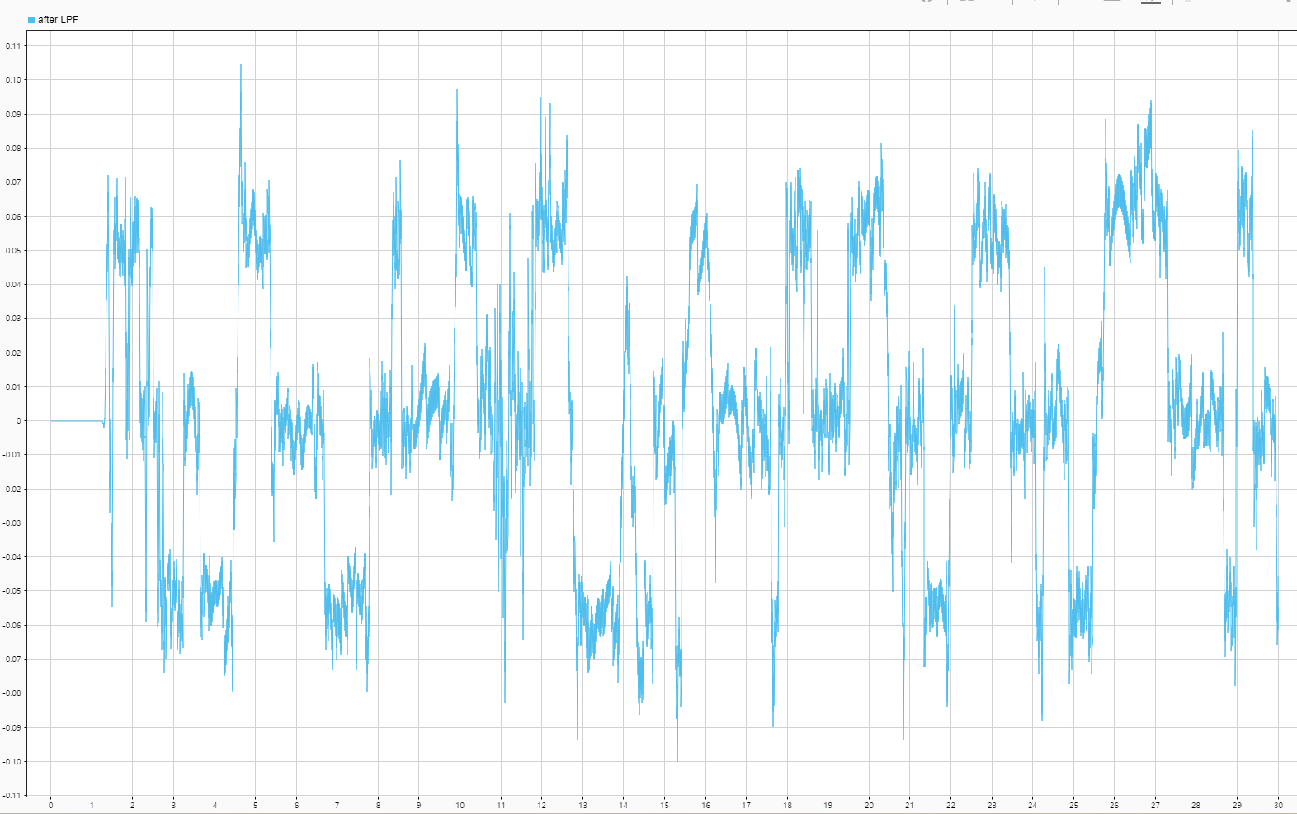
0.007s+1

Slide 11
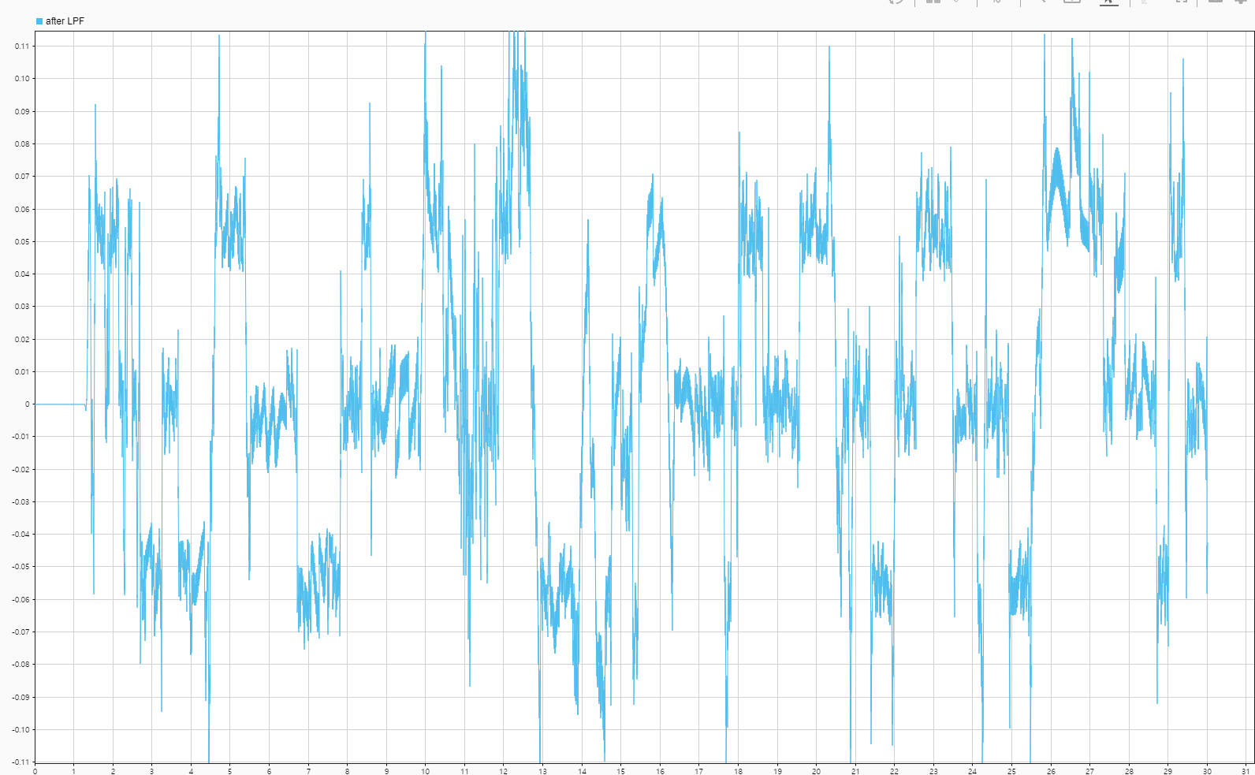
0.006s+1

Slide 12
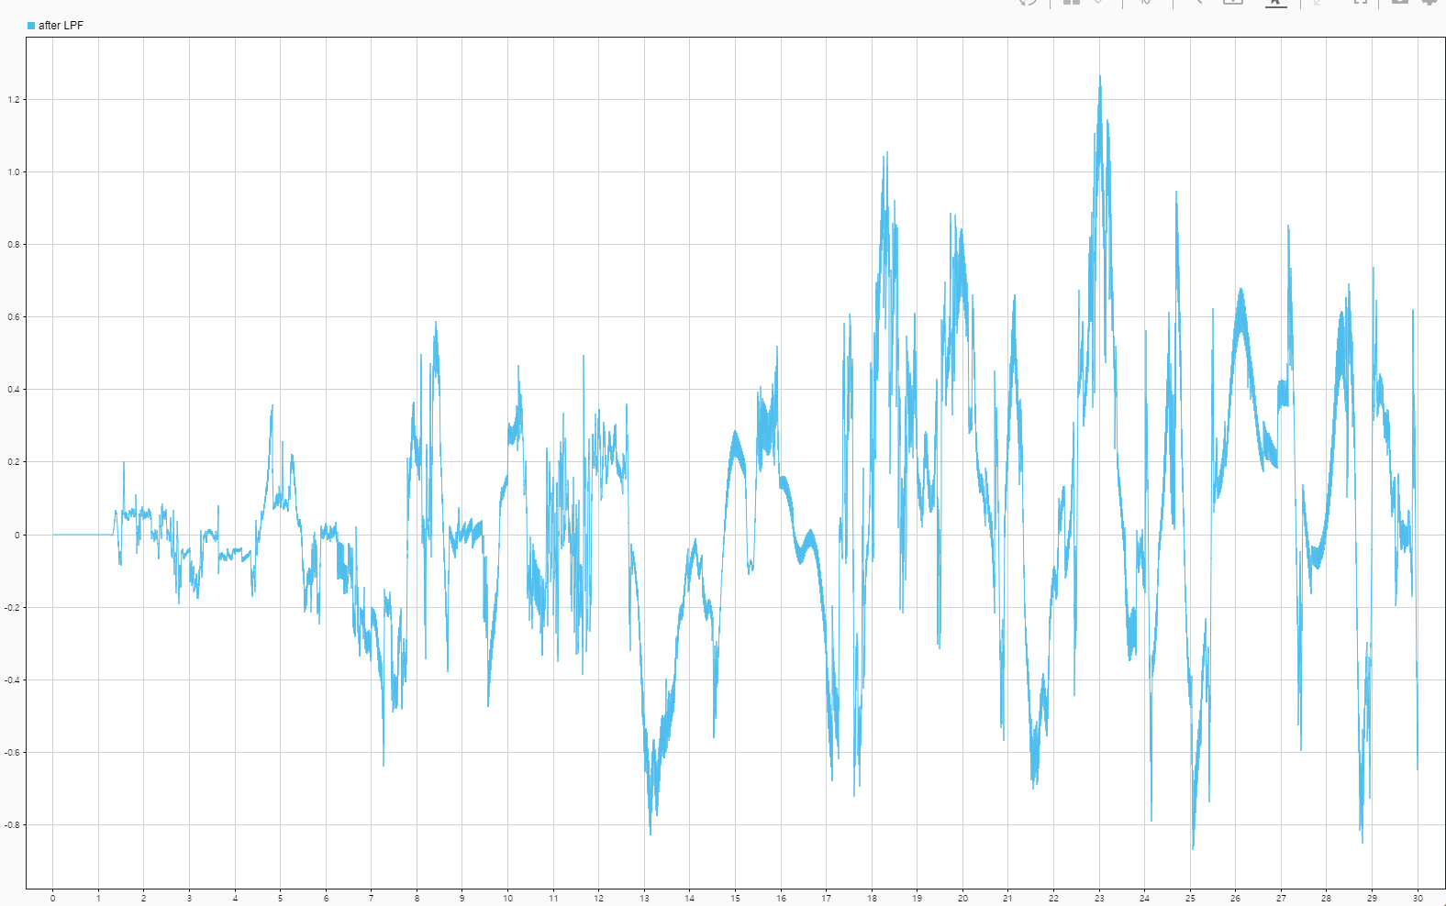
0.005s+1

Slide 13
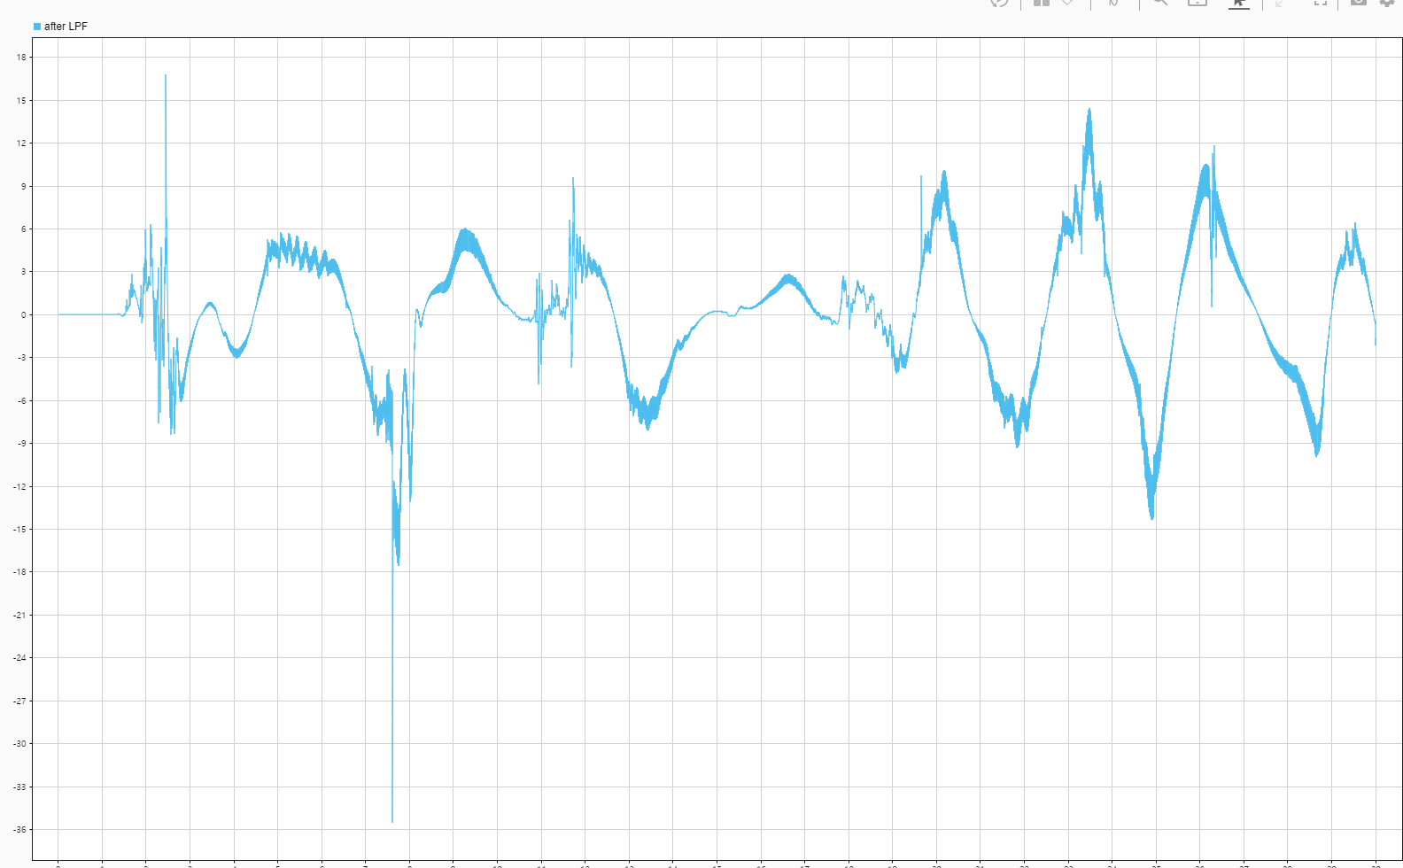
0.004s+1

Slide 14
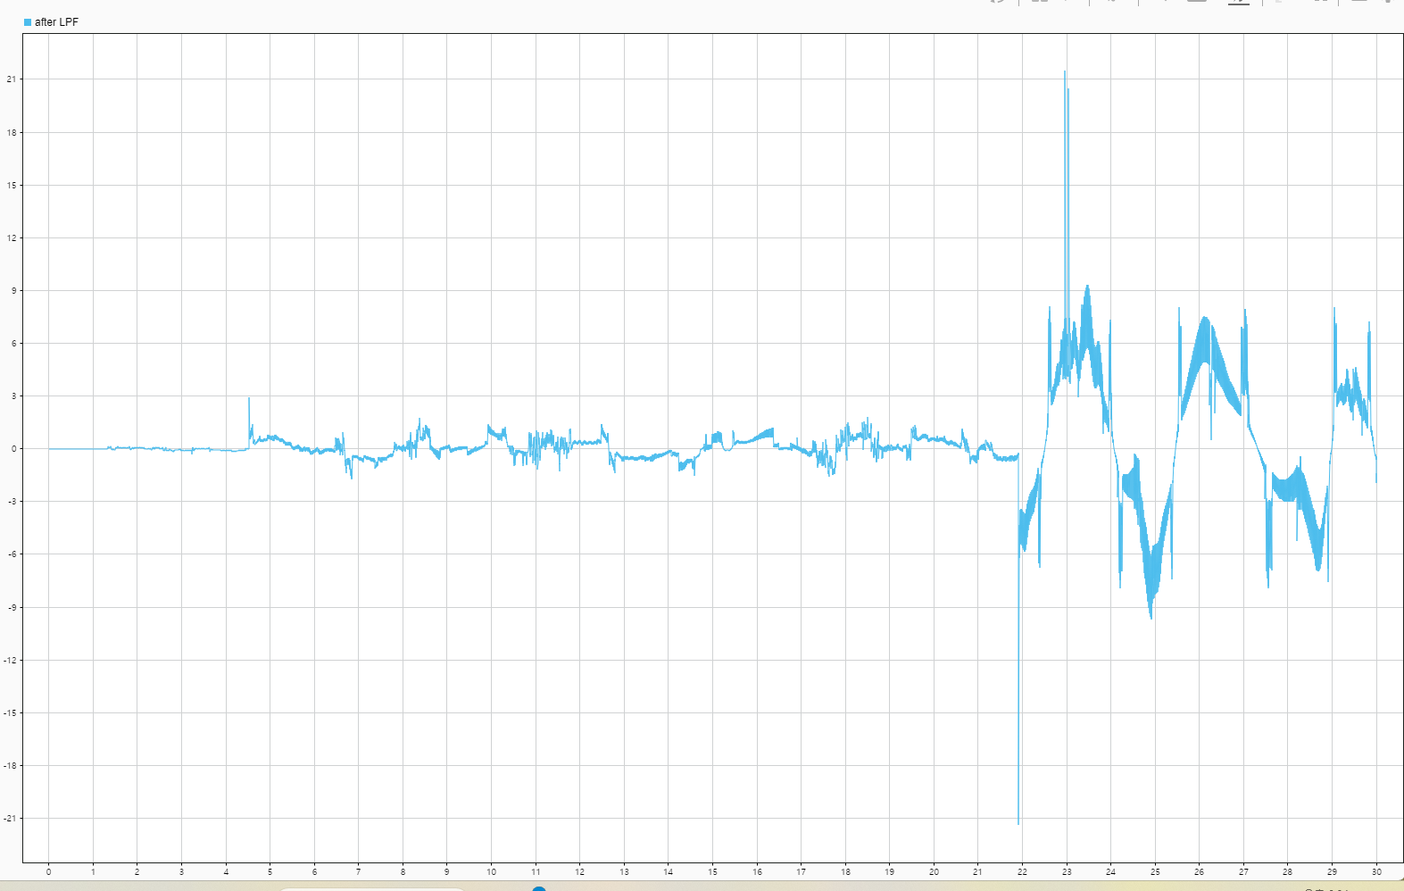
0.003s+1

Slide 15
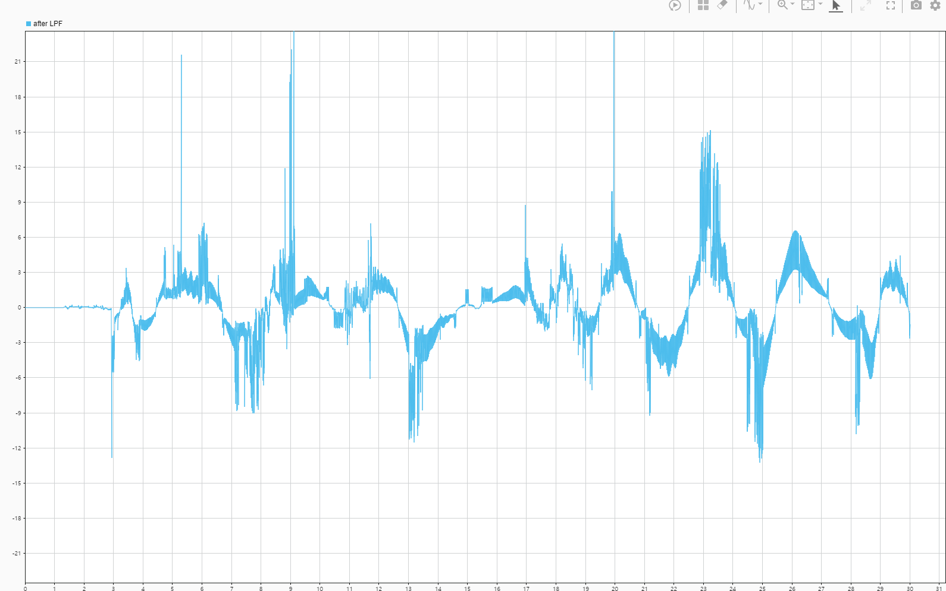
0.002s+1

