Slide 1

Silhouette-based live 3D reconstruction
Stefan Götschi & Enes Poyraz

Slide 2
Outline
Concept
GrabCut
Reconstruction
Voxel Rendering
Problems
Improvements

Slide 3
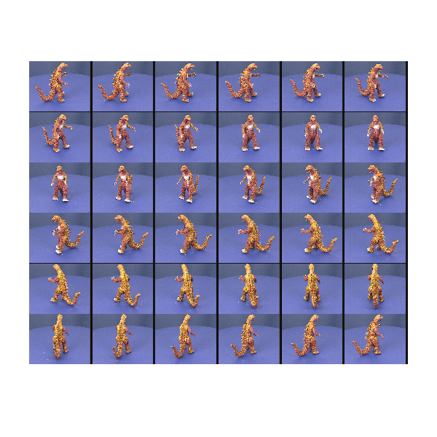
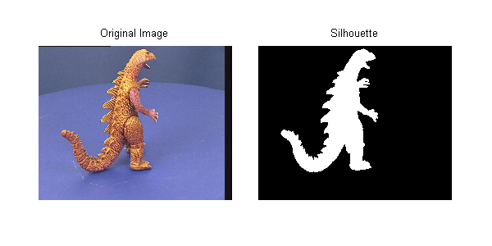
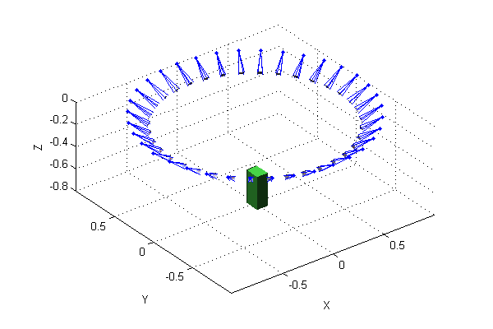
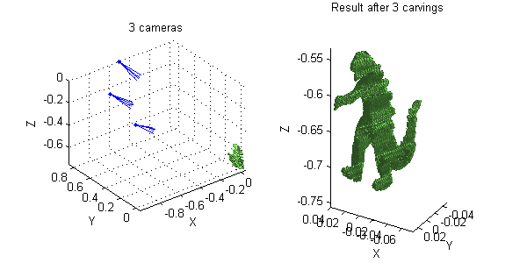
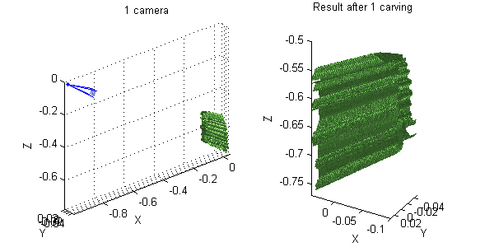
Concept

Slide 4
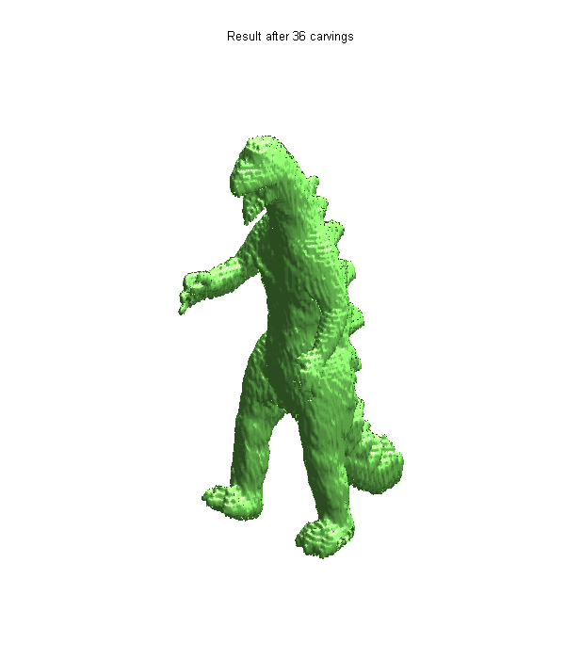
Result

Slide 5





Technologies
Android SDK
Android NDK
Vuforia SDK
OpenGL ES 2.0
OpenCV

Slide 6
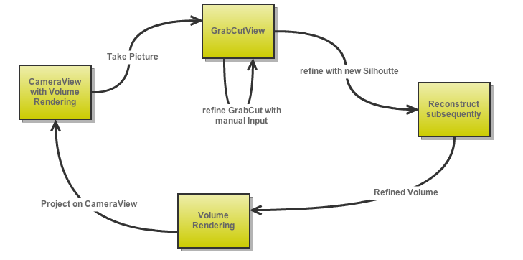
Workflow

Slide 7
GraBCut
initial Step slow ( 5-10 sec. )
only CPU

Slide 8

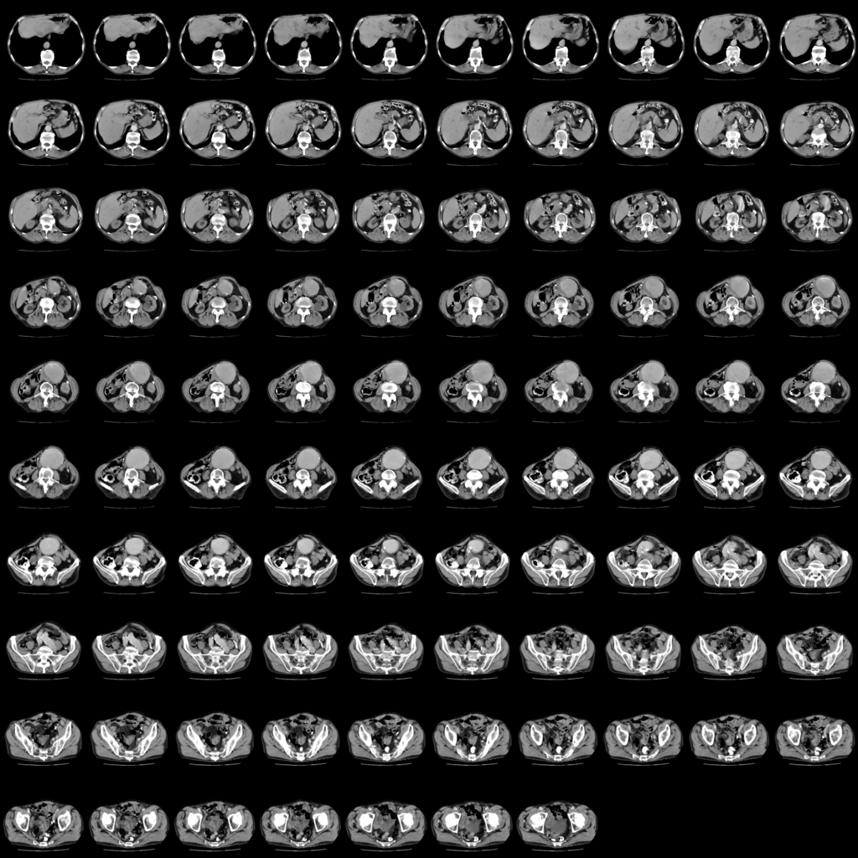
Reconstruction
Voxel Cube 100x100x100
1024x1024 Texture
uses Camera Position from vuforia

Slide 9
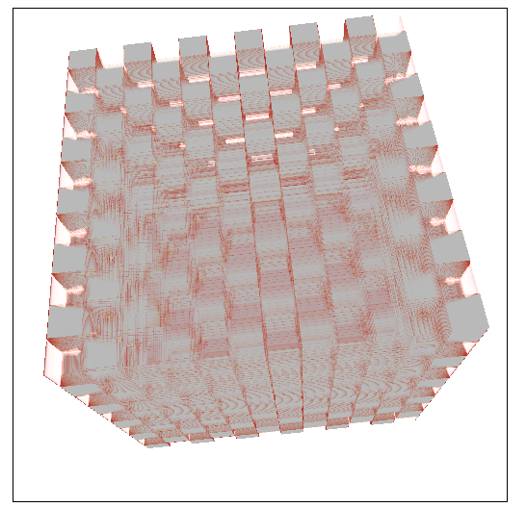
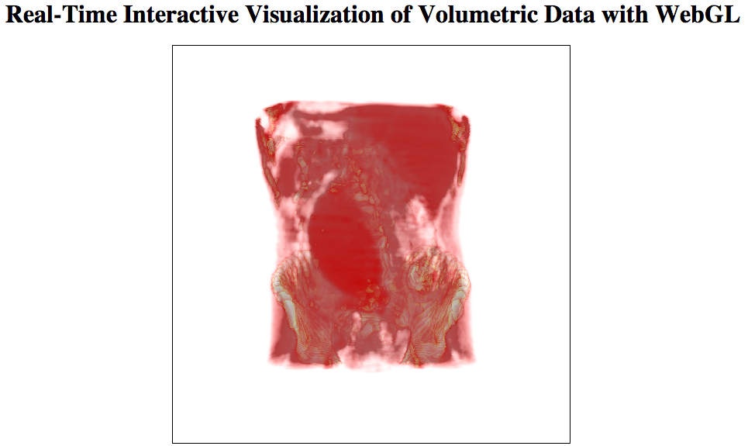
Volume Render
ported from WebGL
  source : http://demos.vicomtech.org/volren
        http://n.ethz.ch/~poyraze/webgl/

Slide 10
How to Use

Slide 11
Demo

Slide 12
Problems
Fragment Shader
Coordinate Systems
different scales of images
inter Library communication

Slide 13
Possible Improvements
Debug Mode/Outputs on Device
MinCut for Reconstruction
Marching Cubes
GrabCut on GPU

Slide 14
Thanks for Listening
Questions ?
References
A Theory of Shape by Space Carving, K. N. Kutulakos & S. M. Seitz, International Journal of Computer Vision 38(3), 199–218, 2000
D. Snow, P. Viola, R. Zabih, "Exact Voxel Occupancy with Graph Cuts"
C. Rother, V. Kolmogorov, A. Blake, "GrabCut — Interactive Foreground Extraction using Iterated Graph Cuts"
http://blogs.mathworks.com/loren/2009/12/16/carving-a-dinosaur/

