Slide 1

Classifying Cylinders and Cones with AI: A Python-Powered Radar Adventure
Dr. Joan Jani
Polytechnic University of Tirana
j.jani@fimif.edu.al

Slide 2
Artificial Intelligence
Intro
Neural Networks
Demo
MNIST
Cylinder and Cones

Slide 3
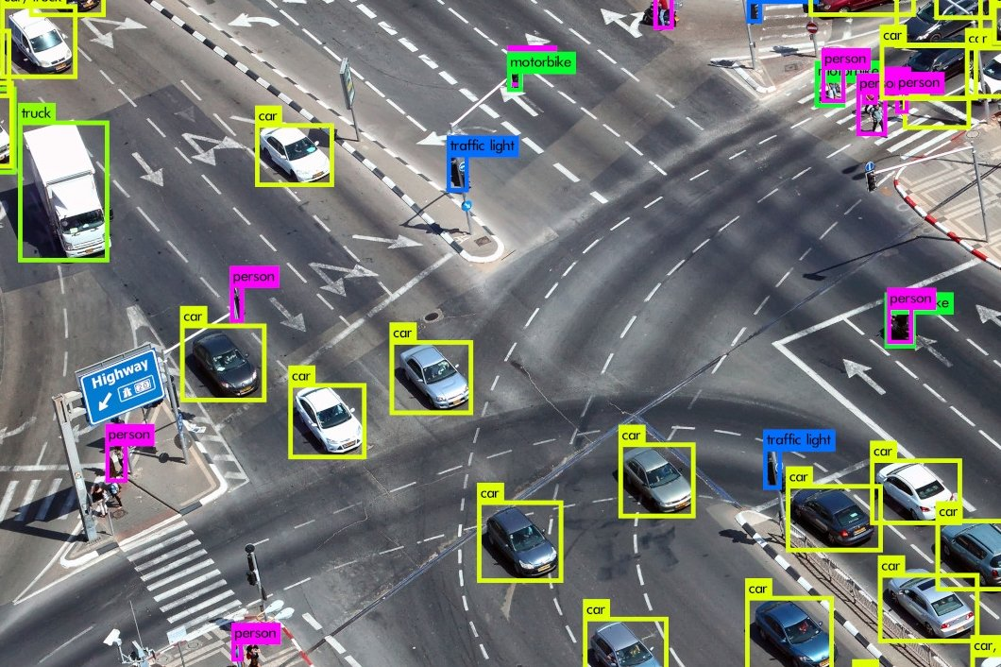

Slide 4
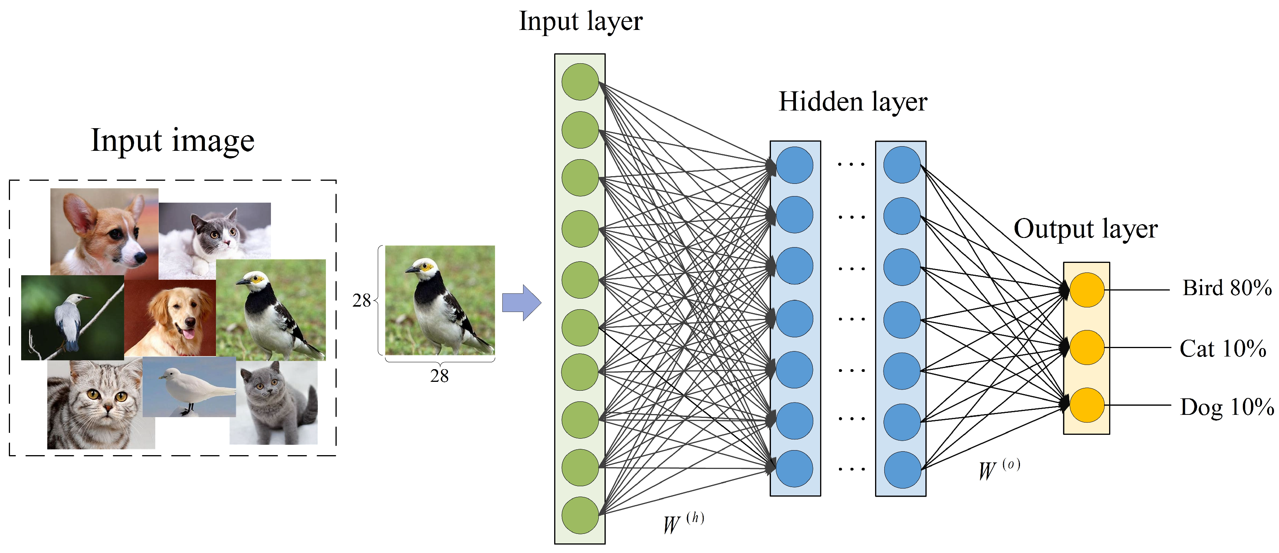
Overview and goal

Slide 5
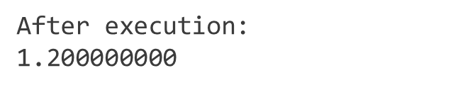



Simplest Neural Network
$$x$$
$$w$$
$$o=w∗x$$
# Simple calculation
x = 1.5 # Input
y = 0.5 # Desired output
w = 0.8 # Weight
o = w*x
# Actual output
print(o)

Slide 6
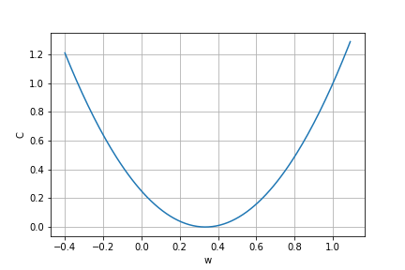
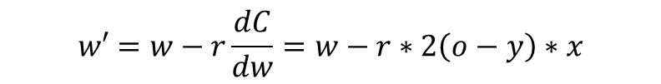




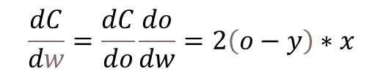
Simplest Neural Network
$$i$$
$$w$$
$$o=w∗i$$
Cost Function:
$$C={(o−y)}^{2}$$
$$\frac{dC}{dw}=\frac{dC}{do}\frac{do}{dw}=2\left(o−y\right)∗x$$
$$w′=w−r\frac{dC}{dw}=w−r∗2\left(o−y\right)∗x$$

Slide 7
Code
After execution:
w o c
0.800 1.200 0.490
0.590 0.885 0.148
0.474 0.712 0.045
0.411 0.616 0.014
0.376 0.564 0.004
0.357 0.535 0.001
0.346 0.519 0.000
0.340 0.511 0.000
0.337 0.506 0.000
0.335 0.503 0.000
0.335 0.502 0.000
0.334 0.501 0.000
0.334 0.501 0.000
0.334 0.500 0.000
0.333 0.500 0.000
# Code with weight update
x = 1.5
w = 0.8
y = 0.5
r = 0.1
print(f'w \t o \t c’)
for i in range(15):
o = w * x # Output
c = (o-y)**2 # Cost function
print(f'{w:.3f} \t {o:.3f} \t {c:.3f}’)
w -= r*2*(o-y)*x # Weight update

Slide 8


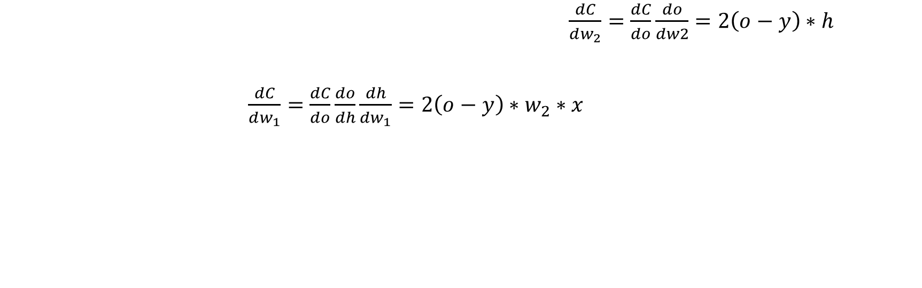




Two-layer
$$x$$
$$h=w_{1}∗x$$
$$o=w_{2}∗h$$
$$w_{1}$$
$${ w}_{2}$$
$$C={(o−y)}^{2}$$
$\frac{dC}{dw_{2}}=\frac{dC}{do}\frac{do}{dw2}=2\left(o−y\right)∗h$
$\frac{dC}{dw_{1}}=\frac{dC}{do}\frac{do}{dh}\frac{dh}{dw_{1}}=2\left(o−y\right)∗w_{2}∗x$
$$w_{2}^{′}=w_{2}−r\frac{dC}{dw_{1}}=w_{1}−r∗2\left(o−y\right)∗h$$
$$w_{1}^{′}=w_{1}−r\frac{dC}{dw_{1}}=w_{1}−r∗2\left(o−y\right)∗w_{2}∗x$$

Slide 9
Code
w1 w1 o c
0.100 0.200 0.030 0.221
0.130 0.214 0.042 0.210
0.162 0.232 0.056 0.197
0.196 0.254 0.074 0.181
0.231 0.279 0.097 0.163
0.268 0.307 0.123 0.142
0.307 0.337 0.155 0.119
0.345 0.369 0.191 0.096
0.382 0.401 0.229 0.073
0.417 0.432 0.270 0.053
0.449 0.460 0.310 0.036
0.476 0.486 0.347 0.023
0.500 0.508 0.381 0.014
0.519 0.526 0.409 0.008
0.533 0.540 0.432 0.005
0.545 0.551 0.450 0.003
0.553 0.559 0.464 0.001
0.559 0.565 0.474 0.001
0.564 0.569 0.481 0.000
0.567 0.573 0.487 0.000
0.569 0.575 0.491 0.000
0.571 0.576 0.493 0.000
# With two layers
x = 1.5
w1 = 0.1
w2 = 0.2
y = 0.5
r = 0.1
print(f'w1 \t w1 \t o \t c’)
for i in range(22):
h = w1 * x
o = w2 * h
c = (o-y)**2
print(f'{w1:.3f} \t {w2:.3f} \t {o:.3f} \t {c:.3f}')
w2 -= r*2*(o-y)*h
w1 -= r*2*(o-y)*w2*x

Slide 10
Activation function
Allow for Complex Decision Boundaries
Control the Output Range
Preventing Gradient Problems
Introduce Sparsity

Slide 11
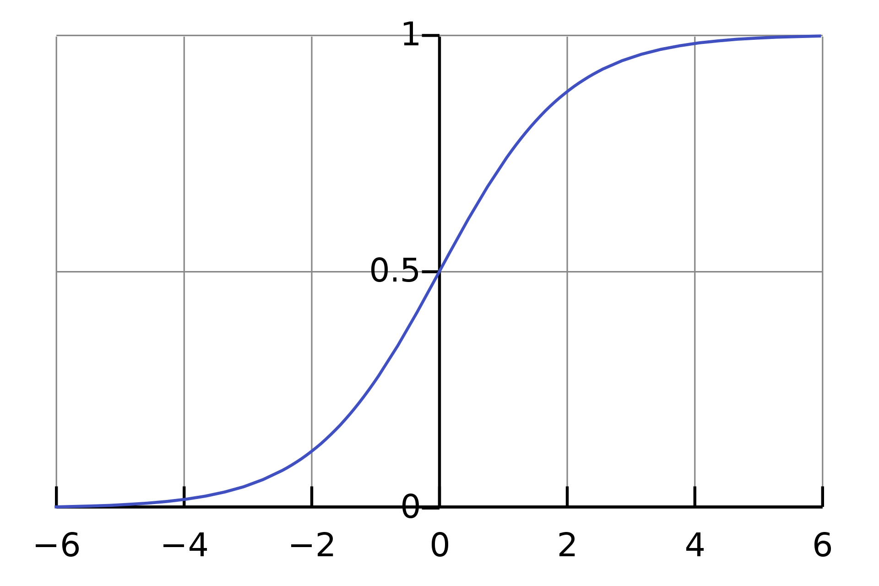
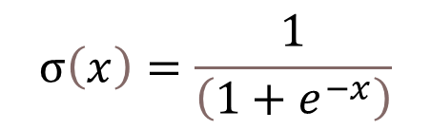
Sigmoid function
$$σ\left(x\right)=\frac{1}{\left(1+e^{−x}\right)}$$

Slide 12
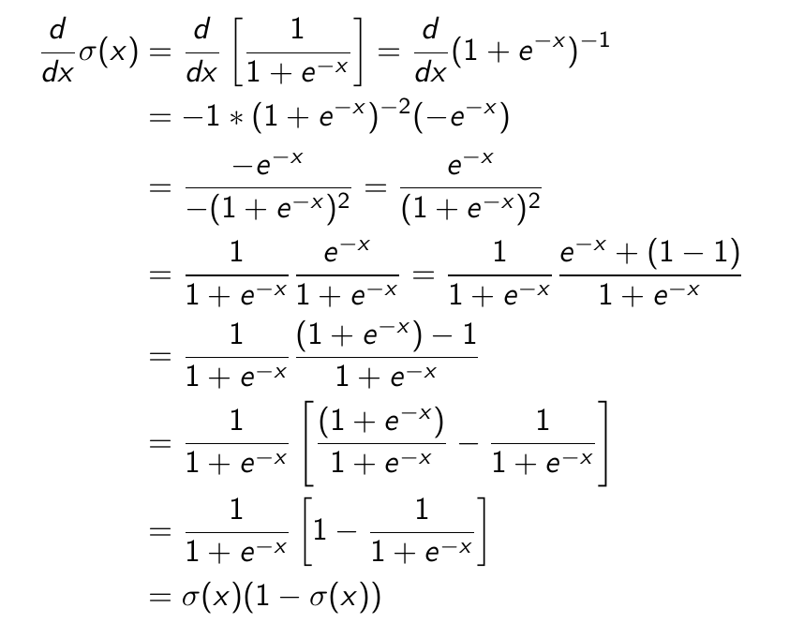
Derivative

Slide 13


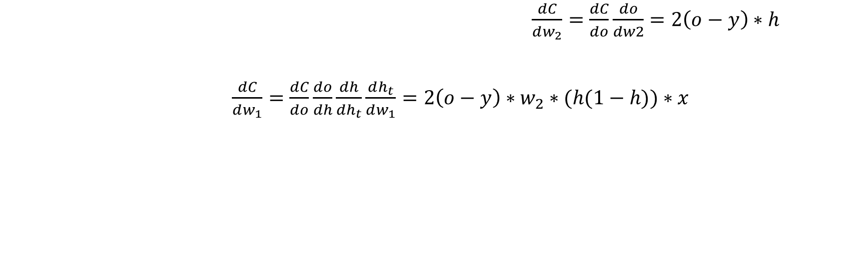




Equations
$$i$$
$$h_{t}=w_{1}∗i$$
$$h=σ(h_{t})$$
$$o_{t}=w_{2}∗h$$
$$w_{1}$$
σ(h)
$$w_{2}$$
$\frac{dC}{dw_{2}}=\frac{dC}{do}\frac{do}{dw2}=2\left(o−y\right)∗h$
$\frac{dC}{dw_{1}}=\frac{dC}{do}\frac{do}{dh}\frac{dh}{dh_{t}}\frac{dh_{t}}{dw_{1}}=2\left(o−y\right)∗w_{2}∗(h(1−h))∗x$
$$w_{2}^{′}=w_{2}−r\frac{dC}{dw_{1}}=w_{1}−r∗2\left(o−y\right)∗h$$
$$w_{1}^{′}=w_{1}−r\frac{dC}{dw_{1}}=w_{1}−r∗2\left(o−y\right)∗w_{2}∗(h(1−h))∗x$$

Slide 14
Code
w1 w1 o c
0.100 0.200 0.054 0.199
0.108 0.248 0.059 0.195
0.118 0.296 0.064 0.190
0.129 0.343 0.071 0.184
0.142 0.390 0.078 0.178
0.155 0.437 0.087 0.171
0.170 0.483 0.096 0.163
0.186 0.528 0.106 0.155
0.202 0.573 0.116 0.147
0.220 0.618 0.128 0.139
0.238 0.661 0.140 0.130
0.256 0.703 0.152 0.121
0.275 0.745 0.165 0.112
0.294 0.785 0.179 0.103
0.313 0.824 0.192 0.095
0.331 0.862 0.206 0.086
0.350 0.898 0.220 0.078
0.368 0.934 0.234 0.071
0.386 0.967 0.248 0.064
0.404 1.000 0.261 0.057
0.421 1.031 0.275 0.051
0.437 1.060 0.288 0.045
import numpy as np
# With two layers and activation
x = 1.5
w1 = 0.1
w2 = 0.2
y = 0.5
r = 0.1
print(f'w1 \t w1 \t o \t c’)
for i in range(22):
h_t = w1 * x
h = 1 / (1 + np.exp(-h_t))
o = w1 * h
c = (o-y)**2
print(f'{w1:.3f} \t {w2:.3f} \t {o:.3f} \t {c:.3f}’)
w2 -= r*2*(o-y)*h
w1 -= r*2*(o-y)*w2*(h*(1-h))*x

Slide 15
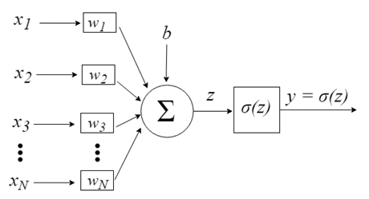



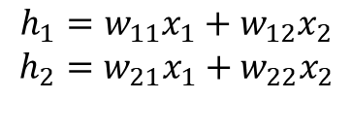




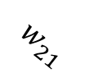
$$w_{11}$$
$$x_{1}$$
$$w_{12}$$
$$h_{1}=w_{11}x_{1}+w_{12}x_{2}$$
$$h_{2}=w_{21}x_{1}+w_{22}x_{2}$$
$$\left(\begin{matrix}h_{1} \\ h_{2}\end{matrix}\right)=\left(\begin{matrix}w_{11} & w_{12} \\ w_{21} & w_{22}\end{matrix}\right)\left(\begin{matrix}x_{1} \\ x_{2}\end{matrix}\right)$$
$$h=w∗x$$
$$w_{21}$$
$$x_{2}$$
$$w_{22}$$

Slide 16
import numpy as np
# With two layers and activation & Matrices
x = np.array([[0.35],[0.9]])
w_h = np.array([[0.1,0.8],[0.4,0.6]])
w_o = np.array([[0.3,0.9]])
y = 0.5
r = 0.5
h_t = w_h @ x
h = 1 / (1 + np.exp(-h_t))
o_t = w_o @ h
o = 1 / (1 + np.exp(-o_t))
# Update
w_o -= r*2*(o-y) * o*(1-o) @ np.transpose(h)
w_h -= r*2*(o-y) * h*(1-h) * np.transpose(w_o) @ np.transpose(x)

Slide 17
import numpy as np
# With two layers and activation & Matrices
x = np.array([[1],[0],[1]])
w_h = np.array([[0.2,0.4,-0.5],[-0.3,0.1,0.2]])
b_h = np.array([[-0.4],[0.2]])
w_o = np.array([[-0.3, -0.2]])
b_o = np.array([[0.1]])
y = 1
r = 0.45
h_t = w_h @ x + b_h
h = 1 / (1 + np.exp(-h_t))
o_t = w_o @ h + b_o
o = 1 / (1 + np.exp(-o_t))
# Update
w_o -= r*2*(o-y) * o*(1-o) @ np.transpose(h)
b_o -= r*2*(o-y) * o*(1-o)
w_h -= r*2*(o-y) * h*(1 - h)* np.transpose(w_o) @ np.transpose(x)
b_h -= r*2*(o-y) * h*(1 - h)* np.transpose(w_o)

Slide 18
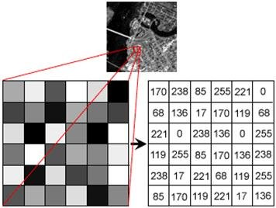
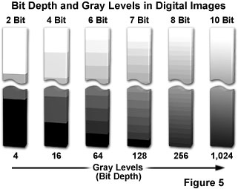

Slide 19
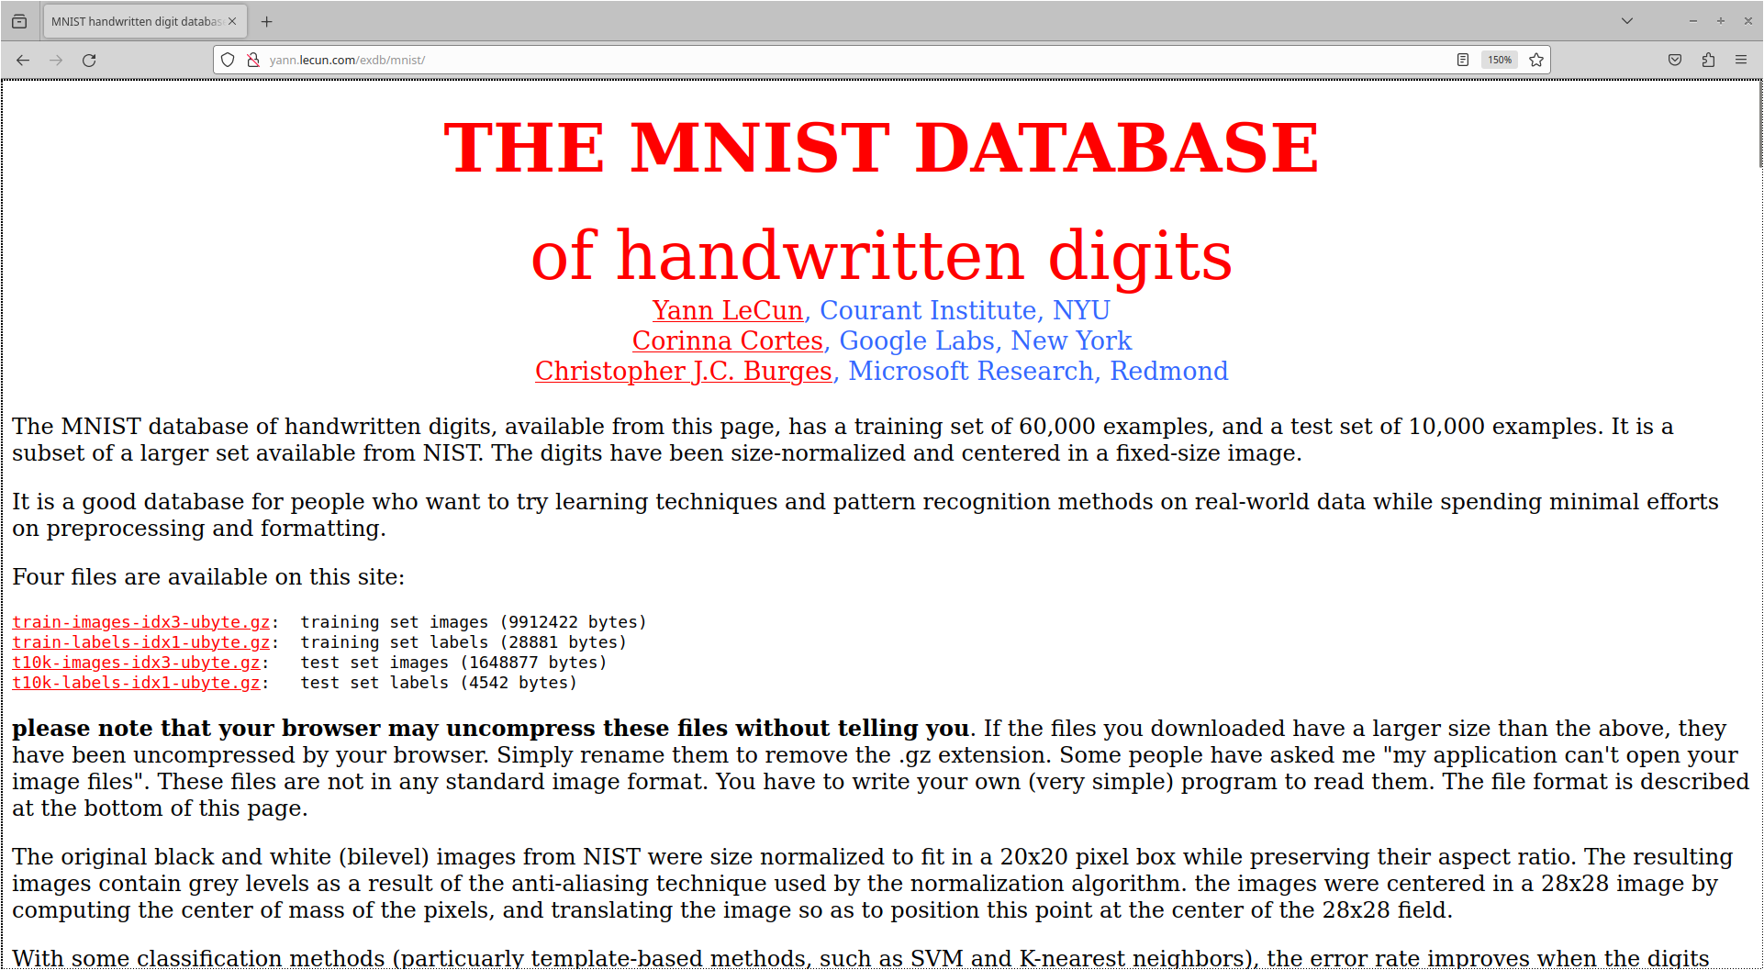

Slide 20
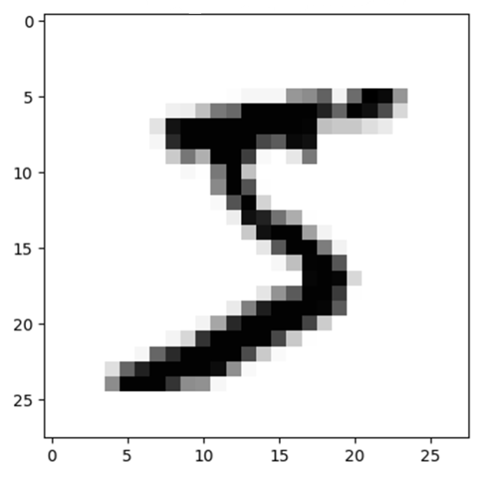
MNIST

Slide 21
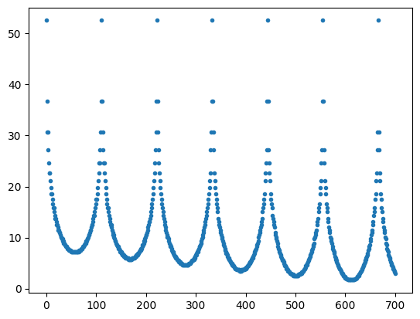
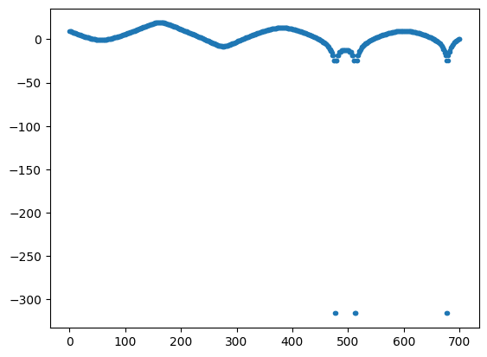
Radars, Cylinders and Cones

Slide 22
Conclusions
Use of Python in NN
Scalability
Real-Time Applications
Interdisciplinary Impact

