Slide 1
p1
File created on: 27-12-2024 20:34:30

Slide 2
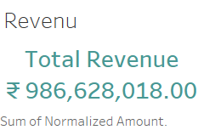

Slide 3
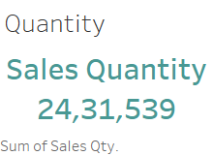

Slide 4
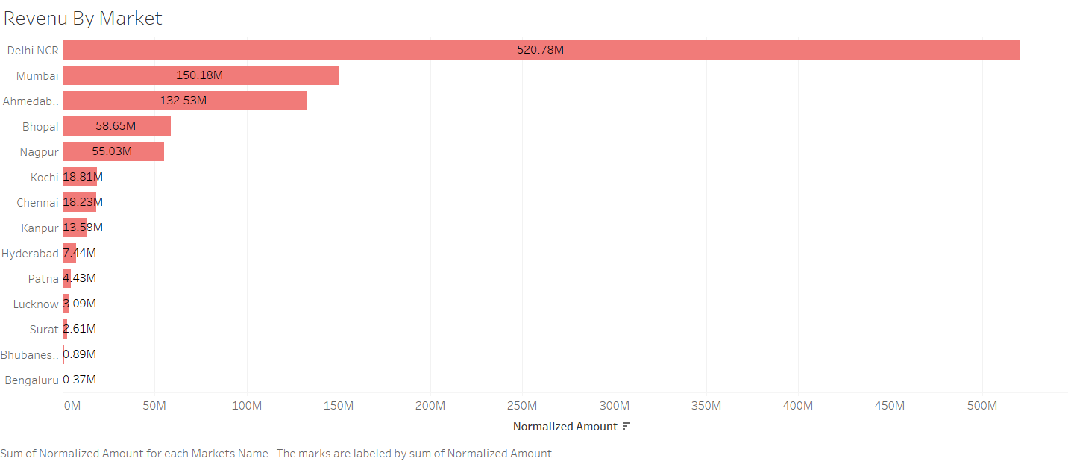

Slide 5
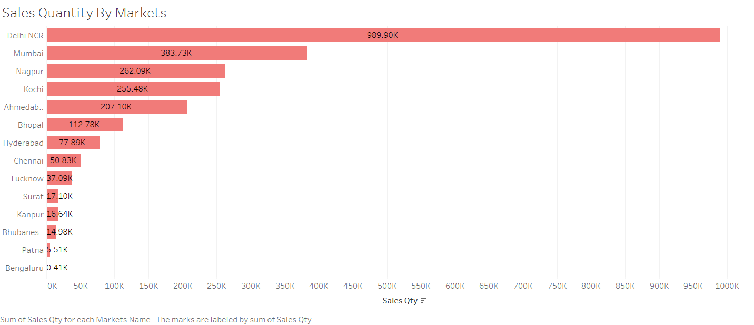

Slide 6


Slide 7


Slide 8
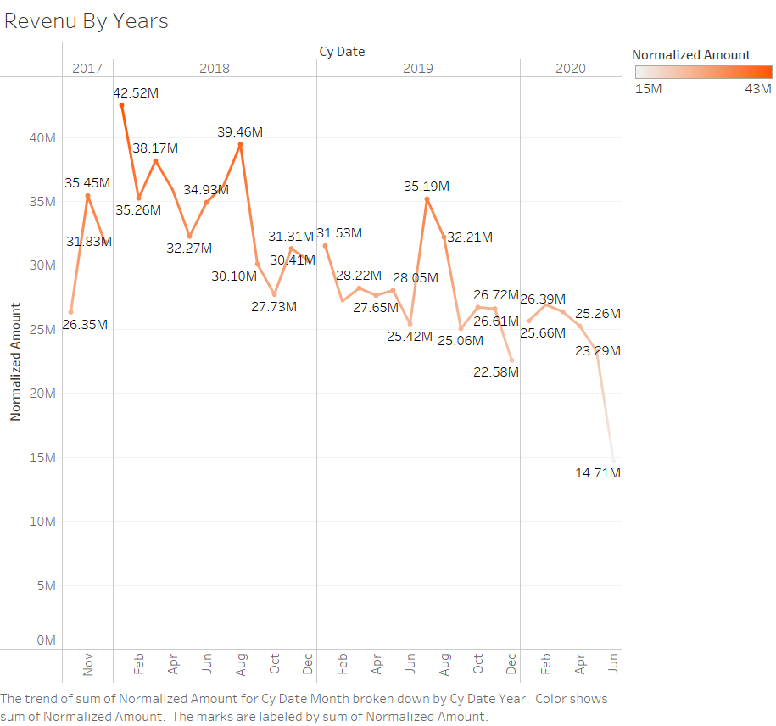

Slide 9


