Slide 1

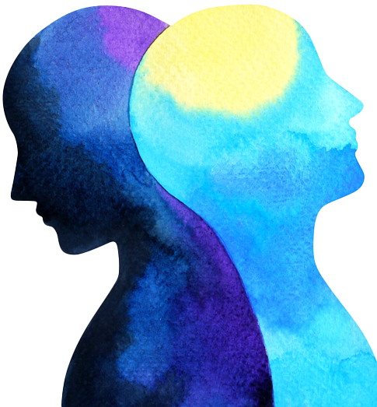
Emotion Phenomenology and Physiology Challenge

Slide 2

