Slide 1
Basic electrical engineering concepts
Eduardo Prieto
Electrical Engineering Department
CITCEA-UPC

Slide 2
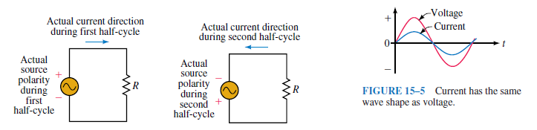
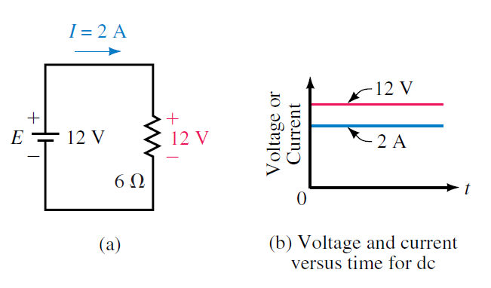
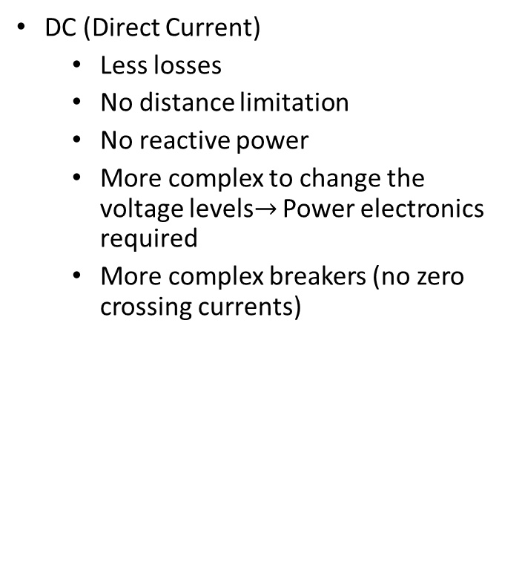
AC and DC current
Main characteristics
DC (Direct Current)
Less losses
No distance limitation
No reactive power
More complex to change the voltage levels$→$ Power electronics required
More complex breakers (no zero crossing currents)
AC (Alternating current)
Three-phase allows to generate a rotating magnetic field in electrical machines, enabling ‘simple’ generation.
Simple voltage change (step-up/step-down) - Transformers
‘Simple’ breakers (zero crossing currents)
Robins & Miller “Circuit analysis theory and practice”

Slide 3
Circuit elements
Basic elements
Passive elements
Linear elements
Resistances (R), inductances (L), capacitors (C)
Lumped constants, passive elements connected using conductors.
Distributed constants (electrical lines)
Non-linear elements: semiconductors (power electronics), magnetic circuits (non-linear hystheresis)
Active elements:
Energy sources
Voltage sources
Current sources

Slide 4
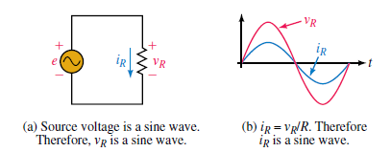
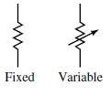
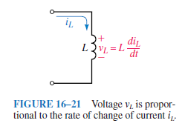
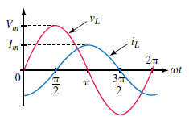
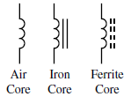
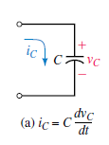

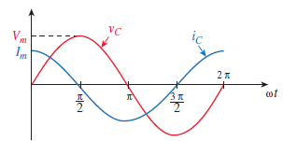
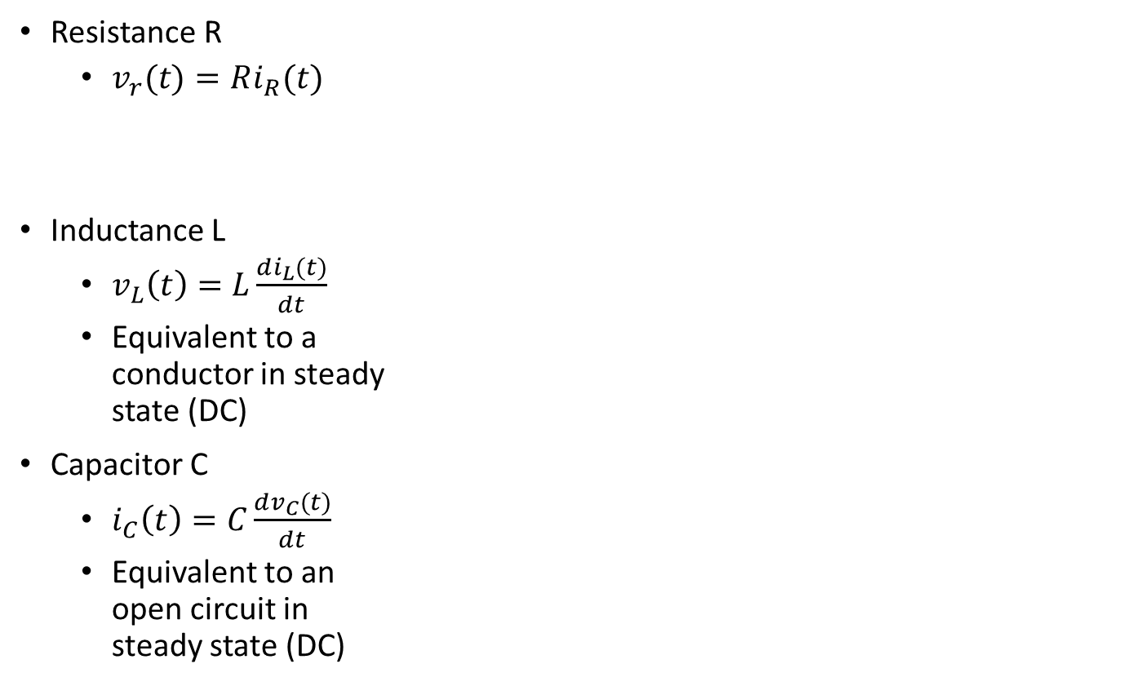
Passive elements
Resistances, inductances and capacitors
Resistance R
$v_{r}(t)=Ri_{R}(t)$
Inductance L
$v_{L}\left(t\right)=L\frac{di_{L}(t)}{dt}$
Equivalent to a conductor in steady state (DC)
Capacitor C
$i_{C}\left(t\right)=C\frac{dv_{C}(t)}{dt}$
Equivalent to an open circuit in steady state (DC)
Robins & Miller “Circuit analysis theory and practice”

Slide 5
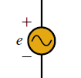
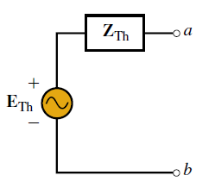

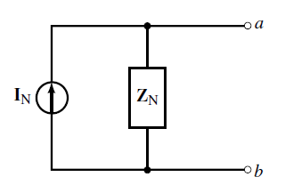
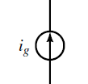
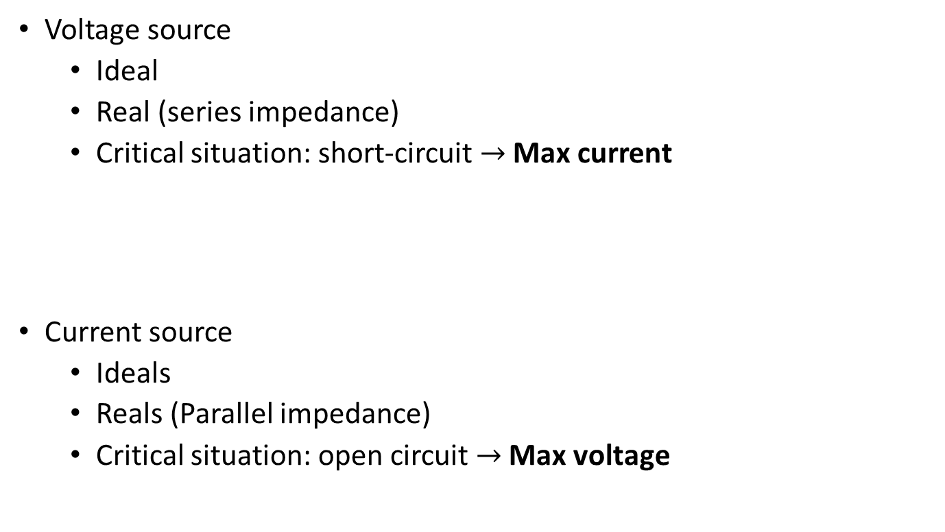
Main electrical sources
Voltage and current
Voltage source
Ideal
Real (series impedance)
Critical situation: short-circuit $→$Max current
Current source
Ideals
Reals (Parallel impedance)
Critical situation: open circuit $→$ Max voltage
Robins & Miller “Circuit analysis theory and practice”

Slide 6
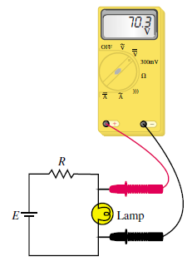
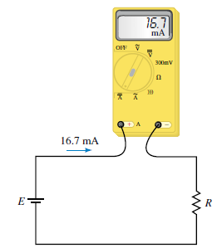
Equipment - Measurements
Voltage and current measurements
Voltage measurement
Parallel connection
High impedance, ideally infinite.
Current measurement
Series connection
Reduced impedance, ideally 0.
Robins & Miller “Circuit analysis theory and practice”

Slide 7
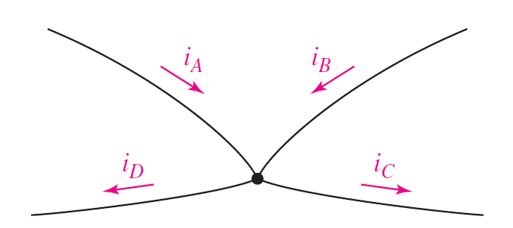
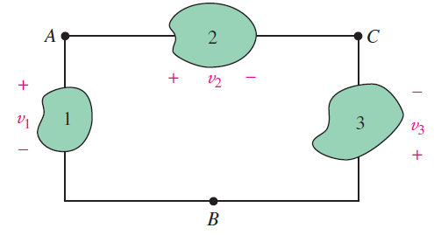




Kirchoff Law’s
Kirchoff circuit and voltage laws
Kirchoff Circuit Laws (KCL) – The sum of the currents entering a node has to be equal to the sum of the output currents
Kirchoff voltage law (KVL) – The sum of the voltages in a closed circuit has to be equal to 0.
Then, the sum of all the powers in a circuit has to accomplish:
$$∑{\underline{I}}_{ input}=∑{\underline{I}}_{ output}$$
$$∑{\underline{V}}_{ k}=0$$
$$∑{\underline{P}}_{ k}=0→Active power$$
$$∑{\underline{Q}}_{ k}=0→Reactive power$$
Wait... we will explain later P and Q !!!
Hayt “Engineering circuit analysis”

Slide 8
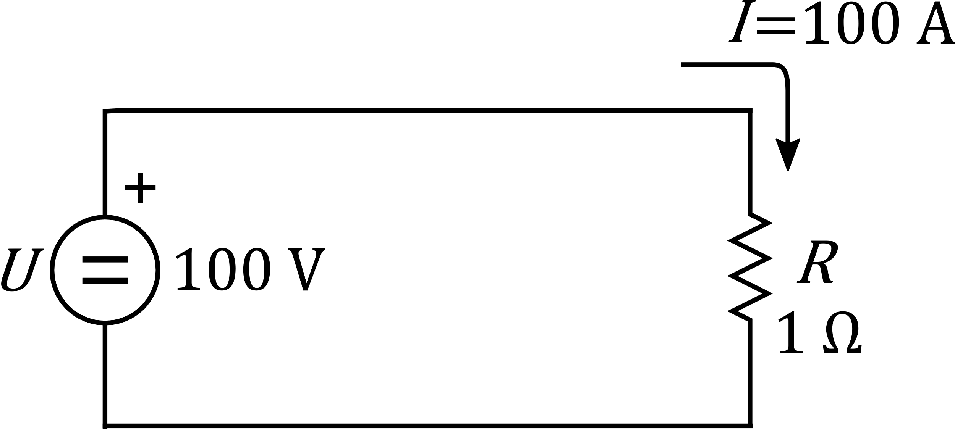
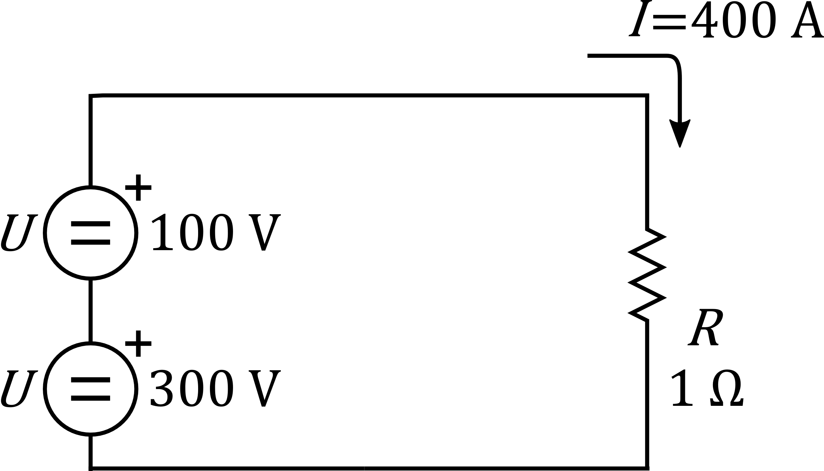
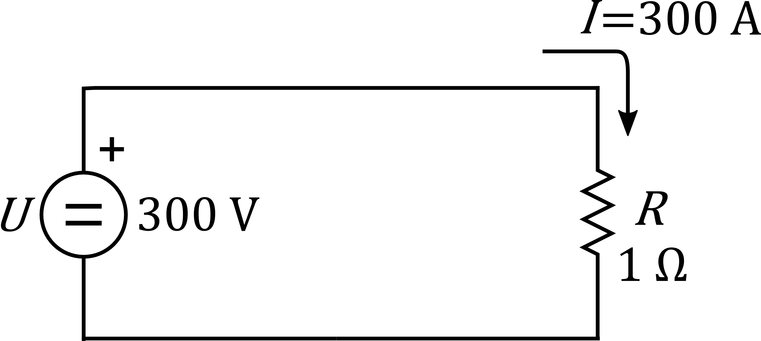

Superposition principle
Main description
If several simultaneous excitations are applied to the same network (either voltage or current sources), the global response is equal to the superposition of the partial results of each of the sources. (Voltage source $→$conductor |Current sources$→$open circuit)
Example circuit (in DC)
+
It also works for AC currents!
Robins & Miller “Circuit analysis theory and practice”

Slide 9
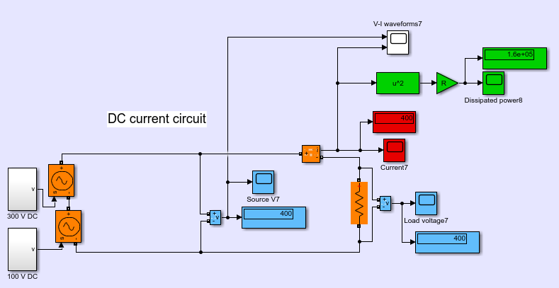
Activity 0
Illustrative example in DC
Simple DC circuit (superposition of 2 voltage sources)
Try it with AC!

Slide 10
Activity I
Illustrative example in DC
Circuit 1 – Resistive circuit (DC)
Circuit 2 – Capacitive circuit (DC)
Circuit 3 – Inductive circuit (DC)
Circuit 4 – Resistive-inductive circuit (DC) - Dynamics

Slide 11
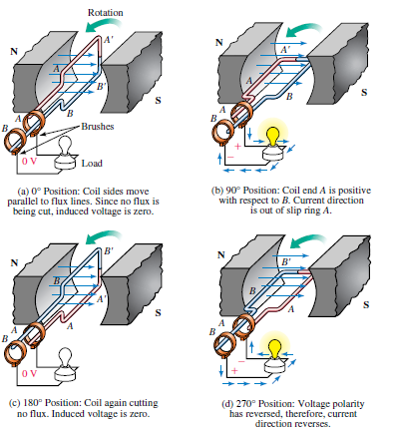
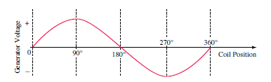
AC voltage generation
Robins & Miller “Circuit analysis theory and practice”

Slide 12
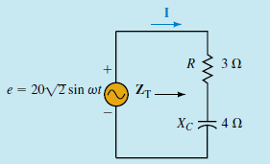


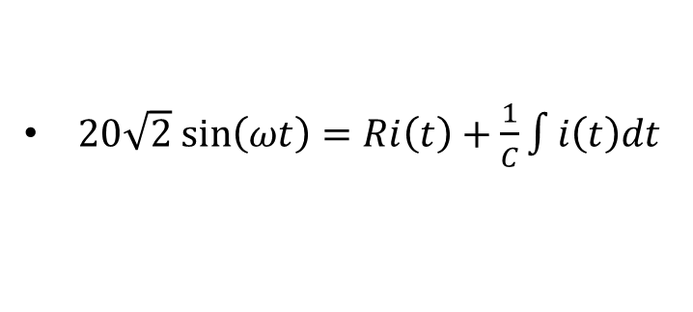

Analysis of AC circuits
How to operate?
RC circuit equations:
$e\left(t\right)=20\sqrt{2}sin\left(ωt\right)=Ri\left(t\right)+v_{c}(t)$
$i\left(t\right)=C\frac{dv_{c}(t)}{dt}$
$20\sqrt{2} sin\left(ωt\right)=Ri\left(t\right)+\frac{1}{C}\int{i\left(t\right)dt}$
How to calculate $i\left(t\right)???$
It is required to solve the differential equation and after observe the steady state.
We could use simulation!
See AC and DC examples
Robins & Miller “Circuit analysis theory and practice”

Slide 13
Activity II
Illustrative example in AC – Simulations to solve differential equations
Circuit 1 – Resistive circuit (AC)
Circuit 2 – Capacitive circuit (AC)
Circuit 3 – Inductive circuit (AC)
Simulations are useful, but analytically, phasors will simplify the analysis!

Slide 14
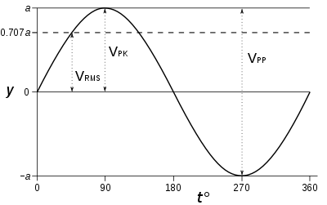

Root Mean Square value (RMS)
Definition
For alternating electric current, RMS value is equal to the value of the direct current that would produce the same average power dissipation in a resistive load – it is useful for power calculation in AC.
If the waveform is a pure sine wave (as in AC), the relationships between amplitudes (peak-to-peak, peak) and RMS are fixed and known, as they are for any continuous periodic wave.
For a sine wave, the relation between the peak and RMS value is:
Typically voltages are provided in RMS values
Verify this in simulation!
$$V_{peak}=\sqrt{2} V_{RMS}$$

Slide 15
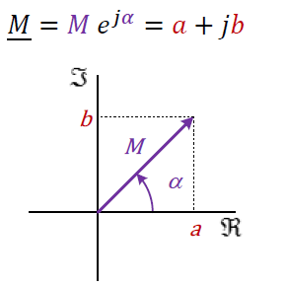

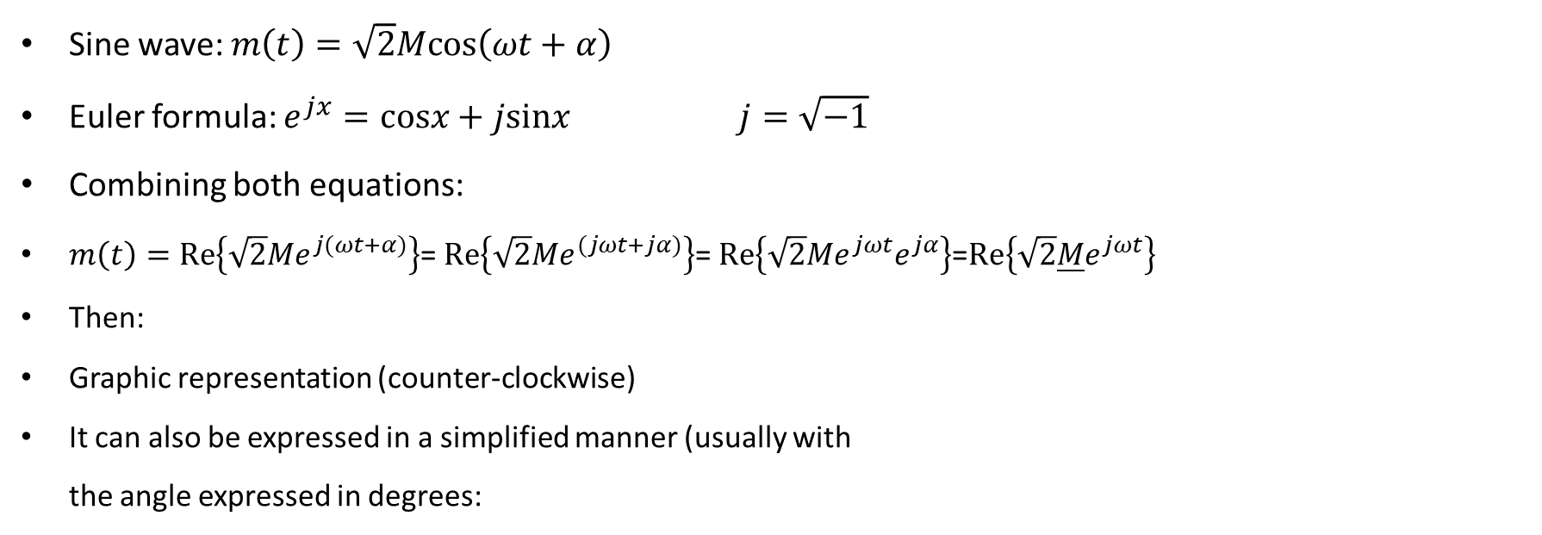





Phasors
Concept definition
Sine wave: $m\left(t\right)=\sqrt{2}Mcos\left(ωt+α\right)$
Euler formula: $e^{jx}=cosx+jsinx$ $j=\sqrt{−1}$
Combining both equations:
$m\left(t\right)=Re\left\{\sqrt{2}Me^{j(ωt+α)}\right\}$= $Re\left\{\sqrt{2}Me^{(jωt+jα)}\right\}$= $Re\left\{\sqrt{2}Me^{jωt}e^{jα}\right\}$=$Re\left\{\sqrt{2}\underline{M}e^{jωt}\right\}$
Then:
Graphic representation (counter-clockwise)
It can also be expressed in a simplified manner (usually with the angle expressed in degrees:
$$m\left(t\right)=\sqrt{2}Mcos\left(ωt+α\right)$$
$$\underline{M}=Me^{jα}$$
$\underline{M}=Me^{jα}$
$$\underline{M}=M∠ (α^{o})$$
$\underline{M}=M∠α=Me^{jα}=a+jb=Mcos\left(α\right)+jMsin(α)$
$$a$$
$$b$$
You can use everything you know about complex numbers!!!

Slide 16
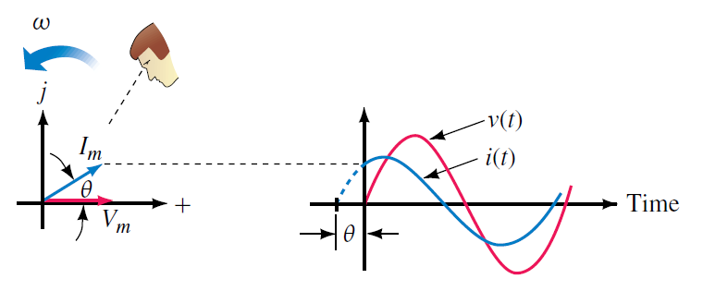
Equivalence phasors – time domain
Visual interpretation
Robins & Miller “Circuit analysis theory and practice”

Slide 17
Phasor properties
Complex-number based operations
Complex number-based operations
Sum/subtraction:
Product/division:
Power:
Complex conjugate operations:
Derivative

Slide 18
Phasors for RLC circuits
Main equations (deduction)
Resistance
Inductance
Capacitor

Slide 19

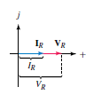

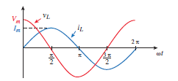
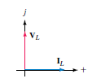

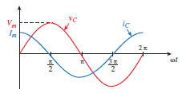

Phasors for RLC circuits
Phasors (summary)
Resistance
Inductance
Capacitor
Robins & Miller “Circuit analysis theory and practice”

Slide 20
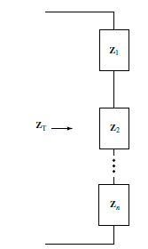
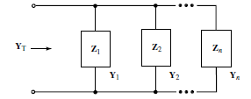
Impedance (Z) and admitance (Y)
Association and sign criteria
I
I
Sing criteria
Series association (I does not change)
Parallel association (V does not change)
+
+
V
V
-
-
Robins & Miller “Circuit analysis theory and practice”

Slide 21
Activity III
Illustrative example in AC – Simulations to solve differential equations
Circuit 1 – Resistive circuit (AC)
Circuit 2 – Capacitive circuit (AC)
Circuit 3 – Inductive circuit (AC)
Simulations are useful, but analytically, phasors will simplify the analysis!
See *.m file

Slide 22


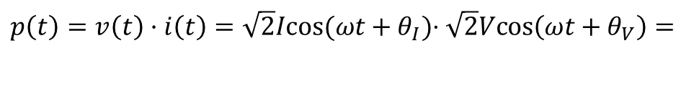
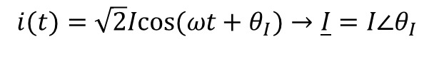
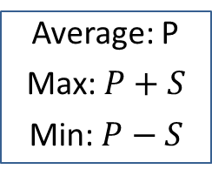

AC power calculation
Derivation
$$v(t)=\sqrt{2}Vcos\left(ωt+θ_{V}\right)→\underline{V}=V∠θ_{V}$$
$cos⁡(θ_{1})$ $\cos\left(θ_{2}\right)=\frac{1}{2}(cos⁡(θ_{1}+θ_{2})$+ $cos⁡(θ_{1}−θ_{2}))$
$$i(t)=\sqrt{2}Icos(ωt+θ_{I})→\underline{I}=I∠θ_{I}$$
$p\left(t\right)=v\left(t\right)·i\left(t\right)=\sqrt{2}Icos(ωt+θ_{I})$· $\sqrt{2}Vcos\left(ωt+θ_{V}\right)=$
$$=2VI cos\left(θ_{V}+ωt\right)cos\left(θ_{I}+ωt\right)=$$
$$=2VI\frac{1}{2} \left(cos\left(θ_{V}+ωt+θ_{I}+ωt\right)+cos\left(θ_{V}+ωt−θ_{I}−ωt\right)\right)$$
$$=VI \left(cos\left(θ_{V}+θ_{I}+2ωt\right)+cos\left(θ_{V}−θ_{I}\right)\right)=$$
$$=VI cos\left(θ_{V}−θ_{I}\right)+VI cos\left(θ_{V}+θ_{I}+2ωt\right)=P+S cos\left(θ_{V}+θ_{I}+2ωt\right)$$
Average power
$$P=VI \left(cos\left(θ_{V}+θ_{I}+2ωt\right)+cos\left(θ_{V}−θ_{I}\right)\right)=VI cos\left(θ_{V}−θ_{I}\right)=VI cos(φ)$$
Power factor
Average: P
Max: $P+S$
Min: $P−S$
$$cos\left(θ_{V}−θ_{I}\right)=cos(φ)$$
Apparent power
$$S=VI$$

Slide 23


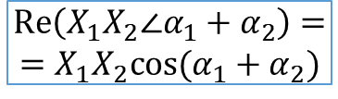
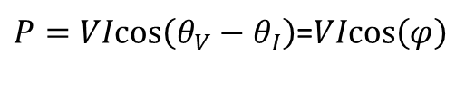




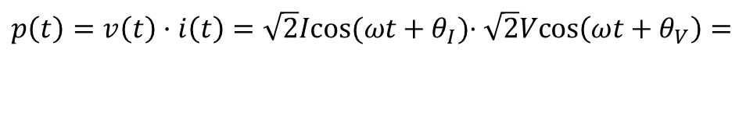
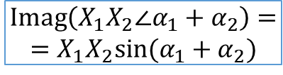

AC power calculation
Phasor-based calculation
Power calculation (phasor domain)
$$\underline{V}=V∠θ_{V}$$
$p\left(t\right)=v\left(t\right)·i\left(t\right)=\sqrt{2}Icos(ωt+θ_{I})$· $\sqrt{2}Vcos\left(ωt+θ_{V}\right)=$
$$\underline{I}=I∠θ_{I}$$
$$=VI \left(cos\left(θ_{V}+θ_{I}+2ωt\right)+cos\left(θ_{V}−θ_{I}\right)\right)=$$
$$=VIcos\left(θ_{V}−θ_{I}\right)+VI\left(cos\left(θ_{V}+θ_{I}+2ωt\right)\right)=$$
$$Re\left(X_{1}X_{2}∠{α_{1}+α}_{2}\right)=$$
$$=X_{1}X_{2}cos⁡({α_{1}+α}_{2})$$
cos(x)->Real part
$$S$$
$$VIcos\left(θ_{V}−θ_{I}\right)=Re(\underline{V} {\underline{I}}^{∗})=P$$
$$Imag\left(X_{1}X_{2}∠{α_{1}+α}_{2}\right)=$$
$$=X_{1}X_{2}sin⁡({α_{1}+α}_{2})$$
$$S=VI$$
$Q=VIsin\left(θ_{V}−θ_{I}\right)=VIsin(φ$)
$$φ$$
$P=VIcos\left(θ_{V}−θ_{I}\right)$=$VIcos\left(φ\right)$

Slide 24
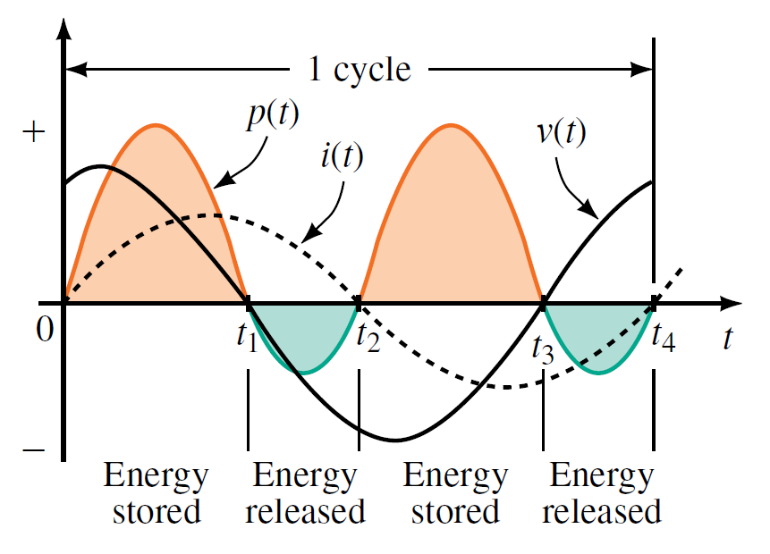

Power in AC circuits
AC power
Instantaneous power
$p(t)=v(t) i(t)$
i(t)
+
v(t)
Load
-
Robins & Miller “Circuit analysis theory and practice”

Slide 25
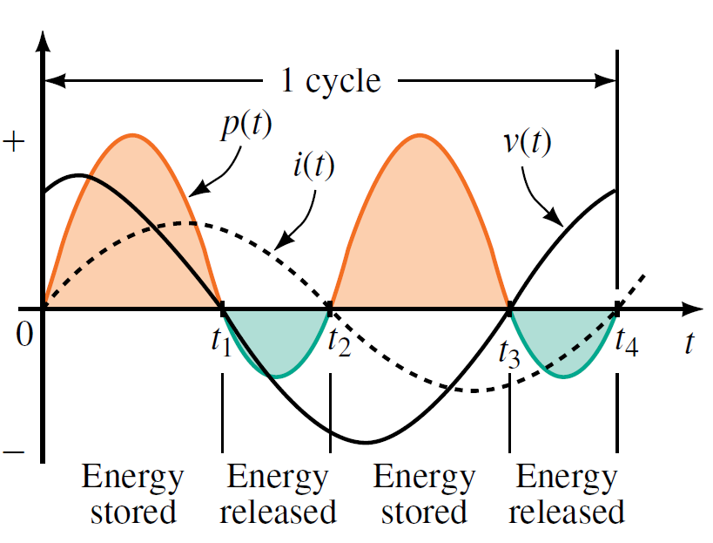
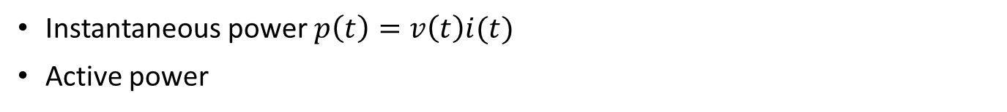

AC power
Instantaneous power $p\left(t\right)=v\left(t\right)i(t)$
Active power
Reactive power
During the intervals that p is negative, power is being returned from the load. (This can only happen if the load contains reactive elements: L or C.)
The portion of power that flows into the load then back out is called reactive power.
Since it first flows one way then the other, its average value is zero; thus, reactive power contributes nothing to the average power to the load.
Although reactive power does no useful work, it cannot be ignored.
Extra current is required to create reactive power, and this current must be supplied by the source;
$p(t)$ represents the power flowing to the load
P its the average power to the load.
More power flows to the load than is returned from it.
If P is zero, all power sent to the load is returned.
If P has a positive value, power is dissipated by the load.
For this reason, P is called real power. In modern terminology, real power is also called active power.
Thus, active power is the average value of the instantaneous power, and the terms real power, active power, and average power mean the same
It should be noted that real power and reactive power do not exist as separate entities.
They are components of the power waveform. However, we are able to conceptually separate them for purposes of analysis.

Slide 26







AC power
Derivation
Resistance
$$z \underline{z}=|{z|}^{2}$$
Inductance
Capacitor
Robins & Miller “Circuit analysis theory and practice”

Slide 27
Activity III – Part II
AC power analysis
Circuit 1 – Resistive circuit (AC) – Active power
Circuit 2 – Capacitive circuit (AC) – Capacitive reactive power
Circuit 3 – Inductive circuit (AC) - Inductive reactive power
Simulations are useful, but analytically, phasors will simplify the analysis!

Slide 28
Why three-phase AC?
Main characteristics and advantages
Single-phase AC system – two conductors (phase + neutral)
Three-phase AC power supply – three conductors (abc phases). Possible four wires if neutral is available.
Main advantages of three-phase systems over single phase systems:
Increased power transfer capacity. With 1,5 more cables (from 2 to 3), three times more power can be transferred.
The power transferred is constant (for balanced systems and loads). Single phase systems show a pulsating power. This is specially relevant in mechanical devices as it can be transferred as torque oscillations.
Three-phase systems can produce a rotating magnetic field with a specified direction and constant magnitude, which simplifies the design of electric motors, as no starting circuit is required.

Slide 29

Three-phase systems
If we interconnect two single-phase circuits and interconnect them, which current I will be established?
Rull, Galceran, Gomis, “Electrical engineering”

Slide 30

Three-phase systems
What about a third circuit?
Rull, Galceran, Gomis, “Electrical engineering”

Slide 31


Three-phase systems
Three-phase system. The common point is called neutral.
=>
Rull, Galceran, Gomis, “Electrical engineering”

Slide 32


Three-phase systems
Typically, a three-phase system is created by a three-phase generator and not by three different generators.
$${\underline{I}}_{n}={\underline{I}}_{a}+{\underline{I}}_{b}+{\underline{I}}_{c}$$
Rull, Galceran, Gomis, “Electrical engineering”

Slide 33


Three-phase systems
Three-phase generator
Rull, Galceran, Gomis, “Electrical engineering”

Slide 34






Three-phase systems
The generator provides a balanced three phase system (the phase-to-neutral voltages are equal).
$$a=e^{j\frac{2π}{3}}=−\frac{1}{2}+j\frac{\sqrt{3}}{2}$$
$$a^{2}=e^{j−\frac{2π}{3}}=−\frac{1}{2}−j\frac{\sqrt{3}}{2}$$
$$U_{ab}=\left|{\underline{U}}_{ab}\right|=2·\left|{\underline{U}}_{an}\right|·\cos{30º}=2{·U}_{an}·\frac{\sqrt{3}}{2}=\sqrt{3}·U_{an}$$
$$Line voltage= \sqrt{3} Simple voltage$$
Rull, Galceran, Gomis, “Electrical engineering”

Slide 35

Three-phase systems
The nominal voltage of a three-phase system is the line voltage!

Slide 36

















Three-phase systems
Voltages
Then, we can write the following relations
$$c$$
$$v_{ca}$$
$$v_{bc}$$
$$v_{cn}$$
$$n$$
$$v_{an}$$
$$a$$
$$v_{bn}$$
$${30}^{o}$$
$$v_{ab}$$
$$b$$
$$v_{an}=\sqrt{2} V cos (ωt)$$
$${\underline{V}}_{ an}=V∠0^{o}$$
$$v_{bn}=\sqrt{2} V cos \left(ωt−\frac{2π}{3}\right)$$
$${\underline{V}}_{ bn}=V∠{−120}^{o}$$
$$v_{cn}=\sqrt{2} V cos (ωt+\frac{2π}{3})$$
$${\underline{V}}_{ cn}=V∠{+120}^{o}$$

Slide 37
Activity IV
Time domain and space representation of three-phase systems
Create in a Matlab script a three-phase system with the following characteristics: nominal voltage: 400 V (phase-to-phase), nominal frequency: 50 Hz.
Draw it in the time domain (40 ms)
Change the following parameters and replot the drawings:
Frequency
Amplitude of the phases
Amplitude of one phase
Angle of one phase
Create a three-phase system in Simulink
Apply the same changes in the time domain.
Connect the voltage sources to a load and calculate the power for a balanced case.

Slide 38
Activity IV
Time domain and space representation of three-phase systems
Expected output

Slide 39
Activity IV
Time domain and space representation of three-phase systems
Useful tips for scripting
Write the script in a *.m file
Write close all, clear all, clc to:
Close all figures
Clear all variables
Clear the command window
Code selection + F9 – run selected code
Use two %% to split the code by sections. Run each section with control+Enter

Slide 40
Activity IV
Backup code
%% Clear variables&workspace and close windows
clear all; clc; close all;
%% Voltages definition
w = 2*pi*50;
t = 0:0.04/200:0.04;
va = cos(w*t)%+0.1*cos(3*w*t)+0.2*cos(w*t);
vb = cos(w*t - 2*pi/3)%+0.1*cos(3*w*t)+0.2*cos(w*t + 2*pi/3);
vc = cos(w*t + 2*pi/3)%+0.1*cos(3*w*t)+0.2*cos(w*t - 2*pi/3);
%% Plot abc functions
f1 = figure(1);
set(f1, 'Position', [50 500 500 250]);
hold on;
plot(t,va,'LineWidth',1.5,'Color',[0 0 1]);
plot(t,vb,'LineWidth',1.5,'Color',[0 0.6 1]);
plot(t,vc,'LineWidth',1.5,'Color',[0.6 0.6 1]);
l1 = legend('$v_a$','$v_b$','$v_c$');
set(l1,'Interpreter','latex','FontSize',10,'Location','NorthEast');
xlabel('time [s]','Interpreter','latex','FontSize',12);

Slide 41
Interesting websites
Links
http://stevenblair.github.io/pq/
http://hyperphysics.phy-astr.gsu.edu/hbase/hframe.html

