Slide 1


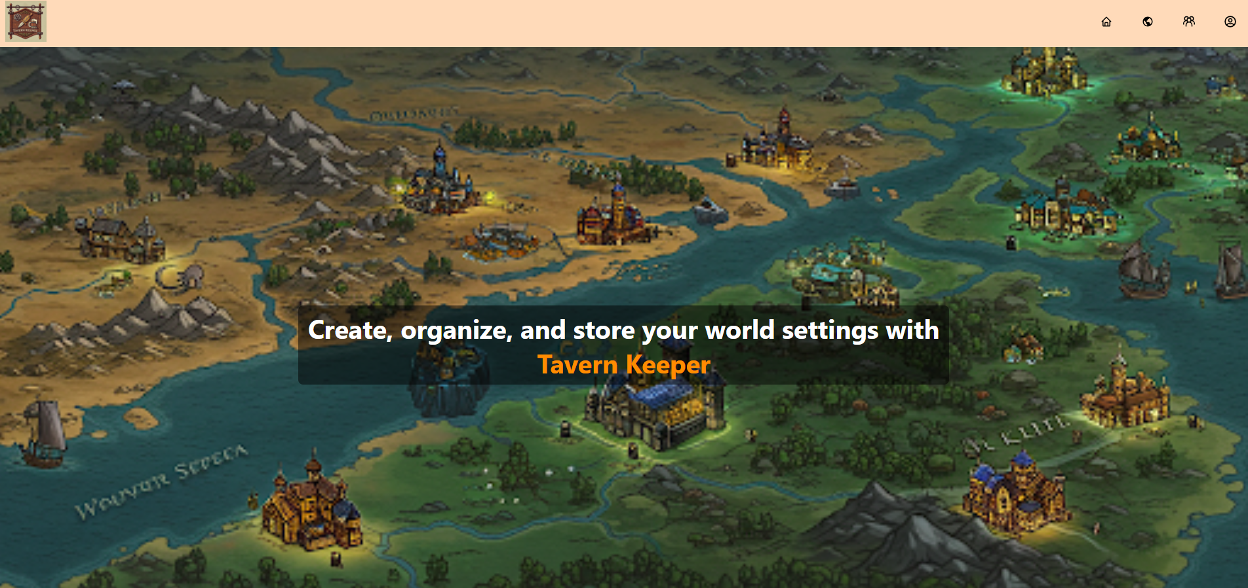
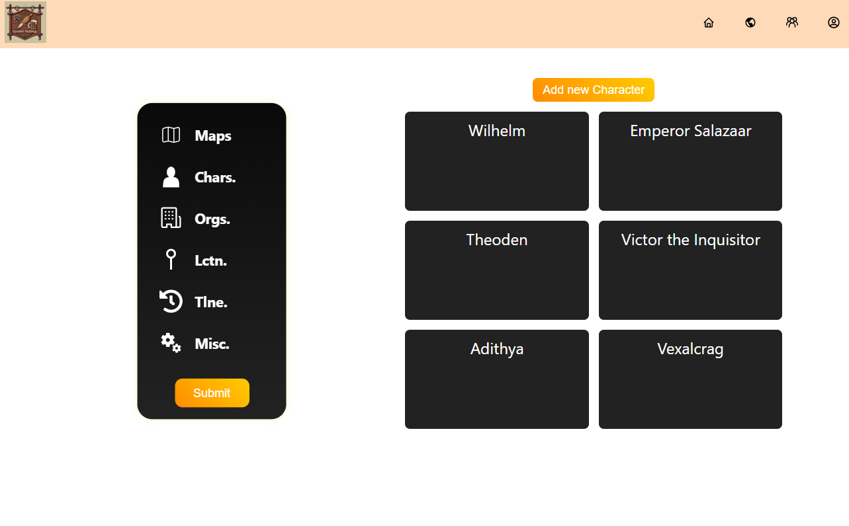
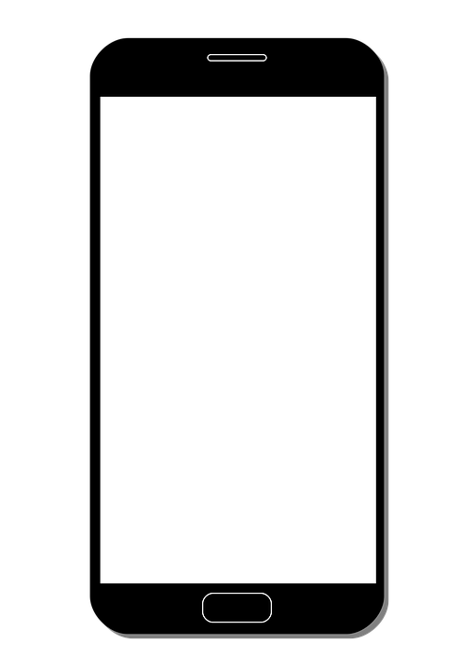
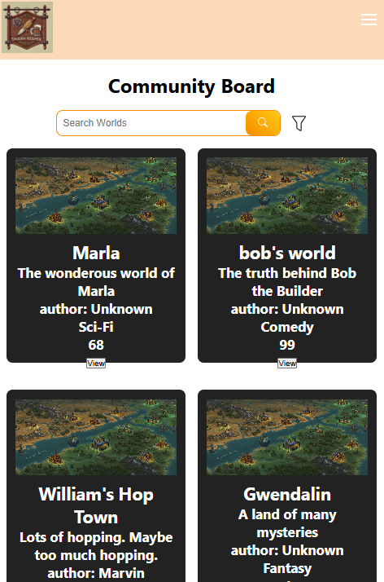
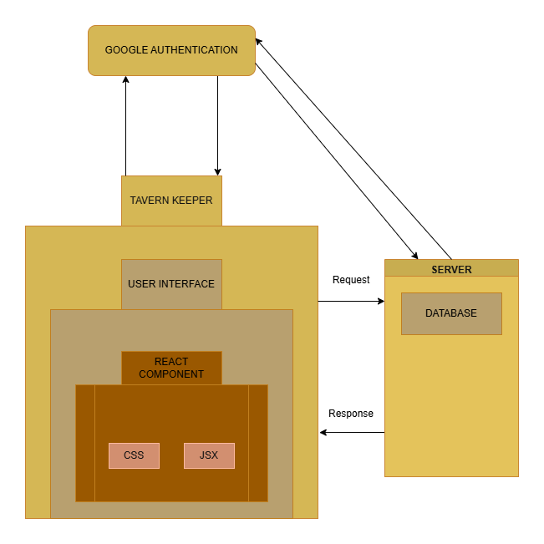
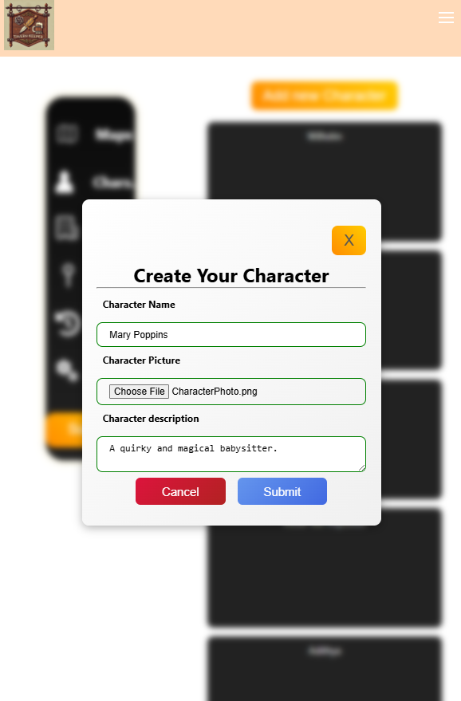
Tavern Keeper
Silas Elder, Kenneth Gray, Kaleb Scott, Evan Primasing
Dept. Of Computer Science and Information Technology
Abstract
Frontend Design
Tavern Keeper is a web-based world-building application. In Tavern Keeper, users can create worlds to document their storytelling adventure conveniently. Once a world is created, users can populate, customize, and manage various attributes of their world, including maps, characters, locations, and more. Unlike other world-building applications on the market, which try to provide every possible functionality at the cost of becoming overly complex, Tavern Keeper is built on the philosophies of simplicity and ease of use. This application is tailored to the needs of fledgling authors, novice dungeon masters, or anyone who wants to bring their world to life, while also providing the necessary features to make veteran world-builders feel at home.
The front-end design of Tavern Keeper emphasizes a clean, intuitive, and responsive user experience. Built with React, the interface uses reusable components to ensure consistency and efficiency across the app. Navigation is streamlined through a persistent header with icon-based links, making it easy for users to access major sections like the homepage, world dashboard, and community board. A grid-based layout is used to display content in an organized and visually appealing way, with pagination and display options to enhance usability. Pop-up models are used for creating and editing entries, helping users stay focused without navigating away from the page. The design is also responsive, ensuring functionality across all screen sizes.
Figure 1: Home page for the website.
Background
Backend Design
The issue with many contemporary world-building applications–such as World Anvil, for instance–is the various options and details when it comes to building and keeping track of a world. This can provide a challenging user experience for fledgling novelists or game masters and can create a steep learning curve for those unfamiliar with the software. The angle Tavern Keeper takes is that of simplicity and ease of use. doing this allows the application to provide a smooth introduction to world building for beginners and an easy, convenient method of creation for more experienced world builders.
To build Tavern Keeper, we carefully chose tools that allowed us to create a fast, reliable, and smooth experience for users. For our database needs, we use Supabase, which helps us securely store and manage all the content users create, update, or delete-such as characters, maps, timelines, and more. To handle providing a server on which the application could run, we utilized Vercel, which allowed us to cheaply and efficiently provide fast and reliable connections to the applications over a large area.
Figure 2: These are the information management pages, they are used to log your characters, access your maps, and more to bring your world to life.
Figure 3: The website uses a responsive design that allows it to be viewed on mobile devices.
Technology
References
We utilized React for our frontend, this has allowed us to easily manage user's states, and successfully display user's data. We are utilizing Node.js for our backend. Node.js makes it simple to communicate efficiently between our frontend and our server, allowing the frontend to be updated with ease. Vercel is hosting our server, as integration was seamless with React and Node.js. Supabase is our database, which is supported by Vercel and is postgreSQL that allows us to fetch data from our database into our user interface for the user to view. The Google OAuth API is handling our login functionality, ensuring that a user's information is securely secured. We have decided on this tech stack, because it is widely adopted in today's job market
React: https://react.dev/learn
Node.JS: https://nodejs.org/en/learn/getting-started/introduction-to-nodejs
Vercel: https://vercel.com/docs
Supabase: https://supabase.com/docs
Visual Studio Code: https://code.visualstudio.com/docs
Acknowledgements
We would like to thank Dr. Karen Meisch for her support of students in the College of Science, Technology, Engineering & Mathematics, and Dr. Leong Lee for his support of students in the Department of Computer Science and Information Technology. We would also like to thank Dr. Nicholson for supporting us through the project design
Figure 4: The Block Diagram shows that Tavern Keeper interacts seamlessly with the Google Auth API and the secure Supabase database.
Figure 5: This is a popup that lets users enter information for a character or other entry.

