Slide 1
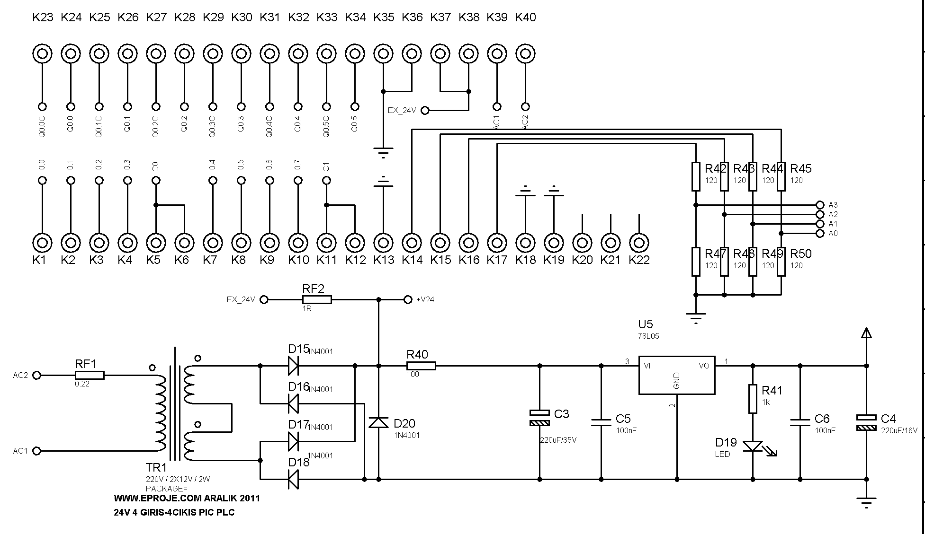

Slide 2
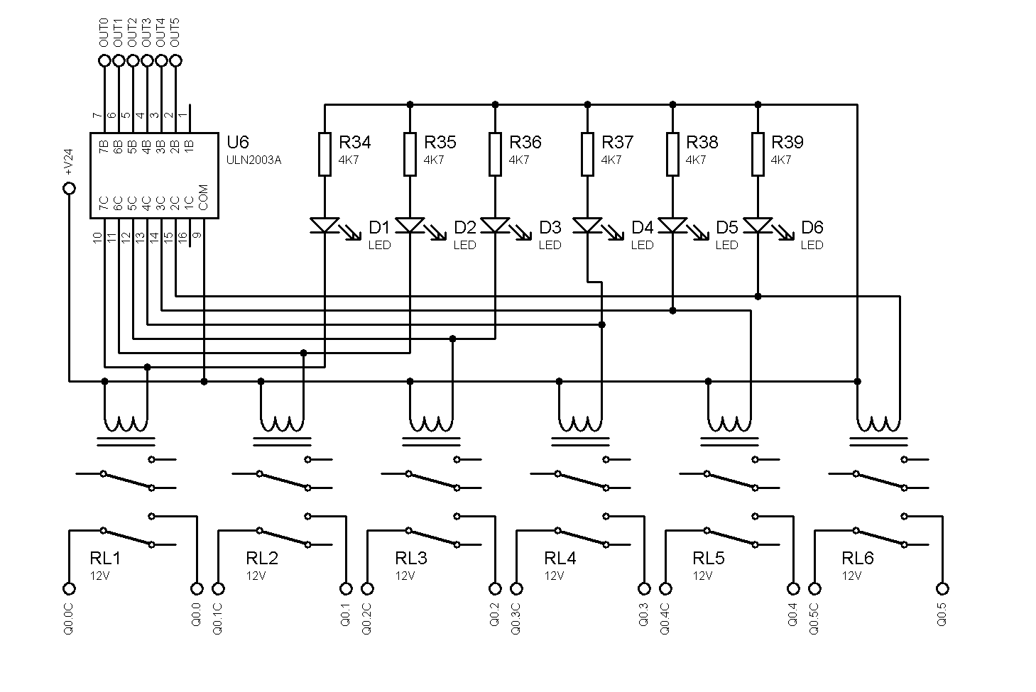

Slide 3
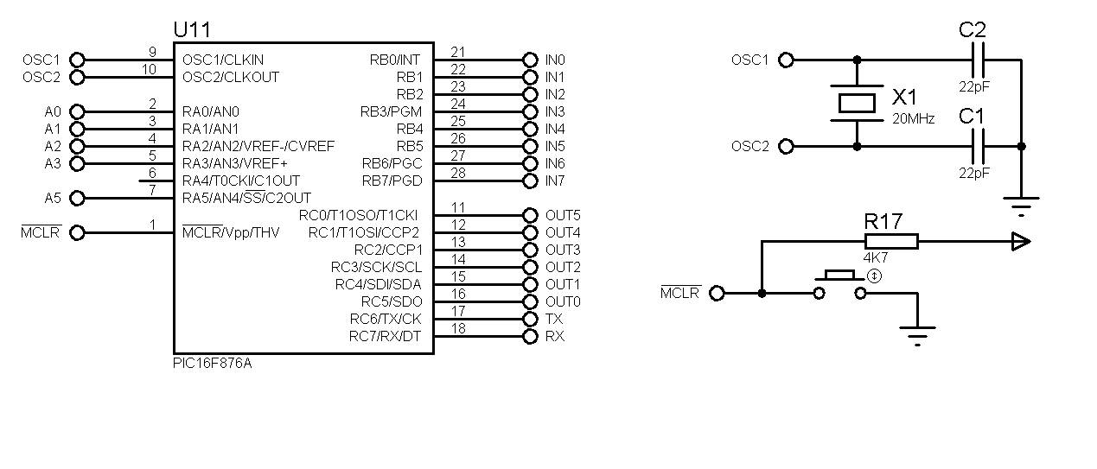
MALZEME ADI | ACIKLAMA | ADET
PC817 | DIP | 8
78L05 | DIP | 1
ULN2003 | SMD SO16 | 1
PIC16F876A | DIP 28 | 1
BC846B | SMD | 8
LED KIRMIZI | 3mm | 7
LED YESİL | 3mm | 8
1N4007 | SMD | 5
0R22 DIRENÇ | DIP | 1
100R DIRENÇ | 0805 SMD | 1
330R DIRENÇ | 0805 SMD | 8
1K DIRENÇ | 0805 SMD | 1
2K2 DIRENÇ | 0805 SMD | 8
22K DIRENÇ | 0805 SMD | 8
4K7 DIRENÇ | 0805 SMD | 24
22pF | 0805 SMD | 2
100nF | 0805 SMD | 2
220uF 35V | DIP | 2
24V ROLE | TIANBO HJR1-2C L-24V VEYA BENZERI | 6
2X12V 5W TRANSFORMATOR | KAPALI TIP | 1
28PIN ENTEGRE SOKETİ | DAR | 1
KRISTAL 20MHZ | SMD | 1
2PIN PCB KLEMENS | NO1 | 18

Slide 4
