Slide 1









CYBER-CYPHER 5.0
TEAM - B103
1

Slide 2
CONTENT
Problem Statement ..............................
What our Agent Does ...........................
How the Agent thinks ..........................
System Block Diagram ........................
Ticket Processing Flow .......................
System Structure .................................
Real-Time Interaction & Event Flow ...
Performance and Efficiency ...............
Built to Work in Reality ........................
Learning and Improvement ................
Developer Dashboard ..........................
3
4
5
6-7
8
9-10
11
12
13
14
15-18
2

Slide 3


PROBLEM STATEMENT- 1
AGENTIC AI FOR SELF-HEALING SUPPORT DURING HEADLESS E-COMMERCE MIGRATION
Design an agentic AI system that acts as a self-healing support layer for a SaaS platform undergoing a hosted-to-headless migration. The agent's role is not just to answer tickets, but to observe signals across the system, reason about root causes, and coordinate action across support, product, and engineering before issues escalate.
At a minimum, your system should demonstrate a clear agent loop:
Observe: Ingest signals such as incoming support tickets, repeated merchant errors, failed checkouts, API/webhook failures, migration stage data, or abnormal behavior patterns
Reason: Identify whether issues stem from migration missteps, platform regressions, documentation gaps, or merchant configuration errors
Decide: Determine appropriate actions support guidance, proactive merchant communication, escalation to engineering, temporary mitigations, or documentation updates
Act (with boundaries): Execute or recommend actions with clear confidence levels, risk assessment, and human approval where required
Crucially, the agent must be explainable and controllable. You are required to design an interface that allows humans to understand what the agent believes is happening, why it believes so, what actions it proposes, and what impact those actions might have. The system should clearly show uncertainty, assumptions, and ethical limits especially when money, live checkouts, or merchant trust are involved.
3

Slide 4

WHAT OUR AGENT DOES
The agent is the intelligence layer of a 4-stage self-healing system. Its core job is to automatically detect errors in an ecommerce app, decide whether they're safe to fix autonomously or need human approval, and then act accordingly.
It sits as the third pillar alongside the ecommerce app (error source) and the monitoring dashboard (visibility + approvals).
It's the only component that actually resolves tickets, everything else either generates them or displays them.
4

Slide 5

HOW THE AGENT THINKS
It works in a strict three-step pipeline: Observer -> Reasoner -> Action Executor
The Observer polls the shared MySQL database every 5 seconds looking for tickets with status = 'open'. Once found, it hands off to the Reasoner.
The Reasoner uses an LLM to classify the ticket into one of two categories based on the description. If it detects keywords like table, database, delete, drop, schema, it flags it as a DB_CHANGE (risky, requires approval). If it detects button, color, font, layout, css, style, it flags it as a UI_CHANGE (safe, auto-execute). Anything else lands in UNKNOWN for manual review.
The Action Executor then branches: UI_CHANGE gets executed immediately and the ticket is marked resolved. DB_CHANGE gets the agent's full plan stored in the proposed_action JSON field, and the ticket status flips to pending_approval — nothing executes until a human approves it through the dashboard.
5

Slide 6
SYSTEM BLOCK DIAGRAM
Four stages, one shared MySQL database (ecommerce_db):
Stage 1 is the ecommerce Flask app: catches errors and generates tickets with status='open', stores them via the Ticket model (User, Product, Order, Ticket) into MySQL.
Stage 2 is the real-time dashboard: FastAPI backend exposes GET /api/tickets, POST /api/approve, and a WebSocket connection. The React TicketFeed UI pulls live ticket data and displays it.
Stage 3 is the CyberCypher26 agent: Observer polls for open tickets, Reasoner classifies them via LLM, Action Executor either auto-fixes (UI_CHANGE) or requests approval (DB_CHANGE).
Stage 4 is the approval loop: pending_approval tickets show up in the dashboard with an APPROVE button. User clicks it, POST hits the endpoint, agent executes the DB change, ticket moves to resolved.
6

Slide 7
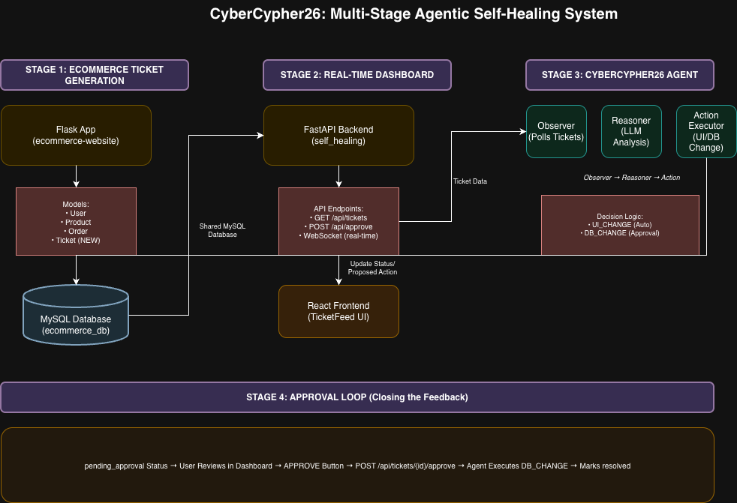
SYSTEM BLOCK DIAGRAM
7

Slide 8
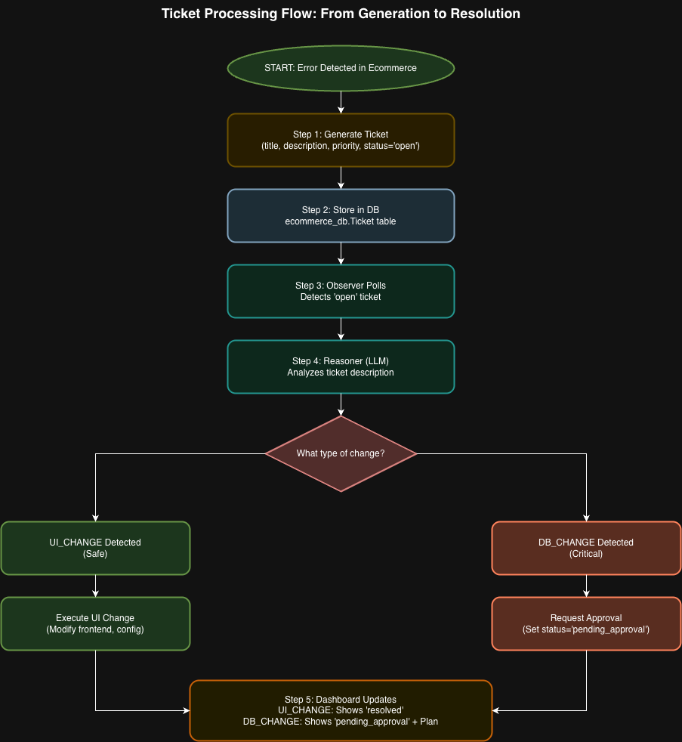
TICKET PROCESSING FLOW
8

Slide 9
SYSTEM STRUCTURE
Three independent services, one shared MySQL database (ecommerce_db):
Ecommerce tier (Flask) — generates tickets when errors occur, owns the Ticket model and ORM layer. Key files: models/ticket.py, route handlers, migrations.
Dashboard tier (FastAPI + React) — reads tickets via GET /api/tickets (polled every 2–5s), renders them in a live feed, and handles approvals via POST /api/tickets/{id}/approve. The React TicketFeed component shows status, priority, description, and an APPROVE button for anything in pending_approval.
Agent tier (CyberCypher26) — three modules: observer.py (polling), reasoning.py (LLM classification), action.py (execution or approval request). Also has memory.py for state tracking and decision.py for decision logic.
9

Slide 10
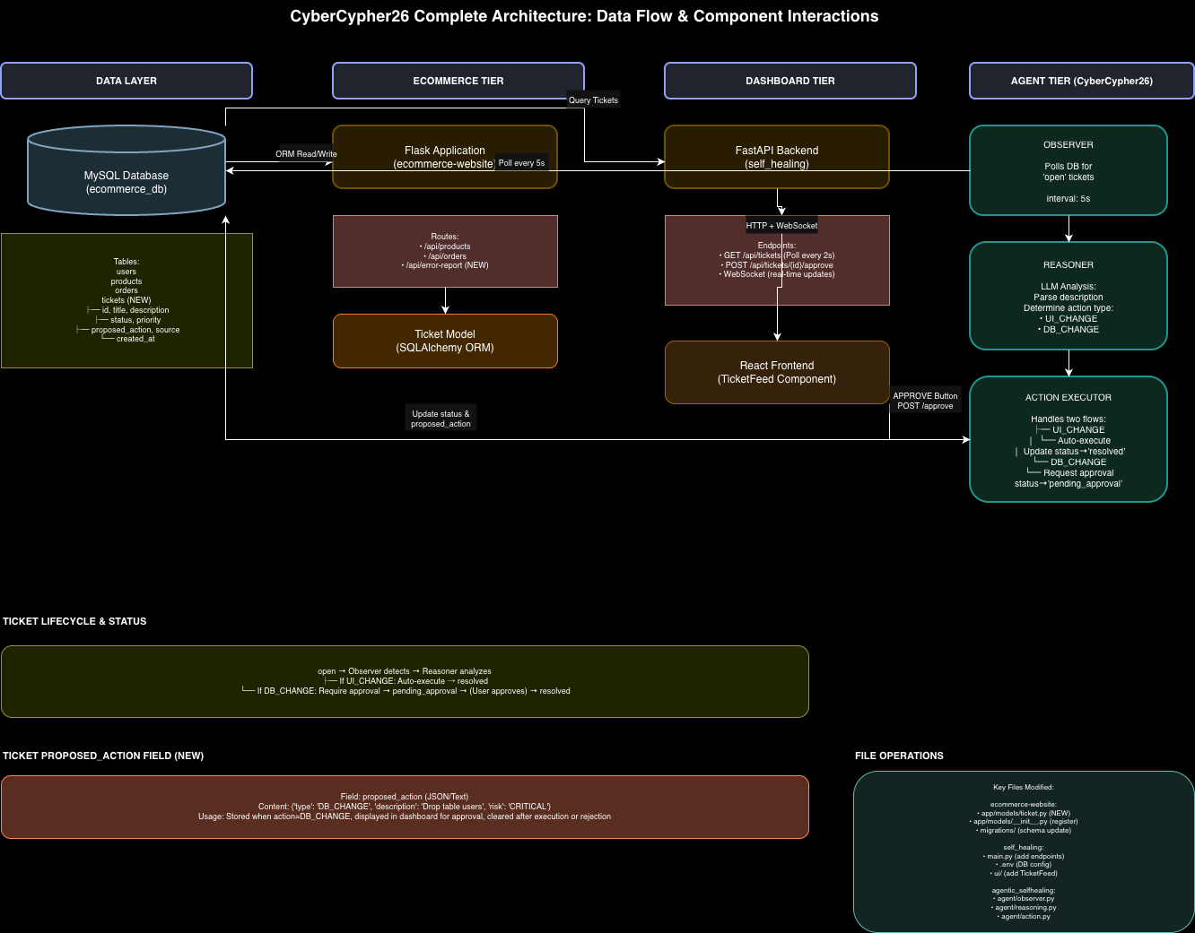
SYSTEM ARCHITECTURE
10

Slide 11
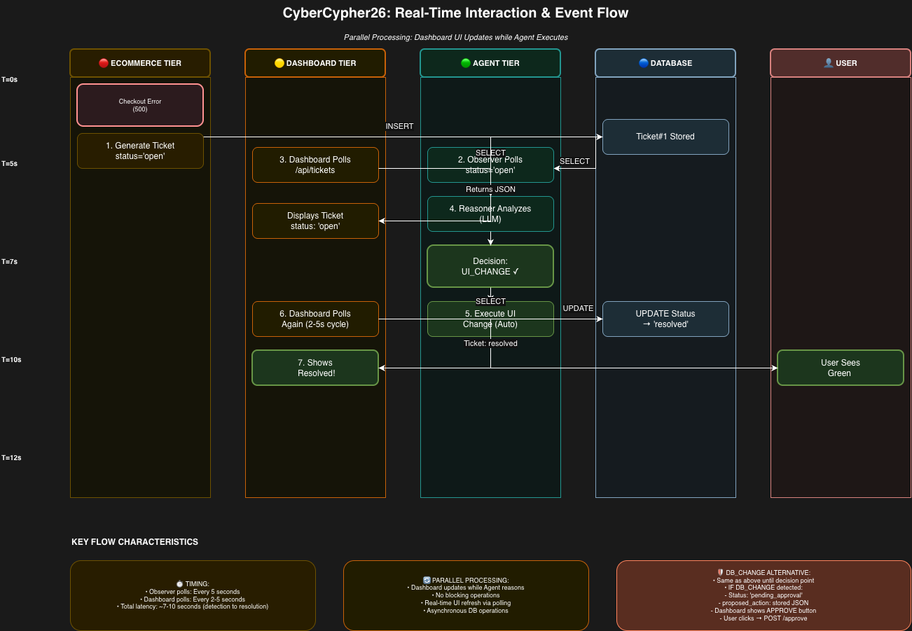
REAL-TIME INTERACTION & EVENT FLOW
11

Slide 12

PERFORMANCE & EFFICIENCY
Detection latency is 0–5 seconds (Observer poll interval). LLM reasoning adds ~1–2 seconds. Dashboard refresh is another 2–5 seconds. Total end-to-end from error to user seeing resolution: 7–12 seconds.
The architecture is non-blocking and async. FastAPI handles the dashboard backend efficiently.
The agent can be scaled horizontally, multiple observer instances can run in parallel without conflict since they're just polling for status = 'open'.
The dashboard poll interval is tunable if you need to trade off between responsiveness and DB load.
12

Slide 13
BUILT TO WORK IN REALITY
Integration points are all through the shared MySQL instance.
Credentials live in config.py (ecommerce side) and .env (dashboard side), kept in sync.
JWT verification on the dashboard endpoints — GET and POST are protected. Only authenticated users can view or approve tickets, so no one can trigger a DB_CHANGE without a valid token
The dashboard exposes two clean REST endpoints.
The approval flow is a full round-trip: dashboard POST → agent executes → status update → dashboard sees it on next poll.
No single point of failure as all three services can be restarted independently.
The database is the only shared dependency. There's a full audit trail: every ticket carries its source, timestamps, proposed action, and status history through the lifecycle.
13

Slide 14
LEARNING & IMPROVEMENT
Ticket history is the training data — every resolved/rejected ticket stores the agent's input (description), its reasoning (proposed_action JSON), and the final outcome (status) automatically
Approval gate = strongest signal — when a human approves or rejects a pending_approval ticket, that's a direct yes/no label on whether the agent's classification was correct
Prompt refinement from failures — misclassified tickets get fed back as few-shot examples into the LLM prompt, no retraining needed, just better context
Keyword sets expand over time — edge cases like "signup form doesn't save users" (DB issue, zero DB keywords) get caught via approval data and added to the classification logic
Observer tuning from priority patterns — polling intervals can adjust based on historical data on which priority levels actually needed fast detection vs. which didn't
Self-contained loop — no external logging or training pipeline needed; the same database that receives tickets also stores all the feedback required to improve
14

Slide 15
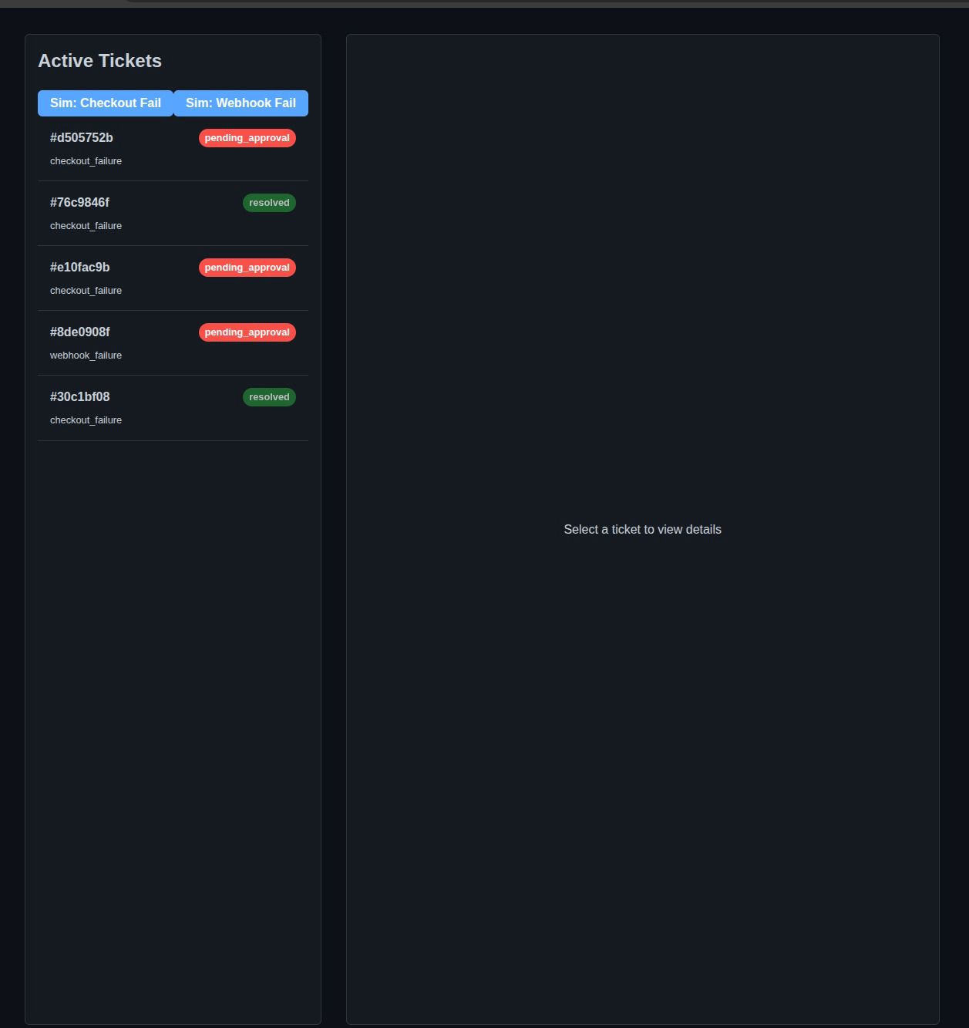
DEVELOPER DASHBOARD
15

Slide 16
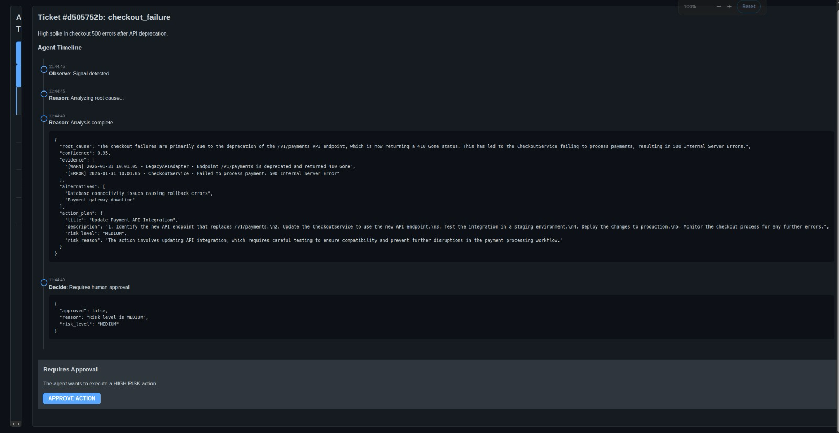
16

Slide 17
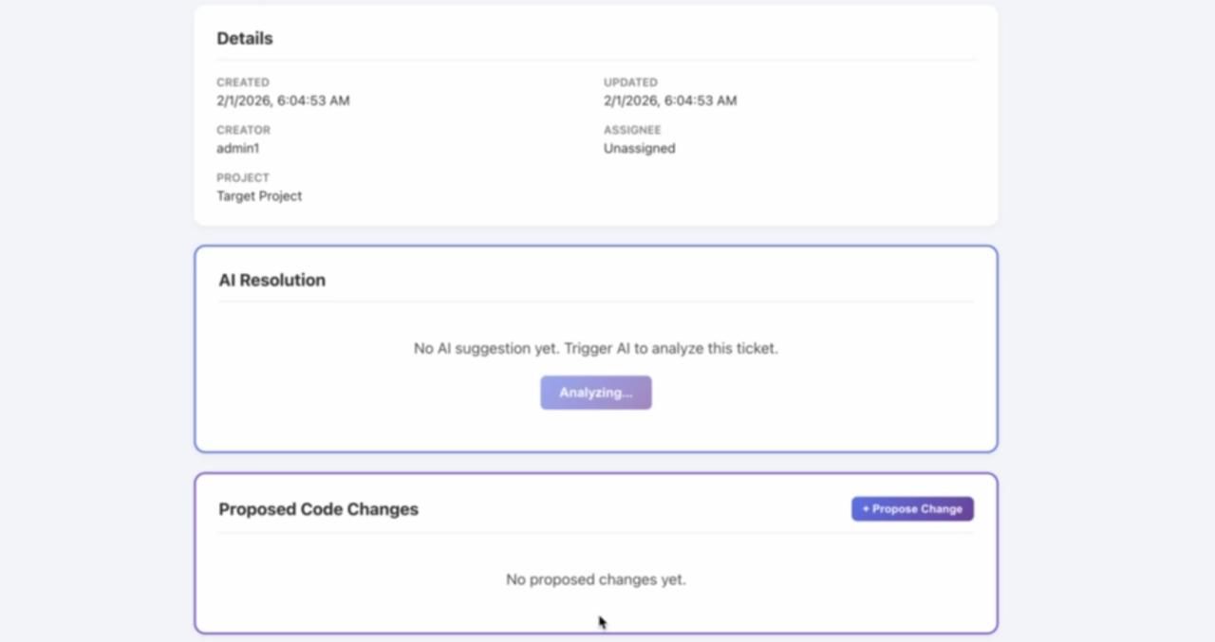
17

Slide 18
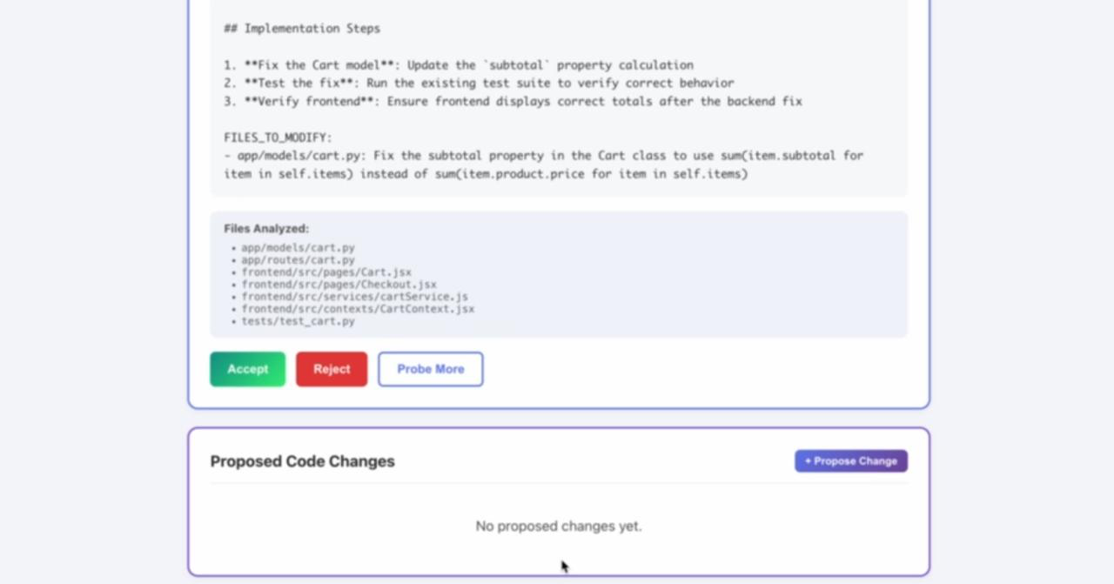
18

Slide 19


THANK
YOU

