Slide 1


SMART INDIA HACKATHON 2025
Problem Statement ID – SIH25061
Problem Statement Title- Digitize and Showcase Monasteries of Sikkim for Tourism and Cultural Preservation
Theme- Travel & Tourism
PS Category- Software
Team ID- 86211
Team Name – Mark 42

Slide 2
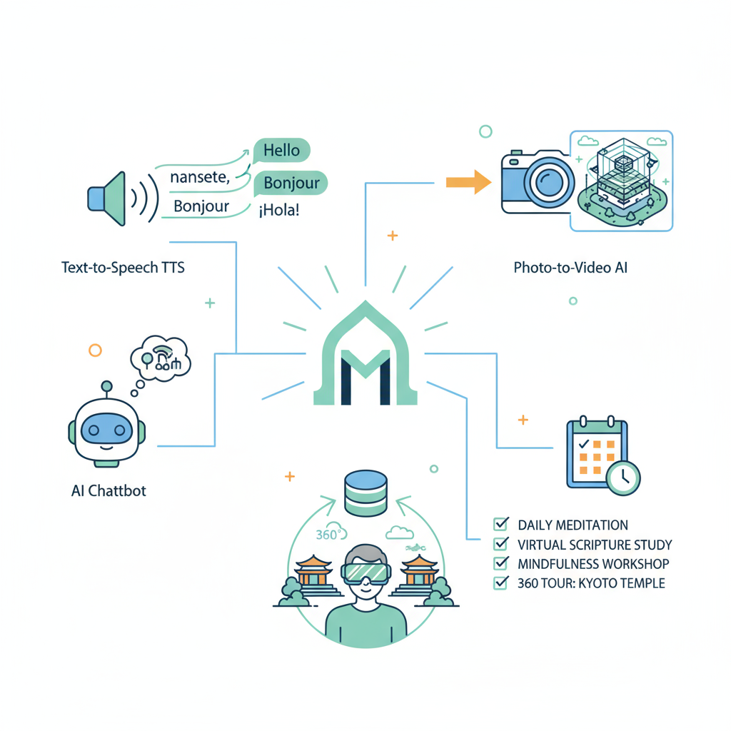
IDEA TITLE
Mark 42
Proposed Solution (Describe your Idea/Solution/Prototype)
Detailed Explanation of the Proposed Solution
How It Addresses the Problem
Remote Accessibility via digital immersion
Cultural Heritage Archival Repository
Enhanced Tourist Engagement & Interaction
Local Community & Guide Integration
Scalable Multilingual Global Access
Innovation and Uniqueness of the Solution
AI-driven Multilingual Narration Engine
Photo-based Generative Video Synthesis
Context-aware Chatbot Travel Assistant
Immersive Geo-tagged VR Exploration
Tech-Culture Fusion for Preservation

Slide 3
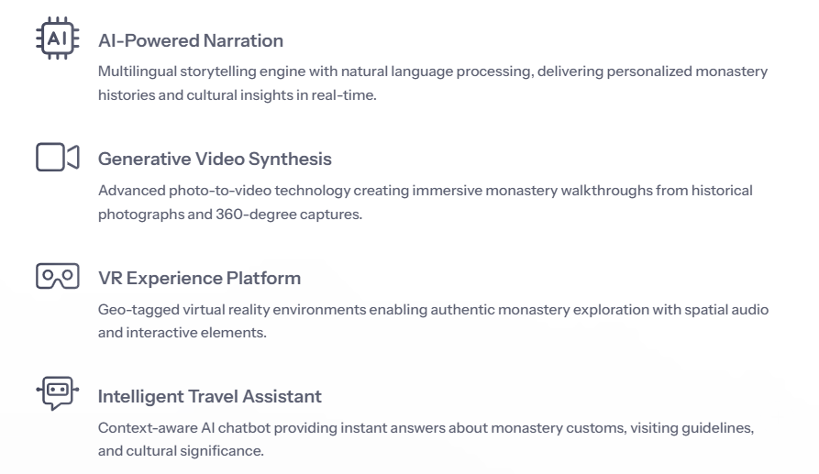
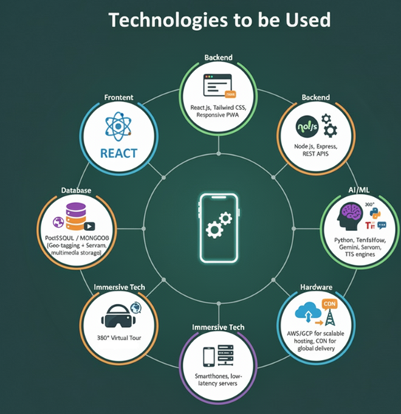
TECHNICAL APPROACH
Mark 42

Slide 4
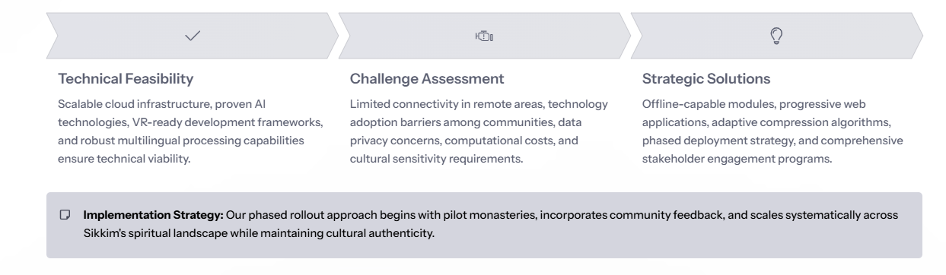
FEASIBILITY AND VIABILITY
Mark 42

Slide 5
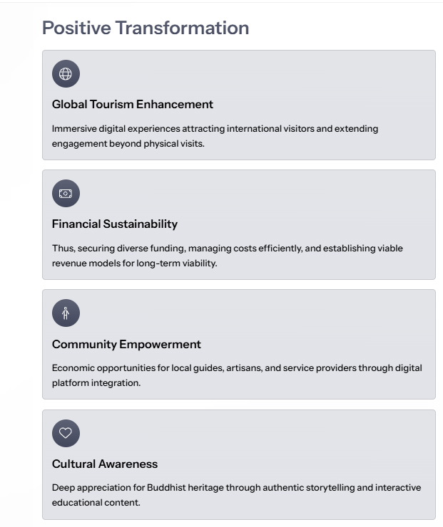
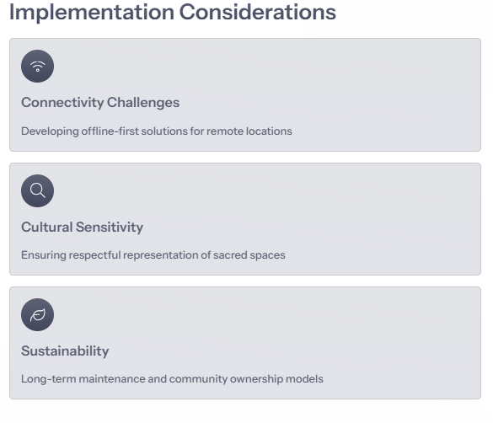
IMPACT AND BENEFITS
Mark 42

Slide 6
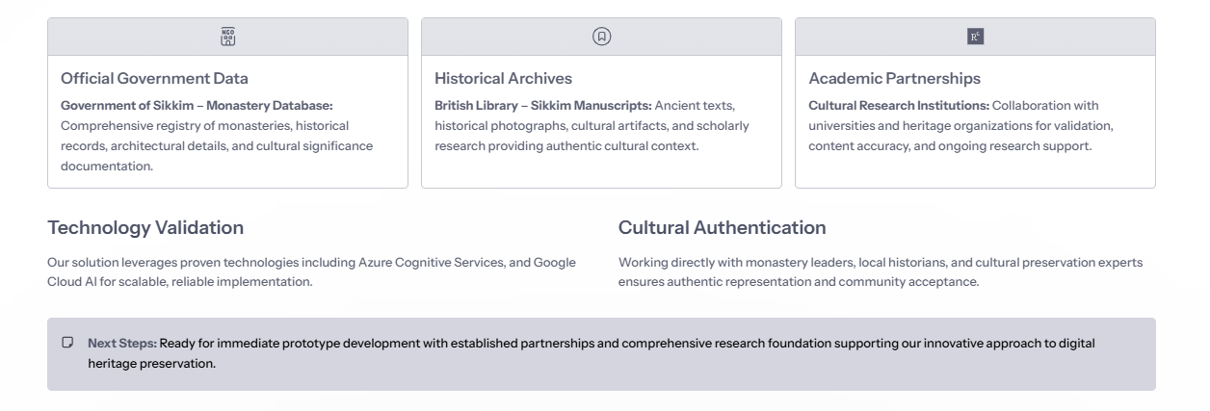
RESEARCH AND REFERENCES
Mark 42

