Slide 1

Linux Diversity
Dive into Linux Subsystem
for Personal Educational Purpose.
Jakarta, Indonesia
11 October, 2020

Slide 2
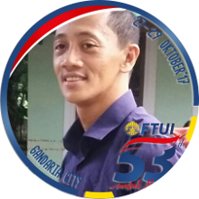

About Epsi
Yet, another underachiever.
But hey, I have my own blog.

Slide 3

About This Material
After watching this, you will understand:
A more systematic steps to learn GNU/linux.
How to make your own learning plan (syllabus).
This material is not really comprehensive.
I still have so much to learn.

Slide 4
After first linux install?

Slide 5

You might desire to
Join linux community.
Read documentation (statistically rare person).
Update system.
Install a bunch of application.
Get busy with command line terminal.
Surfing wiki and search engine.
And then what?

Slide 6
Where to go from here?
Should I try other distro?
What other distro should I try?
So many distro, so little differences!
Should I use VM or multiboot?
Learn part of system!
Instead of just switching distro.

Slide 7
How Modular is Linux?

Slide 8
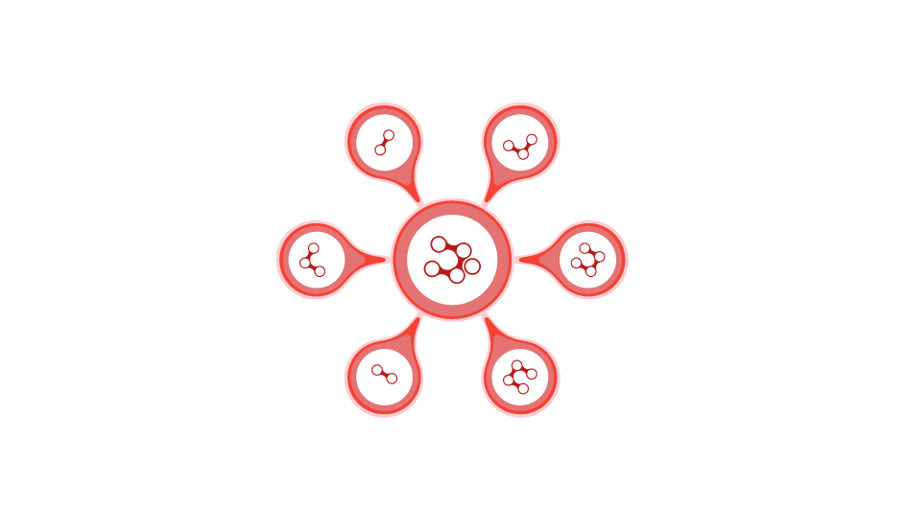
How Modular is Linux?
Package Manager
APT, ALPM, DNF, XBPS,
Zypper, Portage
Standard C Library
glibc or musl
Init
SysV, systemd, openRC,
runit, S6.
File System
ext4, XFS, Reiserfs,
BTRFS, ZFS.
Desktop Environment
GTK+ based, QT based,
enlightenment.
Window Manager
Stacking, Tiling,
Dynamic, Compositor.
Do not forget about kernel differences.

Slide 9




Modular Linux
You still need to Switch distro,
by considering these three diversity
Package Manager
You can learn using docker.
File System
Require long time examination.
Init
You can learn using docker.

Slide 10
When do I need a physical OS?
You can learn Package Manager using Docker.
You can also learn Init using Docker.
But you cannot learn Filesystem using Docker.
File system experience require long time examination.
Thus you have to live with baremetal (physical) OS.

Slide 11
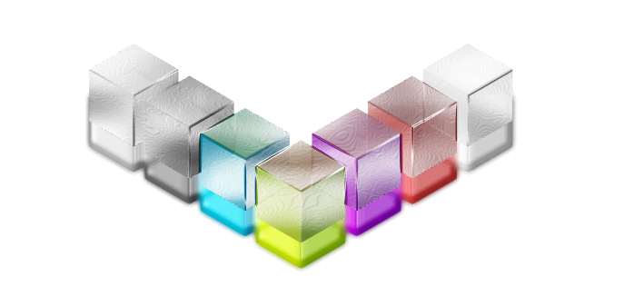
Desktop Environment/ Window Manager
Most beginner start from switching DE/WM
[Desktop Customization]
Yet Another Presentation.

Slide 12




Common Subsytem?
A few must have knowledge
Wireless
[Wireless Command Line]
Audio
[Audio Command Line]
Boot Process: Grub2
[What to Do]
When the System Stuck, on Boot
Dbus (for WM user only)
[dbus in Window Manager]

Slide 13
Package Manager

Slide 14
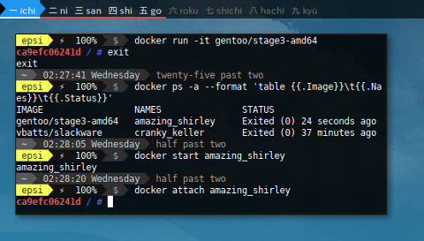
Docker Test Bed
Package Manager with Docker
APT
ALPM
DNF
XBPS
Zypper
Portage
Docker is suitable for
old notebook with low resources.

Slide 15

More Articles about Docker Test Bed
[Debian - APT]
[openSUSE - Zypper]
[Fedora - DNF]
[Void - XBPS]
[Slackware - Package]
[Gentoo - Portage]

Slide 16
Package Manager Feature?
Deep knowledge require long time experience.
Most of issues comes months after install.

Slide 17

Be Aware of Package Manager Advantage/Issue
[APT Pinning]
[Selective Emerge]
[Unbundling AUR in ALPM]
[Upgrading Fedora]
[GhostBSD Ports]

Slide 18
Init?

Slide 19
Who Use What!
OpenRC
Gentoo, Artix,
Devuan, GhostBSD.
SysV
Slackware,
Devuan.
runit
Void,
Artix.
s6
Obarun,
Artix.
systemd
Most major distro.

Slide 20

Civil War
[The systemd Controversy]
Still debating in 2020 between:
systemd+gnome versus linux+diversity.

Slide 21


The Four Elements of an Init System
Reference: [s6_lightning_talk.pdf]
/sbin/init
pid 1
Process Supervision
Service Management
And nothing more.

Slide 22

Example Usage
[Setup LAMP stack with Manjaro OpenRC]

Slide 23
File System?
ext4, XFS, Reiserfs, BTRFS, ZFS.
Deep knowledge require long time experience.
Most of issues comes months after install.
You cannot just install, and just understand file system instantly.

Slide 24
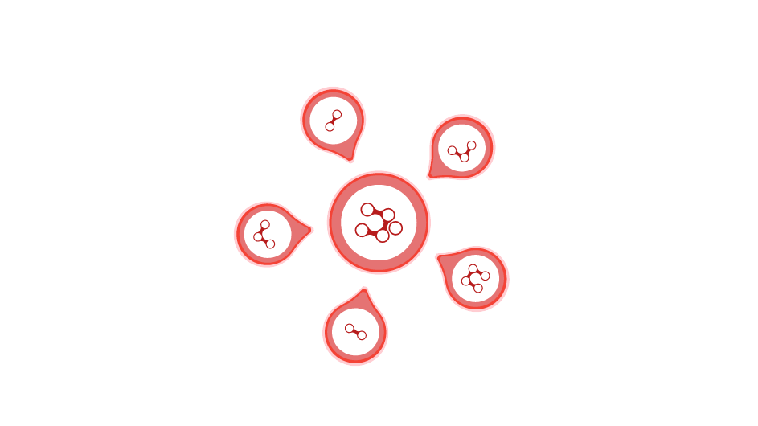
Filesystem, and how to find them.
ext4
Most common in GNU/Linux.
ZFS
Common in BSD.
UFS
Common in BSD
XFS
This can be installed in most linux
BTRFS
Default in openSUSE /

Slide 25

Example Issues and Workarounds
BRTRFS snapshots:
[File System - Trapped in Snapper Rollback]
BRTRFS with GRUB:
[File System - GRUB2 support for BTRFS]
UFS along with linux Multiboot:
[GhostBSD - Multiboot]
NixOS in Multiboot:
Use chainloader in GRUB

Slide 26
Standard C library in OS?
glibc or musl.
I must admit,
I do not have any experience with musl.

Slide 27
Switching Distro?
While you are young and still have time.
Get yourself quarterly (three months) curriculum/plan.

Slide 28

Just get pass through it.
No need to go deep with coding.
Be an ordinary user.
After this one year,
you are already mature enough
with broader view to choose
whatever linux you want.
If you want to get more wisdom.
Learn BSD land in the second year.

Slide 29

Example of Quarterly Syllabus (learning plan)
Make a target of first year with linux.
openSUSE
learn filesystem: btrfs, xfs
also learn yast2
Gentoo
learn init other than systemd
learn patience
Q1
Q3
Ubuntu/ Manjaro/ Mint
learn the DE universe:
gnome-shell, plasma, xfce4
learn basic command line.
Arch
know your system
dive into the world
of cli/terminal shell
Q2
Q4
Learn part of system! Instead just switching distro.

Slide 30

Example Q1:
Ubuntu/ Mint/ Manjaro
Basic Terminal Command
ls, cat, grep, ps, top, man, info, su, sudo
always use $ man for documentation before google.
Read The Fine Manual
[ubuntu-manual] (GUI)
[debian-handbook] (hertzog)
Also learn about basic linux briefly
Examine Filesystem Hierarchy Standard (FHS)
Examine boot process.
Solving audio or wireless issue.
More Terminal Command
nmcli, ncdu, ntop, cfdisk
lspci, lsusb, lsmod, dmesg, ip ,iw

Slide 31

Example Q3:
Arch: Leverage yourself to Arch
Install with command line only
add driver manually, add username manually, add DE manually, use pacman
Dare to use minimalis WM, rather than eyecandy DE
openbox, awesome, i3, bspwm
Use packer, cower, or other AUR Helper
automatic compilation, try any unofficial application from AUR
Penetration Testing Application
add and install repo: BlackArch or maybe ArchStrike
Read the holy arch wiki
there is a lot of good material here
Philosophy: Knowing Your System

Slide 32

Install Log/ Post Install Log
[Fedora]
[openSUSE]
[Debian wheezy] (old)
[GhostBSD]
[Mageia]
[Slackware]

Slide 33
Multiboot?
For linux enthusiast.

Slide 34
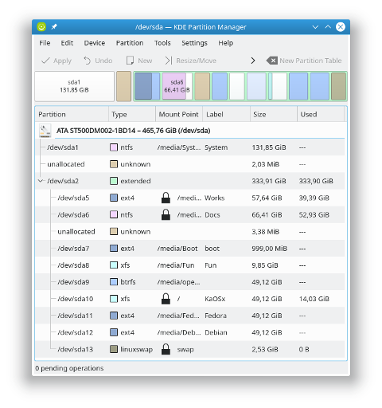
Multiboot
[Partition Schema]

Slide 35

Partition Schema
Old Example Using MBR
Primary
Windows
Extended
EBR
Swap
Shared Partition
First Linux Distro
Second Linux Distro
Third Linux Distro
Extended
BSD
BSD Swap
One or more UFS

Slide 36

fstab
Learn to make shared partition.
BTRFS subvolume is interesting.
[Multiboot - /etc/fstab]

Slide 37

chroot
Some OS is comfortably installed using chroot:
such as: Gentoo, LFS.
Other OS can be updated using chroot:
beware of small issues.
[Multiboot - chroot]

Slide 38
Tips
Keep your samba's network share
persistence along multiboot.
[Multiboot - Samba]

Slide 39
Tips
Linux Multiboot with BSD,
can be done using UFS, instead of ZFS.
[GhostBSD: Multiboot]

Slide 40
Kernel?
make menuconfig

Slide 41
Interesting Diversity?

Slide 42

Interesting Diversity?
Project Trident
Runit + ZOL + XBPS + MUSL.
Alpine Linux
Busybox (no GNU tools).
LFS
No comment.
And many more
You name it!
NixOS
Exotic Package Manager.

Slide 43
What is Next?
More Wisdom!
Learn BSD land!

Slide 44
Questions?
Don’t be shy!

Slide 45
The End
Thank You for Your Time.

