Slide 1




$$We apply the dilatation of center A and ratio q$$
$$q−1$$
$$1$$
$$q$$
A
$$1$$

Slide 2
$$q−1$$
$$1$$
$$q$$
A
$$1$$

Slide 3
$$q−1$$
$$1$$
$$q$$
A
$$1$$

Slide 4
$$q−1$$
$$1$$
$$q$$
A
$$1$$

Slide 5
$$q−1$$
$$1$$
$$q$$
A
$$1$$

Slide 6

$$q−1$$
$$q^{2}$$
$$1$$
$$q$$
A
$$1$$

Slide 7
$$q−1$$
$$1$$
$$q$$
A
$$1$$

Slide 8
$$q−1$$
$$1$$
$$q$$
A
$$1$$

Slide 9

$$q(q−1)$$
$$q−1$$
$$1$$
$$q$$
A
$$1$$

Slide 10
$$q(q−1)$$
$$q−1$$
$$q^{2}$$
$$1$$
$$q$$
A
$$1$$

Slide 11


$$q^{2}(q−1)$$
$$q(q−1)$$
$$q^{3}$$
$$q−1$$
$$q^{2}$$
$$1$$
$$q$$
A
$$1$$

Slide 12








$$q^{2}(q−1)$$
$$q(q−1)$$
$$q^{3}$$
$$q−1$$
$$q^{2}$$
$$q$$
$$1$$
$$1$$

Slide 13








$$q^{2}(q−1)$$
$$q(q−1)$$
$$q^{3}$$
$$q−1$$
$$q^{2}$$
$$q$$
$$1$$
$$1$$

Slide 14








$$q^{2}(q−1)$$
$$q(q−1)$$
$$q^{3}$$
$$q−1$$
$$q^{2}$$
$$q$$
$$1$$
$$1$$

Slide 15










$$⋮$$
$$q^{2}(q−1)$$
$$…$$
$$q(q−1)$$
$$q^{3}$$
$$q−1$$
$$q^{2}$$
$$q$$
$$1$$
$$1$$

Slide 16




$$q^{n}(q−1)$$
$$⋮$$
$$q^{n+1}$$
$$q^{2}(q−1)$$
$$…$$
$$q(q−1)$$
$$q^{3}$$
$$q−1$$
$$q^{2}$$
$$q$$
$$1$$
$$1$$

Slide 17












$$q^{n}(q−1)$$
$$⋮$$
$$q^{n+1}$$
$$q^{2}(q−1)$$
$$…$$
$$q(q−1)$$
$$q^{3}$$
$$q−1$$
$$q^{2}$$
$$q$$
$$1$$
$$1$$

Slide 18
$$q^{n}(q−1)$$
$$⋮$$
$$q^{n+1}$$
$$q^{2}(q−1)$$
$$q(q−1)$$
$$q−1$$
$$1$$
$$1$$

Slide 19







$$q−1$$
$$q(q−1)$$
$$q^{2}(q−1)$$
$$…$$
$$q^{n+1}$$
$$+$$
$$+$$
$$+$$
$$+$$
$$q^{n}(q−1)$$
$$1$$
$$1$$

Slide 20
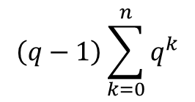
$$\left(q−1\right)\sum_{k=0}^{n}{q^{k}}$$
$$q^{n+1}$$
$$1$$
$$1$$

Slide 21


$$\left(q−1\right)\sum_{k=0}^{n}{q^{k}}$$
$$q^{n+1}−$$
$$1$$
$$1$$

Slide 22



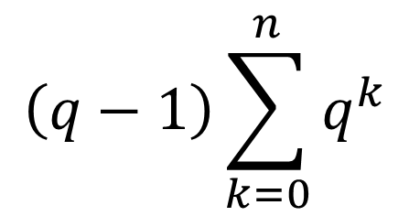
$$\left(q−1\right)\sum_{k=0}^{n}{q^{k}}$$
$$=$$
$$q^{n+1}−$$
$$1$$

Slide 23
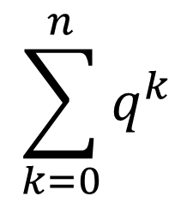
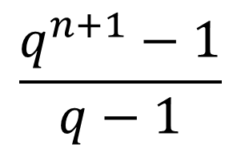
$$\sum_{k=0}^{n}{q^{k}}$$
$$\frac{q^{n+1}−1}{q−1}$$
$$=$$

