Slide 2


Slide 3
Main title

Slide 5

EspiloniaMath
@EspiloniaMath
EpsiloniaMath
@EspiloniaMath

Slide 6

epsilonia.com

Slide 7

















4
$$⇒$$
$$⟺$$
?
$$Ex 1$$
$$Ex 2$$
$$Ex 3$$
$$Ex 4$$
$$Ex 5$$
$$ℕ$$
$$ℝ$$
$$\lim_{n→∞}{a_{n}}$$
Text

Slide 8
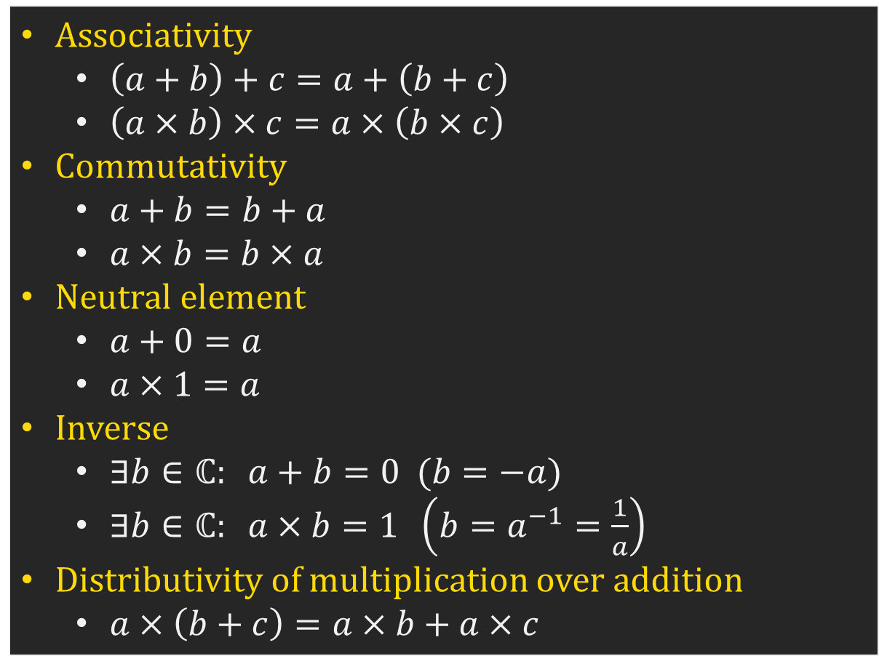
Associativity
$\left(a+b\right)+c=a+\left(b+c\right)$
$\left(a×b\right)×c=a×\left(b×c\right)$
Commutativity
$a+b=b+a$
$a×b=b×a$
Neutral element
$a+0=a$
$a×1=a$
Inverse
$∃b∈ℂ: a+b=0 (b=−a)$
$∃b∈ℂ: a×b=1 \left(b=a^{−1}=\frac{1}{a}\right)$
Distributivity of multiplication over addition
$a×\left(b+c\right)=a×b+a×c$

Slide 9
1: 255, 218, 7
2: 245, 176, 99
3: 246, 139, 23
4 : 242, 99, 105
5: 215, 93, 106
6: 228, 121, 192
7: 190, 106, 121
8: 128, 84, 171
9: 94, 192, 231
10: 81, 152, 206
11: 88, 91, 186
12 : 56, 193, 185
13: 165, 214, 99
14: 98, 201, 117
15: 58, 156, 109
16: 109, 77, 53
9 4 3 1 13 15 8

