Slide 1
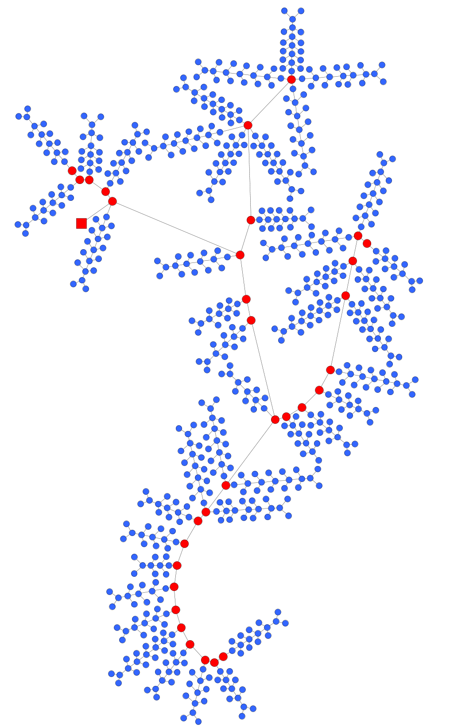
Substation
12.66 kV
0.24 kV

