Slide 1
Predicting Housing Values Using Ensemble Regression Models
Stephan B. Epstein
February 21, 2026

Slide 2
Objectives
Background of the Dataset
Identify potential Models
Develop the most promising Models
Compare and Contrast Results

Slide 3
The Dataset
BostonHousing
A Data Science classic
Used to predict Median Value of Housing
Ethical Considerations
Several predictor variables no longer acceptable
Not suitable for policy decisions
Remains valid for educational / training purpose

Slide 4
Dataset Characteristics
506 Rows (small)
Target Variable is Continuous (Float)
13 Predictor Variables (Integer or Float)
No Time Series or Time related variables
Dataset is Full and Clean

Slide 5
Implications for Modeling
Float & Integer Predictors with a Continuous Float Target strongly suggest Supervised Learning
Tree Models beat Neural Networks
Handle small Datasets well
Less prone to over fitting than Neural Networks
Minimal Tuning required
Discover & Handle Nonlinear relationships naturally (without scaling)

Slide 6
Workflow Strategy
Data Overview
Baseline Models
Advanced Models
Cross Validations
Hyper-parameter Tuning
Variance Bias Analysis
Residuals
Comparisons

Slide 7
The Models
Built 14 Different Models (3 Duplicates)
Selected 7 for Detailed Analysis
3 “Old School” Regression
Simple
Forward (Sequential) Feature Selection
Full Model
4 Supervised Learning Models
Random Forest
Lasso
Ridge
Gradient Boosting

Slide 8
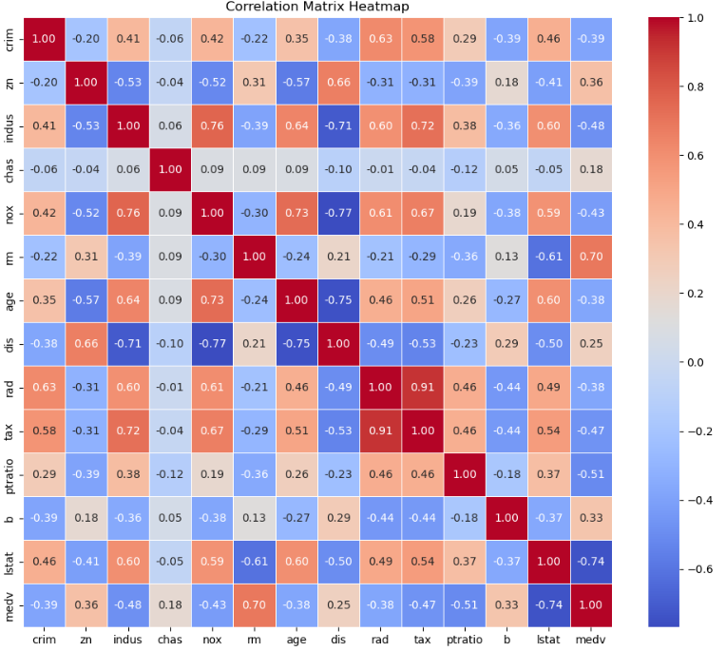

Slide 9
Simple Linear Regression
Test R²: 0.5429180422970384
Test RMSE: 5.789606996393182
CV=5 Mean R²: 0.2971098460066866 Std: 0.17535679047995686
CV=10 Mean R²: -0.1846817315817983 Std: 0.7302073687819293
Train R²: 0.5423180734793516
Test R²: 0.5429180422970384
Balanced Bias-Variance
Intercept: 34.83694982031851
Coefficient for lstat: -0.966530901950353
Model Equation:
y_hat = 34.8369 + -0.9665 * lstat

Slide 10
Forward (Sequential) Feature Selection
Selected Features: ['lstat', 'rm', 'ptratio', 'dis', 'nox', 'chas', 'b', 'zn', 'crim', 'rad', 'tax', 'indus', 'age']
Test R²: 0.6687594935356348
Adjusted R²: 0.6198262368988536
Test RMSE: 4.9286021826653155
CV=5 Mean R²: 0.3532759243958716 Std: 0.376567839332638
CV=10 Mean R²: 0.20252899006057495 Std: 0.5952960169512096
Train R²: 0.7508856358979673
Test R²: 0.6687594935356348
Balanced Bias-Variance
Model Equation:
y_hat = 30.2468 + (-0.5086 * lstat) + (4.4388 * rm) + (-0.9155 * ptratio) + (-1.4479 * dis) + (-17.2026 * nox) + (2.7844 * chas) + (0.0124 * b) + (0.0301 * zn) + (-0.1131 * crim) + (0.2624 * rad) + (-0.0106 * tax) + (0.0404 * indus) + (-0.0063 * age)

Slide 11
Full Model Regression
Test R²: 0.6687594935356317
Adjusted R²: 0.6198262368988501
Test RMSE: 4.928602182665339
CV=5 Mean R²: 0.3532759243958762 Std: 0.37656783933262383
CV=10 Mean R²: 0.20252899006056796 Std: 0.5952960169512175
Train R²: 0.7508856358979673
Test R²: 0.6687594935356317
Balanced Bias-Variance
Model Equation:
y_hat = 30.2468 + (-0.1131 * crim) + (0.0301 * zn) + (0.0404 * indus) + (2.7844 * chas) + (-17.2026 * nox) + (4.4388 * rm) + (-0.0063 * age) + (-1.4479 * dis) + (0.2624 * rad) + (-0.0106 * tax) + (-0.9155 * ptratio) + (0.0124 * b) + (-0.5086 * lstat)

Slide 12
Random Forest Regression
Test R²: 0.8791057217425063
Adjusted R²: 0.8612463397271948
Test RMSE: 2.977521584650359
OOB R²: 0.8407797288917938
CV=5 Mean R²: 0.6251511563494508
Std: 0.21137045355963135
CV=10 Mean R²: 0.4888807023952061
Std: 0.3756344140529044
Train R²: 0.9781775987586625
Test R²: 0.8791057217425063
Balanced Bias-Variance

Slide 13
Random Forest Regression
Feature Importance (Gini):
Feature Gini Importance
5 rm 0.480887
12 lstat 0.334585
7 dis 0.056765
0 crim 0.037667
4 nox 0.016676
10 ptratio 0.015973
9 tax 0.015528
6 age 0.015116
11 b 0.012675
2 indus 0.006671
8 rad 0.004369
1 zn 0.001841
3 chas 0.001247
Permutation Importance:
Feature Permutation Importance
12 lstat 0.478757
5 rm 0.464103
7 dis 0.085105
0 crim 0.038373
4 nox 0.030654
10 ptratio 0.023451
6 age 0.013938
9 tax 0.008656
2 indus 0.002914
8 rad 0.002357
11 b 0.001556
1 zn 0.000611
3 chas 0.000326

Slide 14
Random Forest Regression
Model Interpretability Notes:
- Random Forest captures nonlinearities & interactions.
- Top features identified above drive predictions most strongly.
- OOB score approximates cross-validation performance.

Slide 15
Lasso Regression
Best Alpha: 0.006863892263379668
Test R²: 0.6683883969336302
Adjusted R²: 0.6194003192079165
Test RMSE: 4.931362224853925
CV=5 Mean R²: 0.39178079038455627 Std: 0.32470654684276057
CV=10 Mean R²: 0.2849320530787801 Std: 0.47698247066182403
Train R²: 0.750846841458309
Test R²: 0.6683883969336302
Balanced Bias-Variance

Slide 16
Lasso Regression
Lasso Feature Coefficients:
Feature Coefficient Abs_Coefficient
12 lstat -3.610072 3.610072
5 rm 3.149505 3.149505
7 dis -3.033683 3.033683
8 rad 2.127566 2.127566
10 ptratio -2.025009 2.025009
4 nox -1.978859 1.978859
9 tax -1.643649 1.643649
11 b 1.121376 1.121376
0 crim -0.983042 0.983042
3 chas 0.719674 0.719674
1 zn 0.662207 0.662207
2 indus 0.215572 0.215572
6 age -0.160356 0.160356
Permutation Importance:
Feature Permutation Importance
12 lstat 0.320459
7 dis 0.207781
8 rad 0.175874
5 rm 0.154860
4 nox 0.099663
10 ptratio 0.093250
9 tax 0.077034
1 zn 0.037724
3 chas 0.003307
6 age 0.001798
0 crim 0.000588
11 b -0.000034
2 indus -0.001338
Selected Features
(Non-Zero Coefficients):
Feature Coefficient
12 lstat -3.610072
5 rm 3.149505
7 dis -3.033683
8 rad 2.127566
10 ptratio -2.025009
4 nox -1.978859
9 tax -1.643649
11 b 1.121376
0 crim -0.983042
3 chas 0.719674
1 zn 0.662207
2 indus 0.215572
6 age -0.160356

Slide 17
Lasso Regression
Model Interpretation:
- Lasso performs L1 regularization.
- Coefficients shrunk toward zero.
- Some features eliminated (automatic feature selection).

Slide 18
Ridge Regression
Best Alpha: 2.782559402207126
Test R²: 0.667935555866449
Adjusted R²: 0.6188805811649019
Test RMSE: 4.934728152729692
CV=5 Mean R²: 0.4620262515175225 Std: 0.2624047294957749
CV=10 Mean R²: 0.3528077474337879 Std: 0.3775110075293354
Train R²: 0.7507768518427961
Test R²: 0.667935555866449
Balanced Bias-Variance

Slide 19
Ridge Regression
Ridge Feature Coefficients (Shrunk):
Feature Coefficient Abs_Coefficient
12 lstat -3.577112 3.577112
5 rm 3.161437 3.161437
7 dis -2.981941 2.981941
8 rad 2.046855 2.046855
10 ptratio -2.010950 2.010950
4 nox -1.937316 1.937316
9 tax -1.581748 1.581748
11 b 1.123015 1.123015
0 crim -0.975698 0.975698
3 chas 0.728511 0.728511
1 zn 0.647435 0.647435
2 indus 0.210419 0.210419
6 age -0.179078 0.179078
Permutation Importance:
Feature Permutation Importance
12 lstat 0.315829
7 dis 0.201397
8 rad 0.164654
5 rm 0.157593
4 nox 0.095628
10 ptratio 0.092808
9 tax 0.071122
1 zn 0.036700
3 chas 0.003509
6 age 0.002107
0 crim 0.000415
11 b 0.000084
2 indus -0.001381

Slide 20
Ridge Regression
Model Interpretation:
- Ridge applies L2 regularization.
- Coefficients are shrunk but not eliminated.
- Reduces multicollinearity impact.
- Improves generalization vs full OLS.

Slide 21
Gradient Boosting Regression
Test R²: 0.9137718929980266
Adjusted R²: 0.9010336499181897
Test RMSE: 2.514643772228552
CV=5 Mean R²: 0.6658967764088929 Std: 0.15675232022010183
CV=10 Mean R²: 0.44665559815208083 Std: 0.48204965440354003
Train R²: 0.994030788460668
Test R²: 0.9137718929980266
Balanced Bias-Variance

Slide 22
Gradient Boosting Regression
Feature Importance (Tree-Based):
Feature Feature Importance
5 rm 0.406142
12 lstat 0.374462
7 dis 0.072480
4 nox 0.034583
10 ptratio 0.031870
0 crim 0.027173
6 age 0.021013
11 b 0.013456
9 tax 0.013355
8 rad 0.002484
2 indus 0.002031
1 zn 0.000669
3 chas 0.000282
Permutation Importance:
Feature Permutation Importance
12 lstat 0.484144
5 rm 0.378776
7 dis 0.144583
4 nox 0.051316
6 age 0.045842
0 crim 0.032913
10 ptratio 0.028686
11 b 0.013536
9 tax 0.013261
2 indus 0.004815
1 zn 0.004650
8 rad 0.003667
3 chas 0.000558

Slide 23
Gradient Boosting Regression
Model Interpretation:
- Gradient Boosting builds trees sequentially.
- Each tree corrects residuals from previous trees.
- Captures nonlinearities and interactions.
- Feature importance ranks predictive drivers.

Slide 24
Summary
Understanding the characteristics of a Dataset are critical to selection of Model(s)
Supervised Learning Models consistently demonstrated superior Metrics over traditional Regression Models
Tree ensemble (Random Forest, Gradient Boost) demonstrated superior Metrics over Linear Models (Lasso, Ridge)
Gradient Boosting displayed the best Metrics, followed by Random Forest
All models demonstrate good Bias Variance balance (neither underfit nor overfit)
All models appear to have random Residuals

Slide 25
Areas for Further Research
SHAP (Shapley Additive exPlanations) a framework for explaining individual predictions using concepts from cooperative game theory. SHAP answers: “How much did this feature contribute to this specific prediction?”
VIF (Variance Inflation Factor) measures how much multicollinearity inflates the variance of a regression coefficient. VIF tells you how much a predictor is linearly explained by the other predictors.
Cook’s Distance & Leverage
Cook’s Distance measures how much the regression coefficients would change if you removed a specific observation. It combines Leverage (X extremeness) and Residual size (Y error)
Leverage tells you how unusual an observation’s predictor values (X values) are compared to the rest of the dataset.

