Slide 1
Descriptive Analysis of Baton Rouge Police Department
Crime Incident Reports
Stephan Epstein
December, 10, 2025

Slide 2
Objectives
Why Data Driven Policing?
Provide a General Overview of Baton Rouge and it’s Police Department
Background of the Dataset
Identify Crime Patters through EDA
  Volume
  Time
  Location

Slide 3
Data Driven Policing
Key Components:
  Data Analysis
  Predictive Analytics
  Technology
Move from Traditional Reactive Policing (respond to a call) to more Proactive, Strategic Model (Track Patterns, Predict, Prevent)
Benefits:
  Enhanced Crime Prevention
  Improved Resource Allocation
  Improved Investigations
  Increased Accountability

Slide 4
Baton Rouge
State Capital of Louisiana
Population: 220,907 (2024 estimate)
Size: 86.32 Square Miles
Annual Police Budget (2025): $98,325,000
570 Police Officers
267 Unsworn Members

Slide 5
The Data
CSV file obtained through Data.Gov
Crime Incident Reports from Jan 1, 2021 through December 6, 2025
161,594 Records in Dataset (i.e. Incident Reports)
1,178 Types of Crimes (‘STATUTE DESCRIPTION’)

Slide 6
Data Munging
Multiple Numerical Index Columns needed to be cast as Integers for use,originally defined as object or float
Nan conditions identified, decision made to retain observation, set value to mean
Index Columns normalized to fold different expressions of same index together (e.g. 5 and 5.0, 4A’ = 4A + 4a

Slide 7
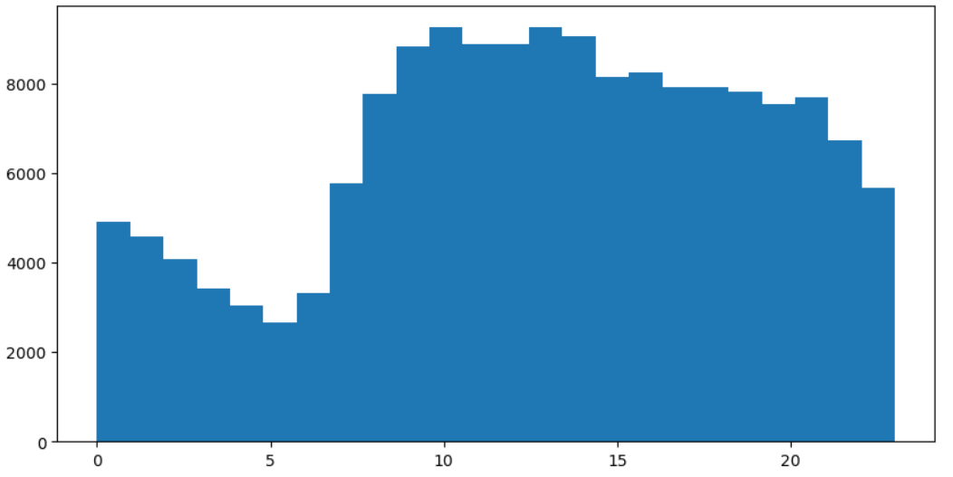
Incident Reports by Time of Day

Slide 8
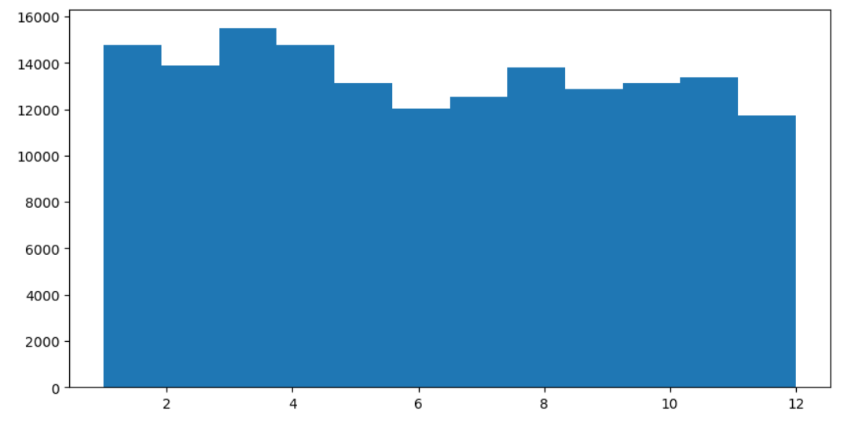
Incident Reports by Month

Slide 9
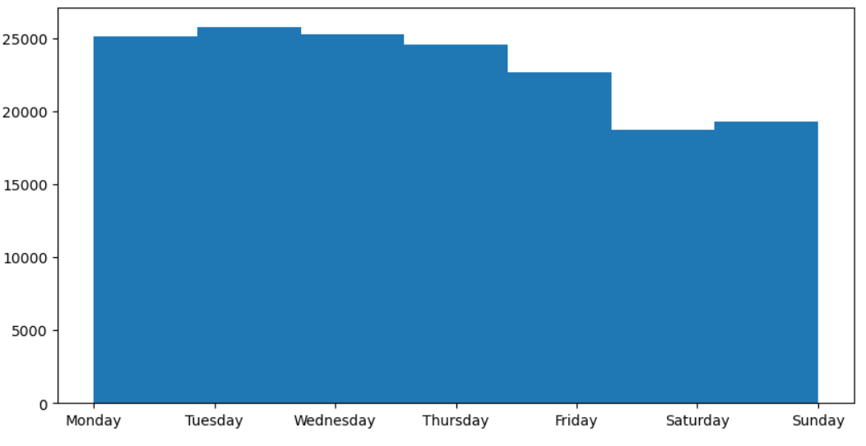
Incident Reports by Day of Week

Slide 10
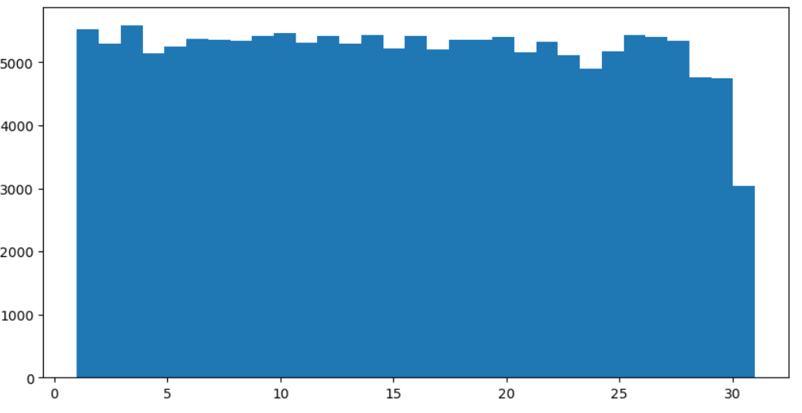
Incident Reports by Day of Month

Slide 11
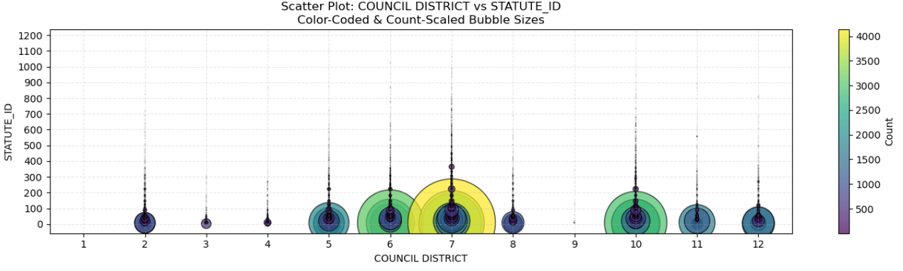
Count Scaled Scatter Plot by Council District

Slide 12
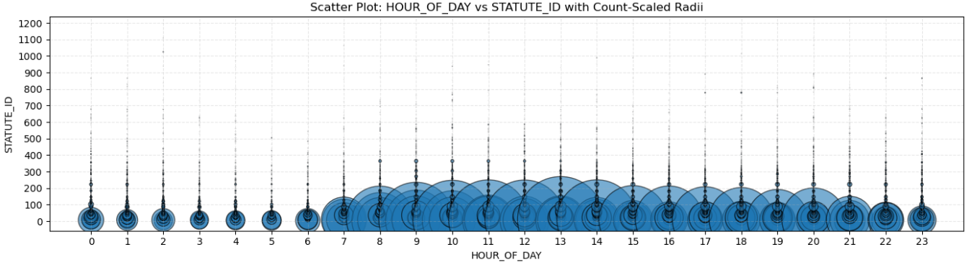
Count Scaled Scatter Plot of
Statute vs. Time of Day

Slide 13
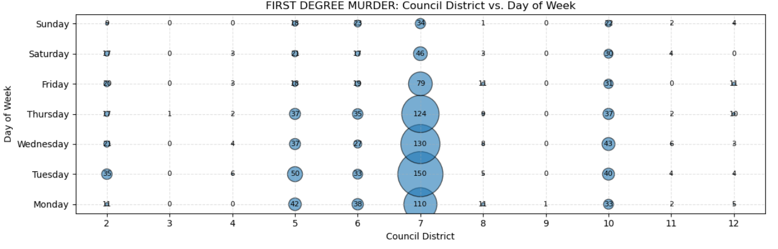
Count Scaled Plot
Council District vs. Day of Week

Slide 14
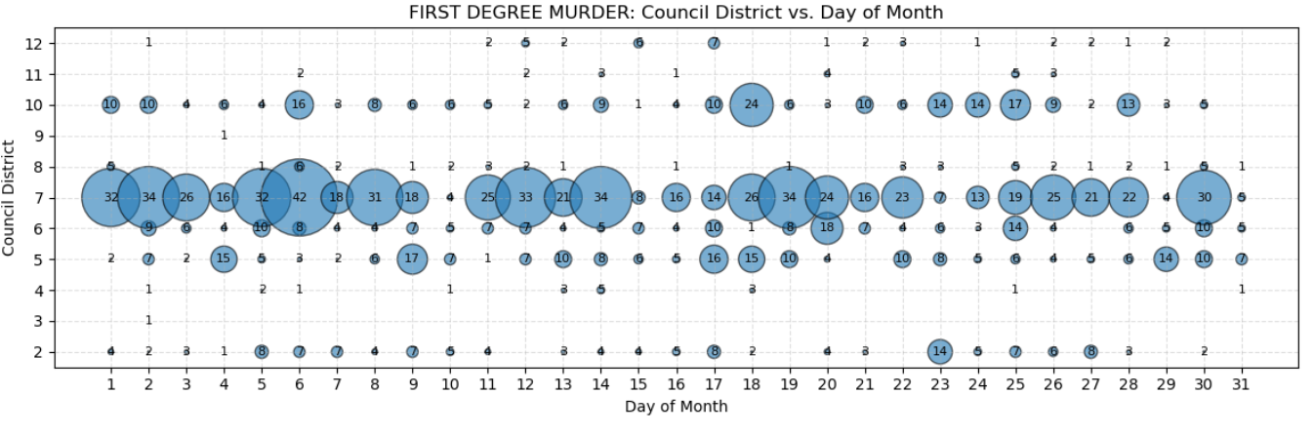
Count Scaled Plot
Council District vs. Day of Month

Slide 15
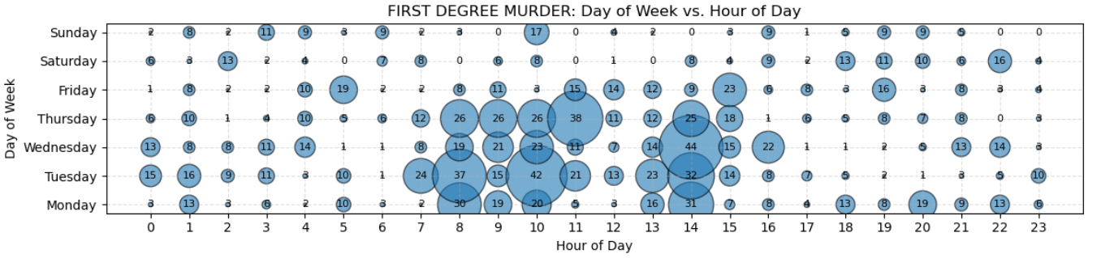
Count Scaled Plot
Day of Week vs. Hour of Week

Slide 16
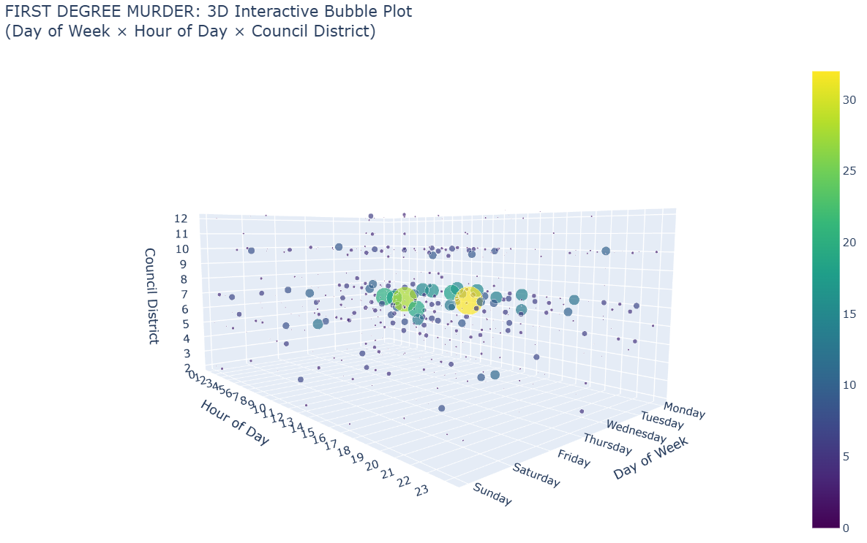
3D Bubble Plot of
Day, Hour and Council District

Slide 17
Suggested Improvements
Need more robust input checking
  Error Checking for empty fields
  Many fields lend themselves to Menu Driven Input
  Auto correcting for Alpha Value Case Sensitvity, Integer Only input

Slide 18
Some Areas for Further Research
Attempt to identify likely Occurrence Date
Analysis using Different Location Identifiers (e.g. Zip Code, Neighborhood, LAT/LONG
Cluster Analysis (e.g. DBSCAN?)
Further Analysis of Specific types of Crime
  Individual Statutes
  Related collections of Statutes (e.g. Homicides, Traffic Violations)

