Slide 1
An In Depth Analysis of Baton Rouge Police Department Homicide Reports
Stephan B. Epstein
January 9, 2026

Slide 2
Objectives
Expand on Previous Analysis
Take a Deeper Dive into a Specific Category of Crime: Homicide
Provide useful Information regarding WHEN and WHERE Homicides Occur

Slide 3
The Data
A subset of the Previously used CSV File
Only Incident Reports for Homicides
Defined as where ‘STATUTE DESCRIPTION’ includes the term Murder, Manslaughter or Homicide
A Net Total of 2,739 Records in DataFrame (i.e. Incident Reports, Case Insensitive)
14 Different Statutes (i.e. Crimes)

Slide 4
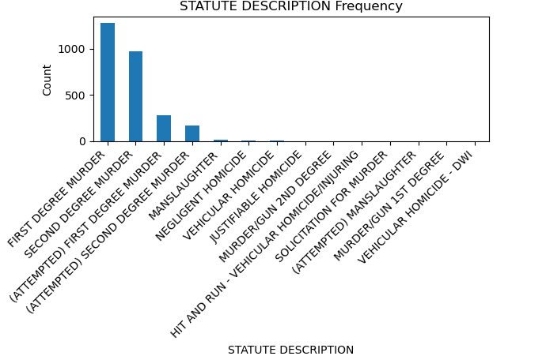
Homicide Breakdown

Slide 5
Data Munging
Create WeekDayHour Column – entire Week by 168 one hour blocks
Create MonthDayHour Column in one hour blocks
Remove all Records with empty Latitude and/or Longitude
Remove Records with Zombie Location

Slide 6
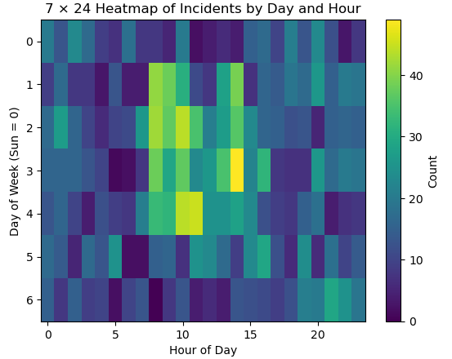
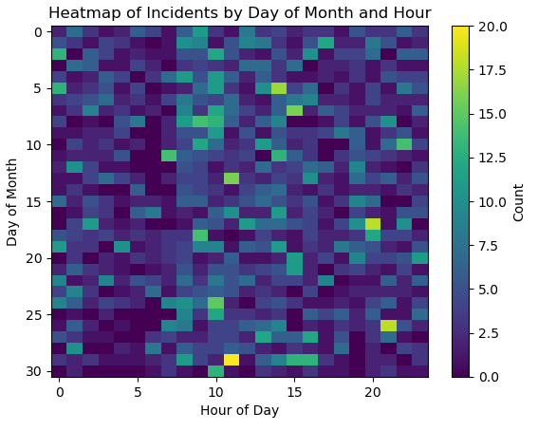
Homicides by Time

Slide 7
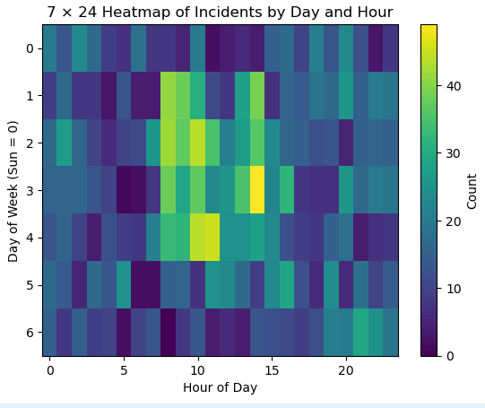
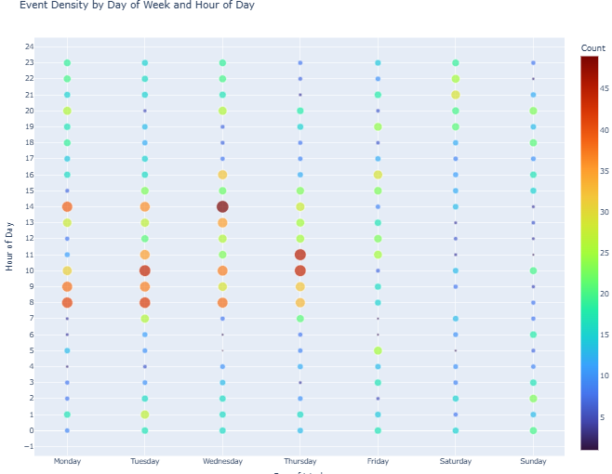
Weekly Homicide Patterns

Slide 8
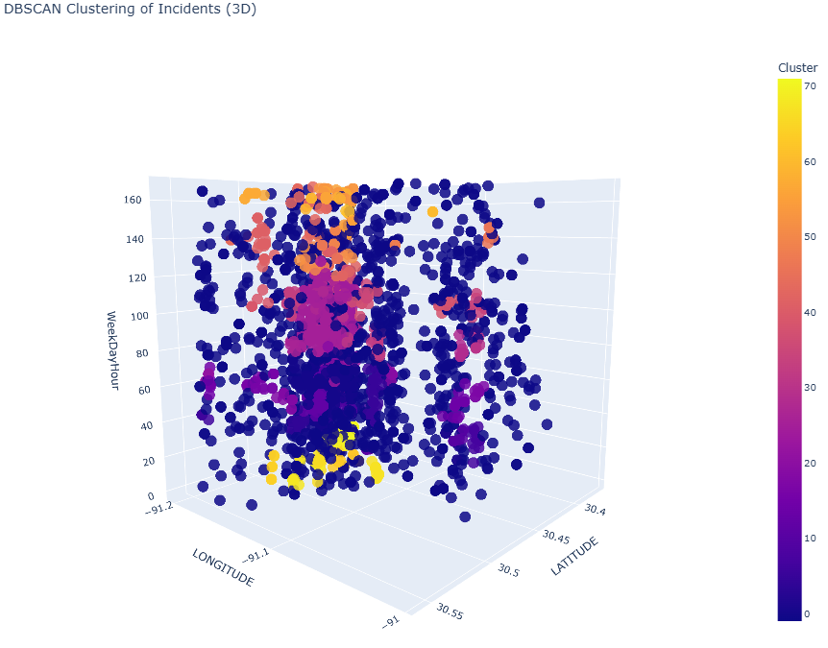
DBSCAN by Location and Time

Slide 9
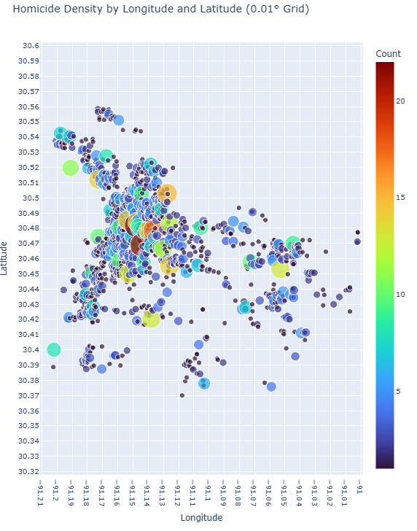
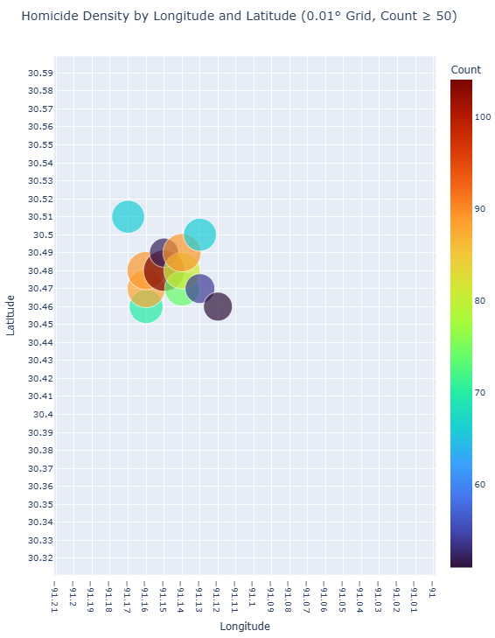
Homicide Density by Location

Slide 10
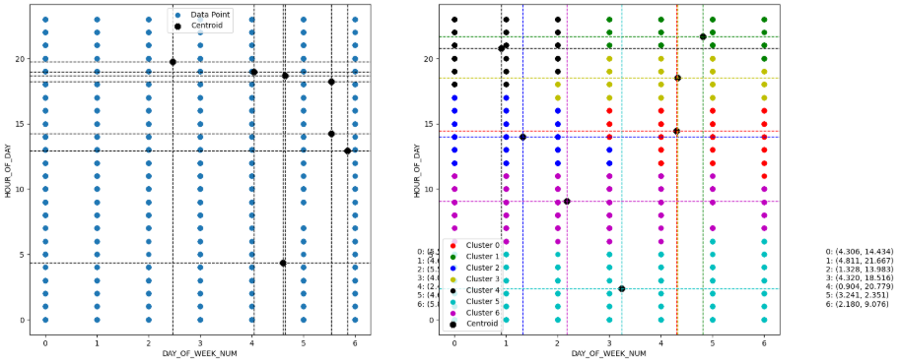
K Means Centroids, n = 7

Slide 11
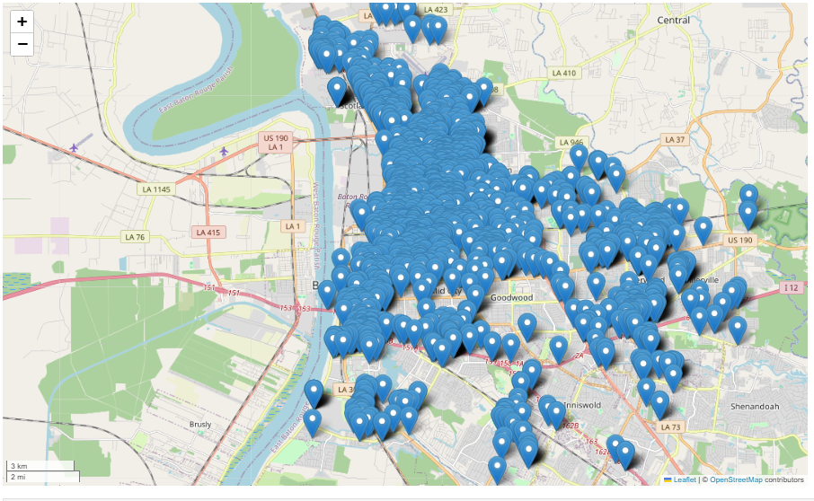
All Homicides Mapped

Slide 12
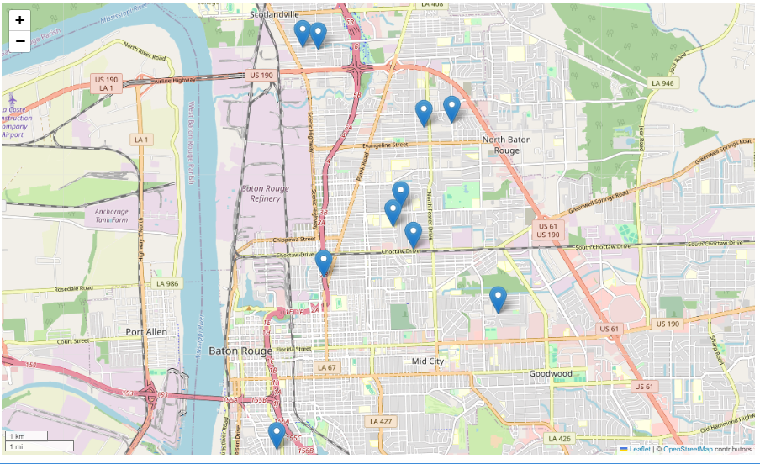
DBSCAN Cluster Locations - By Incident Count

Slide 13
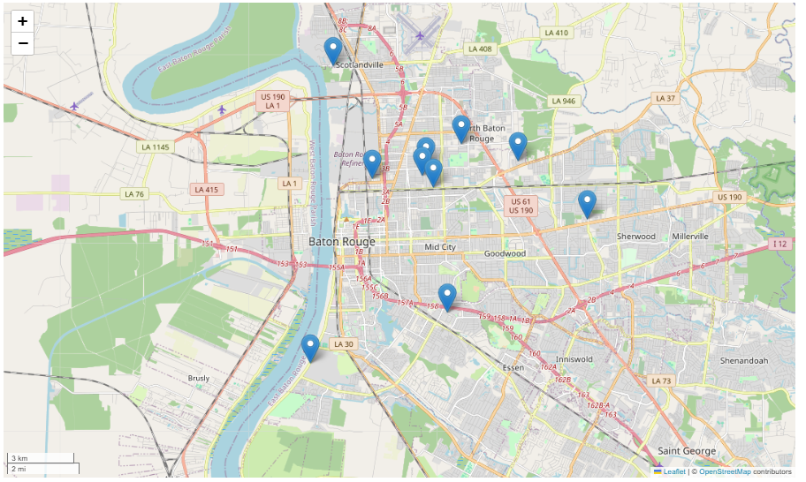
DBSCAN Cluster Locations – By Hourly Density

Slide 14
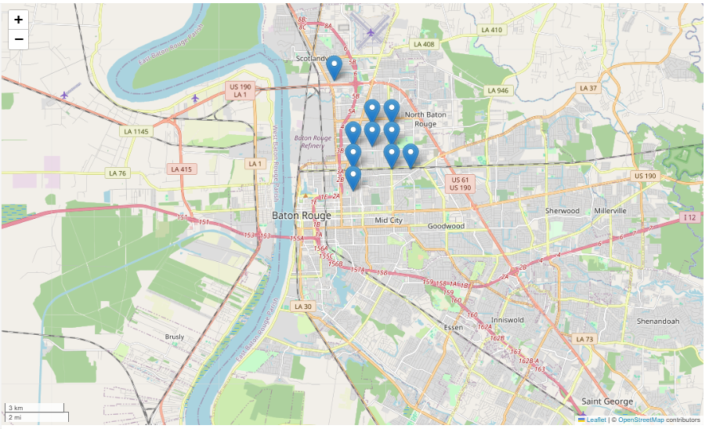
High Incident Clusters by Location

