Slide 1
Spam Filter
Statistical Computer
Team 1: Purevdorj Enkhjargal, Dinesh Siripurapu
Notes:
Hello everyone, Hope everyone is doing good.
We have chosen spam filter as our topic

Slide 2
Outline
Project Background
Motivation and Problem statement
Dataset
Methods / Python packages using to solve
Project plan and timeline
Division of the work
Expected Result
Notes:
We will introduce you our
Project background
Motivation and problem statement
Dataset that we chosen
Also, methods and python packages we use
We made our project plan and timeline
Also, division of the work and expected result.
Lets begin

Slide 3
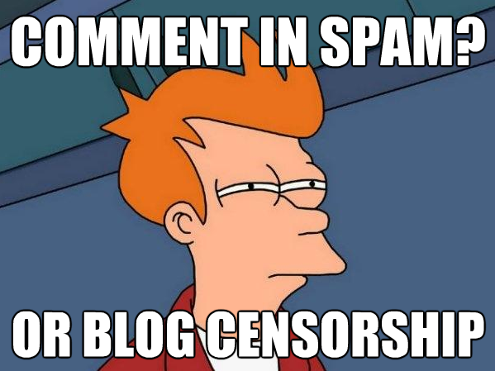
Project Background
What is SPAM?
Spam is any kind of unwanted, unsolicited digital communication that gets sent out in bulk. Often spam is sent via email, but it can also be distributed via text messages, phone calls, or social media.
Notes:
So what is spam?
Spam is basically unwanted text. Often spam is sent via email.
But it can also be distributed via text messages, phone calls, or social media.
We need to avoid of them. We need to be careful when we receive any text messages

Slide 4
Project Background
What are the common spam types?
Spammers use many forms of communication to bulk-send their unwanted messages. Some of these are marketing messages peddling unsolicited goods. Other types of spam messages can spread malware, trick you into masking personal information, or scare you into thinking you need to pay to get out of trouble.
Phishing emails
Email spoofing
Tech support emails
Current event emails
Phishing SMS
Fake package delivery
Credit/Debit card related
Advance fee scams
Notes:
What are the spam types?
Phishing emails are a type of spam cybercriminals send to many people, hoping to “hook” a few people. Phishing emails trick victims into giving up sensitive information like website logins or credit card information.
Spoofed emails mimic, or spoof, an email from a legitimate sender, and ask you to take some sort of action. Well-executed spoofs will contain familiar branding and content, often from a large well-known company such as PayPal or Apple.
In a tech support scam, the spam message indicates that you have a technical problem and you should contact tech support by calling the phone number or clicking a link I
n the message.
All of these spams are cybercrime.

Slide 5
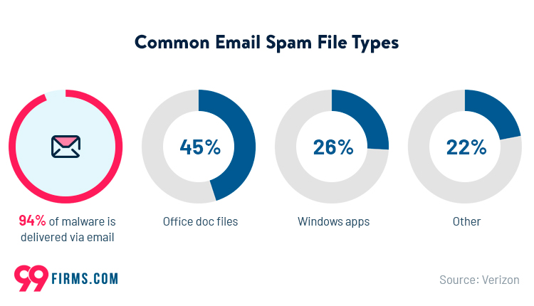
Project Background
Notes:
An investigation of malware concluded that a whopping 94% used email as a delivery method.
These statistics about email spam show just how dangerous it can be to engage in such instances.
The most common spam emails include an attachment, with 45% of malware files being Office doc files.
At 26%, Windows apps were second, as another type of malware delivery through spam mail.

Slide 6
Motivation and Problem statement
Problem
Spam is a big problem of Internet communications. Day by day the amount of incoming spam increase and, scammer attacks are becoming targeted and consequently more of a threat. Most of the Internet users could not recognize which one is spam or not.
Motivation
Our motivation is to build the Machine Learning models to identify spam or not spam from the dataset we have chosen. We compare the results, and accuracies of the models related with this project.
Notes:
Problem
Spam is a big problem of Internet communications. Day by day the amount of incoming spam increase and, scammer attacks are becoming targeted and consequently more of a threat. Most of the Internet users could not recognize which one is spam or not.
Motivation
Our motivation is to build the Machine Learning models to identify spam or not spam from the dataset we chosen. We compare the results, and accuracies of the models related with this project.

Slide 7
Motivation and Problem statement
Spam is a waste of time to the user since they have to sort the unwanted junk mail and it consumed storage space and communication bandwidth.
In the statistics, e-mail spam categories proportions in the table.
E-mail Spam by Category
Products | 25%
Financial | 20%
Adult | 19%
Scams | 9%
Health | 9%
Internet | 7%
Leisure | 6%
Spiritual | 4%
Other | 3%
Notes:
Spam messages include advertisements, free services, promotions, awards, etc.
Users will miss their important emails because of huge numbers of spam emails.

Slide 8
Dataset
Context
The SMS Spam Collection is a set of SMS tagged messages that have been collected for SMS Spam research. It contains one set of SMS messages in English of 5,574 messages, tagged according being ham (legitimate) or spam. (Source: Kaggle.com)
Content
The files contain one message per line. Each line is composed by two columns: v1 contains the label (ham or spam) and v2 contains the raw text.

Slide 9
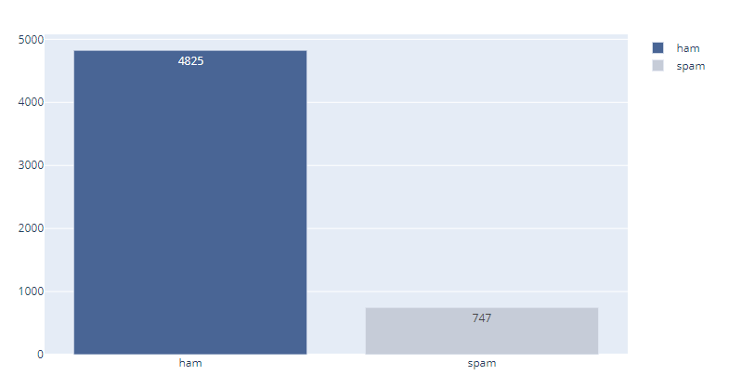
Dataset
Dataset distribution by target
Notes:
This is dataset distribution by target which is spam or not.
About 13% of messages are spam and rest of them are not spam.
It will be helpful to train our models.

Slide 10
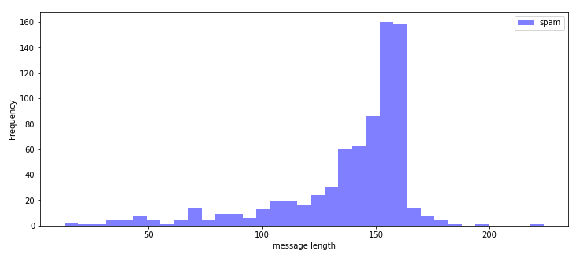
Dataset
Spam frequency by message length
Notes:
Spam frequency by message length, Here the text length between 100 to 170 could be spam.
We will focus on this numbers during model training section.

Slide 11
Methods/Python packages
Naive Bayes Classifier
A Naive Bayes classifier is a probabilistic machine learning model that’s used for classification task. The crux of the classifier is based on the Bayes theorem.
RandomForestClassifier
It supports both binary and multiclass labels, as well as both continuous and categorical features.
Support Vector Machine
The objective of the support vector machine algorithm is to find a hyperplane in an N-dimensional space(N — the number of features) that distinctly classifies the data points.
KNeighborsClassifier
KNN classifier estimates the conditional distribution of Y given X and then classifies the observation to the class with the highest estimated probability.
Notes:
We mainly focus on supervised learning because our dataset has labels.
We chose 4 algorithms.
First one is Naïve Bayes Classifier
Second one is RandomForest Classifier
And Support Vector Machine
Finally, K-neighbors classifier.
All of these models are good fit to our project.

Slide 12
Methods/Python packages
Numpy
Pandas
Matplotlib
Seaborn
NLTK /stopwords, PorterStemmer, WordNetLemmatizer, etc ../
Scikit-Learn
Feature extractions
Preprocessing
Model selection – train_test_split, cross_val_score
Naïve Baynes, SVM, RandomForestClassifier, KneighborsClassifier
Metrics – confusing_matrix, classification_report, accuracy_score, f1_score
Notes:
For data exploration we will use numpy, pandas, matplotlib, seaborn
For data cleaning we use natural language toolkit NLTK.
For model training we use scikit learn
Also we will compare confusing matrix, classification report, accuracy and f1 score.

Slide 13
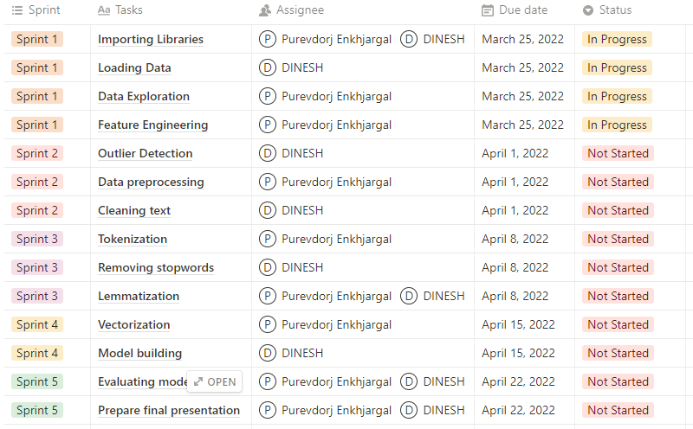
Project plan and timeline
Notes:
We planned our project as Agile scrum within 5 sprints.
Each sprint is 1 week.
Sprint 1 is started today.
For the tasks.

Slide 14
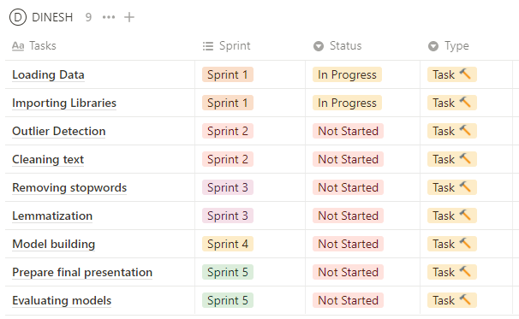
Division by a member

Slide 15
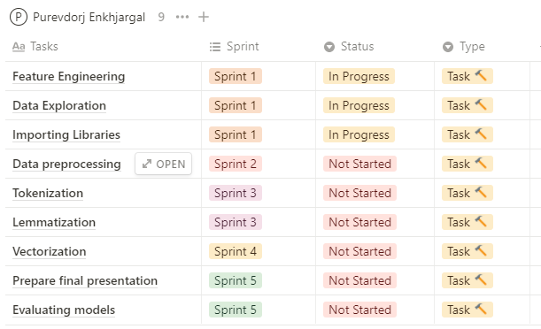
Division by a member

Slide 16
Expected result
Good accuracy which is greater than 95%
Good understanding of statistics libraries in Python
A comparison between Naive Bayes Classifier, Logistic Regression, Support Vector Machine, and KNeighborsClassifier

Slide 17
THANK YOU

