Slide 1
SMACH
SiMulation of human Activity and energy Consumption in the Home
Needs in terms of population synthesis

Slide 2
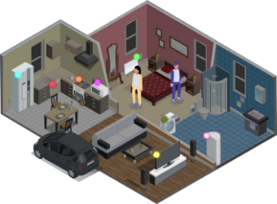

Smach presentation
A multi-agent simulation platform that considers human activity and decisions as one of the main causative factors of energy consumption
A bottom-up, explicit approach
An interdisciplinary team in the fields of psychology, sociology, statistics, AI, building energy modeling
Electricity tariffs
Electrical appliances
Simulation of activity and decisions
Building energy model
Focus on the organisational level of human activity in the home : Individual and collective dynamics and interactions that lead to the emergence of an organisation of daily life in the household
Schumann M., Reynaud Q., Sabouret N., Sempé F., Charrier, B., Albouys, J., Haradji, Y., Inard, C., Multi-Agent based simulation of human activity for building and urban scale assessment of residential load curves and energy use, Building Simulation 2021, Bruges, Belgium

Slide 3


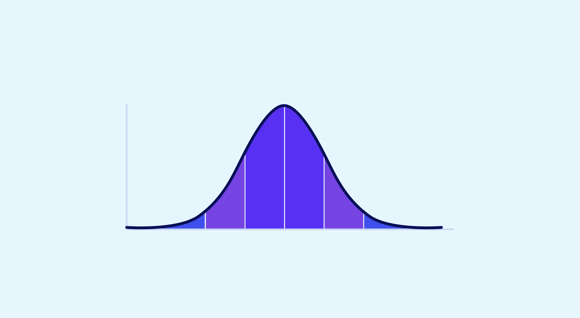
Modelling daily activities
Provisional schedule of activity sequences from Time Use data (time-use diaries)
shower
breakfast
cooking
do the dishes
individual
household
Provisional activities get distributions of frequencies, durations, preferred periods based on the individual’s profile
Action selection
Multi-Agent based simulation of human activity for building and urban scale assessment of residential load curves
Two consecutive days will be different: variability comes from the ABM itself
Notes:
Each individual => an intelligent agent with goals (based on their individual provisional schedule described above), knowledge (other agents’ activities, price of energy, etc.) and preferences (e.g., whether one’s preferred indoor temperature is based more on economic or personal comfort considerations).
Each agent has an individual decision module that will determine the actions that are actually performed. The action selection process uses priority levels that vary dynamically for each action, depending on the agent's knowledge, preferences and context.
Each activity is performed in a specific location inside or outside the building which determines building occupancy.

Slide 4
From activity to energy use
Linking human activities to appliance use and energy consumption
Example of specific electricity uses

Slide 5

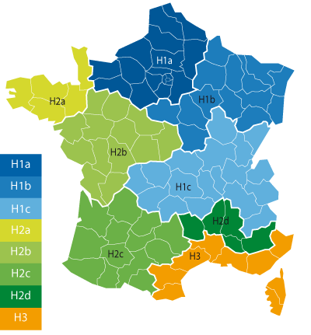

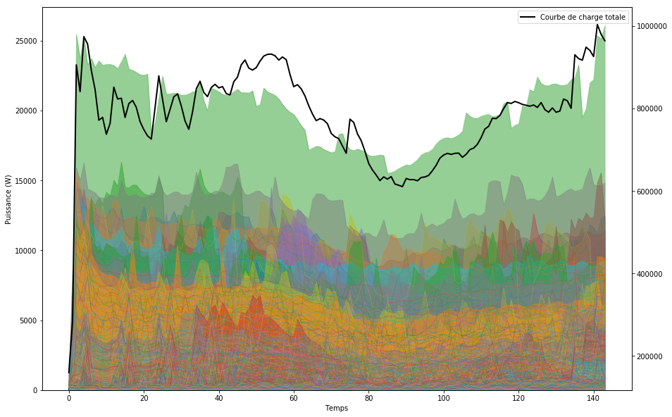
Scaling up to the population level
Generation of a representative population sample, similar to a survey
Simulation of each household sequentially
Moussawel et al. Assessing the benefits of an agent-based approach for occupant behavior modeling in power demand simulation of dwelling stock, 2025, ECOS conference 2025
Notes:
On peut donc faire des études à l’échelle client, comme à l’échelle segment ou remonter au portefeuille EDF ou au national
Un intérêt RTE Echelle France, mais également pour le réseau à échelle plus locale pour des besoins d’investissement

Slide 6
Current population synthesis module
Ad-hoc module
Quick (1 minute for 5,000 households)
No simulation needed. Trips comes from raw ENTD/EMP data (simple distance matrix)
Old IPF like generation, difficult to maintain and update
This generation is unable to generate all characteristics
We use a second generation for the « secondary » characteristics : mainly energy related characteristics (tariff, peak/off peak hours, heater type, reaction to an increase in prices, etc.)

Slide 7


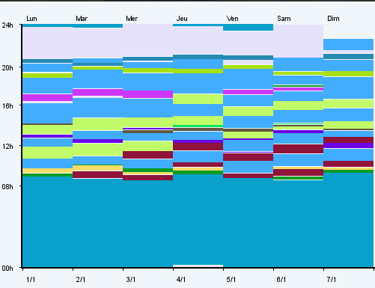
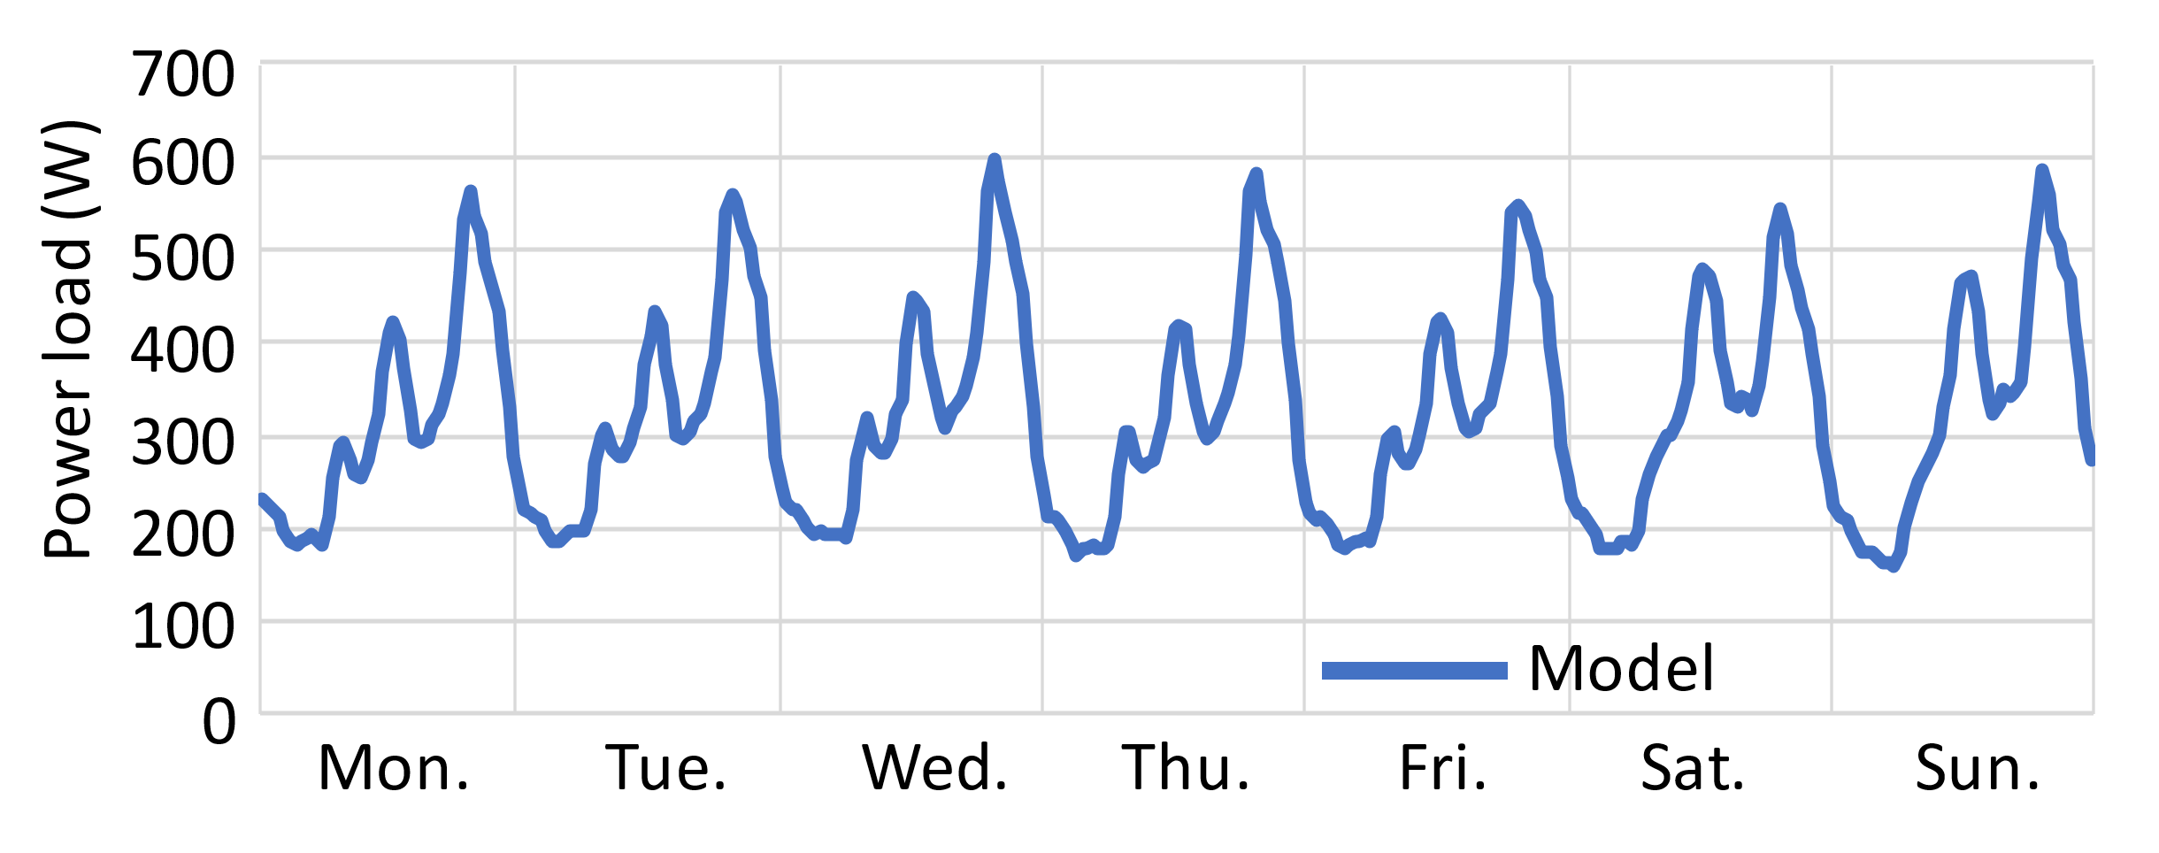
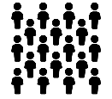



The complete SMACH Model
Inputs
Time Use Surveys
Population generation
Activity and behavior model
Energy model
Individual outputs
Statistical data (census, field-specific surveys, tariff distribution…)
Building model
Inputs
Activity selection
Individual agent
Appliances models
Simulated activity
Load curves
Population
Household
Provisional schedules
Behavior & decisions
Aggregation
Interactions between individuals
Feedback from Building Energy Model
Population output
External information, incentives or constraints

Slide 8
Studies examples
« Classical » simulation = 1 year simulation with 5,000 households representative of metropolitan France
Validation of hypotheses on a modification of the peak/off-peak rate distribution (only households with a peak/off-peak tariff) => Impact on the aggregated load curve at the national (France) level.
Validation of a hypothesis of increased EV consumption during an extremely cold winter (winter simulations for 1,000 urban households in apartments).
Study on self-consumption in a neighborhood (100 houses within a given IRIS zone).
…

Slide 9
Quantifying the impact of “eco-behaviors” for peak shaving: cooking
Results of the model on activity rates and cooking power demand (1000 households average)
Displacement of the preferential periods (PP) of cooking tasks outside of peak hours, with a maximum shift of 45 minutes
morning peak
evening peak
PP
PP
PP
00:00
08:00
02:00
04:00
06:00
12:00
16:00
20:00
22:00
10:00
14:00
18:00
24:00
00:00
08:00
02:00
04:00
06:00
12:00
16:00
20:00
22:00
10:00
14:00
18:00
24:00
➔ A diversity of behaviors (anticipate, postpone, maintain)

Slide 10
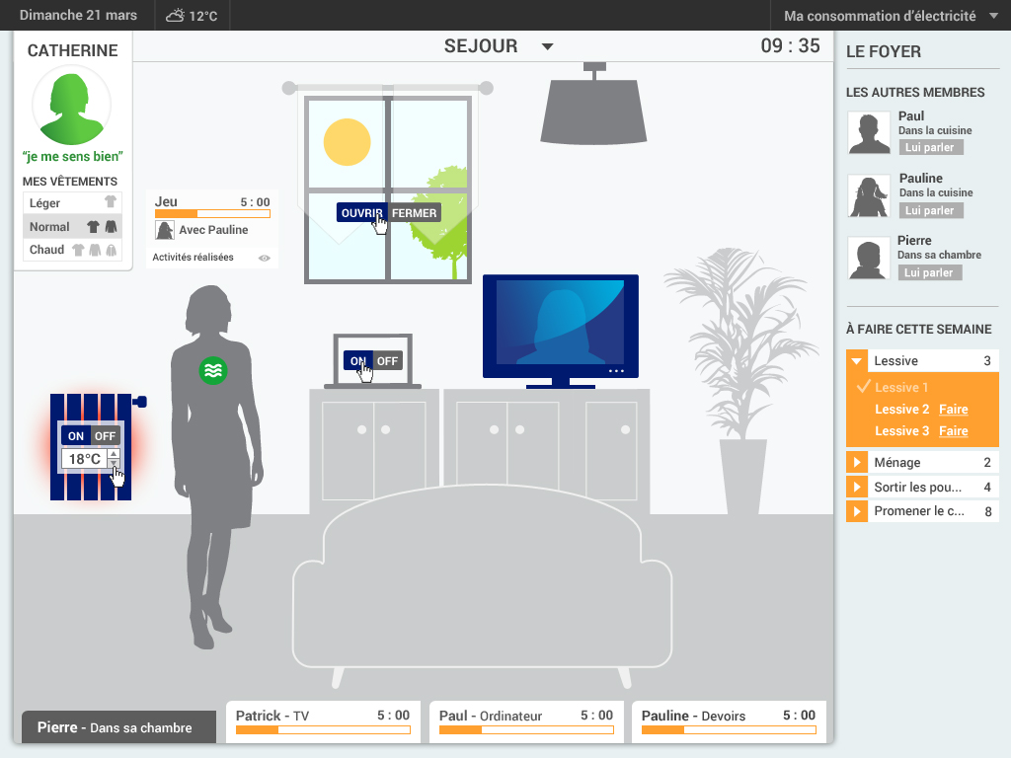
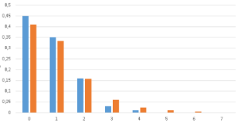
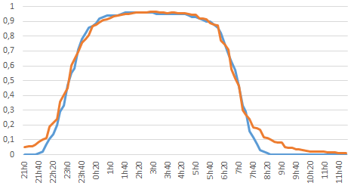
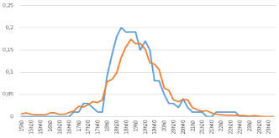
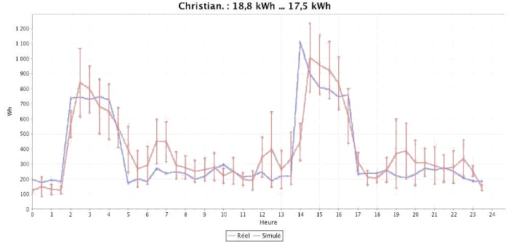
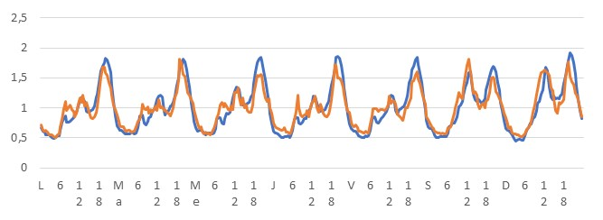
Validation
Micro-scale (household)
Macro-scale (population)
Comparison of SMACH and statistical reference data for each activity, individual type and day type
(population of 100 households)
“Participatory simulation” ergonomics study with a dedicated interface to validate the representation of daily life and interactions in the household
Data
Behavior
cleaning
sleeping
cooking
SMACH
Nb of repetitions
% of individuals
% of individuals
Comparison between simulated and measured average weekly load-curve day-by-day
Dynamics of aggregated load curves
1200
March
1100
Measured
Example of Household A for Tuesdays
Energy
1000
SMACH
900
800
Energy (Wh)
700
600
500
400
300
200
100
0
0
1
2
3
4
5
6
7
8
9
10
11
12
13
14
15
16
17
18
19
20
21
22
23
24
Time (h)

Slide 11
Parameter file
A YAML file for:
Selecting a population
Existing file (pre-generated)
Using SMACH’s population generator(s) (e.g., representative French population)
Selecting simulation parameters
Start time / stop time
Activating specific behavioral / technical modules (vacation, thermal model, phovoltaïc production, using HPC, etc.)
Selecting outputs
Energy consumption, Temperatures, Water consumption, Activity, Vehicule use…
Selecting study parameters
Forcing heating types, electricity tariffs, building characteristics, weather…

Slide 12
Population file

Slide 13
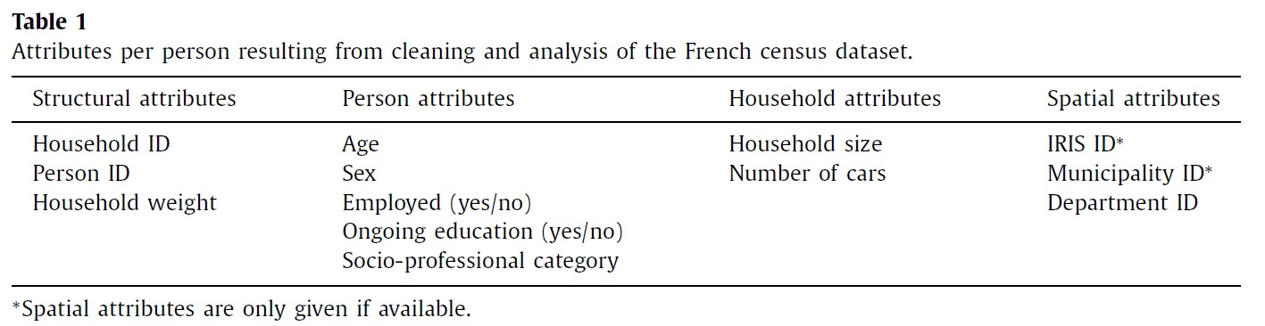
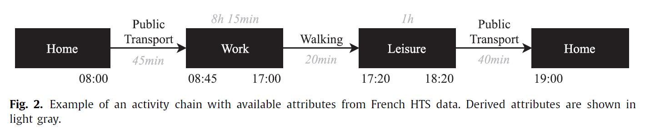
EQASIM population
+ income

Slide 14

integration SMACH/EQASIM
SMACH households
Family
Individual
Age, sex, PCS, …
Household type(couple, family, etc.)
Income
Housing
Type, area, etc.
Geographial data
Energy-related characteristics
Tariff
Heating type
Domestic hot water type
EV
Building energy regulations
…
TUS data (daily life data)
Secondary generation to
Add domain-specific data
Simulations

Slide 15
discussion
Coupling TUS data (provisional schedule) with trips generated by EQASIM
Need for population generation at different geographic levels (country, region, department, municipality, IRIS), within an “acceptable” time frame
Shared database (size / accessability / …)
Trip variability
Link with ENTD data (individual scale /household scale)

