Slide 1
Java
Notes:
Organizace, who is who.
Kdyz jsem se pripravoval, tak jsem si uvedomil, ze to nedokazu vysvetlit
Kdo vi, co znamena java?
Kdy byla java 1995?

Slide 2
O cem to bude?
Java – uvod
Install java, eclipse, glassFish
Hello world
Server
Konec
https://github.com/jajir/skoleni
Instalace
  Java
  IDE – eclipse
  Server – Tomcat
Priklady
  HelloWorld
  Napojeni na REST/JSON sluzbu
    Servlety & JSP
    REST/JSON

Slide 3
Notes
Simple hello world, i s kompilovanim
Kompilace, binarni kod, JVM
Eclipse
Namalovat:
  Kompilovani
  Spousteni
  Web applikace
  Servlet
  JSP
  Komunikace s dalsimi stranami – integrace
  Promenne typovany

Slide 4
Java & JVM
Zdrojovy kod x binarni kod
Kompilace .class → .java
Javac (ukazat, kde je to na disku)
JVM
Proc je to uspesne ( http://pypl.github.io/PYPL.html)
  Google
  Tooling ()
  Knihovny
Notes:
- obrazek?

Slide 5
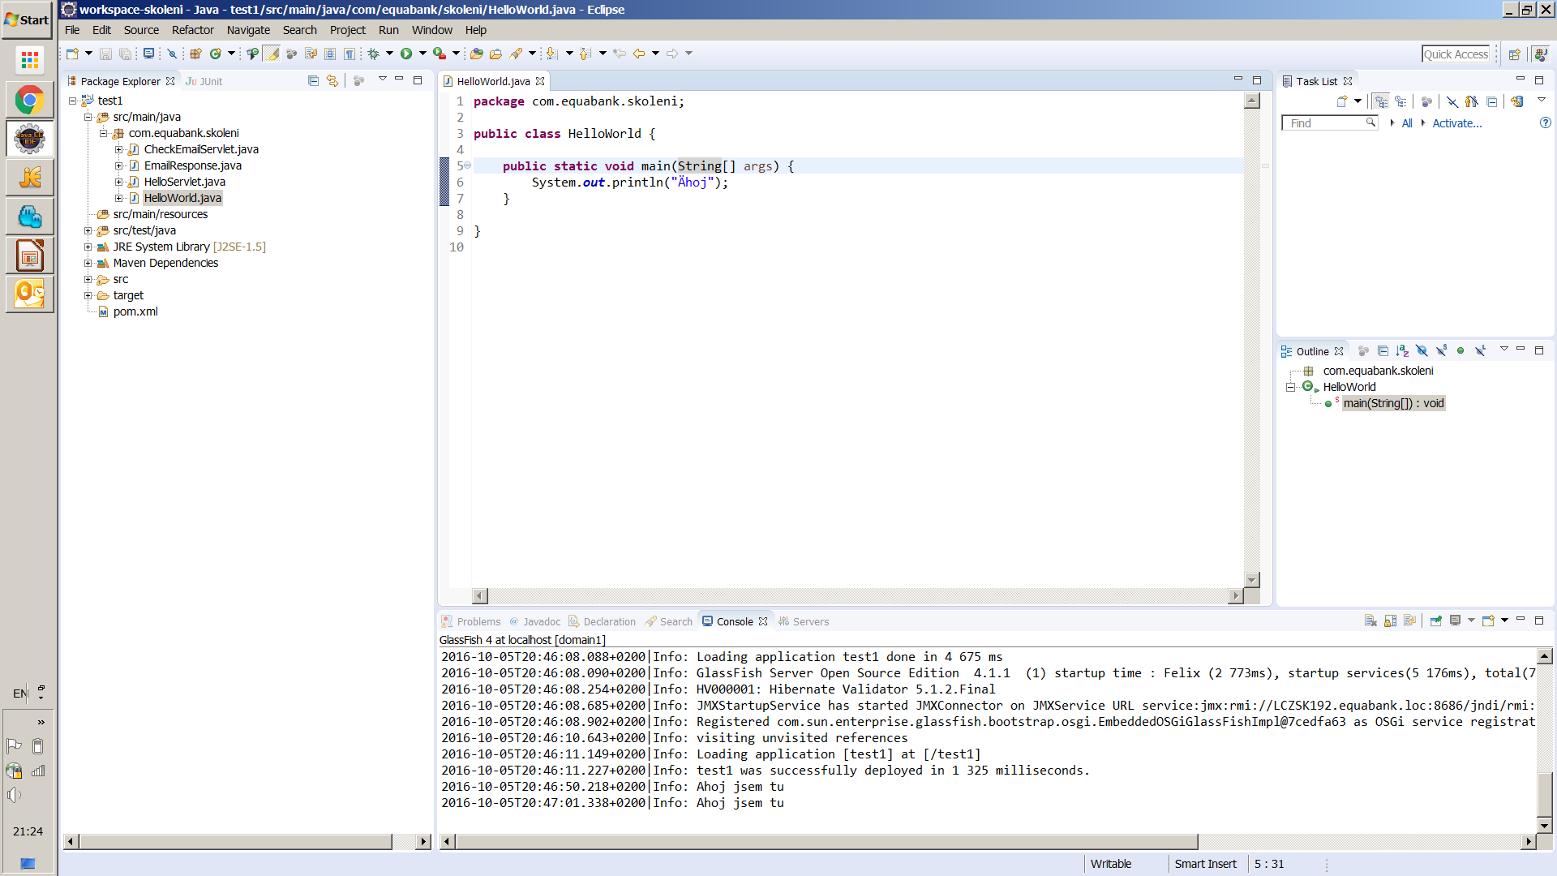
IDE - Eclipse

Slide 6
Zalozeni projektu ...
New maven project -maven-archetype-webapp
New package
New class HelloWorld
Pom.xml – maven (vysvetlit)

Slide 7
Hello World
package com.equabank.skoleni;
public class HelloWorld {
public static void main(String[] args) {
System.out.println("Ahoj");
}
}
Notes:
Package, class, main, promenna, parametr, system out

Slide 8
Web Server
Server
  html (php)
  .js, .css .ico …
HTTP
  Method get, post, delete …
  Formular
Server
Browser
HTTP
<form name="checkEmailForm" method="post" action="checkEmail">
Email: <input type="text" name="email"/> <br/>
<input type="submit" value="Odeslat" />
</form>
Notes:
Html, http? Vysvetlit, rozdil

Slide 9
Web application
Servlet
Servlet – JSP
.war
META-INF
Web.xml
  Servlet mapping
  Welcome page
Server
Servlet
html
HTTP
Servlet
JSP
html

Slide 10
War
Server
a.war
.war - projekt
Web.xml
Deploy – nasazeni
Redeploy – aktualizace
Server (enterprise, servlet container …)
Mvn package → .war
/a/..
b.war
/b/..
Notes:
? co udela mvn ..?

Slide 11
Hello world servlet
Web.xml
HelloServlet.java
<servlet>
<servlet-name>helloServlet</servlet-name>
<servlet-class>com.equabank.skoleni.HelloServlet</servlet-class>
</servlet>
<servlet-mapping>
<servlet-name>helloServlet</servlet-name>
<url-pattern>/index</url-pattern>
</servlet-mapping>
<welcome-file-list>
<welcome-file>index</welcome-file>
</welcome-file-list>
@Override
protected void doGet(HttpServletRequest req, HttpServletResponse resp) throws ServletException, IOException {
System.out.println("Ahoj jsem tu");
req.setAttribute("ahoj", "Ahoj vzacny hoste");
RequestDispatcher requestDispatcher = req.getRequestDispatcher("/index.jsp");
requestDispatcher.forward(req, resp);
}
Notes:
Disapatch, exception

Slide 12
Form – email (validace)
Servlet
  Get → form
  Post → result
Jsp
  form
  result
Notes:
Neosetrujem chybove stavy ...

Slide 13
Email – super validace
Client client = Client.create();
WebResource webResource = client
.resource("https://ajith-Verify-email-address-v1.p.mashape.com/varifyEmail?email=" + email + "");
ClientResponse response = webResource.getRequestBuilder().header("Accept", "application/json")
.header("X-Mashape-Key", "c1CZ2L4YdimshRiXqsgHuCoJXfI2p1N4RLOjsn2zYu6JrPnBF9")
.accept("application/json").get(ClientResponse.class);
if (response.getStatus() != 200) {
throw new RuntimeException("Failed : HTTP error code : " + response.getStatus());
}
return response.getEntity(EmailResponse.class);

Slide 14

Kde hledat pomoc?
Gfo team
http://stackoverflow.com/
Google
  Negativni odpoved je taky odpoved
Dlasi znalosti
  Oracle certifikace
  Amazon – treba:
    https://www.amazon.com/Java-Beginners-Guide-Herbert-Schildt/dp/0071809252/ref=sr_1_1?s=books&ie=UTF8&qid=1474528527&sr=1-1&keywords=java+programming
Notes:
Nekonecne moznosti se ucit, mnozstvi frameworku rychle roste

Slide 15
O cem to nebylo
Jazyk
Logging
IoC
Tooling ( … )
kvalita kodu
Release process
DB (ORM)
Messaging
Navrh kodu – design patterny
Big data
… tuna dalsiho
Do javy kompilovane jazyky
SCM – git …
Image processing
Java.* libraries
Navrh applikaci

