Slide 1
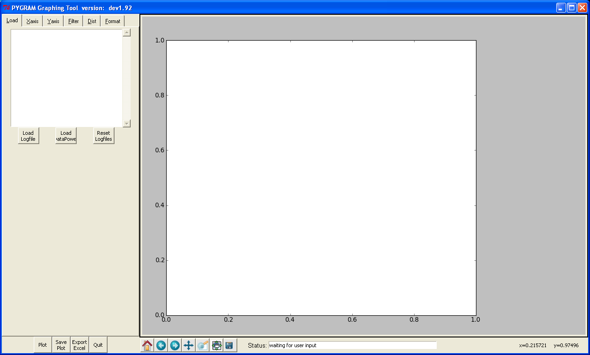
tabs
Graphing tool
Plot control pane
Matlab like plot
Control commands
Plotting pane

Slide 2
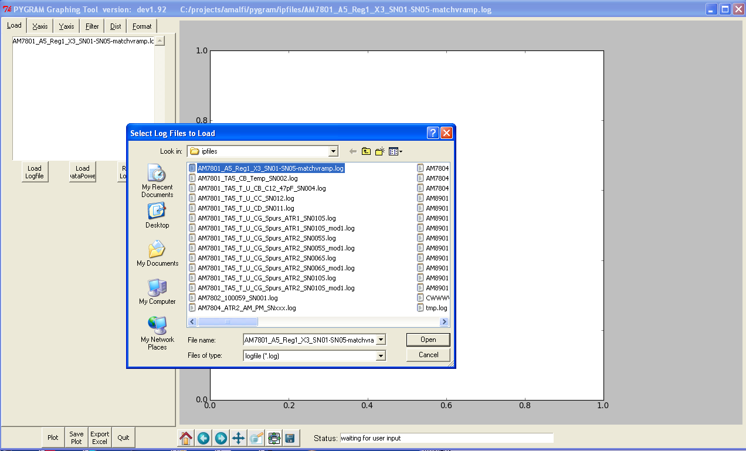
Loading Data Log files, also loads from DB
1
List of test files
loaded
2
3
4

Slide 3
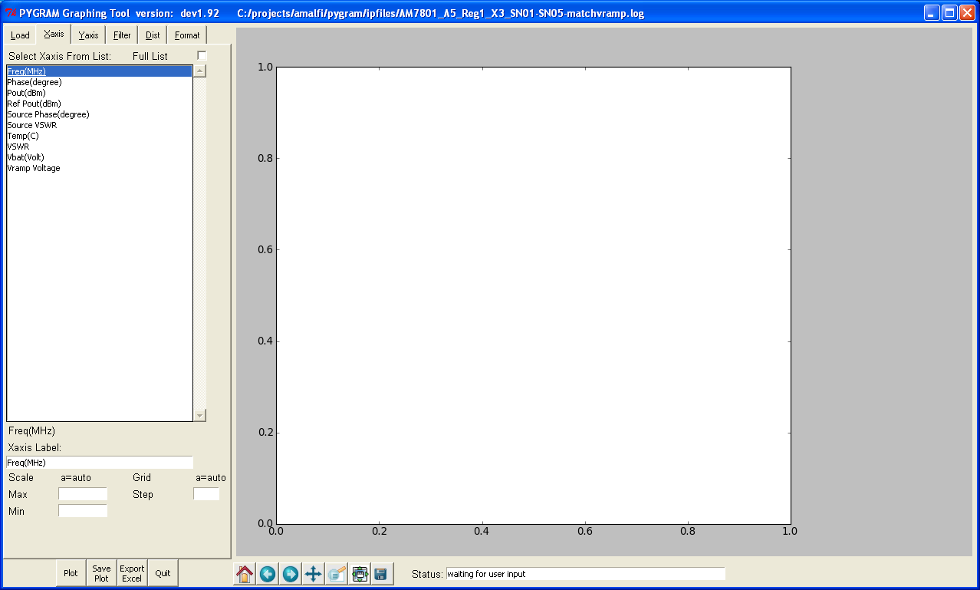
Selecting which parameter to use for the X axis
1
2
Can select axis
Limits if needed

Slide 4
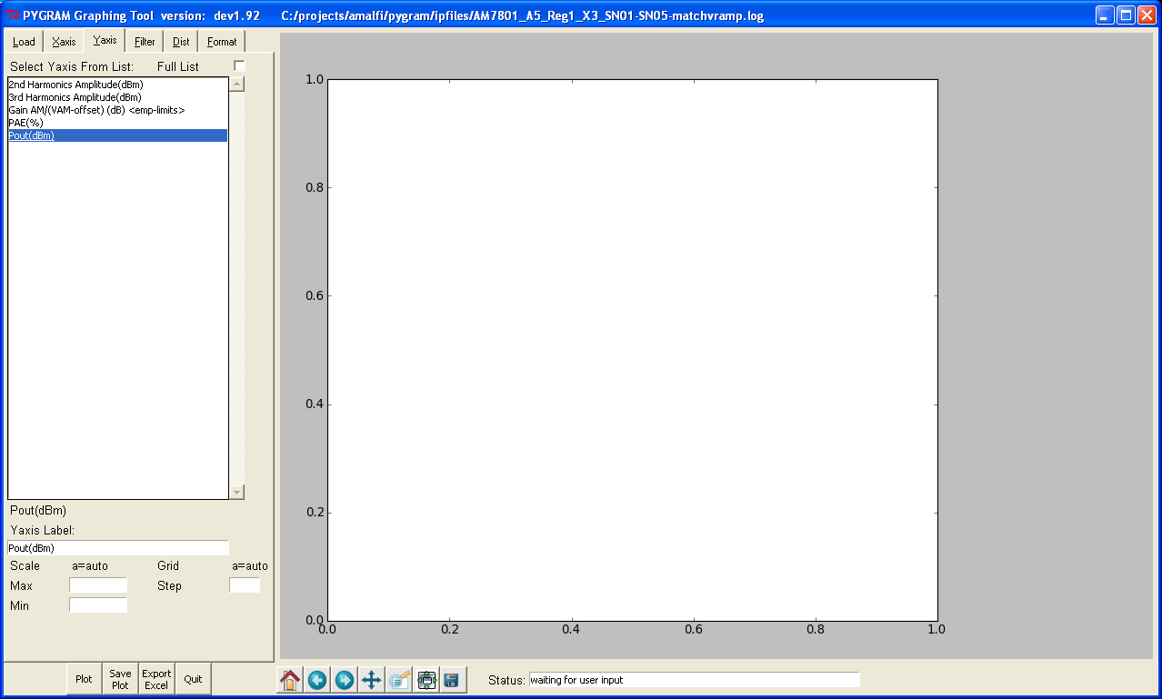
Selecting which parameter to use for the Y axis
(Multiple parameters may be selected)
(there is also a Y2 axis, but is not present in this version)
1
2

Slide 5
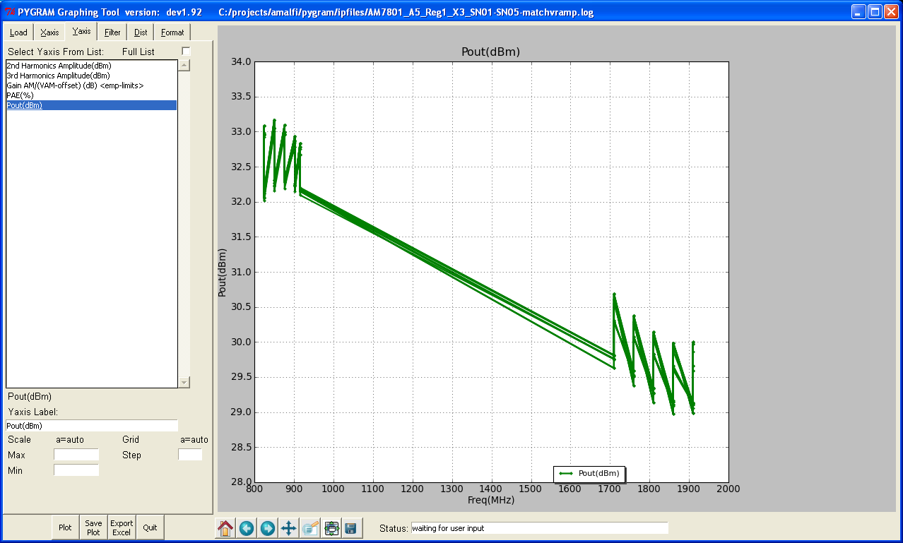
Click the ‘Plot’ button creates a plots showing all the data
We must filter the data to produce more useful plot
1

Slide 6
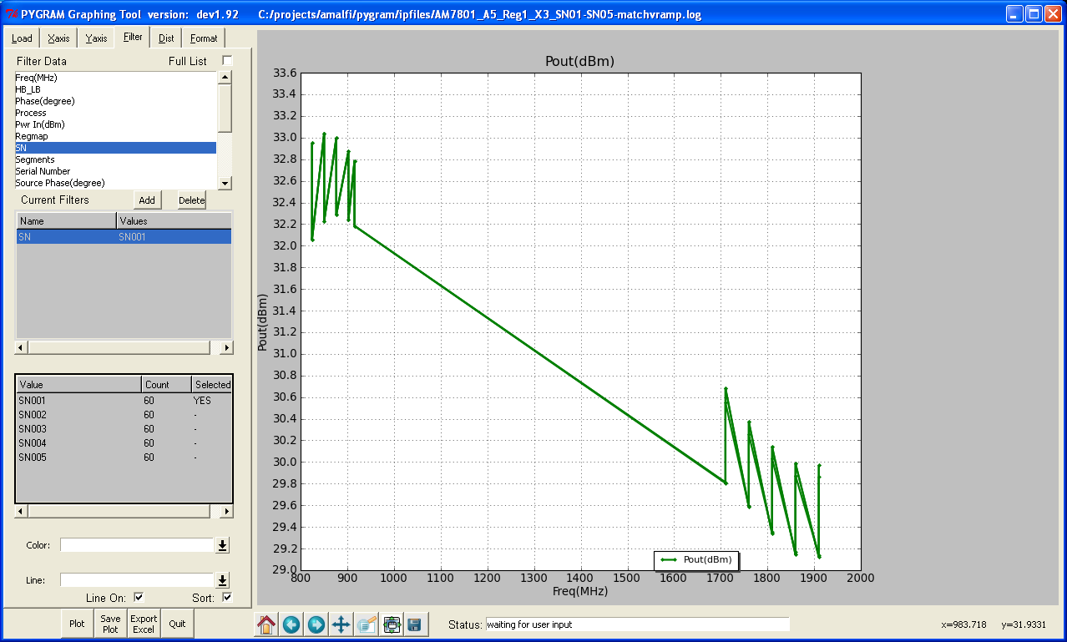
Filter the data
Select Filter Tab
Pick Parameter to be Filtered
It appears in the List of Filters
Select which parameter values to use, in this case we select SN = SN001
(we could select multiple SNs if we wanted, and also add more more filters)
5) Replot
1
2
3
4
5

Slide 7
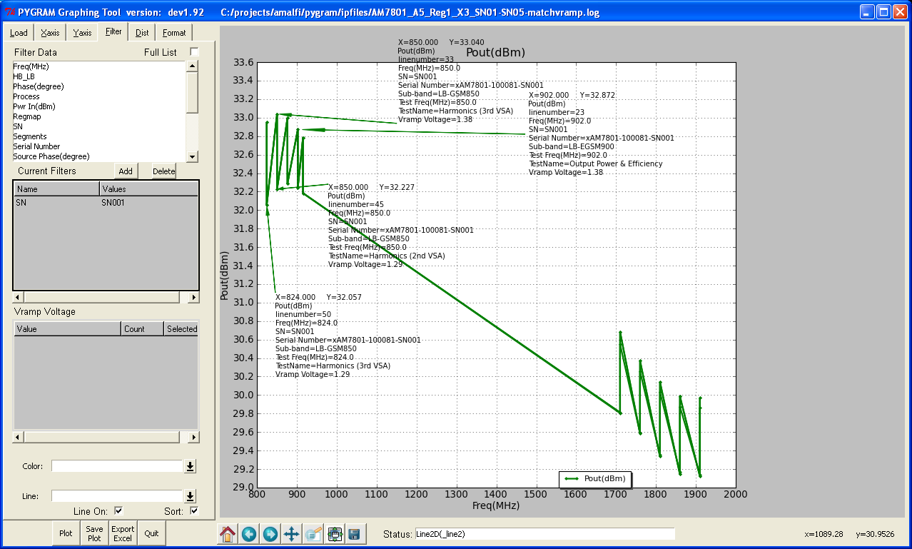
We can query the data to help identify how best to filter the data
Click on Data point to show a list of parameter values
Click on more data points
Look to see which parameters are changing between the plot lines
‘Vramp Voltage’ differs between upper and lower points
1
2
3

Slide 8
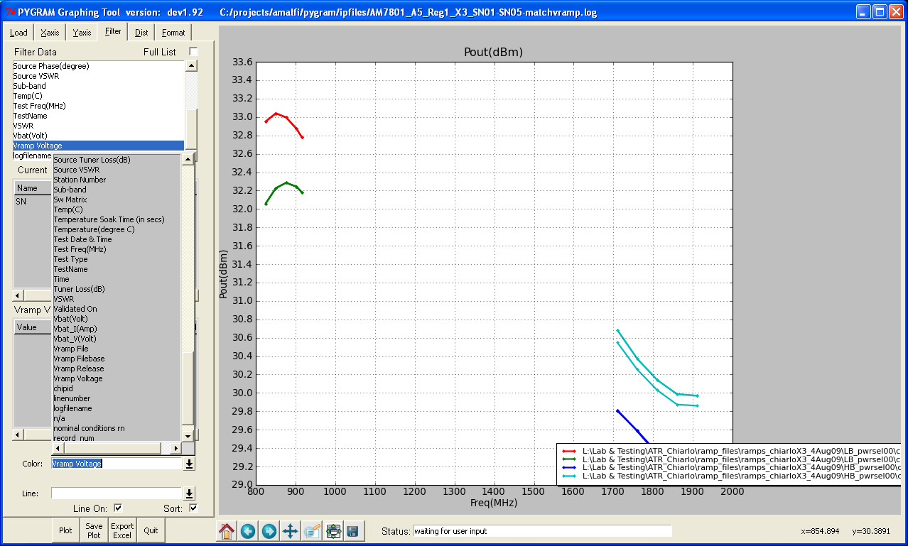
Separate the plot lines based on ‘Vramp Voltage’ and replot using different colors
(can select to replot using lines of different colors or use lines of different line dash style)
1
2

Slide 9
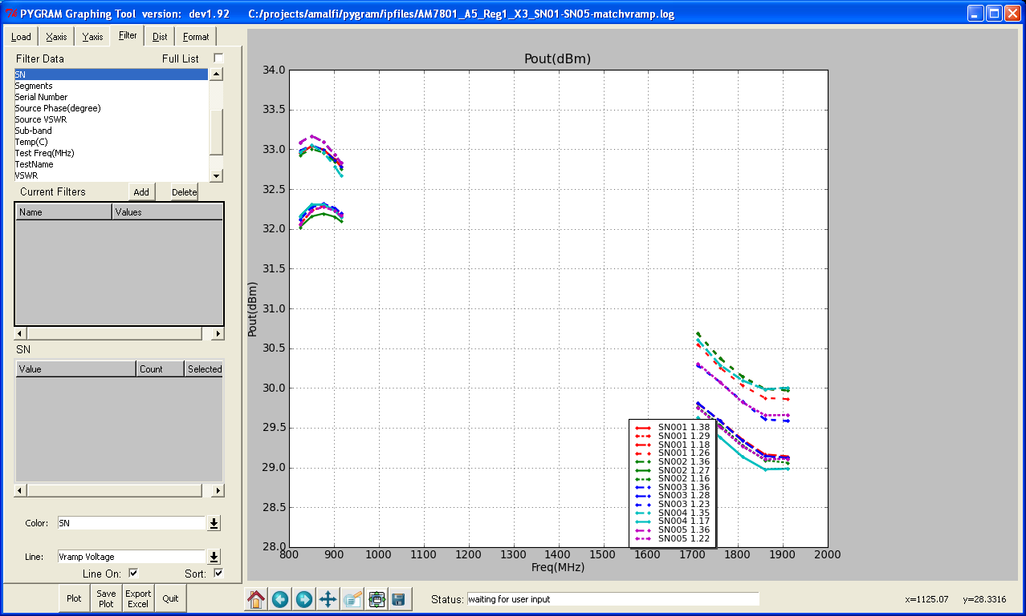
Using both line color and line dash style for the plot lines
The Legend is automatically generated
1
2
3

Slide 10
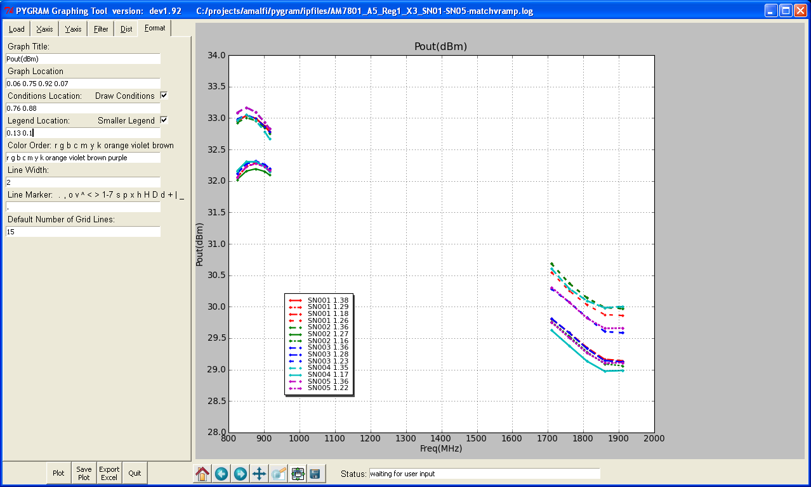
Using the Format Tab it is possible to control many of the plot features
1
2
3

Slide 11
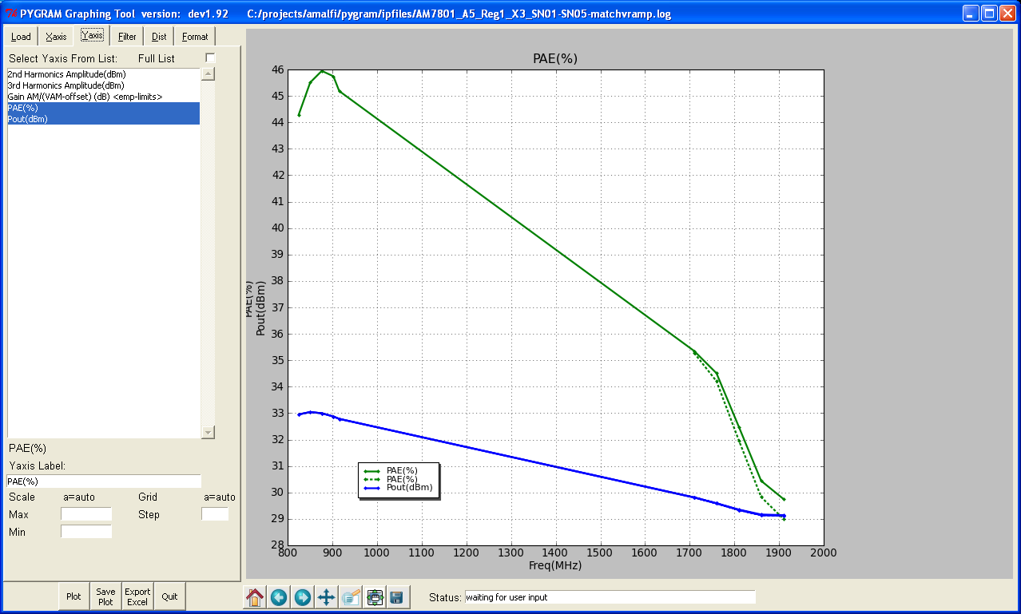
Multiple values can be plotted on the same plot Y axis
Second Y2 axis allows the values with different scales to be compared
Second X2 axis is also useful

